Slide 1

Designing a Scalable and Secure Cloud-Based Environment
Using AWS Services and Infrastructure as Code (IaC)
Presented by: Mohamed Nasser Hassan

Slide 2
Project Overview
Objective:
• Design and deploy a highly available, scalable, and secure cloud environment for hosting a web application.
• Use AWS services, automatic monitoring, and disaster recovery mechanisms.
• Implement Infrastructure as Code (IaC) for consistent and efficient management.

Slide 3
Architecture Overview
AWS Services Used:
• Compute: Amazon EC2 for hosting the application.
• Storage: Amazon S3 for static content.
• Networking: Amazon VPC, Load Balancer, NAT Gateway.
• Security: IAM roles, Security Groups, HTTPS encryption.
• Automation: EC2 Autoscaling, CloudWatch, and SNS.
• IaC Tool: AWS CloudFormation.

Slide 4
Compute & Storage Layers
Compute:
• EC2 instances in an Auto Scaling group across multiple Availability Zones (AZs).
Storage:
• Amazon S3 stores static content (e.g., images, HTML, CSS).

Slide 5
Networking & Security
Networking:
Custom VPC with public and private subnets.
Load Balancer directs traffic to EC2 instances.
Security:
IAM Roles for managing access.
Security Groups for controlling traffic.

Slide 6
Monitoring & Remediation
Monitoring:
• CloudWatch tracks CPU utilization, memory, and traffic.
• SNS sends notifications for performance issues or instance failure.
Remediation:
• Auto-scaling based on CloudWatch alarms for automatic recovery.

Slide 7
Disaster Recovery (DR)
• Multi-AZ Deployment: Ensures failover by distributing application across multiple AZs.
• S3 Backup: Cross-region replication and versioning for enhanced data protection.

Slide 8
Additional Features
• HTTP to HTTPS Redirection: Secure all communications through HTTPS via Load Balancer.
• Mounting S3 on EC2: S3FS integration for accessing S3 buckets from EC2 instances.
• API Gateway Integration: Create secure API endpoints to access images in S3.

Slide 9

Infrastructure as Code (IaC)
• AWS CloudFormation: Automates provisioning of AWS resources.
• Ensures consistency and scalability.

Slide 10
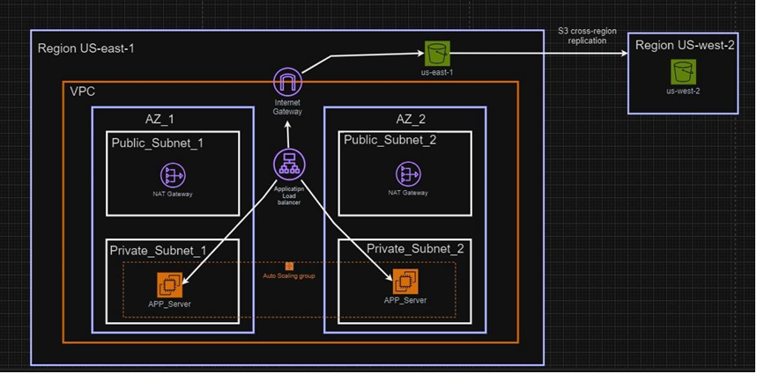
Architecture (Draw.io):

Slide 11
Conclusion
• Secure, highly available, and scalable cloud architecture.
• Built-in monitoring, disaster recovery, and auto-remediation.
• IaC simplifies management and improves operational efficiency.

