Slide 1
Cloud Fundamentals
Dr. Hazem AL- Najjar

Slide 2
Learning Outcomes
1
2
LO2 - Design a deployment model to be hosted in the cloud for a given scenario.
3
LO3 - Explain different Cloud Service Providers’ (CSPs) approaches to providing a cloud architecture framework for business use
4
LO4 -Assess the technical challenges and risks inherent in moving IT systems to the cloud.
LO1 -Examine the fundamentals of cloud computing in relation to areas of application, architecture and platform.

Slide 3
Learning Outcome 1
Cloud Fundamentals.
Processing (Compute in USA), storage and network environments.
Migrating to the cloud.

Slide 4
Cloud fundamentals

Slide 5
Computing Generations
1. Mainframe Computing
4. Internet Computing
Internet
Server
Terminal
PC
Server
Mainframe
2. PC Computing
5. Grid Computing
PC
PC
Grid
PC
3. Network Computing
6. Cloud Computing
Cloud
PC
Server
PC
Server

Slide 6
What is Cloud Computing?
Cloud Computing is a general term used to describe a new class of network based computing that takes place over the Internet,
basically a step on from Utility Computing
a collection/group of integrated and networked hardware, software and Internet infrastructure (called a platform).
Using the Internet for communication and transport provides hardware, software and networking services to clients
These platforms hide the complexity and details of the underlying infrastructure from users and applications by providing very simple graphical interface or API (Applications Programming Interface).

Slide 7
What is Cloud Computing?
In addition, the platform provides on demand services, that are always on, anywhere, anytime and any place.
Pay for use and as needed, elastic
scale up and down in capacity and functionalities
The hardware and software services are available to
general public, enterprises, corporations and businesses markets

Slide 8
Cloud Notation
Cloud computing is an umbrella term used to refer to Internet based development and services
A number of characteristics define cloud data, applications services and infrastructure:
Remotely hosted: Services or data are hosted on remote infrastructure.
Ubiquitous: Services or data are available from anywhere.
Commodified: The result is a utility computing model similar to traditional that of traditional utilities, like gas and electricity - you pay for what you would want!

Slide 9
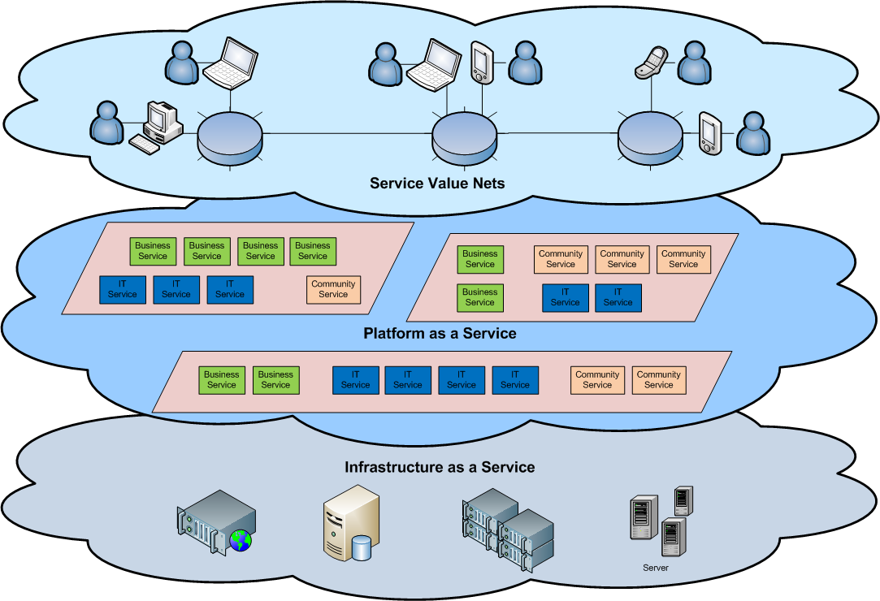
Cloud Architecture

Slide 10
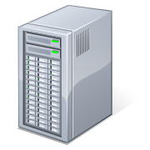
What is Cloud Computing
Shared pool of configurable computing resources
On-demand network access
Provisioned by the Service Provider
Applications
Services
Computer Network
Storage (Database)
SERvers
Adopted from: Effectively and Securely Using the Cloud Computing Paradigm by peter Mell, Tim Grance
Notes:
Cloud computing is a model for enabling convenient, on-demand network access to a shared pool of configurable computing resources (e.g., networks, servers, storage, applications, and services) that can be rapidly provisioned and released with minimal management effort or service provider interaction.
cloud computing customers do not own the physical infrastructure.
Cloud computing users avoid capital expenditure (CapEx) on hardware, software, and services when they pay a provider only for what they use.
Low shared infrastructure and costs, low management overhead, and immediate access to a broad range of applications

Slide 11
Cloud Computing Characteristics
Common Characteristics:
Massive Scale
Resilient Computing
Homogeneity
Geographic Distribution
Virtualization
Service Orientation
Low Cost Software
Advanced Security
Essential Characteristics:
On Demand Self-Service
Broad Network Access
Rapid Elasticity
Resource Pooling
Measured Service
Adopted from: Effectively and Securely Using the Cloud Computing Paradigm by peter Mell, Tim Grance
Notes:
ScalabilityInfrastructure capacity allows for traffic spikes and minimizes delays.
ResiliencyCloud providers have mirrored solutions to minimize downtime in the event of a disaster. This type of resiliency can give businesses the sustainability they need during unanticipated events.
Homogeneity: No matter which cloud provider and architecture an organization uses, an open cloud will make it easy for them to work with other groups, even if those other groups choose different providers and architectures.
On-demand self-service. A consumer can unilaterally provision computing capabilities, such as server time and network storage, as needed automatically without requiring human interaction with each service’s provider.
Broad network access. Capabilities are available over the network and accessed through standard mechanisms that promote use by heterogeneous thin or thick client platforms (e.g., mobile phones, laptops, and PDAs).
Resource pooling. Multi-tenant model.. There is a sense of location independence in that the customer generally has no control or knowledge over the exact location of the provided resources but may be able to specify location at a higher level of abstraction (e.g., country, state, or datacenter). Examples of resources include storage, processing, memory, network bandwidth, and virtual machines.
Rapid elasticity. Capabilities can be rapidly and elastically provisioned, in some cases automatically, to quickly scale out and rapidly released to quickly scale in. To the consumer, the capabilities available for provisioning often appear to be unlimited and can be purchased in any quantity at any time.
Measured Service. Cloud systems automatically control and optimize resource use by leveraging a metering capability at some level of abstraction appropriate to the type of service (e.g., storage, processing, bandwidth, and active user accounts).

Slide 12
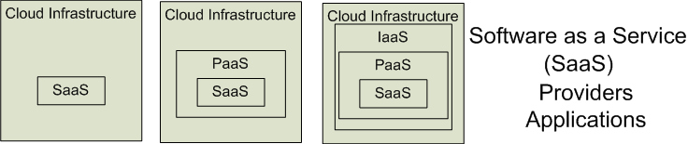

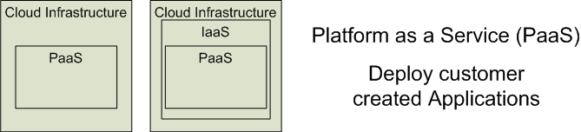

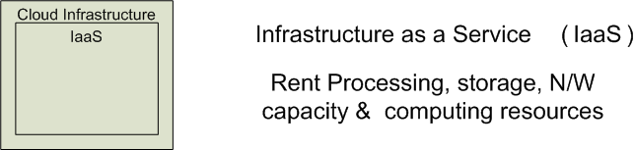


Cloud Service Models
Software as a Service (SaaS)
Platform as a Service (PaaS)
Infrastructure as a Service (IaaS)
SalesForce CRM
LotusLive
Google App Engine
Adopted from: Effectively and Securely Using the Cloud Computing Paradigm by peter Mell, Tim Grance
Notes:
IaaSdelivers computer infrastructure, typically a platform virtualization environment, as a service. Rather than purchasing servers, software, data center space or network equipment, clients instead buy those resources as a fully outsourced service.
PaaSdeliver a computing platform where the developers can develop their own applications.
SaaSis a model of software deployment where the software applications are provided to the customers as a service.

Slide 13
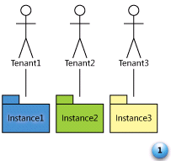
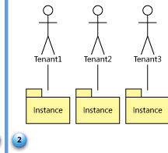
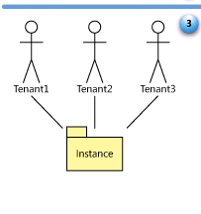
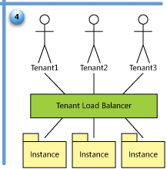
SaaS Maturity Model
Level 1: Ad-Hoc/Custom – One Instance per customer
Level 2: Configurable per customer
Level 3: configurable & Multi-Tenant-Efficient
Level 4: Scalable, Configurable & Multi-Tenant-Efficient
Source: Frederick Chong and Gianpaolo Carraro, “Architectures Strategies for Catching the Long Tail”

Slide 14
Cloud Computing Definition
Five Characteristics
On-demand self-service
Broad network access
Resource pooling
Rapid elasticity or expansion
Measured service
Service Models
Software
Platform
Infrastructure
Deployment Models
Private
Community
Public
Hybrid

Slide 15
Basic Cloud Characteristics
The “no-need-to-know” in terms of the underlying details of infrastructure, applications interface with the infrastructure via the APIs.
The “flexibility and elasticity” allows these systems to scale up and down at will
utilising the resources of all kinds
CPU, storage, server capacity, load balancing, and databases
The “pay as much as used and needed” type of utility computing and the “always on!, anywhere and any place” type of network-based computing.

Slide 16
Software as a Service (SaaS)
SaaS is a model of software deployment where an application is hosted as a service provided to customers across the Internet.
Saas alleviates the burden of software maintenance/support
but users relinquish control over software versions and requirements.
Terms that are used in this sphere include
Platform as a Service (PaaS) and
Infrastructure as a Service (IaaS)

Slide 17
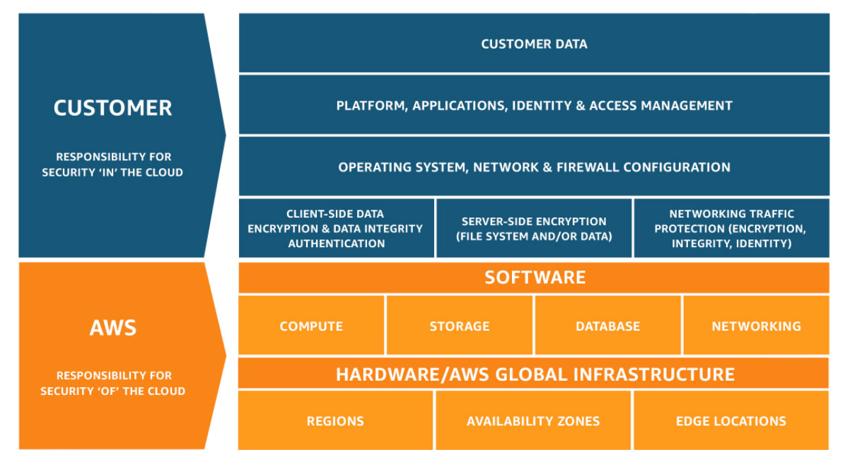
Shared Responsibility Model

Slide 18
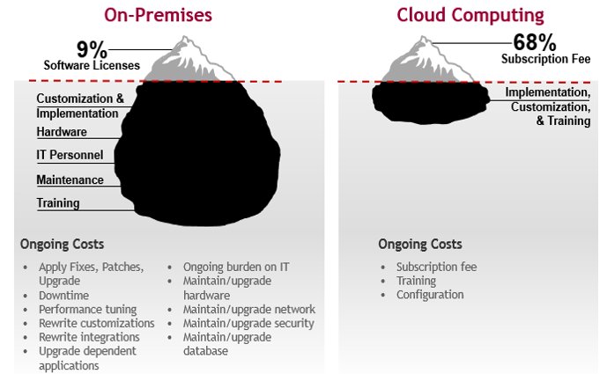
The Total Cost of Ownership for Cloud

Slide 19
What is the purpose and benefits?
Cloud computing enables companies and applications, which are system infrastructure dependent, to be infrastructure-less.
By using the Cloud infrastructure on “pay as used and on demand”, all of us can save in capital and operational investment!
Clients can:
Put their data on the platform instead of on their own desktop PCs and/or on their own servers.
They can put their applications on the cloud and use the servers within the cloud to do processing and data manipulations etc.

Slide 20
Advantages of Cloud Computing
Trade capital expense for variable expense: pay only when you consume computing resources, and pay only for how much you consume.
Benefit from massive economies of scale: lower variable cost.
Stop guessing capacity
Increase speed and agility .
Stop spending money running and maintaining data centers.
Go global in minutes.
Improved performance.
Reduced software costs
Unlimited storage capacity.
Latest version availability.

Slide 21
Disadvantages of Cloud Computing
Requires a constant Internet connection.
Does not work well with low-speed connections.
Features might be limited.
Stored data might not be secure.
Stored data can be lost.

Slide 22
Examples
Email.
social media
office applications
multiplayer games
entertainment
government services
backups, data storage
iCloud
OneDrive, Dropbox.

Slide 23
Processing, storage and network environments

Slide 24
Virtualization
Virtual workspaces:
An abstraction of an execution environment that can be made dynamically available to authorized clients by using well-defined protocols,
Resource quota (e.g. CPU, memory share),
Software configuration (e.g. O/S, provided services).
Implement on Virtual Machines (VMs):
Abstraction of a physical host machine,
Hypervisor intercepts and emulates instructions from VMs, and allows management of VMs, VMWare, Xen, etc.
Provide infrastructure API:
Plug-ins to hardware/support structures
App
App
App
OS
OS
OS
Hypervisor
Hardware
Virtualized Stack

Slide 25
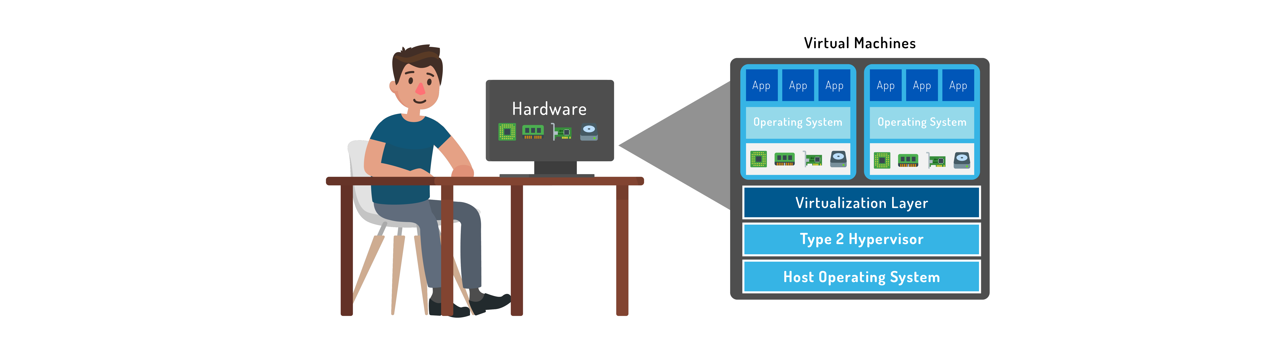
Why learn virtualization-Hypervisor
Modern computing is more efficient due to virtualization
Hypervisor: Software installed on top of hardware that created virtualization layer.
Virtualization is the “layer” of technology that goes between the physical hardware of a device and the operating system to create one or more copies of the device.

Slide 26
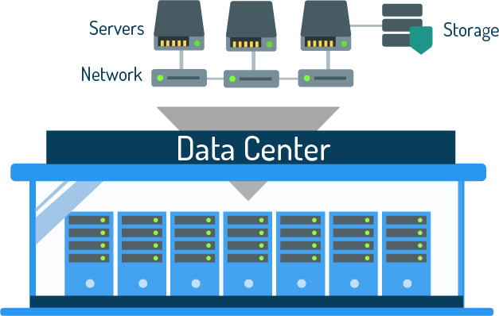
What is a Data Center?
Hardware infrastructure that supports virtualization
Focus is on processing large amounts of data
What are the three main components?
Compute
Storage
Networks

Slide 27
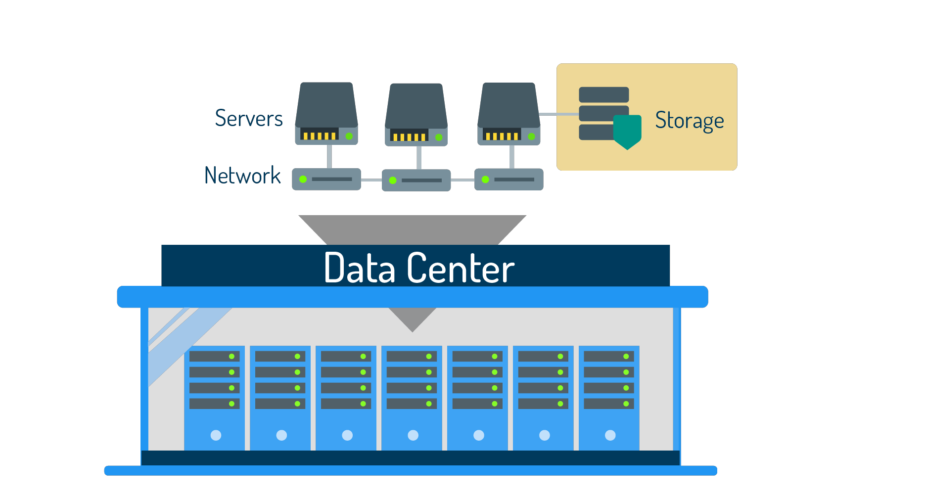
Storage
Data center storage should have two features: availability and redundancy

Slide 28
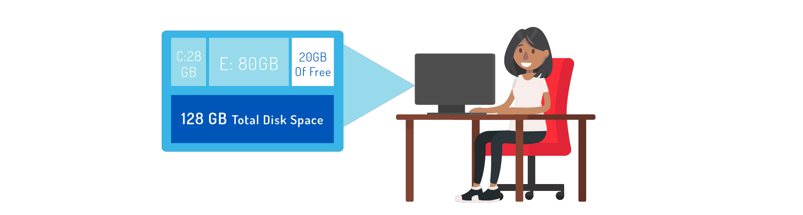
Storage Provisioning
Thick provisioning: Disk space is strategically pre-allocated to a server, or a VM. This means that the logical space provided by partitioning is equal to the amount of actual physical space set aside on the physical disk.

Slide 29
Benefits of a Virtualization
Data centers use a lot of hardware and virtualization makes hardware more efficient
Increased computing resources results in higher availability of applications
Less labor needed to monitor data center (administrator can monitor from desk using a program)

Slide 30
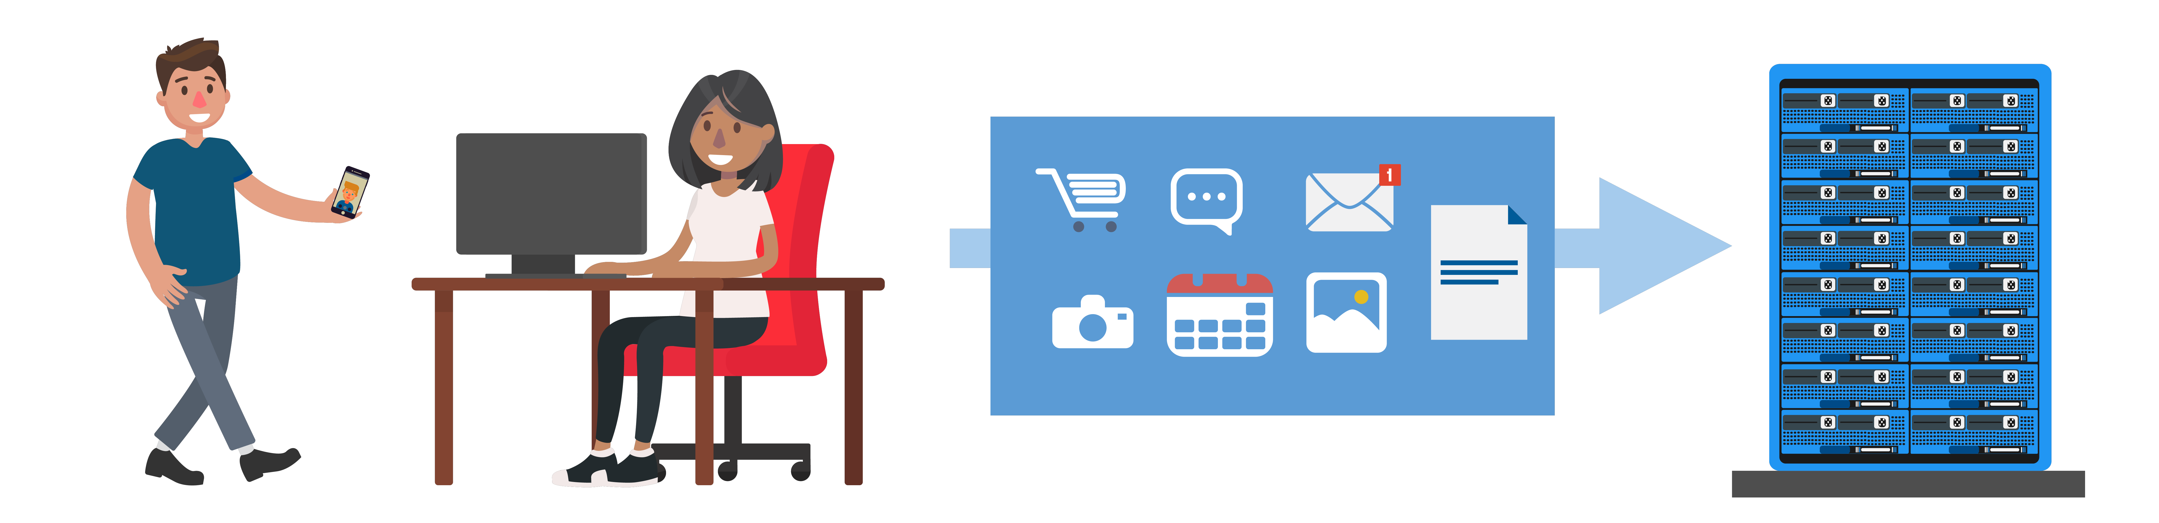
Server Virtualization
Results in increased efficiency of data center servers because multiple VMs can be hosted on one server
Computing resources can be distributed to customers using less hardware

Slide 31
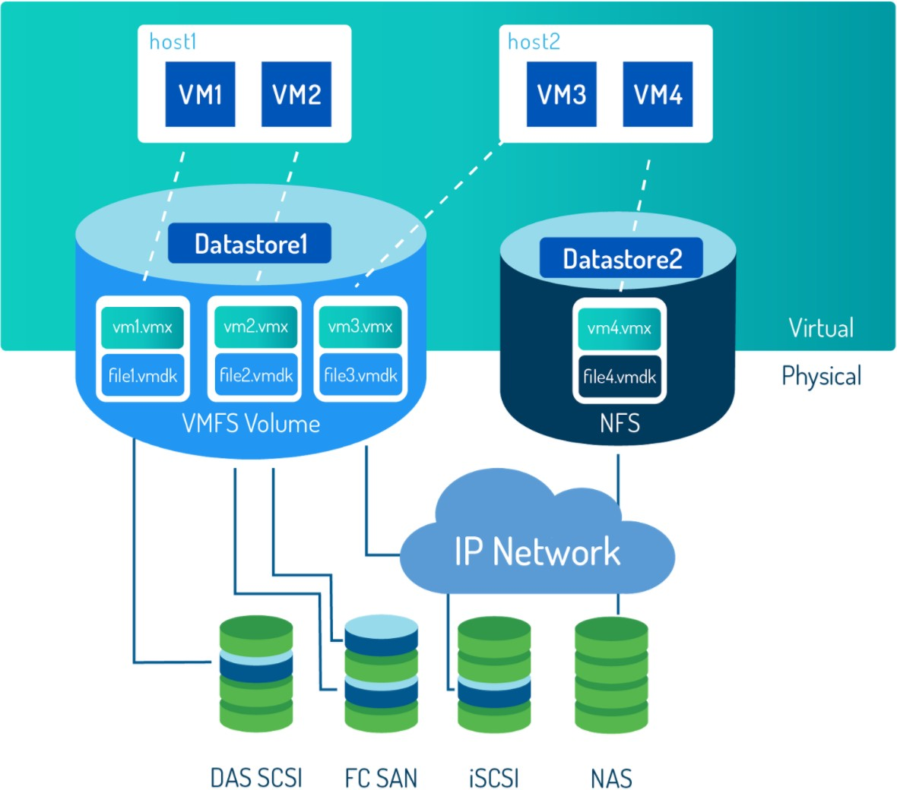
Storage Virtualization
Storage capacity is pooled and distributed to the VMs
Physical storage devices are partitioned into logical storage.

Slide 32
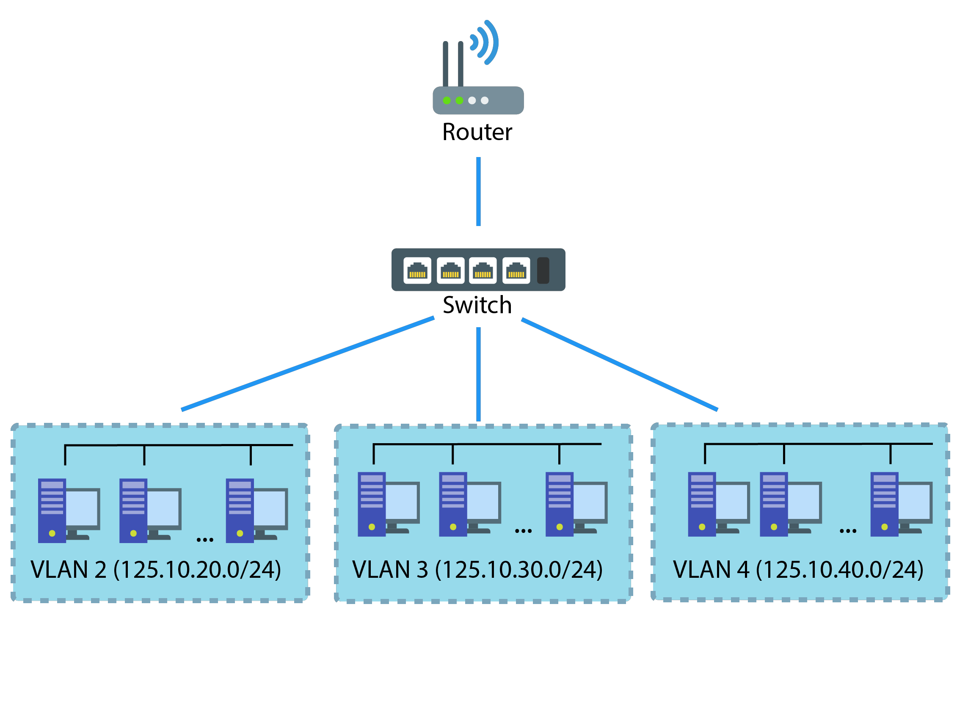
Network Virtualization
Physical components that make up the physical network are virtualized to create a virtual network
What is a vSwitch?
Virtual switch that virtual devices can connect to in order to communicate with each other
What is a vLAN?
Virtual Local Area Network that is segmented into groups of ports isolated from one another, creating different network segments

Slide 33
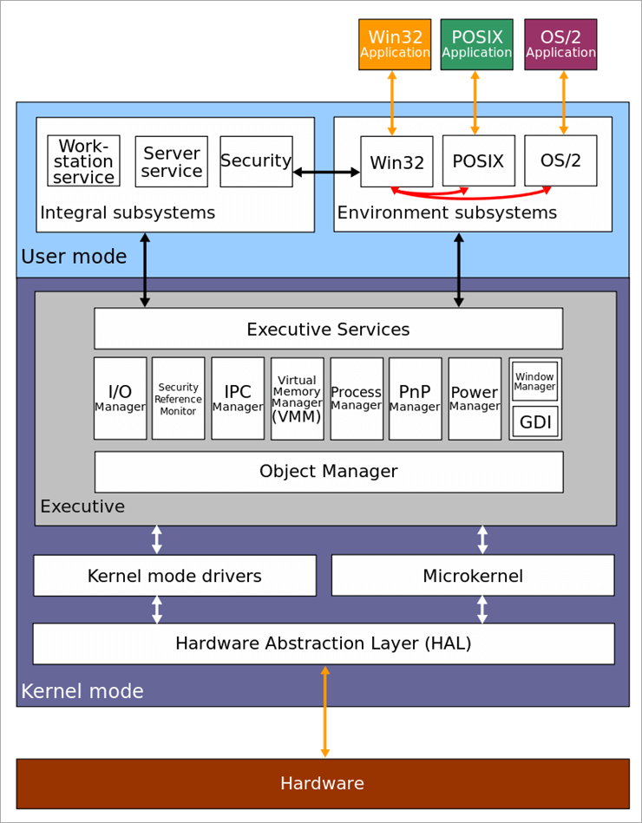
Windows Architecture
User mode
Kernel mode

Slide 34
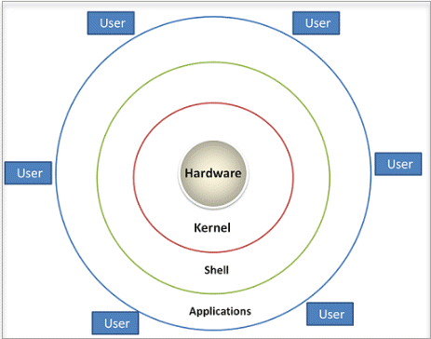
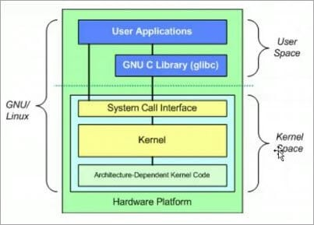
Linux Architecture

Slide 35
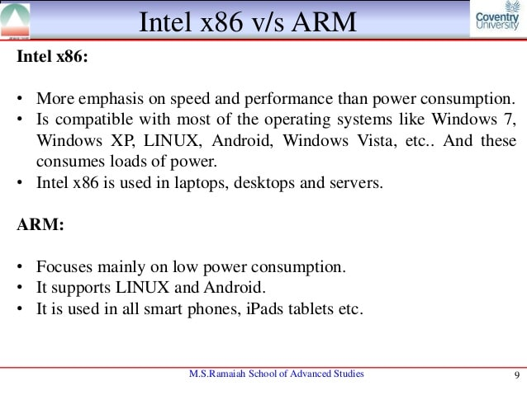
X86 VS ARM

Slide 36
Why to choose ARM ?
Arm-based systems and instances are readily available in public clouds such as AWS.
The computational performance of AWS’s Arm EC2 instances is similar to that of the x86_64 instances.
Considering that Arm instances are significantly cheaper, the cost effectiveness of Arm instances are better than x86_64 instances.
Arm instances perform better with “close to metal” applications. We hypothesize that the operating systems have received more engineering efforts to optimize for Arm than high level application frameworks.

Slide 37
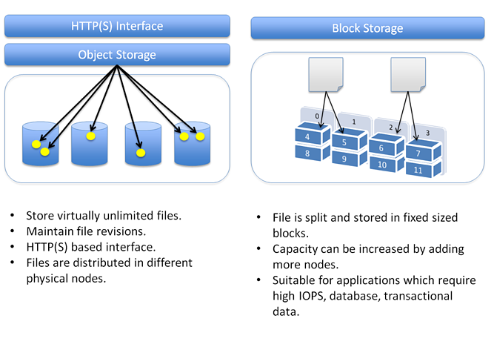
Infrastructure as a Service

Slide 38
Infrastructure as a Service - Block storage
Infrastructure as a Service (IaaS) platforms allow you to store your data in either:
‘Block storage’ devices provide fixed-sized raw storage capacity. Each storage volume can be treated as an independent disk drive and controlled by an external server operating system. This block device can be mounted by the guest operating system as if it were a physical disk. The most common examples of Block Storage are SAN, iSCSI, and local disks.

Slide 39
Infrastructure as a Service - Object Storage
“Block storage” volumes can only be accessed when they’re attached to an operating system. But data kept on object storage devices, which consist of the object data and metadata, can be accessed directly through APIs or http/https.
Block storage options in the cloud
Azure Premium Storage
Google Persistent Disks
Object storage
Amazon S3
Azure Blob Storage
Google cloud storage:

Slide 40
Block storage/Object Storage
Object storage and Block storage both have unique advantages and limitations. Understanding the use cases and costs associated with each medium will help you get the best possible mileage out of your application storage profile.

Slide 41
VPN and Public Network
Virtual Private Network Describes the opportunity to establish a protected network connection when using public networks.
A public network is a type of network wherein anyone, namely the general public, has access and through it can connect to other networks or the Internet.

Slide 42
Main Concepts
IP address: An IP address is a 32-bit number. It uniquely identifies a host (computer or other device, such as a printer or router) on a TCP/IP network.
Routing is the process of selecting a path for traffic in a network or between or across multiple networks.
Subnetting is the process of partitioning a network into two or more networks based on utilization.
Network isolation concept of taking your network and creating silos within it called VLANs (virtual local area networks)

Slide 43
Main Concepts
Classless Inter-Domain Routing is a method for allocating IP addresses and for IP routing.
Classless IP addresses, enabled by CIDR, are required when creating a Virtual Private Cloud (VPC) that is logically isolated from other virtual networks. When creating a VPC, a range of IPv4 addresses must be specified in the form of a CIDR.

Slide 44
Migrating to the cloud

Slide 45
Cloud Migration
Cloud migration is the process of moving data, applications or other business elements to a cloud computing environment.
Why migrate to the cloud?
Should your application stay or go?
What's the cost to run an application in the cloud?
Which cloud model fits best?
How do I choose the right cloud provider?

Slide 46
Cloud Migration: Management
Cloud computing deployments must be monitored and managed in order to be optimized for best performance.
Cloud management software provides capabilities for managing faults, configuration, administration
, performance, and security; this is referred to as FCAPS.

Slide 47
Management of Cloud Services
Administration of resources
Configuring resources
Enforcing security
Monitoring operations
Optimizing performance
Policy management
Performing maintenance
Provisioning of resources

Slide 48
Network management systems acronym FCAPS
Fault
Configuration
Administration
Performance
Security

Slide 49
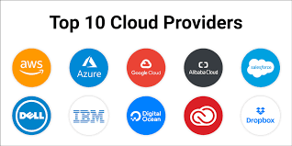
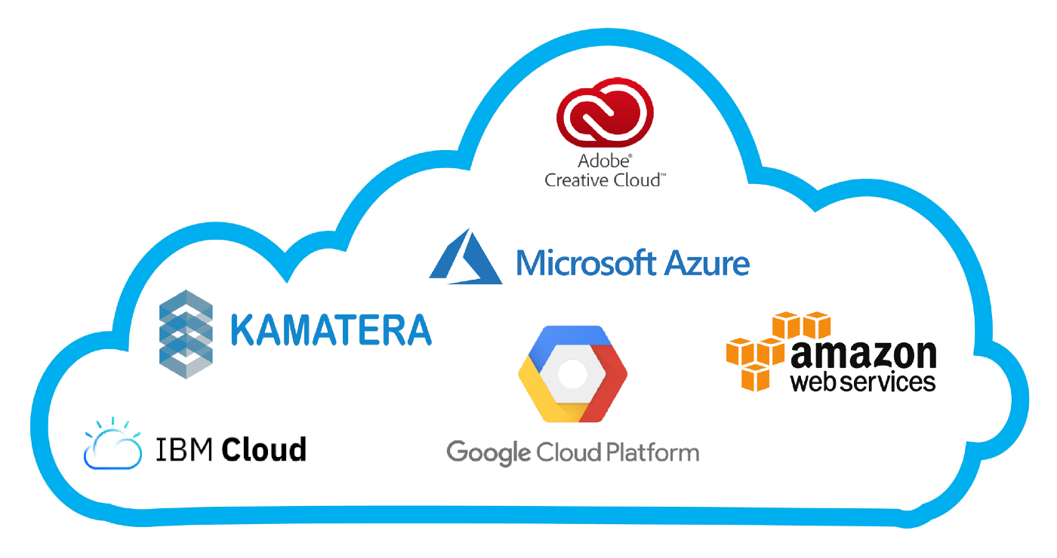
Range of Cloud Service Providers

Slide 50
Cloud Migration Types
Public Cloud: lets many users access compute resources through the internet or dedicated connections.
Private Cloud: keeps data within the data center and uses a proprietary architecture.
Hybrid cloud model: mixes public and private cloud models and transfers data between the two.
Multi-cloud scenario: a business uses IaaS options from more than one public cloud provider.

Slide 51
Before Migrating
Consider where the application should live.
Consider how well it will perform once it's migrated.
Be sure there is adequate bandwidth for optimal application performance.
Investigate whether an application's dependencies may complicate a migration.

Slide 52
Cloud migration process
Evaluation of performance and security requirements.
Selection of a cloud provider.
Calculation of costs.
reorganization deemed necessary.
Ascertaining if a service is a cloud service.

Slide 53
Identifying services to be migrated to the cloud
Email.
Office applications.
Data storage.
Data processing.
Backup.
File sharing.
Security.
Server functions.

Slide 54
Benefits of Cloud Migrating
To End Users
Access from anywhere : the best way to access your data from anywhere.
Multi-platform access: Software as a service (SaaS), platform as a service (PaaS) and infrastructure as a service (IaaS) models.
To Organization
Cost.
Removal of data center.
Requirement for excess capacity.
Availability on demand of storage and processing.

Slide 55
Disadvantages
To End Users
Network access requirements.
Availability of service.
To Organizations
legal aspects of different locations
Control
levels of auditing and security concerns.

Slide 56
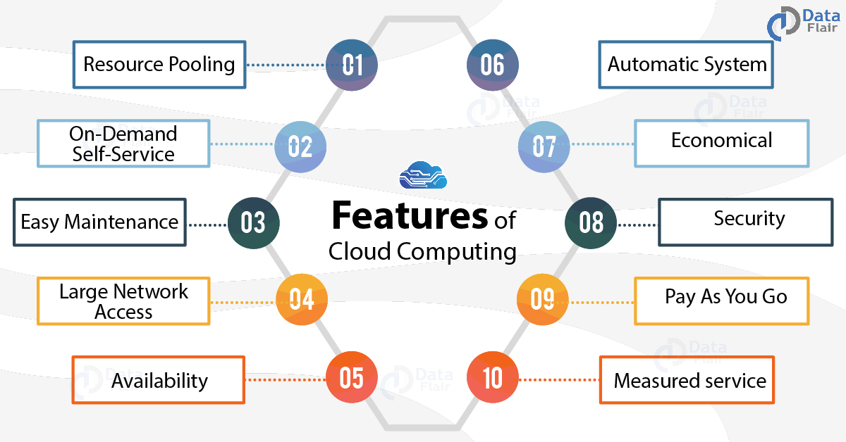
Features of Cloud Computing – 10 Major Characteristics of Cloud Computing

Slide 57
Feature of Cloud Computing-1
1. Resources Pooling: It means that the Cloud provider pulled the computing resources to provide services to multiple customers with the help of a multi-tenant model. There are different physical and virtual resources assigned and reassigned which depends on the demand of the customer.
2. On-Demand Self-Service:the user can continuously monitor the server uptime, capabilities, and allotted network storage.
3. Easy Maintenance: The servers are easily maintained and the downtime is very low and even in some cases, there is no downtime.
Notes:
Multi-tenancy means that a single instance of the software and its supporting infrastructure serves multiple customers. Each customer shares the software application and also shares a single database. Each tenant's data is isolated and remains invisible to other tenants.

Slide 58
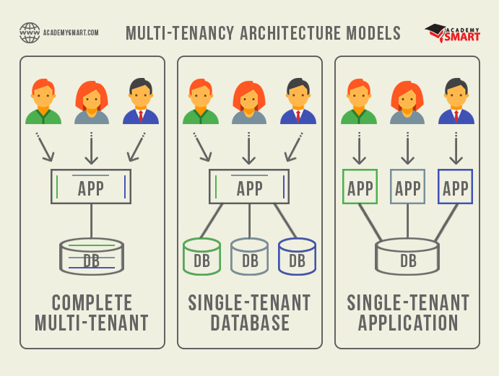
Multiple tenancy Models

Slide 59
Feature of Cloud Computing-2
4. Large Network Access: The user can access the data of the cloud or upload the data to the cloud from anywhere just with the help of a device and an internet connection.
5. Availability: It analyzes the storage usage and allows the user to buy extra Cloud storage if needed for a very small amount.

Slide 60
Feature of Cloud Computing-3
7. Economical: It is the one-time investment as the company (host) has to buy the storage and a small part of it can be provided to the many companies which save the host from monthly or yearly costs.
8. Security: The data is stored within the storage devices, which cannot be hacked and utilized by any other person. The storage service is quick and reliable.
9. Pay as you go
10. Measured Service: This means that the resource usages which can be either virtual server instances that are running in the cloud are getting monitored measured and reported by the service provider.

