Slide 1
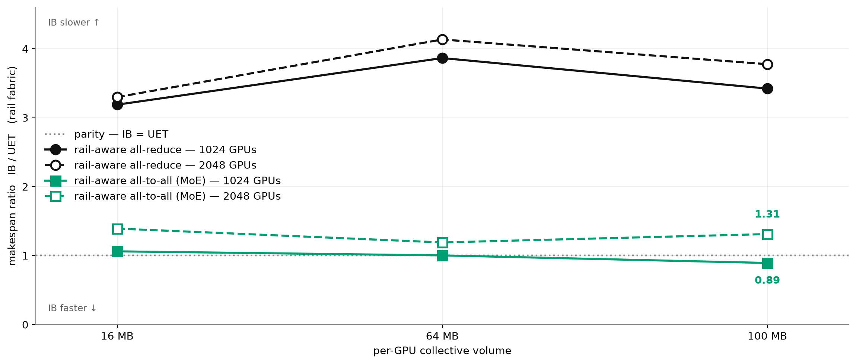
IB vs UET on the rail fabric — 1024 vs 2048 GPUs
IB's MoE win does not survive the scale-up: it is a 1024-GPU result only.
At 1024 GPUs IB edges UET on MoE all-to-all at 100 MB (0.89x). At 2048 the same cell reverses to 1.31x — IB is 31% slower — and every MoE point sits above parity. All-reduce is unaffected by scale, staying at a flat 3.2-4.1x UET lead on both.
Colour = workload, line style = scale (solid/filled = 1024, dashed/open = 2048); the dotted line is parity. The 2048 / 100 MB IB cells come from the completed re-runs — the earlier rows were truncated (incomplete) and understated makespan by ~25%.

