Slide 1
Lossless vs Lossy Datacenter Transports
IB (RoCE + DCQCN) vs Ultra Ethernet (UEC) — flat fabrics and rail-optimized GPU clusters
Two congestion philosophies, measured on a flat 200G fat-tree and on a 1024-GPU rail-optimized cluster with NVLink

Slide 2
Motivation
• AI / HPC datacenters are bottlenecked by the network, not compute: distributed training and storage are dominated by collective communication (incast, all-to-all, all-reduce).
• These patterns create extreme, bursty congestion — many senders hitting one link at once — which a naïve fabric handles badly (drops, retransmissions, collapse).
• Two competing industry philosophies for the fabric:
• InfiniBand-style / RoCE: keep the fabric LOSSLESS (PFC back-pressure) and add DCQCN congestion control to slow senders before buffers overflow.
• Ultra Ethernet (UEC): let the fabric DROP, but spray each packet across all paths and retransmit fast — tolerate loss instead of preventing it.
• Question: which wins, on which workloads, and what does each pay for its performance?
• Approach: build BOTH stacks in the htsim packet simulator and measure them under identical conditions.

Slide 3
The two stacks
• IB — RoCE transport + DCQCN + lossless PFC fabric:
• Per-flow ECMP (one path per flow, in-order delivery).
• PFC pauses upstream when a switch buffer fills → no packet loss.
• DCQCN: switches mark packets (ECN) as queues build; senders cut rate on the signal.
• UET — UEC transport (NSCC congestion control) + lossy fabric:
• Per-packet spray across ALL paths → uses full bisection bandwidth.
• Packet trimming: overflowing packets are dropped (payload trimmed) and NACK'd → fast retransmit.
• Reorder-tolerant receiver (spray causes heavy reordering).
• Both simulated in htsim on the SAME topology and workloads → a controlled, apples-to-apples comparison.

Slide 4
Experimental setup — matched on both sides
Everything held constant except the transport/fabric — so differences are attributable to the stack.
• Topology: 3-tier fat-tree, 200 Gbps links (a3_200g topos).
• Scale: 128 nodes and 1024 nodes.
• Oversubscription sweep: 1:1, 4:1, 8:1 (core bandwidth reduced — models cost-driven real fat-trees).
• Flow sizes: 16, 64, 100 MB (bulk collective-style transfers).
• Identical traffic matrices (.cm) fed to both stacks; identical link speed & topology.
• The only intentional difference besides the transport: MTU 4000 (IB) vs 4150 (UET) — each stack's native default; effect is small and proportional.

Slide 5
Workloads we ran — and what they mimic (1/2)
• Permutation — random & full-bisection: each node sends to one other node.
• Mimics uniform shuffle / general point-to-point traffic; full-bisection maximally stresses the network core.
• Incast (random) — many senders → one receiver (all-to-one):
• The classic datacenter pain point: distributed-storage reads, MapReduce shuffle-to-reducer, parameter-server gather, partition/aggregate query fan-in.
• Incast (remote) — incast where senders are the far half of the fabric:
• Same fan-in but forced across the core → stresses incast AND core bandwidth together.
• Outcast-incast — combined fan-out then fan-in:
• Scatter-then-gather / tree-reduction communication.

Slide 6
Workloads we ran — and what they mimic (2/2)
• All-to-all (a2a) — every node sends to every other node:
• The most demanding collective. Mimics MPI_Alltoall: Mixture-of-Experts routing, embedding/table shuffles in recommendation models, FFT transposes, distributed sort.
• Serial vs concurrent variants: staged rounds vs all pairs firing at once (peak stress).
• Ring all-reduce — ring-structured gradient aggregation:
• The dominant collective in data-parallel deep-learning training (gradient sync every step).
• Oversubscription (1:1 → 8:1) mimics real fat-trees thinned at the core for cost — testing each stack as the network gets more contended.
• Together these span the traffic that actually limits AI/HPC clusters — from benign permutation to pathological all-to-one incast.

Slide 7
What we measure
• Common (directly comparable between stacks):
• Makespan — time for the whole workload to complete (the bottom line).
• Flow-completion time (FCT) & slowdown = FCT ÷ ideal (tail latency).
• Per-tier link utilization (how well each fabric uses the network).
• Completion / robustness — did every flow actually finish?
• Each stack's native congestion signal (different mechanisms):
• UET: packet-trim / NACK rate and retransmission count (its cost of dropping).
• IB: PFC pause count & pause-time, and peak buffer occupancy (its cost of back-pressure).
• IB also: per-flow Jain fairness (how evenly bandwidth is shared).

Slide 8
Results — UET (Ultra Ethernet)
Lossy fabric, per-packet spray + trimming, NSCC

Slide 9
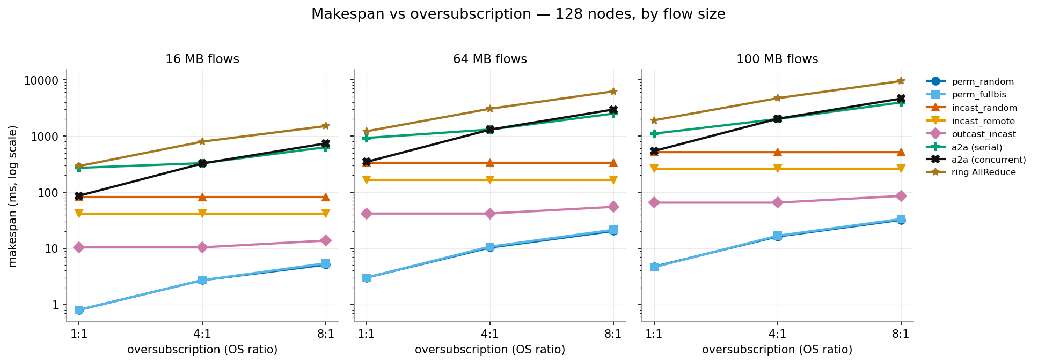
UET — makespan vs oversubscription (128 nodes)
Takeaway: Spray uses all paths, so permutation finishes fast; incast/all-to-all dominate and grow steeply with oversubscription.

Slide 10
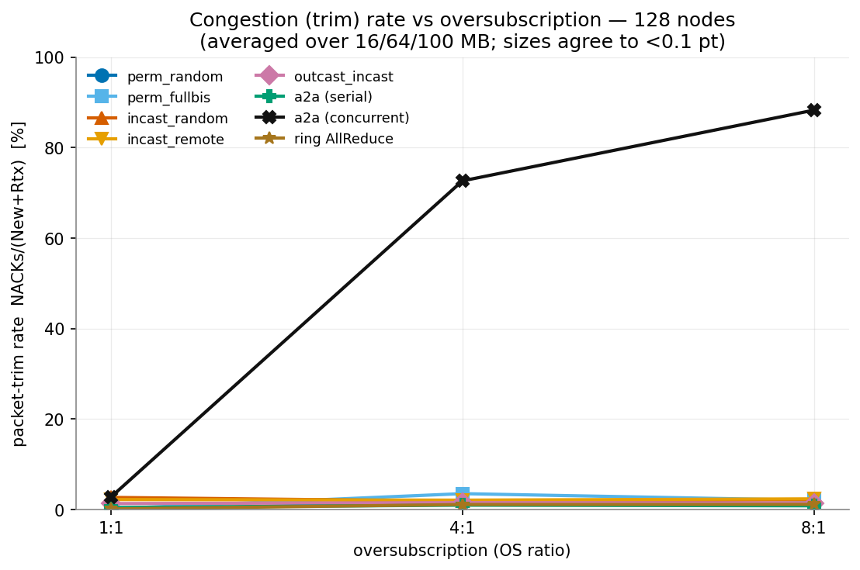
UET — congestion (packet-trim / NACK rate)
Takeaway: Trim rate climbs sharply with oversubscription — under 8:1 a large fraction of packets are dropped and retransmitted (up to billions of retransmits for all-to-all).

Slide 11
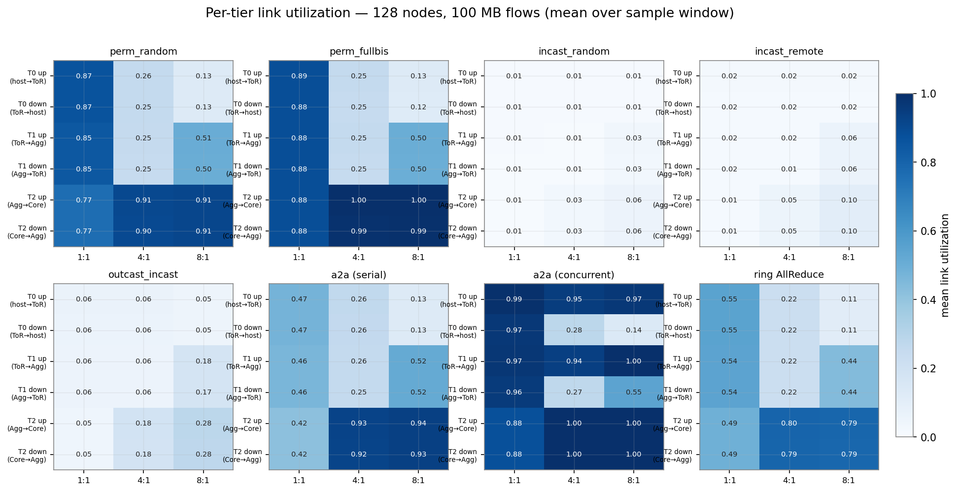
UET — per-tier link utilization (128 nodes, 100 MB)
Takeaway: Per-packet spray saturates links to ~100% across tiers — UET extracts maximum bandwidth from the fabric.

Slide 12
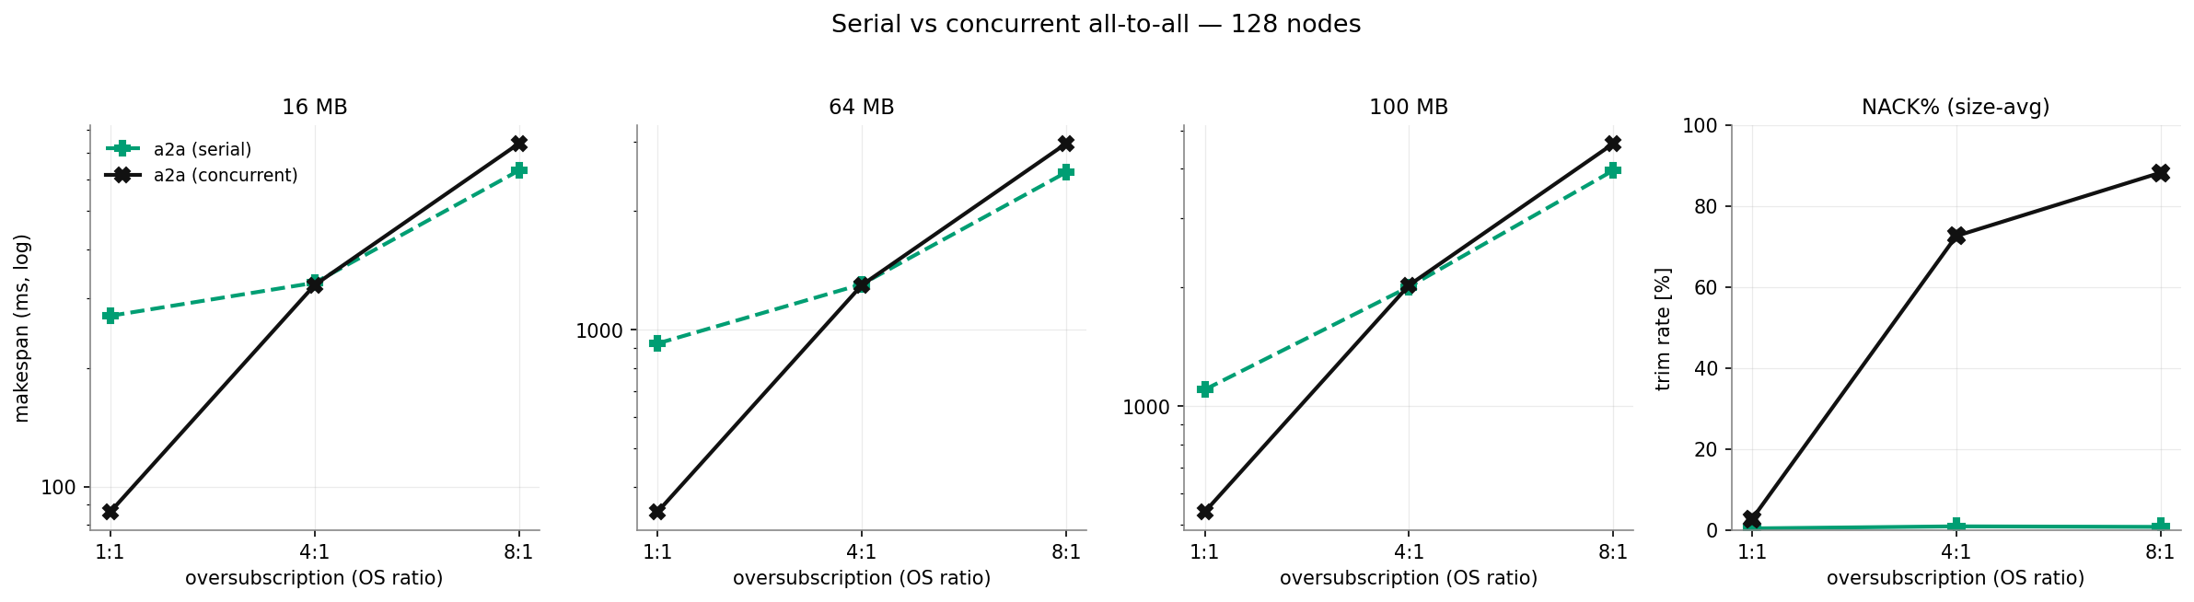
UET — serial vs concurrent all-to-all (128 nodes)
Takeaway: Concurrent all-to-all is far harder than staged/serial — peak contention drives both makespan and trim rate up.

Slide 13
Results — IB (RoCE + DCQCN)
Lossless PFC fabric, per-flow ECMP, DCQCN

Slide 14
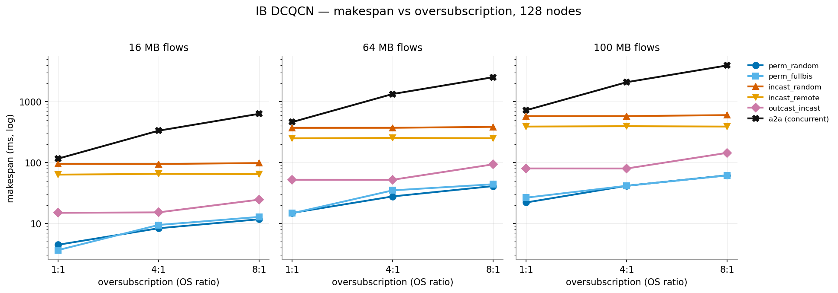
IB — makespan vs oversubscription (128 nodes)
Takeaway: Incast is flat in OS (receiver is the bottleneck); permutation grows with OS because IB uses one path per flow (no spray).

Slide 15
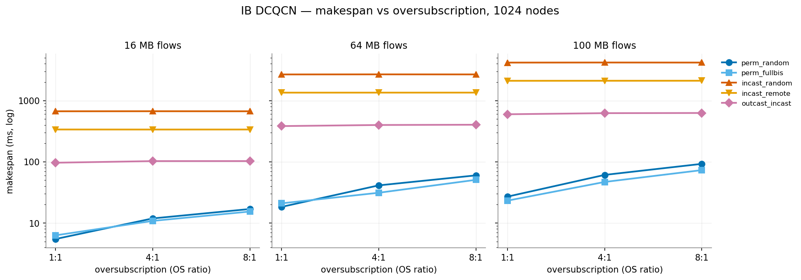
IB — makespan vs oversubscription (1024 nodes)
Takeaway: Same structure holds at scale; IB completes every 1024-node workload, including the extreme incasts.

Slide 16
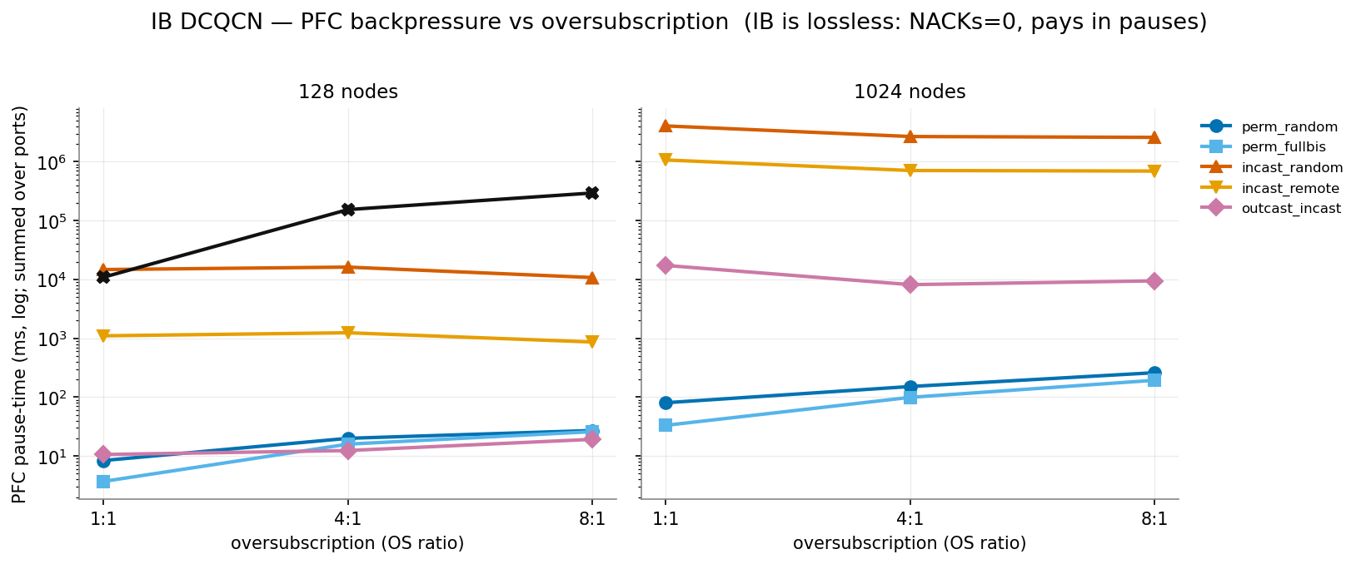
IB — PFC back-pressure (its congestion cost)
Takeaway: IB is lossless (zero retransmits) — instead it pays in PFC pause-time, which rises steeply with oversubscription, most for incast.

Slide 17
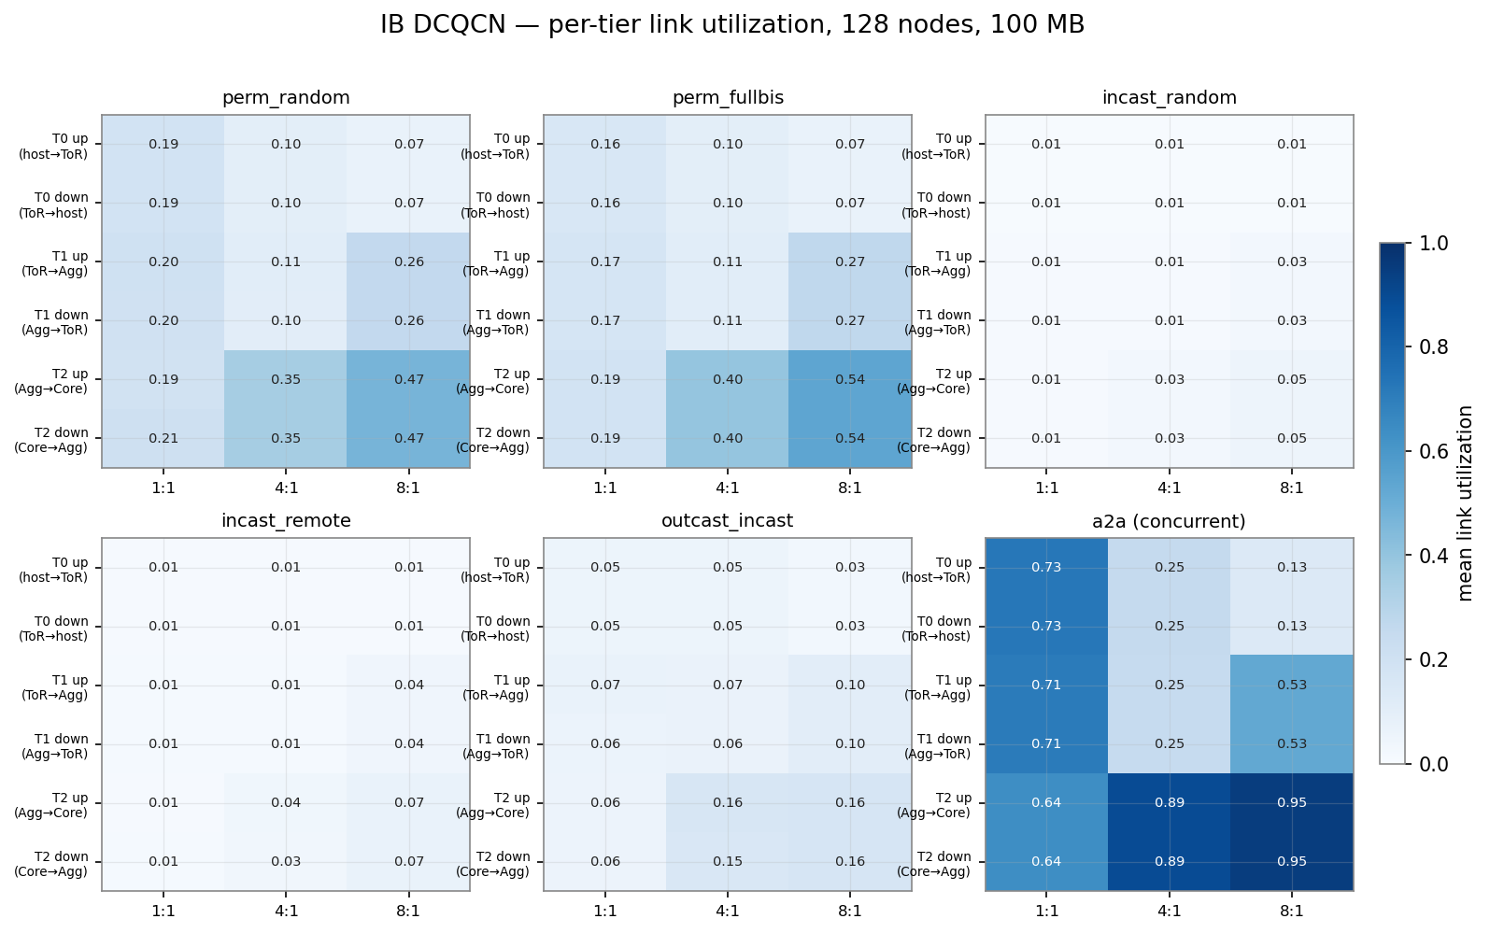
IB — per-tier link utilization (128 nodes, 100 MB)
Takeaway: DCQCN paces senders → link utilization is lower and smoother than UET's saturation (bandwidth traded for gentleness).

Slide 18
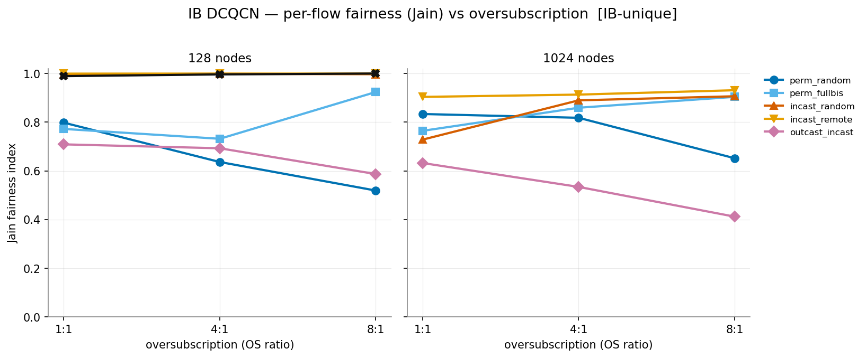
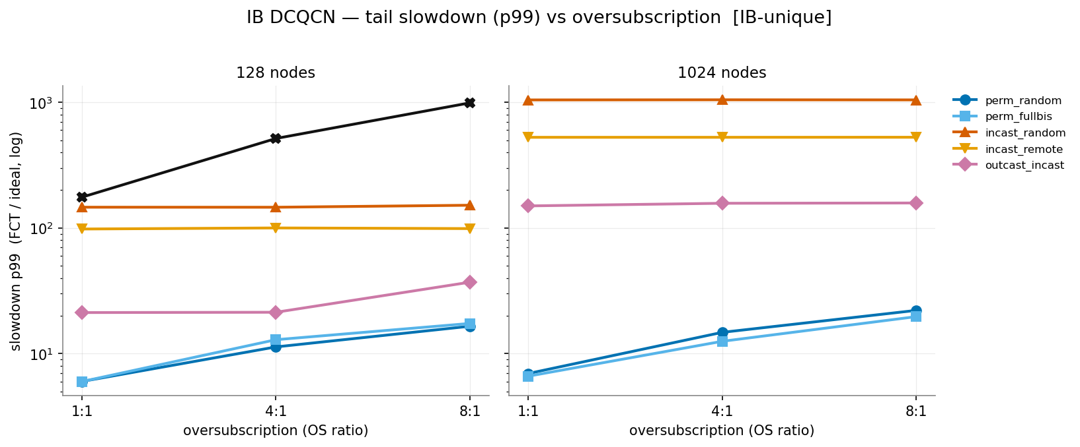
IB — fairness & tail slowdown (unique to IB instrumentation)
Jain fairness: incast is near-perfectly fair; permutation & outcast grow UNFAIR under oversubscription (down to ~0.4).
Tail slowdown (p99): incast pays a huge tail (100×+), permutation stays low.

Slide 19
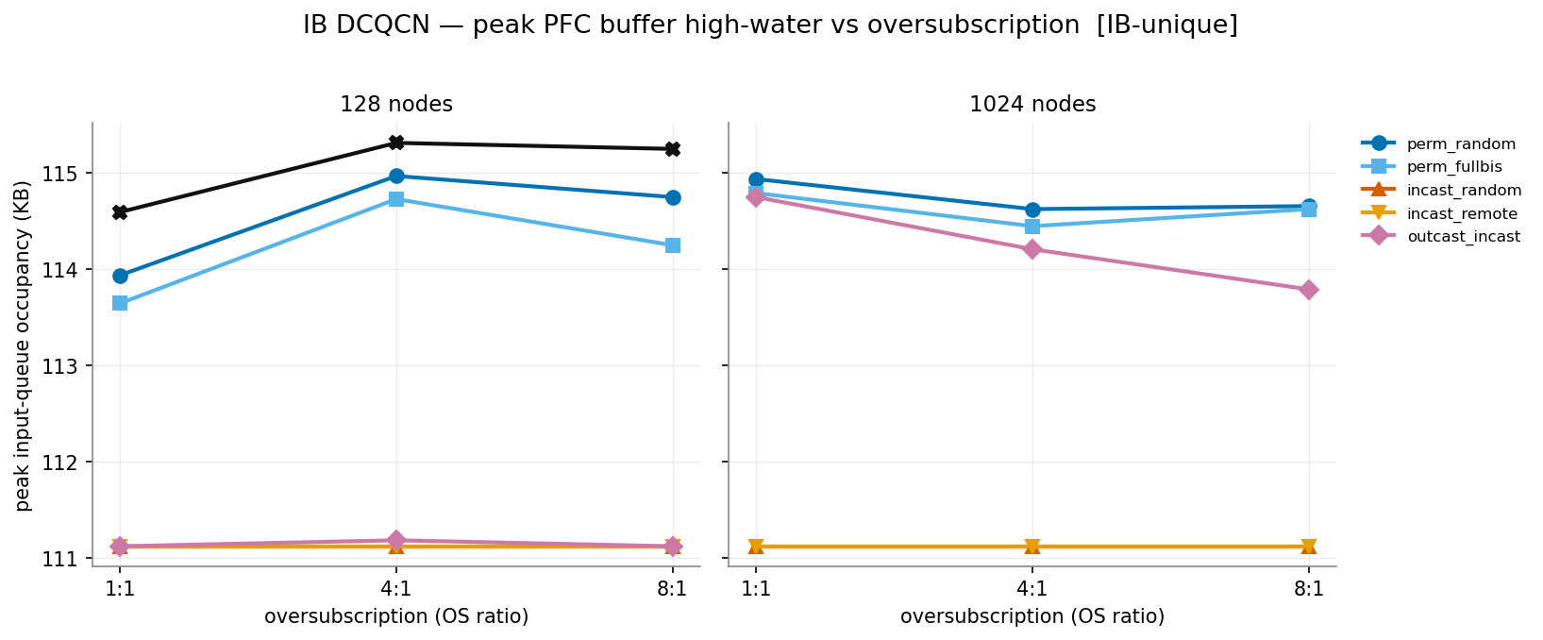
IB — peak PFC buffer occupancy (lossless buffer cost)
Takeaway: How much buffer the lossless fabric actually needs — the memory price of never dropping a packet.

Slide 20
Analysis — putting them side by side

Slide 21
Analysis (1): speed
• UET is generally faster — makespan ratio IB/UET ≈ 2.2× on average; IB is faster on only ~18 of 96 matched runs.
• Biggest gap is PERMUTATION: IB is 3–4× slower.
• Why: UET sprays every packet across all 128 paths and saturates the fabric; IB pins each flow to one ECMP path (RoCE needs near-in-order delivery), so flows collide.
• IB wins the HARD incasts: on 1024-node random incast IB is ~12% faster with a better tail.
• Why: the receiver port is the physical bottleneck — spray can't help — and IB avoids UET's retransmission overhead there.

Slide 22
Analysis (2): robustness & the cost of speed
• Robustness — IB completed ALL 99 runs. UET left the most extreme cases unfinished:
• 1024-node random incast at 8:1 oversubscription — incomplete (all sizes).
• 1024-node all-to-all — timed out.
• The cost each stack pays under heavy congestion is opposite:
• UET burns BANDWIDTH on retransmissions — up to ~3 billion retransmits in one all-to-all run (each packet sent ~8× at 8:1 oversubscription).
• IB burns TIME on back-pressure — zero retransmits, but PFC pauses stall senders (hundreds of port-seconds), and it needs large lossless buffers.
• Utilization mirrors this: UET saturates links (~100%); IB deliberately runs them cooler (DCQCN pacing).

Slide 23
Part 2 — Rail-Optimized Clusters + NVLink
Modelling how AI clusters are actually built

Slide 24
Why rail-optimized? (the real hardware)
• Everything so far assumed a FLAT fabric: every GPU is just an endpoint on a fat-tree. Real AI clusters are not built that way.
• A DGX-class server holds 8 GPUs joined internally by NVLink/NVSwitch — roughly 450 GB/s per GPU per direction, ~18x a 200G NIC.
• Each GPU also has its OWN 200-400G NIC, and each of those NICs is wired to a DIFFERENT switch — its 'rail'. 8 GPUs per server => 8 rails.
• So a leaf switch does NOT hold whole servers: it holds ONE GPU from each of many servers — that is what makes it a rail.
• Consequence: two GPUs on the same rail are one hop apart; two GPUs in the same server are NOT (they are on different rails) — but they have NVLink between them.
• Purpose: make the traffic that collectives generate either stay inside the server (NVLink, very fast) or stay inside a rail (one leaf, no spine).

Slide 25
The topology we built (1024 GPUs, DGX SuperPOD-class)
• 128 servers x 8 GPUs = 1024 GPUs; each GPU has its own 200G NIC on its own rail.
• 8 rails; each rail is served by 4 leaf switches (32 servers each) => 32 leaves total, each 32 down + 32 up = 64 ports (real Quantum-2-class radix).
• 32 spines, 2-tier leaf-spine, fully NON-BLOCKING, diameter 4.
• Host->leaf mapping (this is the whole difference):
• GPU g -> rail r = g mod 8, server s = g / 8, leaf = r*4 + s/32
• i.e. hosts are attached STRIDED, not consecutively. A leaf holds GPU r of 32 different servers.
• Control topology: identical shape (32 leaves, 32 spines, same speeds) but CONSECUTIVE attachment — so any difference is attributable to the rail assignment alone, not the switch layout.
• A second topology models the NVLink domain: 128 leaves = 128 servers, 8 GPUs each at 3600 Gbps, 100 ns links.

Slide 26
How NVLink is modelled — and why it was essential
• A GPU has TWO attachments: NVLink to its 7 server-mates, and a rail NIC to everything else. A fat-tree gives each host only one, so we run two topologies.
• The choice is made per FLOW at connect time (a flow's destination is fixed):
• same server -> NVLink topology at NVLink rate; otherwise -> rail topology at 200G.
• The fabric alone was not enough: the HOST send-rate is the binding constraint. Same NVLink path, 64 MB flow:
• 200G host rate -> 2601 us vs 3600G host rate -> 145 us (18x)
• Validated on both stacks: intra-server flows hit 145 us; cross-server flows are unchanged (never mis-routed onto NVLink); and a GPU can drive NVLink and its rail NIC simultaneously.
• Ablation finding: rails WITHOUT NVLink are actively harmful (IB 2.2x worse than flat) — because rails scatter a server's GPUs across 8 leaves. Rails and NVLink only make sense together.

Slide 27
The workloads: rail-AWARE collectives
• A rail fabric only pays off if the collective is written for it. Standard collectives are rail-agnostic and would just pay the cost (7/8 of destinations are cross-rail).
• Rail-aware all-reduce (hierarchical, as used on DGX):
• 1. intra-server reduce-scatter over NVLink 2. rail-local all-reduce (recursive halving/doubling) 3. intra-server all-gather over NVLink
• Rail-aware all-to-all = the MoE dispatch pattern (Mixture-of-Experts routing):
• 1. NVLink shuffle so data for rail r sits on the GPU at rail r 2. rail-local all-to-all
• trades ~1.87x more bytes for perfect locality — the bytes are cheap because they ride NVLink
• Both generators assert the key property: every flow is either intra-server or same-rail — 0 flows cross a spine.

Slide 28
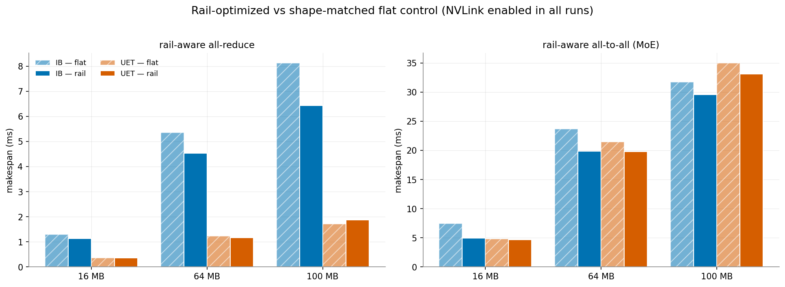
Rail results — makespan vs the shape-matched control
Takeaway: Same switch layout in both; only the host->leaf assignment differs. IB (blue) gains on every configuration; UET (orange) barely moves.

Slide 29
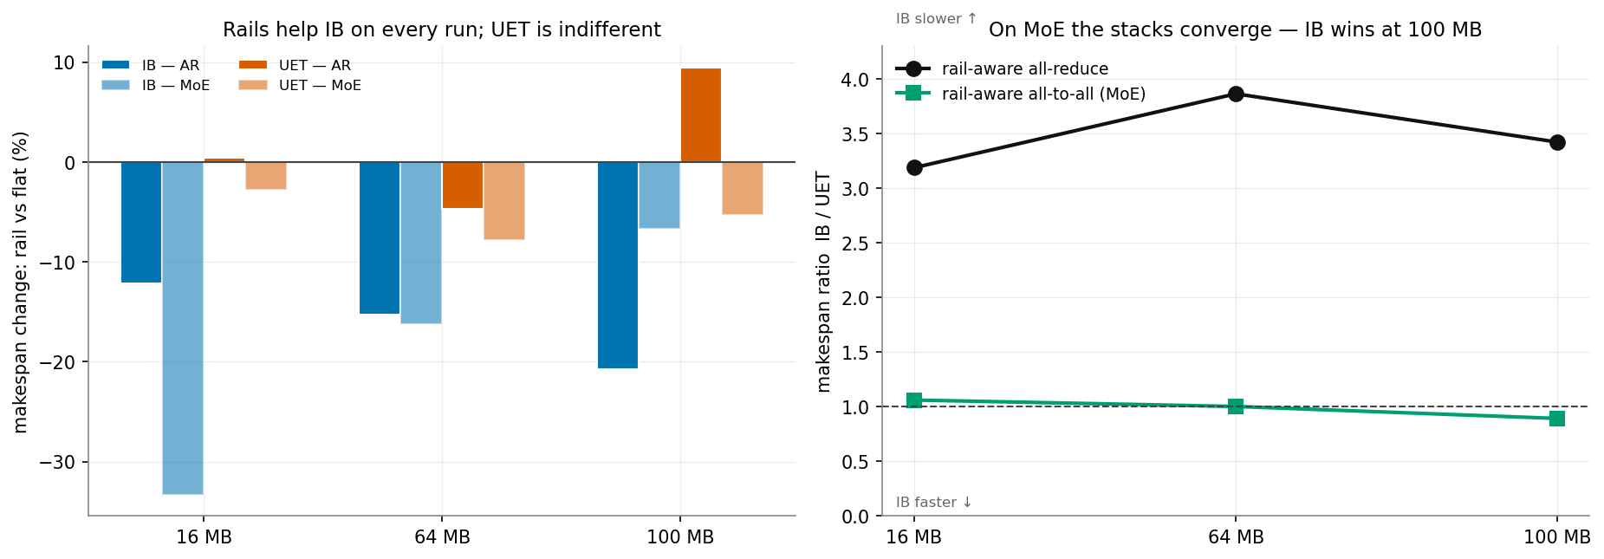
Rail benefit, and the IB/UET ratio
Takeaway: Left: rails help IB by 7-33% on all six runs, UET within noise. Right: on MoE all-to-all the stacks converge — and at 100 MB IB is 11% FASTER.

Slide 30
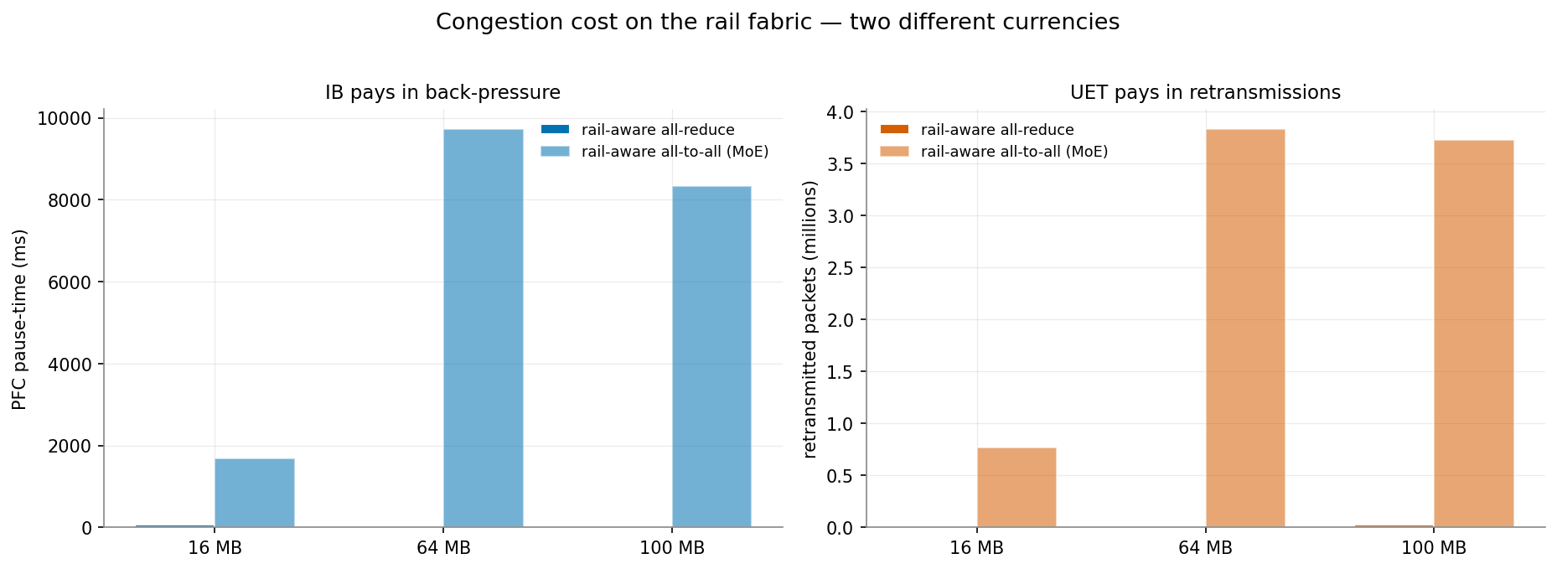
What each stack pays on the rail fabric
Takeaway: Two different currencies: IB burns time in PFC back-pressure (up to ~9.7 s of pause), UET burns bandwidth in retransmissions (up to 3.8 M packets).

Slide 31
Analysis — three findings
• 1. Rail-optimization is an IB optimization.
• Rails helped IB on all six runs (-7% to -33%); UET stayed within noise (+9% to -8%).
• Why: rails are a LOCALITY optimization. IB pins each flow to one path, so keeping traffic on one leaf matters. UET sprays across all paths and has spare bandwidth on a non-blocking fabric, so it is largely indifferent to where traffic goes.
• 2. On MoE all-to-all the two stacks converge — IB even wins at 100 MB (0.89x).
• Versus UET's usual 3-4x lead on all-reduce. This is the sharpest reversal in the study.
• 3. The mechanism: rail locality does NOT reduce UET's retransmits (~0% change vs flat).
• MoE all-to-all makes every GPU receive from its 127 rail peers, so the bottleneck is receiver-side INCAST at the endpoint — not congestion in the fabric.
• An endpoint bottleneck cannot be fixed by locality, and cannot be fixed by spray either. That single fact explains all three findings — and why IB's losslessness edges ahead where UET's retransmissions become pure overhead.

Slide 32
Conclusions
• Part 1 — flat fabric: a clean speed-vs-robustness trade-off.
• UET (lossy spray) is 2-4x faster on well-behaved/permutation traffic and saturates links, but retransmits enormously under congestion and fails to complete the most extreme incasts.
• IB (lossless PFC + DCQCN) is slower but never drops a packet, completes every workload UET cannot, and has a better tail on the heavy 1024-node incasts — paying in back-pressure and buffering.
• Part 2 — rail-optimized + NVLink: the picture changes.
• Rails+NVLink must be adopted together: rails alone are 2.2x WORSE than a flat fabric, because they scatter each server's GPUs across 8 leaves.
• Rail-optimization is an IB optimization (-7% to -33% on every run); UET is indifferent, because spray already makes it insensitive to locality.
• On MoE all-to-all the two stacks converge and IB overtakes UET at 100 MB — the workload is bound by receiver-side incast at the endpoint, which neither locality nor spray can relieve.
• Overall: which transport wins is workload- and topology-dependent, not absolute. UET's advantage comes from path diversity, so it shrinks exactly where the bottleneck stops being the fabric.

Slide 33
Future work
• Confirm the endpoint-incast explanation directly by instrumenting per-receiver backlog (currently inferred from retransmit behaviour, not measured).
• Tune DCQCN (ECN threshold K, min rate) — K=8 was one operating point, never swept.
• Adaptive routing for IB (ecmp_ar): would give IB some path diversity and likely close part of the permutation gap.
• Rail-aware workloads beyond these two: all-gather / reduce-scatter (FSDP, ZeRO-3) and pipeline-parallel point-to-point.
• Sensitivity to the NVLink rate, and to rail count / servers-per-leaf (the sweep fixed 8 rails x 4 leaves).
• Larger scale (8192 GPUs) and real AI communication traces (GOAL / ATLAHS).
• Symmetric fairness metrics: per-flow fairness for trigger-staged workloads needs per-flow start times (currently an artifact for staged collectives).

Slide 34
Thank you
IB (RoCE/DCQCN) vs Ultra Ethernet — controlled comparison in htsim

