Slide 1
CSE 3111: Computer Networking Lab
Project title:
ShareNet
Team Members:
Abdullah Al Mahmud, Roll - 15
Zisan Mahmud, Roll - 23

Slide 2
Objectives

Slide 3
To make a successful file transferring application
Ensuring lossless data transmission
To make real time video chat application
User friendly interface
Understanding networking concept in real life application

Slide 4
Features

Slide 5
File transfer
Video chat
Audio chat
User interface

Slide 6
Tools

Slide 7
Programming language: Python
UI: TKinter, pyaudio, OpenCV
IDE: VS Code

Slide 8
Protocols

Slide 9
Socket Programming
TCP Reno
UDP
Packet Switching and forwarding

Slide 10
Project Interface

Slide 11
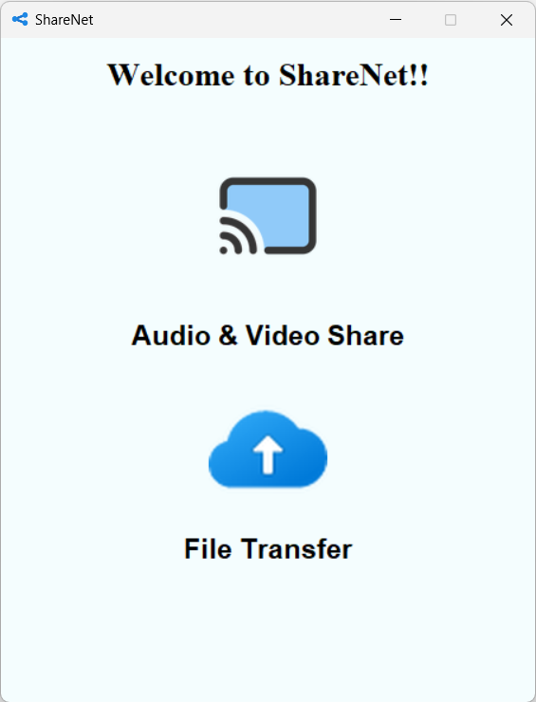
Landing page:

Slide 12
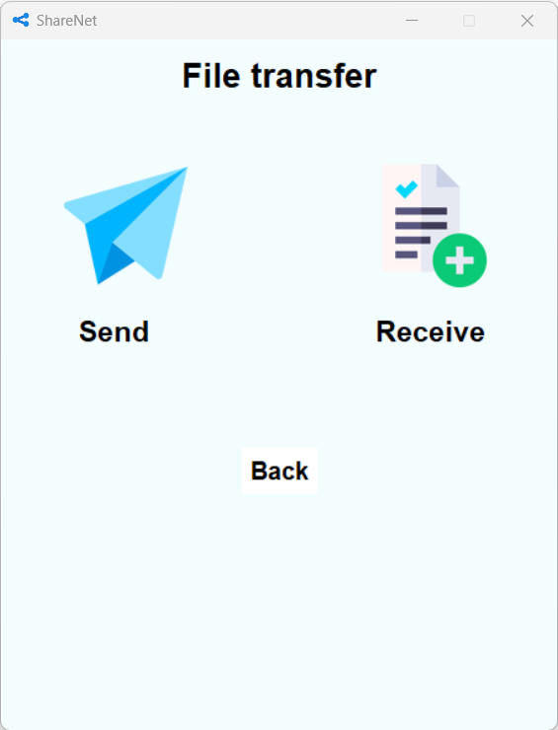
File transfer option:

Slide 13
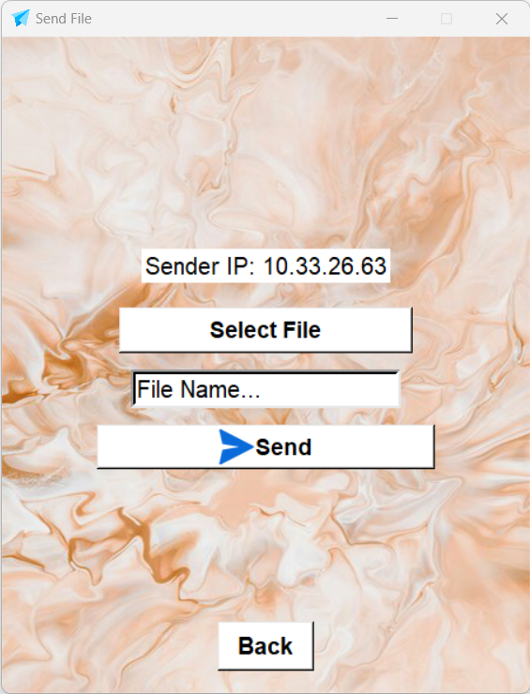
Send file:

Slide 14
File transfer option:

Slide 15
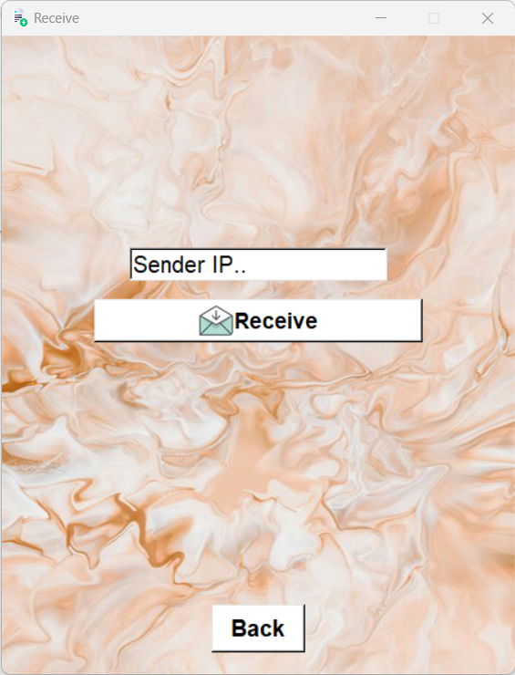
Receive file:

Slide 16
Audio and Video chat:

Slide 17
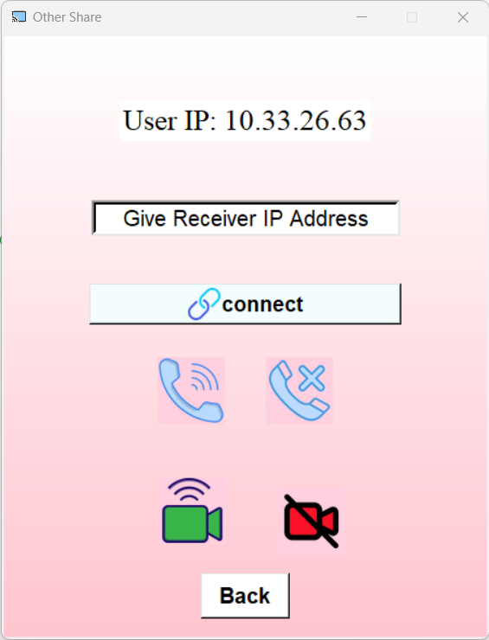
Start Audio and Video chat:

Slide 18
Thank You

