Slide 1

MAWLANA BHASHANI SCIENCE AND TECHNOLOGY UNIVERSITY
Department of Computer Science and Engineering
PROJECT PRESENTATION
FailureAntyTheft
A phone-based IoT movement detection and anti-theft alert system
Local-first • Real-time • No dedicated sensor hardware
PRESENTED BY
July 2026
MOTION
[Presenter Name] • [Student ID]
Official MBSTU logo source: mbstu.ac.bd
Notes:
Good morning/afternoon. Our project is FailureAntyTheft, a local IoT anti-theft system that converts ordinary smartphones into wireless motion sensors. Add presenter names and student IDs on this slide before presenting.

Slide 2
02
PROBLEM & OPPORTUNITY
Why build this system?
Portable assets need monitoring, but dedicated IoT hardware adds cost and setup effort.
The core problem
Opportunity
Reuse hardware people already own
Portable assets are easy to move
Bags, drawers, bicycles and lab equipment may be unattended.
Turn a phone into a sensor node and a laptop into the complete local monitoring platform.
Raw sensor noise causes false alarms
A useful detector must distinguish noise from sustained movement.
Commercial hardware is unnecessary
≋
Local server
!
Alert
Most smartphones already contain accelerometers, Wi-Fi and batteries.
Collect, detect, store
See + hear
Cloud dependence adds friction
A classroom demo should work privately on a local network.
LOW COST
PRIVATE LAN
REUSABLE
FailureAntyTheft
Notes:
The project starts from a practical observation: phones already contain the required sensing and networking hardware. The engineering challenge is not simply reading acceleration; it is producing a reliable, understandable alert without dedicated hardware or cloud services.

Slide 3
03
SOLUTION OVERVIEW
One phone. One local server. One clear response.
FailureAntyTheft covers the complete IoT loop: sense, communicate, process, store, visualize and act.
≈
1 SENSE
◇
2 DECIDE
!
3 RESPOND
Phyphox exposes live X, Y and Z acceleration plus device time from each phone.
A deterministic detector calibrates a baseline, filters noise and verifies sustained movement.
The dashboard updates in real time, persists the event and plays a repeating siren.
DESIGN PRINCIPLE
Local-first by default
No paid cloud, no custom mobile app and no silent fallback when MQTT is configured.
MULTI-PHONE
REAL-TIME
AUDITABLE
FailureAntyTheft
Notes:
The solution is deliberately simple for the operator while remaining modular internally. Phones sense, the server decides, and the dashboard responds. The whole system remains on the local network.

Slide 4
04
SYSTEM ARCHITECTURE
A modular local IoT pipeline
Typed messages separate collection, detection, persistence and presentation while one FastAPI process supervises the application.
SENSOR LAYER
FastAPI + WS
↯
◆
Per-device runtime
Commands and live UI
⇣
Collector
MQTT
Ordered inbox
Pure detector
State transitions
Alert publication
Validate LAN URL
Cursor + deduplication
Normalize telemetry
Mosquitto
typed topics
HTTP queries
▤
SQLite
arm / disarm / acknowledge
Devices, state, events
Phones + Phyphox
HTTP /get polling
Browser dashboard
Live chart • controls • siren • event history
FailureAntyTheft
Notes:
Explain the architecture from left to right. Phyphox is polled over HTTP. The collector validates and normalizes readings. MQTT decouples components. Each phone has its own ordered runtime and deterministic detector. SQLite is the durable authority. FastAPI and WebSocket serve the dashboard and accept commands. The browser produces the audible alarm.

Slide 5
05
SENSOR-TO-ALERT FLOW
What happens after the phone moves?
Every stage removes ambiguity before the operator is interrupted.
01
02
03
04
05
06
Sample
Collect
Normalize
Score
Confirm
Alert
Phyphox emits time + X/Y/Z
Poll, validate and deduplicate
Publish typed telemetry
Magnitude → EMA → baseline delta
3 crossings inside 0.5 s
Persist, push UI and sound siren
WHY DEVICE TIME MATTERS
This preserves the sustained-movement rule and prevents network timing from changing the detector’s decision.
Buffered samples are judged by the phone’s sample time—not by clustered HTTP arrival time.
FailureAntyTheft
Notes:
Walk through the six stages. Emphasize that one noisy sample is not enough. The collector uses a cursor and device time for deduplication. The detector requires three threshold crossings within half a second before creating an alert.

Slide 6
06
DETECTION LOGIC
Calibrate first. Filter noise. Confirm sustained movement.
The detector is a pure, replayable state machine with no network, database or clock dependencies.
valid sample
arm
baseline ready
score > threshold
3 crossings / 0.5 s
OFFLINE
DISARMED
CALIBRATING
ARMED
SUSPICIOUS
ALARM
SCORE NORMAL → ARMED
ACKNOWLEDGE → DISARMED
CALIBRATION
MOTION SCORE
5 s placement delay + 2 s sampling window
score = | EMA(√(x² + y² + z²)) − baseline |
Median magnitude becomes the baseline; excessive variance rejects calibration.
Sensitivity sets the threshold; α = 0.35 smooths short sensor noise.
FailureAntyTheft
Notes:
The detector states make behavior predictable. After arming, the operator gets five seconds to place the phone, followed by a two-second stable calibration. The detector computes acceleration magnitude, smooths it with an exponential moving average, compares it with the median baseline and requires three crossings within 0.5 seconds. Acknowledgement disarms the device.

Slide 7
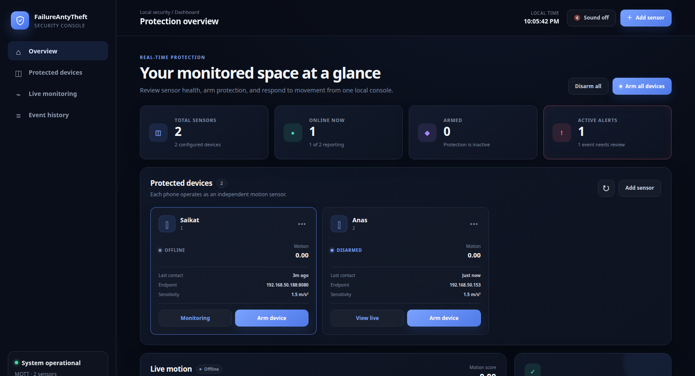
07
OPERATOR EXPERIENCE
A professional real-time security console
The interface turns low-level sensor data into one clear operational view.
Designed for fast decisions
At-a-glance health
Online, armed and active-alert counts.
Independent sensors
Arm, disarm, edit and monitor each phone.
Live WebSocket chart
Selected-device motion score without raw-data overload.
Actionable alarm
Visual banner, repeating siren and acknowledge workflow.
Auditable history
Persistent events with CSV export.
LIVE DASHBOARD CAPTURE
FailureAntyTheft
Notes:
This is a live capture of the implemented dashboard. Point out the health summary, device cards, live chart, quick-start guide, event history and sound control. The interface intentionally sends chart-ready motion scores rather than overwhelming the browser with raw XYZ data.

Slide 8
08
TECHNOLOGY STACK
Simple tools, clear responsibilities
Each technology was selected for local reliability, testability and low operational cost.
P
PHONE SENSOR
Py
BACKEND
Phyphox
Python + FastAPI + asyncio
Accelerometer access + remote HTTP API
Lifecycle, REST commands and WebSocket delivery
M
MESSAGING
DB
PERSISTENCE
MQTT + Mosquitto
SQLite (WAL)
Typed publish/subscribe topics and reconnect behavior
Device configuration, runtime state and event history
UI
FRONT END
✓
QUALITY
HTML + CSS + JavaScript
Pytest + Ruff + mypy + Docker
Responsive dashboard, canvas chart and Web Audio siren
Replay tests, static checks and reproducible broker
Deployment: one laptop runs the application, Mosquitto, SQLite and dashboard; phones remain sensor nodes on the same private LAN.
FailureAntyTheft
Notes:
The stack demonstrates a complete IoT architecture without overcomplicating deployment. Python and asyncio supervise the components, MQTT models IoT messaging, SQLite avoids another server, and the browser supplies a platform-independent control surface and siren.

Slide 9
09
ENGINEERING EVIDENCE
Verified in tests—and against a real phone
Automated replay protects detector behavior while live checks prove the Phyphox integration path.
105
84%
200
4
tests passed
coverage at handoff
live /config status
verified buffers
1 environment-gated skip
Core detector: 94%
Phone measuring = true
acc_time + accX/Y/Z
Test strategy
LIVE PHONE RESULT
Pure detector unit tests
Saikat
DISARMED • ONLINE
Calibration, noise filtering, crossings and transitions.
Recorded-shape replay
The collector’s default time buffer was corrected from t to acc_time using the phone’s live /config evidence.
Stationary data stays quiet; movement triggers exactly once.
Integration checks
Repository, API, runtime, WebSocket assets and live MQTT round-trip.
FailureAntyTheft
Notes:
This slide separates synthetic evidence from physical evidence. The current suite has 105 passing tests and one environment-gated MQTT test. A live phone returned HTTP 200, confirmed measurement, exposed the four expected buffers and transitioned online in the dashboard. Coverage figures are from the final handoff report.

Slide 10
10
LIVE DEMONSTRATION
A seven-step proof in under two minutes
Use a private hotspot or Wi-Fi network where the phone and laptop can communicate directly.
1
START
5
ARM
Open Acceleration with g and enable remote access
Keep still for 5 s placement + 2 s calibration
2
CONNECT
6
MOVE
Register the displayed private URL
Move the phone; observe Alarm + siren
3
VERIFY
7
CLOSE
Device appears Disarmed—not Offline
Acknowledge, disarm and show event history
4
SOUND
Click Sound off and hear the test siren
Keep a screenshot and event-history explanation ready if venue Wi-Fi isolates devices.
DEMO SAFETY NET
FailureAntyTheft
Notes:
This is the recommended live demo order. Use a personal hotspot if institutional Wi-Fi blocks peer-to-peer traffic. Wait the full seven seconds after arming before movement. If the live network fails, use the dashboard screenshot and explain the verified live-phone report rather than improvising configuration changes on stage.

Slide 11
11
HONEST SCOPE
What the prototype does—and what comes next
The current system is presentation-ready on a trusted LAN, but it is not a certified security product.
CURRENT LIMITATIONS
ROADMAP
Trusted private LAN only
01
Auto-discover buffers
Read /config and map experiments automatically.
No authentication or TLS for public deployment.
Browser is the alarm endpoint
02
Secure remote access
Authentication, HTTPS and role-based controls.
The tab must remain open with audio enabled.
Default Phyphox profile
03
Mobile/PWA notifications
Background push when the dashboard is not visible.
Custom experiments may expose different buffer names.
Prototype acceptance scope
04
Multi-sensor correlation
Combine simultaneous movement to reduce false alarms.
One live phone verified; multi-phone physical stress testing remains.
Not theft prevention
05
Packaged deployment
Install as a background service with guided setup.
It detects and reports movement; it does not physically secure an asset.
FailureAntyTheft
Notes:
Be explicit about scope. This is a trusted-LAN classroom prototype, not a certified security product. The next engineering priorities are automatic Phyphox configuration discovery, authentication and TLS, mobile background notifications, multi-sensor correlation and packaged deployment.

Slide 12
CONCLUSION
A complete IoT loop—built from devices we already own
FailureAntyTheft proves that a smartphone, a local network and a carefully designed detector can deliver practical real-time monitoring without dedicated hardware or paid cloud services.
105
REAL-TIME
LOCAL
AUDIBLE
passing tests
WebSocket updates
privacy by default
actionable alarm
Questions?
Thank you
Notes:
In conclusion, FailureAntyTheft demonstrates the entire IoT cycle using ordinary devices: sensing, local communication, deterministic processing, persistence, visualization and an audible response. Thank the audience and invite questions.

