Slide 1
Multiplication Table
Jewel Mahmud
CSE 13th, MBSTU
Date: 26-03-21

Slide 2
Contents
Introductions
ScreenShot
Features

Slide 3
Introductions
The project is about Multiplication table.
This is a simple project for javascript beginners.

Slide 4
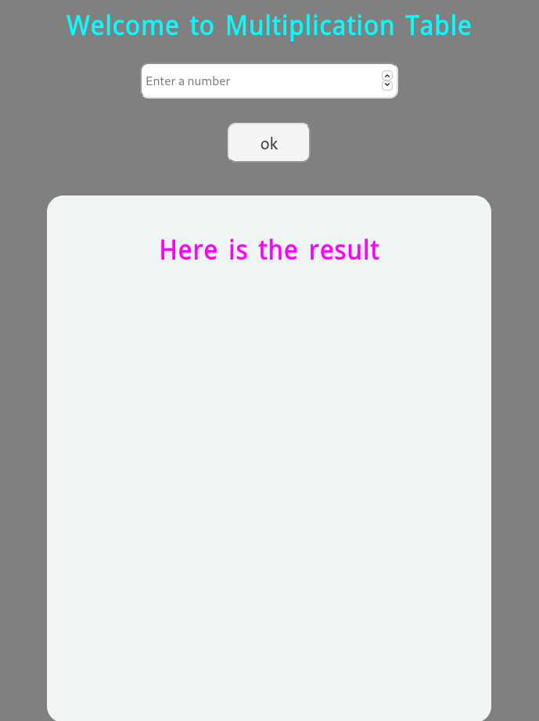
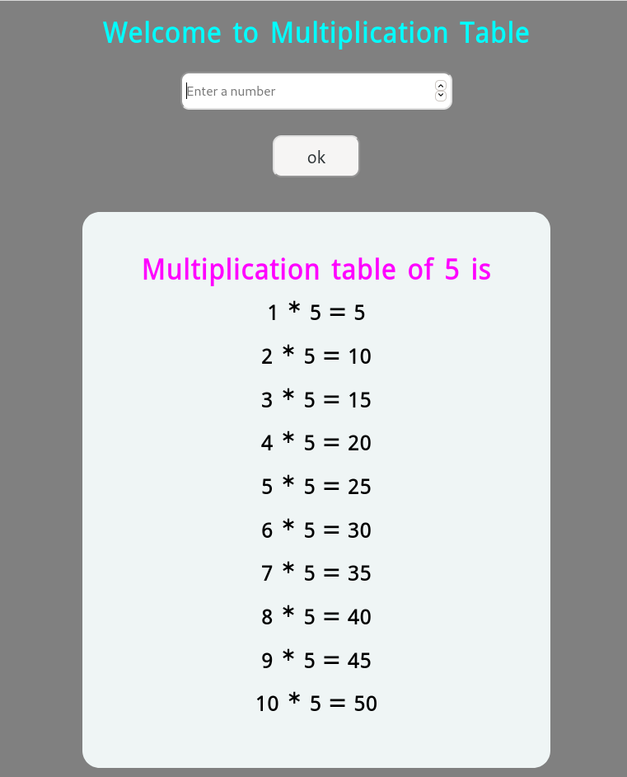

Slide 5
Features
Input field
Button
Output field
Working of enter key
Language: HTML, CSS, JS

Slide 6
Ht ml
Div ==> as output
Input field (text, number, button)
I have divided whole part into 2 parts
Div-1 for header, input, button
Div-2 for result area.

Slide 7
CSS
Flex-
Bg-gray
H1- cyan
Result- fuchsia

Slide 8
Js
DOM selction==> querySelector
Create Event for button
Validation on input area
Create element for result
Loop .

