Slide 1
Mawlana Bhashani Science And Technology University
Department Of Computer Science And Engineering
A Project Report
On
Pharmacy Store Management System
Course Title: Java And Mobile Application Development Lab
Course Code: CSE-2216
Supervised By, Group Members,
Mohammad Ashraful Islam Md. Juwel Mahmud (CE-16035)
Lecturer, Jaminur Rashid (CE-16034)
Department Of CSE ,MBSTU. Papia Akter (CE-16049)
Sanzida Haque Supti(CE-15045)

Slide 2
Introduction:
The pharmacy store management system provides functions on identity usages instructions ,minimize human errors in medication safety facilitate accessibility of drugs information and information management among employees ,providing optimal drugs movement in pharmacy unit ,enable reports with in significantly short period of time, despite simultaneous usages of database for the purpose stated above. The system will suggest the preventive medicine list for some specific diseases in the absence of doctor.
The system will solve the problem of the current system by minimizing time wastage and reduce resources which simply change manual based system to computerized system.

Slide 3
Purpose Of This Project:
The main purpose of this project is that, suppose someone is suffering from a disease and he needs medicine to be cured so he went to a pharmacy but the doctor is not present here .At this situation this system can suggest medicine for the required disease.
The main goal of the project is to maintain the records of user details ,sales and stock details ,report with cash transaction maintenance.
Scope and Objectives:
As it is generic software it can be used by a wide variety of outlets (Retailers And wholesalers to automate the process of

Slide 4
Manually maintaining the records related to the subject of maintaining the stock ,user documents , sale management and view report.
This projects basically updating the manual chemist inventory system to automated inventory system so that organization can manage their record in efficient and organized form.
Pharmacy store management is very needy for pharmacy store to maintain day by day transaction in computer.
This Project helps you to track all the medicines of pharmacy store moreover it’s a pharmacy accounting software suited to pharmacy stores or pharmacies of any size.

Slide 5
Drawbacks:
The reasons for do this Pharmacy Store Management System Project are given below:
Problem to maintain the record of daily transaction.
They have work load so they also have problem in dealing with their customer.
At the end of the day they also have problem in calculating their profit ,sales etc.
They also have problem to find a specific product .
They can not suggest medicine in absence of the doctor.
Why People Use This Project?
There are several benefits for use this project .They are-

Slide 6
Proper storage condition and storage facilities of medicines: Storage condition and storage facilities play an important role in a pharmacy.
. Proper supply, availability and authentic source of medicines: Proper supply and availability of drugs and devices should be ensured in pharmacy. Requisitions of medicines should be sent to the suppliers before they are short in the inventory
Digital inventory control management system: Inventory control should be computerized and all the systems should be maintained by software systems like System analyses and Data Processing software.
Less time required: This project minimize time for various processing in pharmacy store management. It is flexible and adaptive for this it provides great efficiency and better service.

Slide 7
Project Features:
Login: This process checks the authentication and admin and user can able to access the application.
Admin:- Who will act as administrator.
User:- Who will act as staff.
Stock: Stock gives the information about which current stock is available .The admin and user can Search Medicine By Disease also Add , Edit , Delete any medicine.
User Documents: The admin manages the user documents by Add , Edit ,Delete any user details.

Slide 8
Sales: User enter the sales button for selling medicine by Searching (Disease Wise).
View Report: The admin enter the view report to see sales information and also check details.
Future Developments:
To add Sales return & Purchase return Modules.
We can add Bar Code Reader.
We convert our system into website.
Automated Inventory Storage and Dispensing System.
We can add Cheques & Credit Cards payment.
We can add customer and supplier details.

Slide 9
Software Requirements:
Netbeans IDE 8.2
SQL Server Management.
Language Requirements:
Java Programming Language (Java Swing).

Slide 10
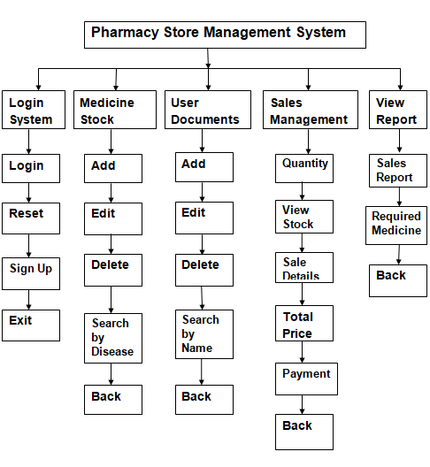
Project Structure :

Slide 11
Project Modules:
Login System (admin/user).
Medicine Stock Management.
User Documents.
Sale Management.
View Report.
Database Operations.
Login System:
This process checks the authentication and admin and user can able to access the application.
Admin:- Who will act as administrator.
User:- Who will act as staff.

Slide 12
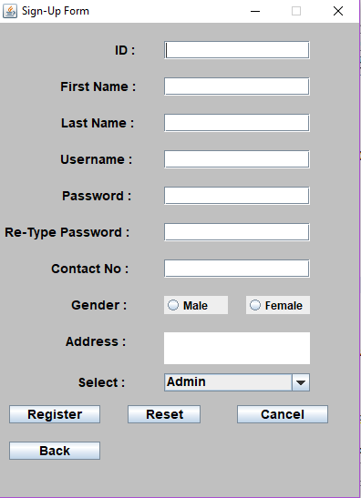
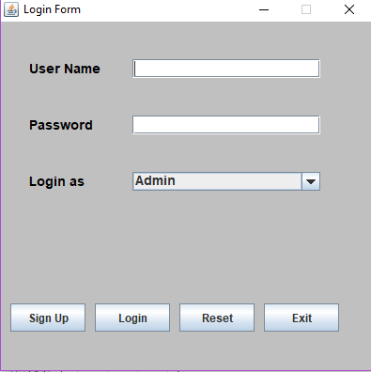

Slide 13
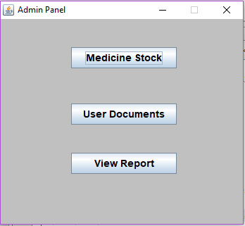
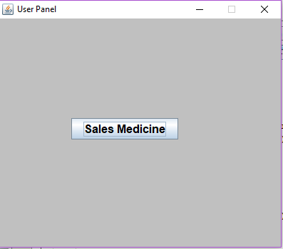
Medicine Stock Management:
The module in which stock details are maintained including:
Add new medicine
Edit medicine
Delete medicine
Search medicine by Disease

Slide 14
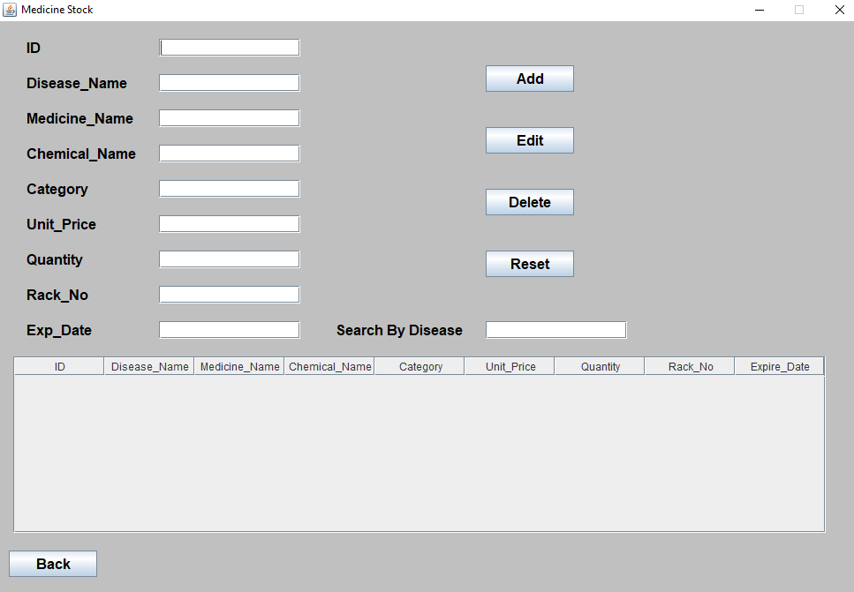
Reset
Back to Pharmacy Store Management form.
Medicine Details Table.

Slide 15
User Documents:
This is the module in which various user are created. Different privilege levels can be assigned to each user for providing high sequrity.
Including:
Add new user.
Edit user details.
Delete user details.
Search by username.
User details table.
Back to Pharmacy Store Management form.

Slide 16
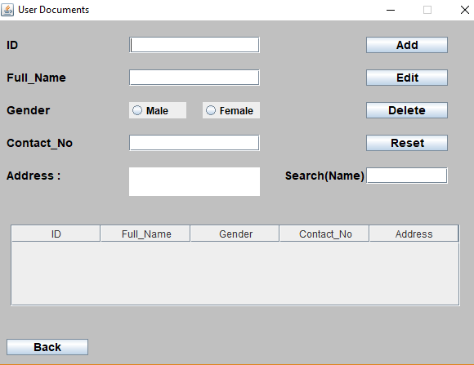

Slide 17
Sale Management:
This Module in which transaction of cash and material is
carried out. Including:
Input the Quantity.
Search Medicine by Disease.
Medicine Stock Details.
Sale Details.
Total Price.
Payment.
Back to Pharmacy Store Management form.

Slide 18
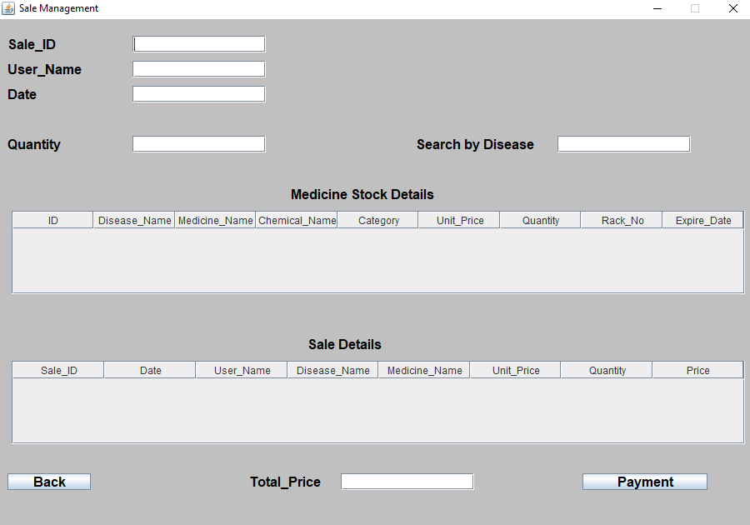

Slide 19
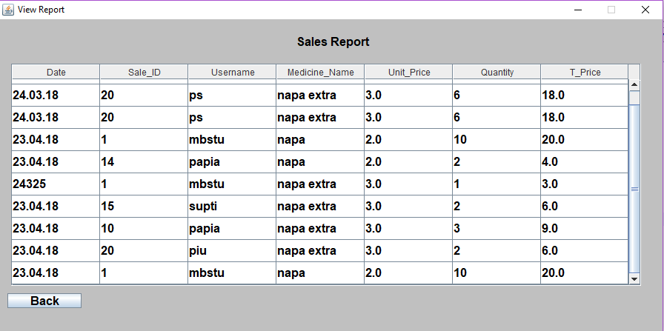
View Report:
This module in which sales report and required medicine is shown. Including:
Sales Report
Required Medicines.

Slide 20
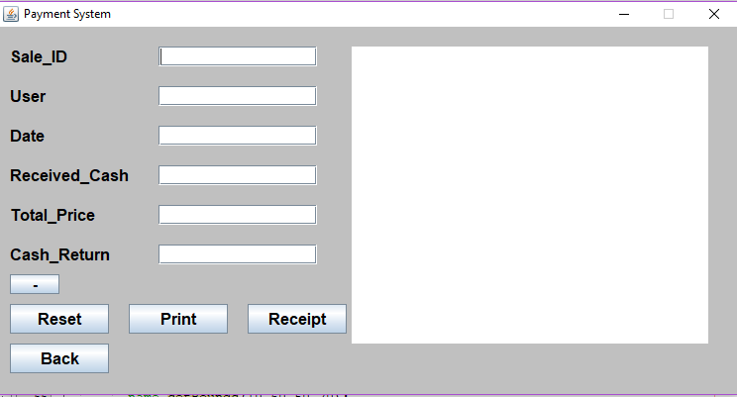
Payment:
The payment system views the billing system in pharmacy store. Including,
Total price.
Received Cash and Return Cash.
Money Receipt .

Slide 21
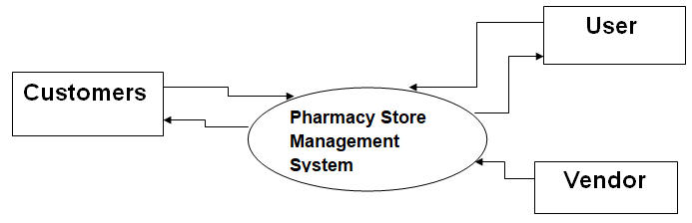
Database Operations:
All operations to database is carried out in this module. Including:
Backup.
Restore.
Store all information of Pharmacy.
DataFlow Diagram:

Slide 22
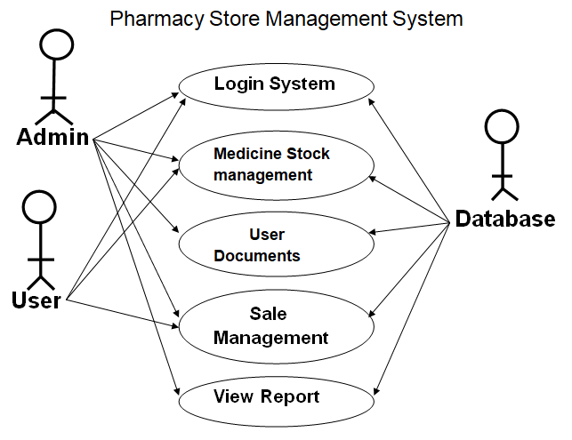
UseCase Diagram:

Slide 23
Conclusion:
Pharmacy store management system is very much needed for patient compliance. Patient counseling, proper dispensing of drugs and other patient oriented issues can be managed properly if the pharmacy is developed. By ensuring a quality management system of pharmacy, it is possible to enrich the health sector. It may be a paragon to the others.
References:
https://www.javatpoint.com

Slide 24
Thank You !

