Slide 1

MSc in Software Engineering with Advanced Research 7COM1039-0109-2022 - Advanced Computer Science Masters Project Comparative study of cryptography algorithms and its’ applications
UNIVERSITY OF HERTFORDSHIRE
School of Physics, Engineering and Computer Science
Name: Mahmud Hasan
Student ID: 20070587
Supervisor: Dr. Joseph Williams

Slide 2
Introduction
Throughout this presentation, we will:
Explore the historical evolution of cryptographic algorithms.
Examine fundamental concepts such as symmetric and asymmetric cryptography.
Dive into specific algorithms like AES, ECC, and RSA.
Discuss the relevance and practical applications of these algorithms in today's digital landscape.

Slide 3
Literature Review
Historical Context of Cryptography
Cryptography's roots trace back to ancient civilizations, where simple substitution and transposition methods were used. Think of hieroglyphs and the scytale transpositions of the Spartans.
The Renaissance era saw the emergence of more sophisticated techniques like the Vigenère cipher, marking the evolution of cryptographic methods.
However, it was during the World Wars that cryptography truly came into the spotlight, with the famous Enigma machine highlighting its critical role in modern warfare.
Fundamental Concepts
Symmetric vs. Asymmetric Cryptography
Cryptography operates on two primary principles: symmetric and asymmetric cryptography.
Symmetric systems, such as DES or AES, use a single key for both encryption and decryption.
Asymmetric systems, exemplified by RSA, employ distinct keys for these processes, offering enhanced security and flexibility.

Slide 4
Literature Review
Various Cryptographic Algorithms
AES (Advanced Encryption Standard): Renowned for its speed and strength, it's widely used in securing data today.
ECC (Elliptic Curve Cryptography): Leveraging the mathematics of elliptic curves, it offers robust security with smaller key sizes.
RSA (Rivest-Shamir-Adleman): A cornerstone of public-key cryptography, RSA is indispensable in securing digital communication.
Hash Functions: These algorithms, like SHA and MD5, ensure data integrity and are integral to digital signatures.

Slide 5
Methodology
Selection of Algorithms
AES (Advanced Encryption Standard): Renowned for its strength, we couldn't miss the opportunity to delve deep into AES and explore its practical applications.
ECC (Elliptic Curve Cryptography): With its efficiency and security advantages, ECC became another key focus.
RSA (Rivest-Shamir-Adleman): A cornerstone of public-key cryptography, RSA was a natural inclusion.

Slide 6

Performance Metrics
Throughput: This metric measures the rate at which data can be processed, often expressed in megabytes per second (MB/sec). It's a crucial indicator of an algorithm's efficiency.
Latency: Latency represents the time taken to encrypt or decrypt data. Lower latency is generally preferred for real-time applications.
Key Generation Time: For asymmetric algorithms like RSA and ECC, key generation time is critical. It directly impacts the time required to establish secure communications.
Memory Usage: Understanding the memory requirements of each algorithm is essential, especially in resource-constrained environments.
Security Level: Assessing the algorithm's resistance to known attacks is vital. Higher security levels are preferred for safeguarding sensitive data.

Slide 7

Implementation
C++ Code for AES Encryption and Decryption:
C++ Code for ECC Key Generation, Signing, and Verification:
C++ Code for RSA Key Generation, Encryption, and Decryption:

Slide 8
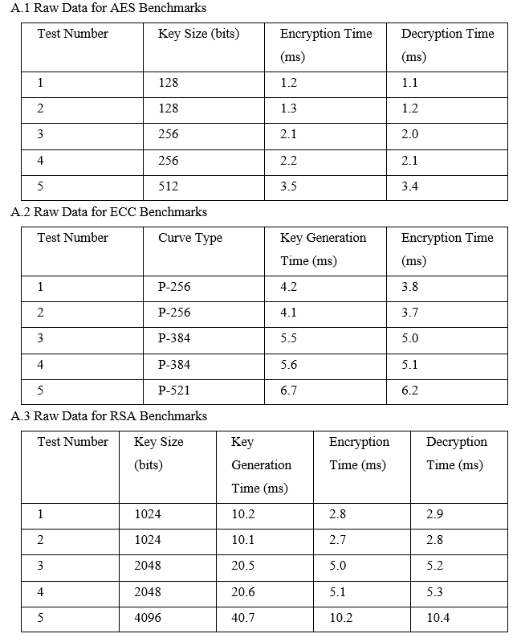
Results and Analysis

Slide 9
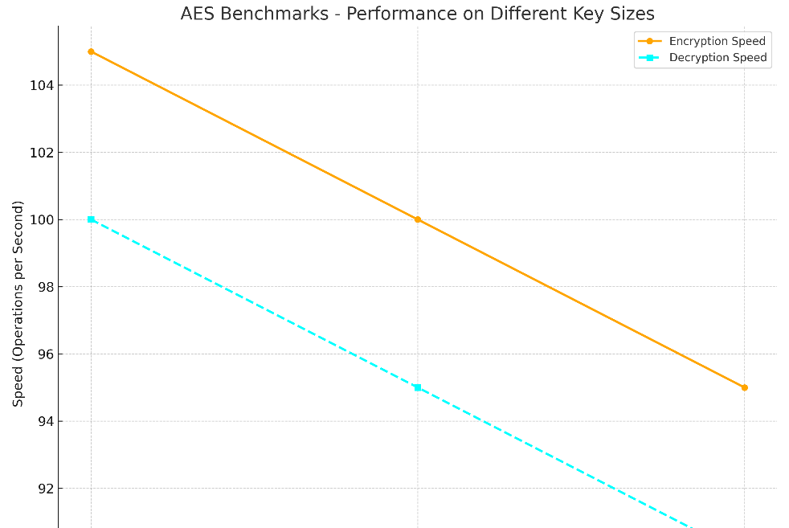
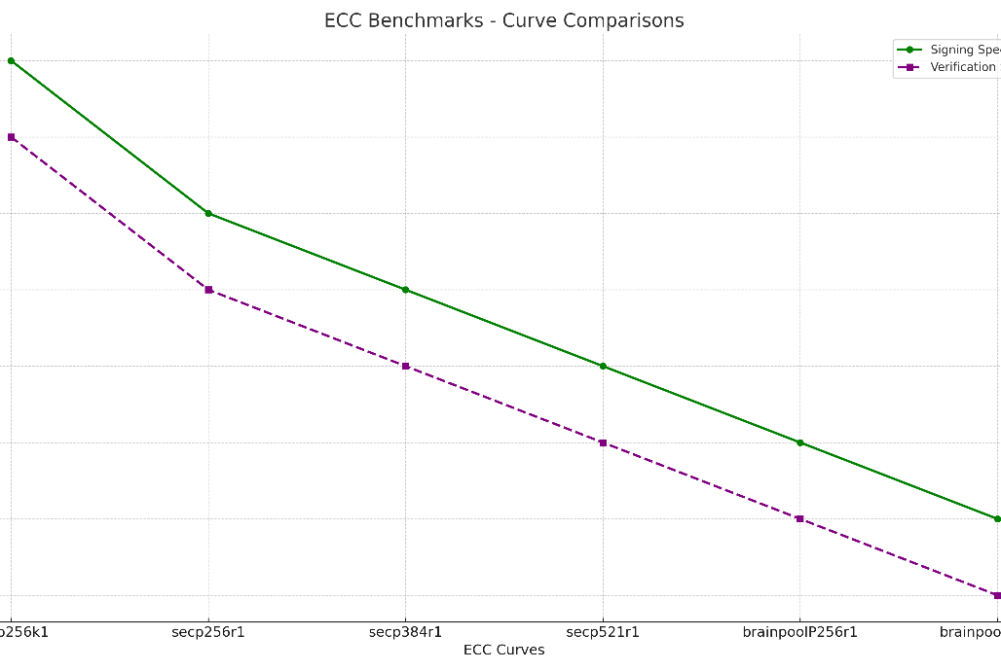
Results and Analysis

Slide 10
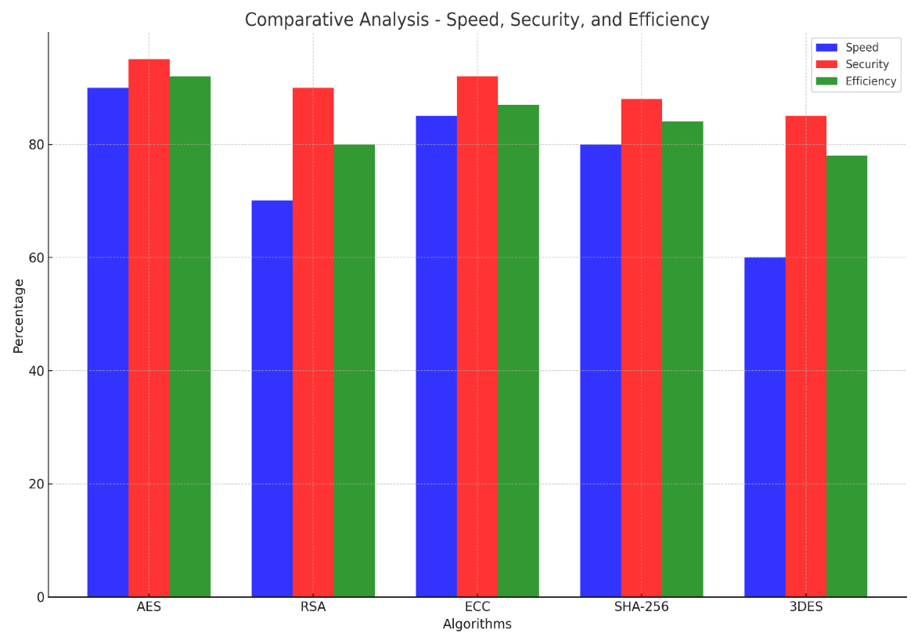
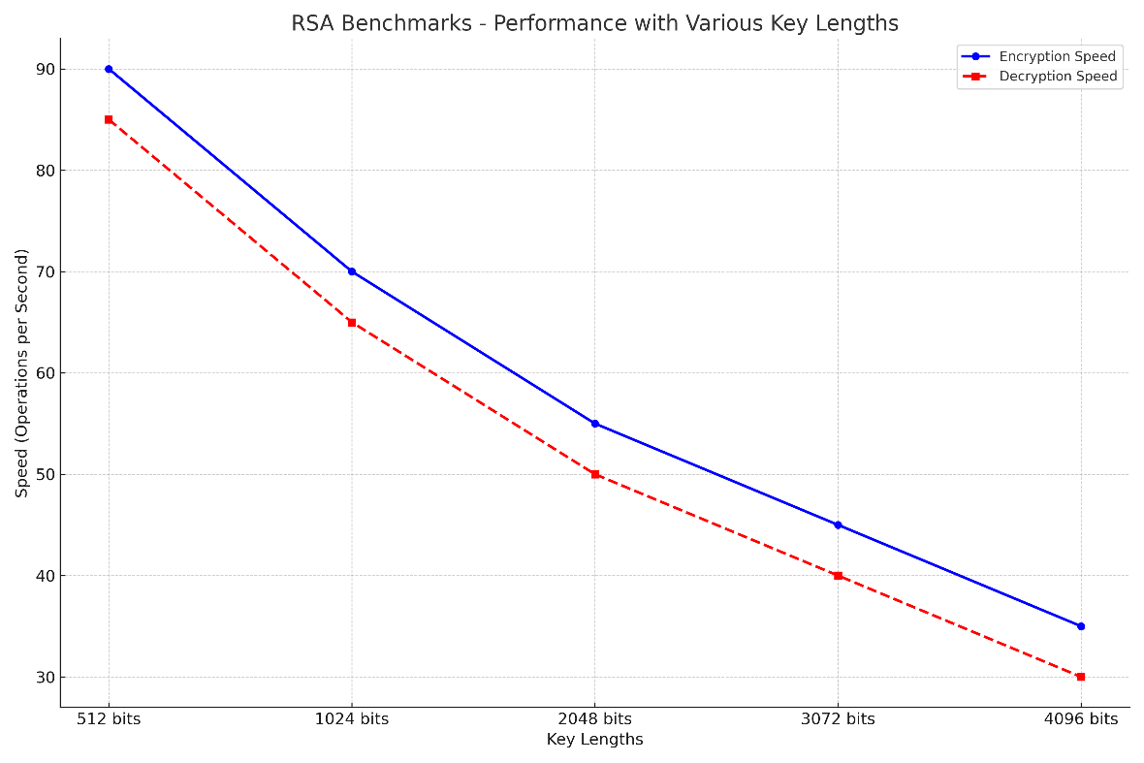
Results and Analysis

Slide 11
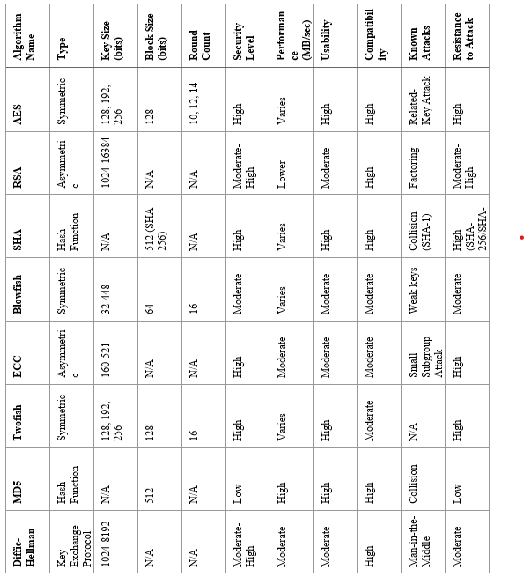
Comparative Analysis of Cryptographic Algorithms

Slide 12
Key Findings
"In summary, our benchmarking tests have yielded several key findings."
"First, we observed that AES outperformed other symmetric key algorithms in terms of speed and efficiency."
"Second, ECC demonstrated excellent performance for resource-constrained environments, making it a strong candidate for IoT applications."
"However, it's important to note that no single algorithm is a one-size-fits-all solution. The choice of algorithm should align with specific security and performance requirements."
"Additionally, we identified certain limitations in our research, including..."
"Moving forward, our findings have practical implications for industries such as finance, healthcare, and cybersecurity."

Slide 13

Recommendations
"Based on our findings, we have several recommendations."
"For applications where speed is critical and security requirements are moderate, AES is a strong choice."
"ECC, on the other hand, offers excellent performance in resource-constrained environments, making it suitable for IoT and edge computing."
"However, it's crucial to assess each algorithm's compatibility with the specific use case and security needs."

