Slide 1
Comparative Study of Cryptography algorithms and its applications

Slide 2
Members:
1.HASAN,MD.MAHADE ID:14-25547-1
2. HASAN,MAHMUD ID:14-25874-1
3. LOREN JAFRIN ZAFAR ID: 14-25728-1
4.HOSSAIN,S.M.TANJIM ID-14-27037-2

Slide 3
Motivation
Our motivation of thesis work is to do the performance analysis of different algorithms of symmetric and asymmetric cryptography based on different performance metrics and network attacks which will help the researchers to identify the suitable algorithms for different types of applications.

Slide 4
Outline
INTRODUCTION
SYMMETRIC CRYPTOGRAPHY ALGORITHM
ASSYMETRIC CRYPTOGRAPHY ALGORITHM
PERFORMANCE ANALYSIS METRICS
COMPARISION OF SYMMETRIC AND ASSYMETRIC ALGORITHMS
DISCUSSION
CONCLUSION

Slide 5
WHAT IS CRYPTOGRAPHY????
Cryptography is a process of translating the original plain text in to cipher text. The sender translates the plaintext in to cipher text.
The passion of the cryptography is to protect data from unauthorized access.
When the data sends to receiver as chipper text, then third party can’t access the data as the original form

Slide 6
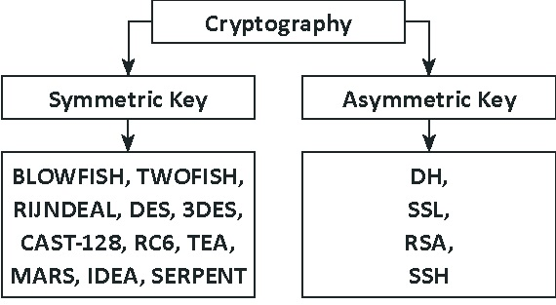
CRYPTOGRAPHIC ALGORITHMS
1.SYMMETRIC CRYPTOGRAPHY ALGORITHM 2.ASSYMETRIC CRYPTOGRAPHY ALGORITHM

Slide 7
Symmetric Algorithm
In Symmetric, it’s uses only one key to send data from sender to receiver. It uses private key and secret key number which can be number, word and also string.
Both the sender and the receiver must know the same key in order to use the technique.
Original Plaintext
Plaintext
Encryption
Ciphertext
Decryption
Symmetric Cryptosystem

Slide 8
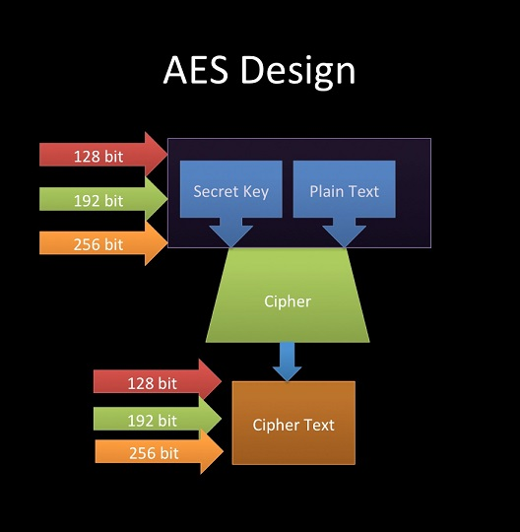
AES ALGORITHM
AES (Advanced Encryption Standard) was first introduced by Rijndael in Oct-2000 Designed by Vincent Rijmen and Joan Daemen in Belgium.
RSA is an asymmetric cryptosystem. There are two different keys. This is also called public key cryptography, because one of them can be given to everyone. The other key is private because its kept secret.it is based on number theory and is a block cipher system.
AES is a symmetric block cipher that can Block size128bit, Cipher keys 128,192and 256 bits.

Slide 9
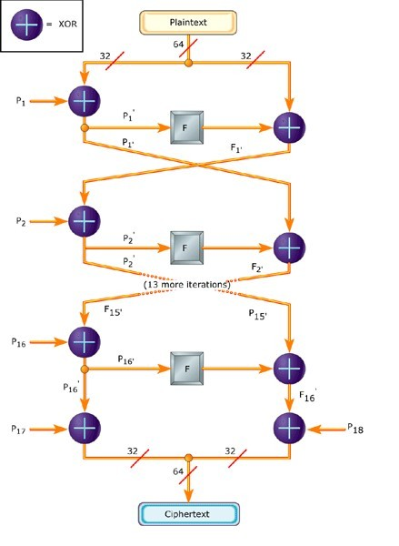
Blowfish algorithm
Designed in 1993 by Bruce Blowfish
64-bit block cipher with variable length key
Large key-dependent S-boxes
The key length is variable ,it can be in the range of 32~448 bits: default 128 bits key length.

Slide 10
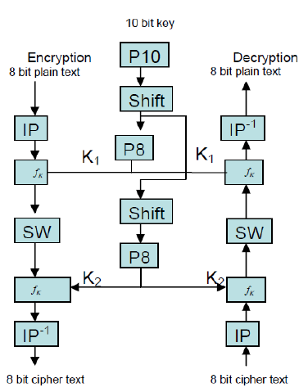
DES ALOGORITHM
Des (Data Encryption Standard) was developed in 1970 at IBM by Horst Feistel. This encryption standard was recommended by NIST (National Institute of Standards Technology)
DES consists of a16-round series of substitution and permutation. Thus, data and key bits are shifted, permutated, XORed, and sent through 8 boxes, a set of lookup tables that are essential to the DES algorithm.

Slide 11
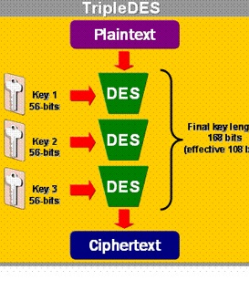
3DES ALGORITHMS
3DES was developed in 1999 by IBM by a team led by Walter Tuchman
3DES is the same thing except it encrypts the data 3 times and uses a different key for at least one of the passes
This creates a cumulative key size of 112-168 bits

Slide 12
ASSYMETRIC ALGORITHMS
Asymmetric encryption use two keys, one to encrypt the data, and another key to decrypt the data. These keys are generated together. One is named as Public key and is distributed freely. The other is named as Private Key and itis kept hidden.
Both Sender & Recipient has to share their public keys for Encryption and has to their private keys for Decryption.
Encryption
plaintext
ciphertext
public key
Decryption
ciphertext
plaintext
private key

Slide 13
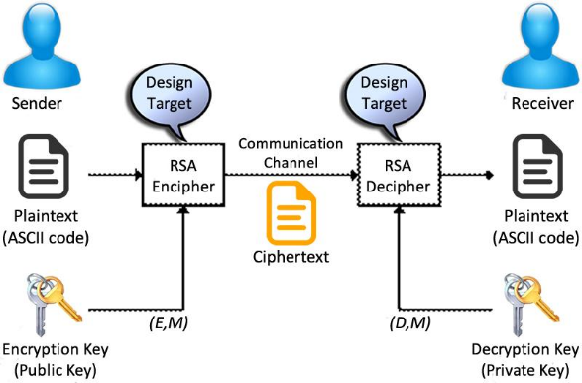
RSA ALGORITHM
Invented by Rivest/Shamir/Adelman (1978)
First asymmetric encryption algorithm
Most widely known public key cryptosystem
Used in many protocols (e.g., SSL, PGP, …)
Number theoretic algorithm: security based on difficulty of factoring large prime numbers
1024, 2048, 4096-bit keys common

Slide 14
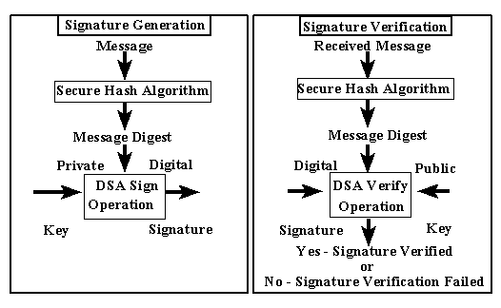
DSA ALGORITHM
DSA was proposed by the National Institute of Standards and Technology (NIST) in August 1991 for use in their Digital Signature Standard (DSS)
A digital signature is basically a way to ensure that an electronic document (e-mail, spreadsheet, text file,etc.) is authentic

Slide 15
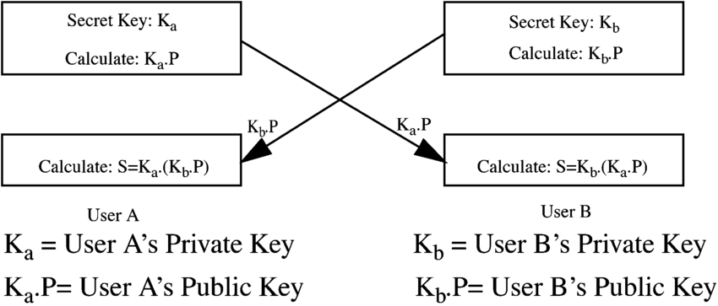
ECC ALGORITHM
Miller and Koblitz (independently) introduced elliptic curves into cryptography in the mid-1980s
Elliptic Curve Cryptography algorithms entered wide use between 2004 and 2005
Based on the discrete logarithm problem, i.e. determining an integer 1 ≤k ≥ p –1 such that
gk = b (mod p)

Slide 16
PERFORMANCE METRICS
Key length: Key length is the number of bits in a key used by a cryptographic algorithm which determined the time complexity of transferring the data to the sender and receiver ends.
Block Size: A block is a sequence of bytes or bits, usually containing some whole number of records, having a maximum length, a block size. Data thus structured are said to be blocked.
Round: Round is a function, which measures how much time the operation needs to perform for retrieve data.
Vulnerabilities: Weakness points of a system which can be exploited by attacker.
Efficiency: Determines how fast or slow it behaves when implemented in hardware and software.
Applications: Performance area of algorithm with specific function directly for the user or, in some cases, for another application program. Identify the best protocol for different applications in computer networking system.

Slide 17
Performance analysis of symmetric Cryptography Algorithms
Performance Metrics | AES | BLOWFISH | DES | 3DES
Key-Length (bits) | 128,192,256 | 32-448 | 56 | 112,168
Developed | 2000 | 1993 | 1975 | 1978
Block Size | 128 | 64 | 64 | 64
Security | Mostly Secure | Unpatented and royalty-free | Not Good Enough | Low Level Of Security
Possible thread | Related Key Attack | Brute force attack | Brute force attack, man in the middle attack | Some Channel Attack
Rounds | 10,12,14 | 16 | 16 | 48
Efficiency | Fast | Fast | Slow | Fast for hardware but Slow in software
Application | Wireless communication | Aedit, JFile, Foopchat | Image Processing | Smart Card,e-Payment

Slide 18
Performance analysis of Asymmetric Cryptography Algorithms
Performance Metrics | RSA | DSA | ECC
Key-Length (bits) | 1024-2048 | 2048-3072 | 160
Developed | 1977 | 1991 | 1980
Block Size | 192 | Variable | 80
Security | Low Level Of Security | Mostly Secure | Mostly Secure
Possible thread | Cycle Attacks, Sharing of common modules | Set of parameters can be generated for pre-chosen message | Curve generation attacks, zero-value point attack
Rounds | 1 | 16 | 1
Efficiency | Slow in hardware specially when decryption | Slow for both software and hardware | Slow for both software and hardware
Application | Internet Banking | Web application and email verification | Key exchange over web and mobile

Slide 19
Conclusion
Although Symmetric and Asymmetric algorithms both are highly efficient for protecting the data in their own relevant field of data transferring but based on the result analysis and discussion we can conclude that symmetric cryptography algorithms
AES, BLOWFISH,DES, 3DES are more suitable for the applications like wireless communication,JFile image processing, smart card or e-commerce type of serveries respectively
RSA, DSA, ECC are the best options for the applications like Internet banking, web application, email verification, key exchange over web, mobile

Slide 20


