Slide 1
Climate Prediction and Simulation
Using Distributed Learning
1
RA: Md Sabbir Hossain
ST: Farah Binta Haque
Team 2
20101178 Ayon Ahmmed
20101368 Mahmudul Hassan
20341032 Mir Jadir Siddique
23241032 Shammo Faiyaz Ahmed

Slide 2
Introduction
2
Distributed Learning
Climate Prediction & Simulation
Distributed learning trains machine learning models locally on devices, avoiding centralization of raw data
Climate prediction and simulation use computational models to forecast future conditions and understand Earth's climate dynamics
Objective: Apply Distributed Learning for climate prediction and simulation!

Slide 3
Why Do We Need Distributed Learning?
3
Privacy and Security: Protects sensitive data by enabling local model training.
Reduced Communication Costs: Minimizes data transmission, saving bandwidth and time.
Edge Computing: Fits well with local processing on devices, crucial for IoT.
Scalability: Easily scales with the addition of new devices.
Data Diversity: Aggregates models trained on different datasets without sharing raw data.
Regulatory Compliance: Helps organizations comply with data storage and transfer regulations.
Real-time Learning: Enables real-time model updates based on dynamic data.
Energy Efficiency: More energy-efficient training compared to centralized approaches.

Slide 4
Related Works
4
S. Jha and G. Fox (2019). Understanding ML Driven HPC: Applications and Infrastructure. 15th International Conference on eScience, 421-427. https://ieeexplore.ieee.org/document/9041752/citations#citations
Balaji, V., & Sivagami, M. (2023). A Study on Distributed Machine Learning Techniques for Large-Scale Weather Forecasting. Advances in Computational Intelligence and Robotics Book Series, 44–64. https://doi.org/10.4018/978-1-6684-9804-0.ch003
Joost Verbraeken et al. (2020). A Survey on Distributed Machine Learning. ACM Comput, 1-33, https://doi.org/10.1145/3377454
Chen, L., Han, B., Wang, X., Zhao, J., Yang, W., & Yang, Z. (2023). Machine Learning Methods in Weather and Climate Applications: a survey. Applied Sciences, 13(21), 12019. https://doi.org/10.3390/app132112019

Slide 5
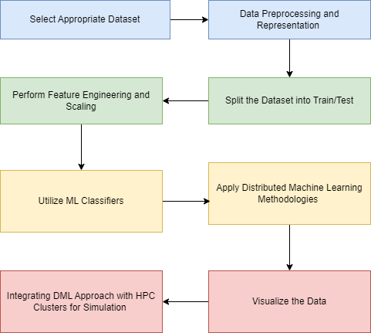
Proposed Work Plan
5
Select a dataset and conduct Exploratory Data Analysis (EDA): Data Preprocessing and Representation to allow further analysis and figure out trends and features with a higher level of significance.
Splitting the dataset into train and test data
Perform Feature Engineering and Feature Scaling
Apply Machine Learning Classifiers on training data to compare with test data
Utilizing Distributed Machine Learning Models for accurate predictions
Visualize the Input/Output data using libraries for adequate representation
Integrate this Distributed Machine Learning approach with HPC Clusters
Simulate the predictions after improving computational performance

Slide 6
Challenges
6
Data Volume and Distribution
Combining multiple Machine Learning Algorithm
Communication Overhead and Synchronization
Integrating extreme event prediction
Data Privacy and Security

Slide 7
Future Plans
7
Machine learning integration
Increased model resolution
Data assimilation techniques
High-performance computing
Extreme events focused computing

