Slide 1
Review of the paper “A Comprehensive Survey on Internet of Things (IoT) Towards 5G Wireless Systems”
By
Name: Mahmudul Hassan
ID: 20101368
mahmudul.hassan1@g.bracu.ac.bd
For
Annajiat Alim Rasel
annajiat@bracu.ac.bd
ST: Farah Binta Haque
RA: Md Sabbir Hossain

Slide 2
Table of contents
01
02
03
04
Fundamentals and Security in IoT
Introduction
IoT and Communication
IoT and Automation
05
06
5G Advancements and Relevance for Researchers
Conclusion

Slide 3
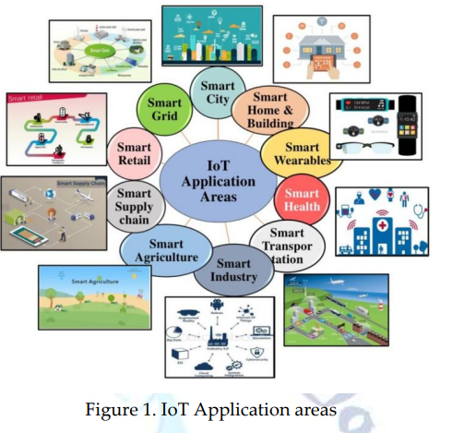
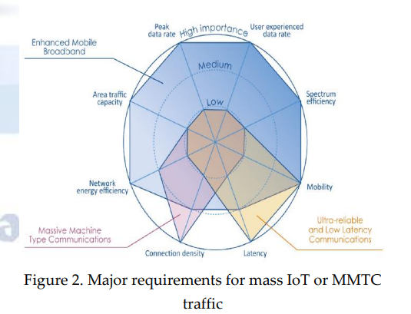
01
Introduction
IoT and 5G: Transforming Daily Life
IoT Impact on Daily Lives
The Need for Enhanced IoT Security

Slide 4
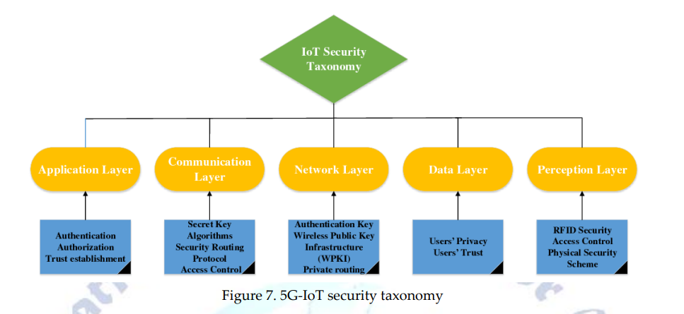
02
Fundamentals and Security in IoT
Sensor Integration
Data Communication
Environmental Considerations
Addressing IoT Security Challenges
Ensuring Safe IoT Deployments

Slide 5
03
IoT and Communication
Direct Internet Connectivity
IoT as Smart Object Sensors
Data Sharing and Insights

Slide 6
04
IoT and Automation
IoT's Role in Automation
Changing How We Interact with the Environment
IoT Enhances Efficiency and Sustainability

Slide 7
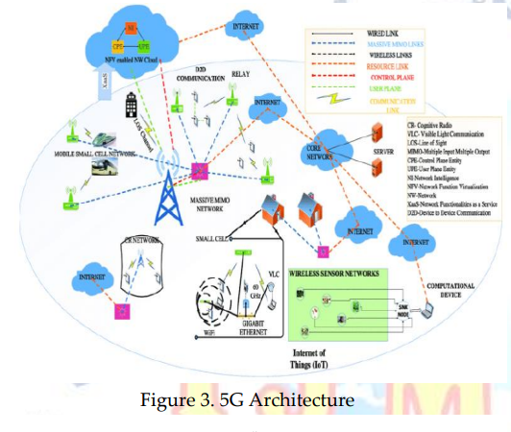
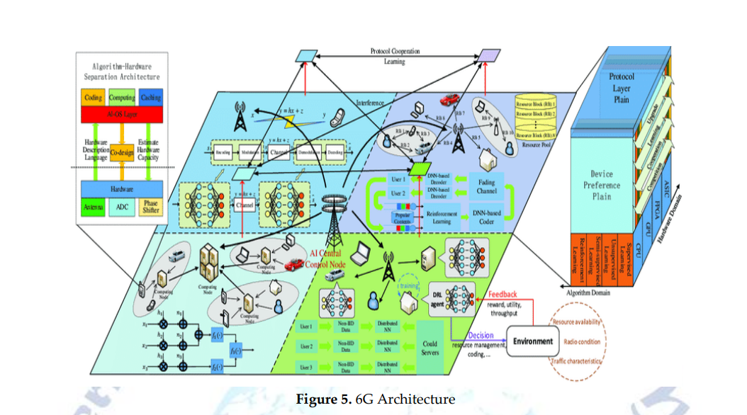
05
5G Advancements and Relevance for Researchers
Enhancing IoT Communication
Improving Efficiency in Daily Life
Insights for IoT and 5G Technology Research
Exploring Opportunities in IoT

Slide 8
06
Conclusion
Evolving Landscape of IoT and 5G
The Promise of Enhanced Daily Life

Slide 9
Thank You

