Slide 1

Final Presentation DDDS
Welcome to the Renewable Energy Consumption Dashboard Presentation. We will discuss the importance of renewable energy, our dashboard design, and how it helps in understanding global energy trends.
Presenters:
Benjamin: User Story & Potential Customers
Mahmudul: Data & Human Factors
Jürgen: Dashboard & Live Presentation

Slide 2
User Story
User Story 1: Global Electricity Production by Source
Visualize the breakdown of global electricity production by different sources.
Interactive elements: Time series, filter on country, trend of share.
Description: Users can explore the proportion of each energy source over time.
User Story 2: Exploring Renewable Energy Consumption Worldwide
Time series slider, scatter plot, size regarding renewable energy consumption.
Description: Users can gain insights into the distribution and impact of renewable energy consumption globally.
User Story 3: Which Countries Lead in Renewable Energy
Slider with energy consumption, filter on year, color code.
Description: Compare countries based on their main sources of electricity generation and highlight leaders in renewable energy.
User Story 4: Interactive Country-specific Analysis
Filter on year, slider on % in renewables, detailed overview for every continent.
Description: Users can select their country and estimate the percentage of electricity generated from renewable sources interactively.

Slide 3









Potential Dashboard Customers
Importance for various institutions:
- Government Agencies and Ministries
- International Organizations
- Non-Governmental Organizations (NGOs)
- Research Institutes and Universities
- Energy Companies and Utilities
- Cities and Municipalities
- Investors and Financial Institutions
- Industrial Companies
- Public and Educational Institutions

Slide 4
Data Sources
List and describe the data sources used:
- Renewable Energy (1960-2023) from Kaggle.
- World Energy Consumption from Kaggle.
- Renewable Energy Worldwide: 1965-2022 from Kaggle.
- Renewable Energy Share from Kaggle.

Slide 5
Data Preprocessing
Describe the steps taken to preprocess the data:
- Cleaning and filtering the datasets.
- Merging different datasets for comprehensive analysis.
- Handling missing values and standardizing data formats.

Slide 6
Human Factors in Dashboard Design
Behavioral and Social Aspects:
Decision support systems (DSS): Improving decision quality through the dashboard.
Human bias: Identifying and minimizing biases in dashboard use.
Bias-Focused Design Science Approaches: Methods for reducing bias in analysis.
Visualization and visualization skills: Importance of the correct presentation of data in the dashboard and user-friendly design:
- Ensuring accessibility and ease of use.
- Incorporating feedback from potential users to improve the dashboard.
Ethical issues: Ensuring the ethical use and representation of data.

Slide 7
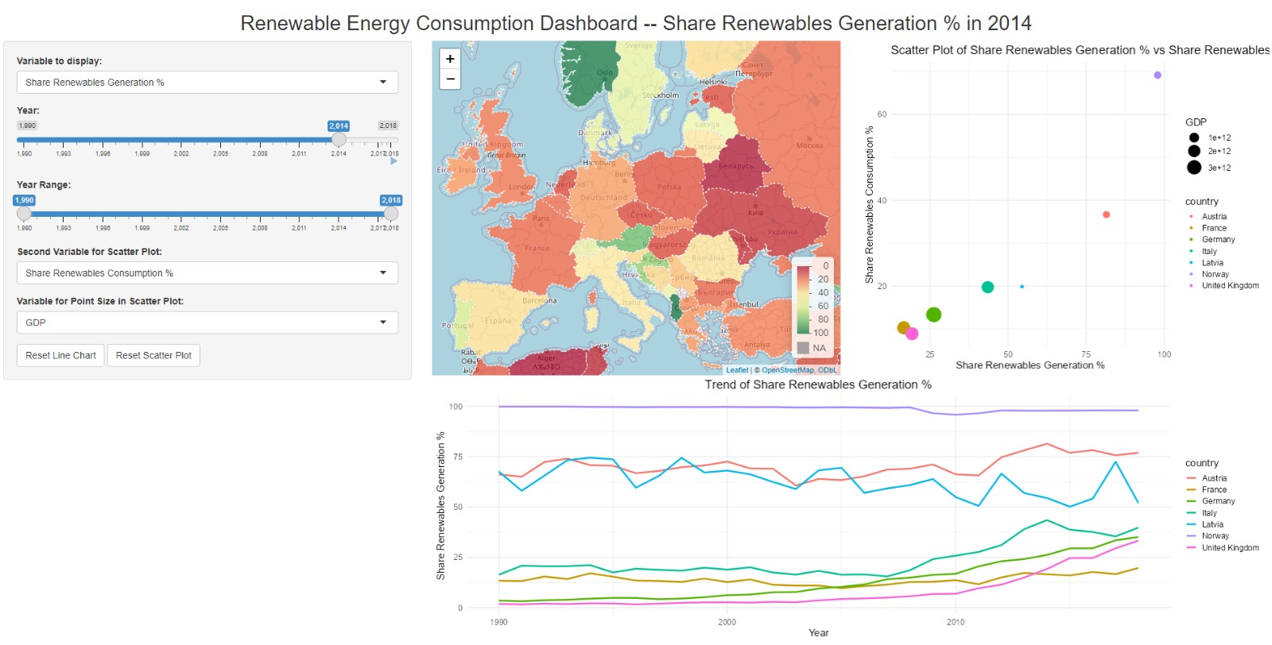
Dashboard Overview
Brief overview of the dashboard's functionalities

Slide 8
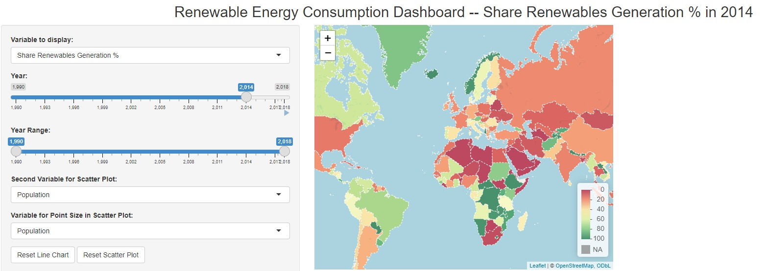
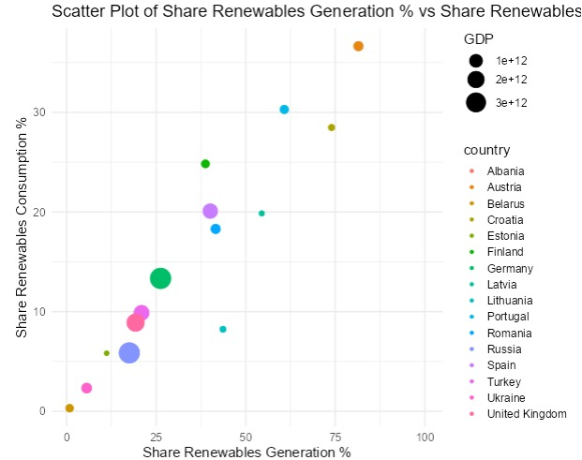
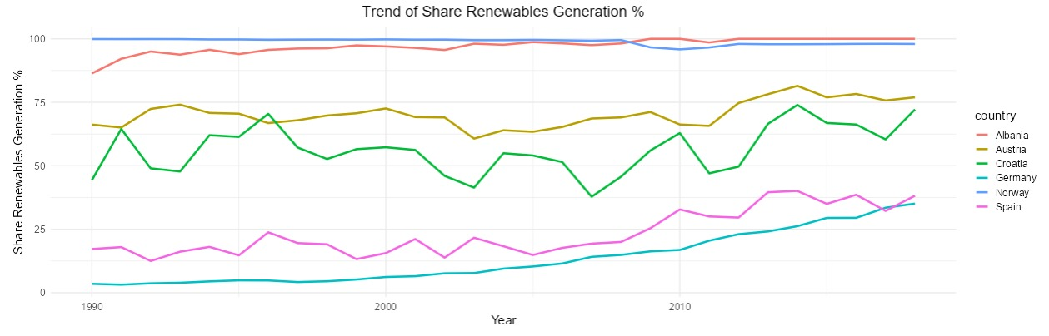
Key Features
Interactive maps, scatter plots, and time series charts

Slide 9
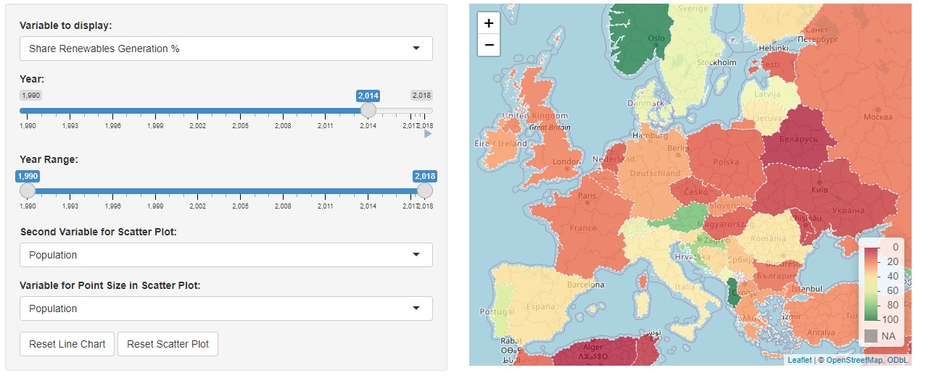
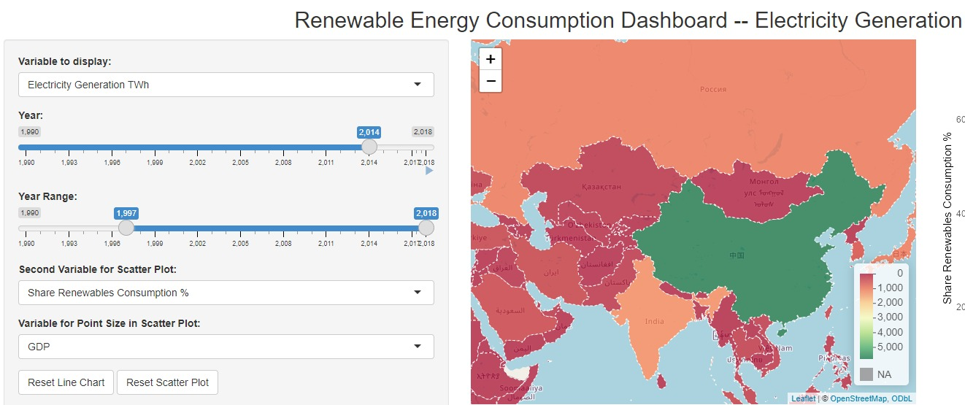
Live Dashboard Demonstration
Walkthrough of the dashboard's features:
- Selecting variables to display on the map.
- Filtering data by year and country.
- Viewing trends and patterns through line charts and scatter plots.

Slide 10

Conclusion and Q&A
Open the floor for questions and discussion.

