Slide 1
Role | Name | Responsibility
Strategic Lead & Advisor | Sayed Enaytul Hoque | Overall direction, strategy and advisory guidance across all four projects.
Lead Developer & Implementation | Md Mahmudul Islam | System design, development and implementation of all four projects.
QA & Validation | Wahed Zaman | Quality assurance, testing and validation of deliverables.

Slide 2
ENTERPRISE WORKFORCE & PUNCH AUTOMATION
ATTENDANCE HUB
Intelligent GPS Geofencing, Multi-Channel Punch & Real-Time Approval System
🎯 Zero-Trust Punch
Haversine GPS 200m radius, Dynamic 30s QR & IoT Biometric Scanner
⚡ Admin Approval Flow
Out-of-bounds punch alerts, manager one-click approval & instant push sync
📱 Unified Dual-Suite
High-performance Next.js 14 Web Portal + Native Flutter Mobile App

Slide 3
PLATFORM ECOSYSTEM
Unified Enterprise Architecture & Dual Synchronization
Desktop Web Portal (Next.js 14)
Next.js 14 App Router, React 18, Tailwind CSS, Prisma ORM, Server Actions, NextAuth.js JWT authentication, and executive analytics.
(Android)
│ │
└─────────────┬─────────────┘
▼
[API GATEWAY & NEXTAUTH JWT]
• Route Guards & 7-Tier RBAC
• Strict Haversine GPS Recalculation
▼
┌────────────────────┼────────────────────┐
▼ ▼ ▼
[PUNCH CORE] [HR WORKFLOW] [PAYROLL]
• GPS Geofence • Leaves & Backup • Deductions
• 30s Dynamic QR • Gate Passes • Overtime
• IoT Hardware • Task Coverage • Advances
▼
[PERSISTENCE: POSTGRESQL + PRISMA]
Native Mobile Suite (Flutter 3.3.4+)
Cross-platform Android & iOS app with native Geolocator sensors, MobileScanner camera, locked live GPS tracking, and instant 2s real-time state sync.
Persistence & Database Engine
PostgreSQL database with Recursive Common Table Expressions (CTE) for dynamic organizational hierarchies and transactional audit integrity.
Hardware & Sensor API Gateway
Centralized REST endpoints with isolated x-api-key headers for physical biometric finger scanners, RFID cards, and facial recognition terminals.

Slide 4
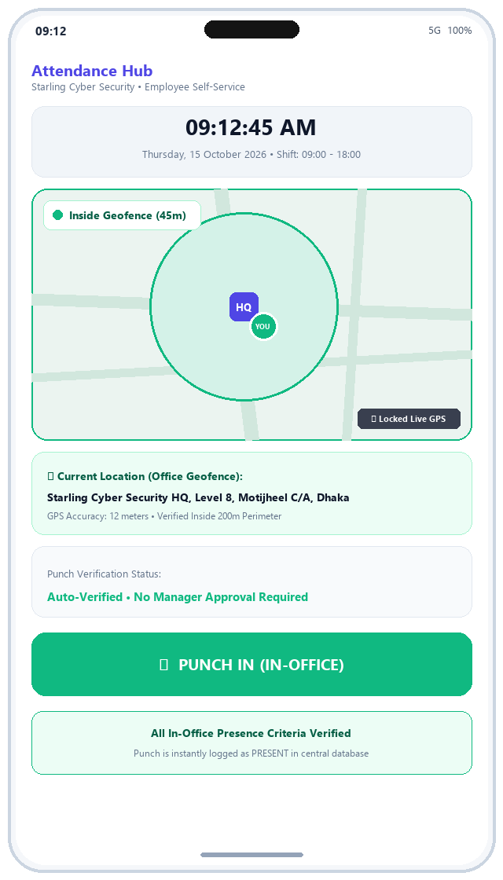
CORE FEATURE #1 • ZERO-TOUCH VERIFICATION
Punch System: In-Office Geofenced Punch (Inside Bounds)
1. Real-Time Haversine GPS Distance Calculation
The Flutter app acquires high-precision device coordinates via the native Geolocator sensor. The backend server recalculates the exact Haversine distance against configured office coordinates (Lat: 23.7330, Lng: 90.4172) to eliminate client-side spoofing.
2. Visual In-Fence Indicator: 'Inside Geofence (45m)'
The live map renders the configured office 200m perimeter in emerald green with the employee pin safely inside. A prominent status badge confirms 'Inside Geofence (45m)' with verified GPS accuracy.
3. Instant Automated Validation (Auto-Verified / PRESENT)
When the employee taps 'PUNCH IN (IN-OFFICE)', the system validates that distance <= 200m. The punch is immediately committed as PRESENT with zero administrative overhead.
4. Shift Grace Period & Late Penalty Tracking
If the employee punches in past the configured company grace period (default: 15 minutes past 09:00 AM shift start), the system automatically flags late arrival minutes and assigns LATE status.

Slide 5
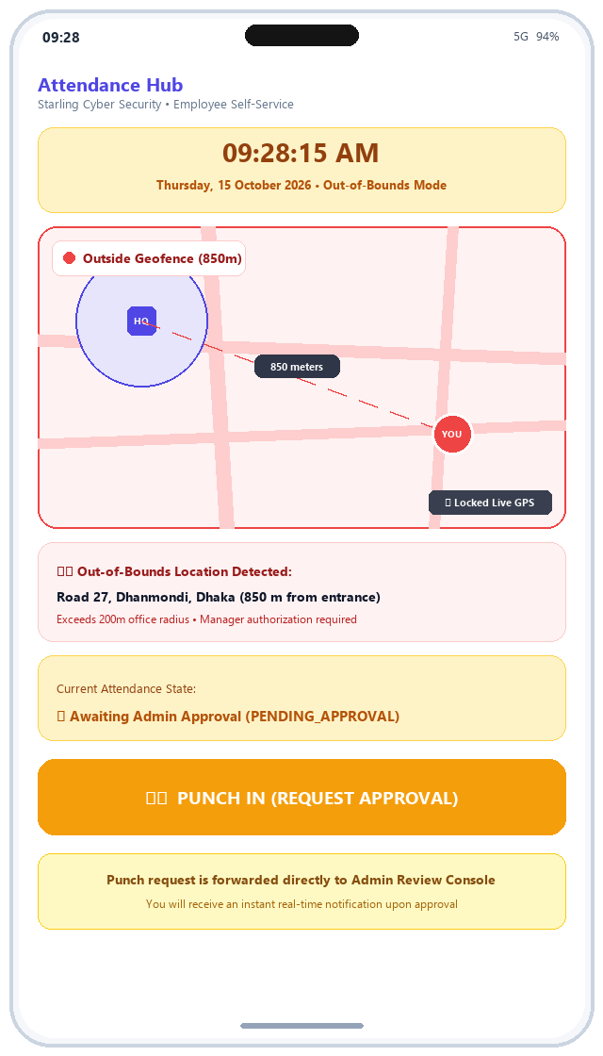
CORE FEATURE #2 • ANTI-FRAUD SECURITY
Punch System: Out-of-Bounds Punch (Outside Location)
1. Automated Perimeter Breach Detection
When an employee is situated outside the authorized 200m office boundary (e.g., in Dhanmondi or client premises, 850m away), the system immediately detects the out-of-bounds coordinate.
2. Prominent Out-of-Bounds Warning: 'Outside Geofence (850m)'
The live GPS map renders a red alert perimeter and dotted vector line measuring exact distance. The app prominently alerts the employee with an amber badge: 'Outside Geofence (850m)'.
3. Exception Status Triggered: PENDING_APPROVAL
Tapping 'PUNCH IN (REQUEST APPROVAL)' prevents automatic attendance credit. The record is logged with status PENDING_APPROVAL alongside the exact street address and GPS coordinates.
4. Employee Awaiting Status Banner
Upon submission, the mobile interface immediately displays a persistent warning banner: 'Waiting for admin approval'. The punch remains pending until an authorized manager reviews it.

Slide 6
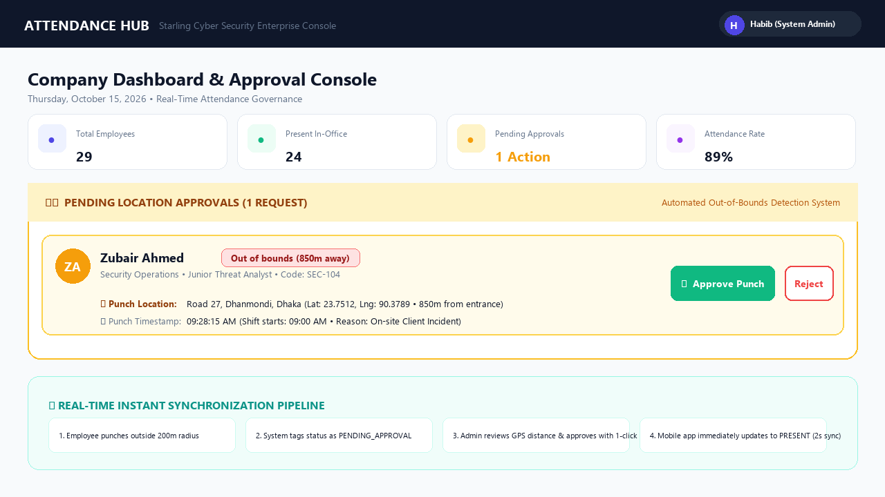
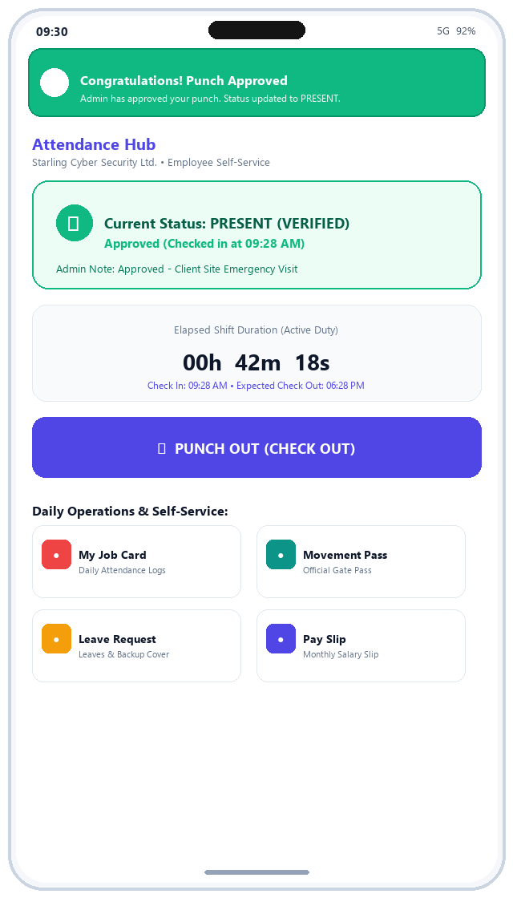
CORE FEATURE #3 • MANAGEMENT AUTHORIZATION
Admin Approval Workflow & Real-Time Sync Pipeline
Management Approval & Instant Real-Time Mobile Push Pipeline:
• The Admin Dashboard highlights pending out-of-bounds punches under 'Pending Location Approvals' with employee name, department, 850m distance tag, and exact address.
• Managers authorize the attendance in 1-click using the [Approve Punch] action, instantly logging the status as PRESENT.
• The employee's Flutter app detects authorization in 2 seconds, triggering a real-time celebration banner: 'Congratulations! Admin has approved your punch. Status updated to PRESENT.'

Slide 7
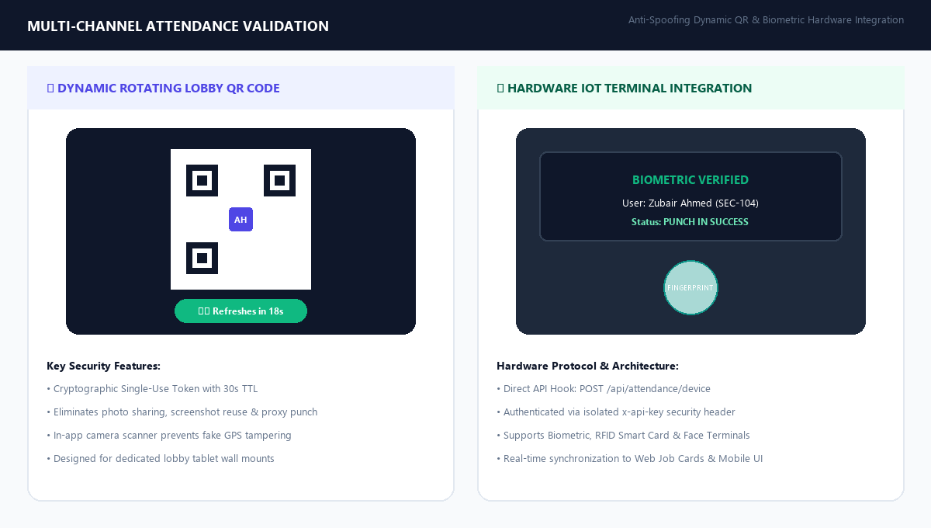
ZERO-TRUST SECURITY
Multi-Channel Validation: Dynamic 30s QR & IoT Biometric

Slide 8
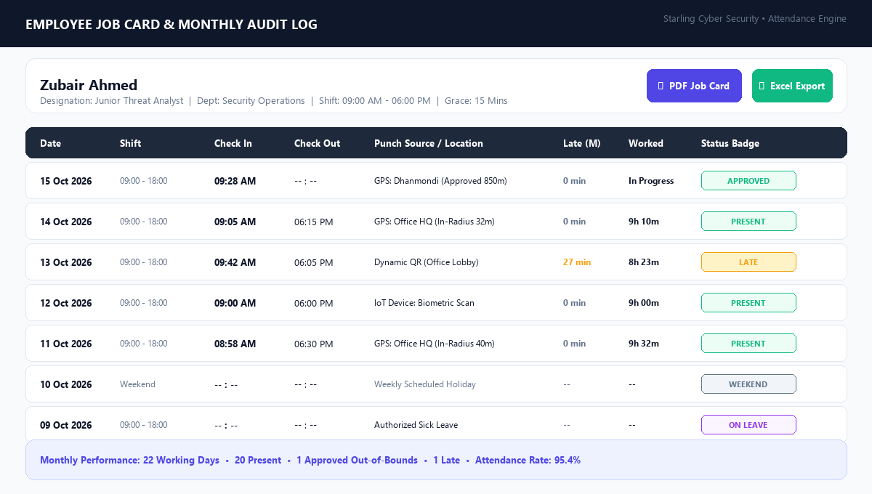
OPERATIONAL ACCOUNTABILITY
Digital Job Card & Individual Attendance Audit Trail

Slide 9
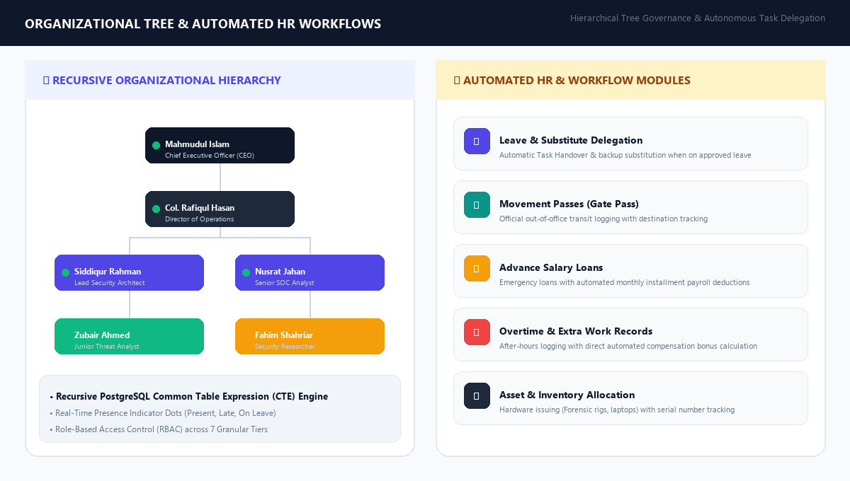
COMPLETE HR LIFECYCLE AUTOMATION
Organizational Hierarchy & Automated HR Workflow Suites

