Slide 1











Fantom PL
Home
Introduction
1
Domains
2
Paradigm
3
Evaluation Criteria
4
Types & Declaration
5
Initialization
6
Scope & Lifetime
7
List & Map
8
Control Statements
9
 | Name | ID
1 | Abdulrahman Mohammed Alqarni | 2135106
2 | Mahmued Ahmad Alardawi | 2135209

Slide 2

Fantom PL
Home
Introduction
1
Domains
2
Introduction of Fantom PL
Fantom is an advanced, open-source high-level general-purpose programming language designed to be as versatile and user-friendly as possible It is a software designed by Brian Frank developed in 2005 that became famous in the Java Virtual Machine (JVM) community.
Paradigm
3
Evaluation Criteria
4
Types & Declaration
5
Initialization
6
Scope & Lifetime
7
It has a simple syntax and is ideal for beginners. Furthermore, Fantom has various programming paradigms like imperative and functional object-oriented programming and it’s highly modular.
It is also compatible with several platforms such as Windows, macOS, and Linux with no platform dependency.
List & Map
8
Control Statements
9

Slide 3

Fantom PL
Home
Introduction
1
Domains
2
Paradigm
3
Web development
Scientific computing
Game development
Evaluation Criteria
4
Types & Declaration
5
Initialization
6
Scope & Lifetime
7
List & Map
8
Control Statements
9
Networking
Machine learning

Slide 4

Fantom PL
Home
Introduction
1
Domains
2
Paradigm
3
Evaluation Criteria
4
Object-oriented programming
Functional programming
Types & Declaration
5
Initialization
6
Imperative programming
Scope & Lifetime
7
List & Map
8
Control Statements
9

Slide 5

Fantom PL
Home
Readability
Introduction
1
Domains
2
Paradigm
3
Evaluation Criteria
4
Fantom was developed to provide easy-to-read code and simple, understandable grammar. Its simple syntax helps in reducing the amount of boilerplate codes used for accomplishing tasks. It has an excellent and wide internet lesson and guidelines repository that is well documented. Overall, Fantom is quite straightforward as far as learning and usage go, while remaining highly legible.
Types & Declaration
5
Initialization
6
Scope & Lifetime
7
List & Map
8
Control Statements
9

Slide 6

Fantom PL
Home
Writability
Introduction
1
Domains
2
Paradigm
3
Evaluation Criteria
4
Fantom is an extremely writable language because it supports multiple programming paradigms including imperative, functional, and object-oriented programs. It exhibits an understandable syntax which makes it easy to write powerful coded expressions based on a wide range of built-in properties. Secondly, it has several libraries and frameworks that help in the programming of complex applications.
Types & Declaration
5
Initialization
6
Scope & Lifetime
7
List & Map
8
Control Statements
9

Slide 7

Fantom PL
Home
Reliability
Introduction
1
Domains
2
Paradigm
3
Evaluation Criteria
4
The language of Fantom is trusted as it was designed for stability and security. It comes with inherent functionality like, for instance, typing safety, memory safety, or exception handling, which simplifies the creation of trustworthy and mistake-free coding. The standard library for the language is also very well-defined; and should be both reliable and trusted.
Types & Declaration
5
Initialization
6
Scope & Lifetime
7
List & Map
8
Control Statements
9

Slide 8

Fantom PL
Home
Cost
Introduction
1
Domains
2
Paradigm
3
Evaluation Criteria
4
This language is open source and free, hence disseminating and implementing it does not incur any cost. Therefore, it is a cheap alternative for people or companies that want to create applications without spending large amounts of money on software licenses. Its efficacy makes this language run on low-cost equipment that does not impact the pace of operations in any way.
Types & Declaration
5
Initialization
6
Scope & Lifetime
7
List & Map
8
Control Statements
9

Slide 9

Fantom PL
Home
const pi := 3.14
Inferred type x := 10
Explicit type Int y := 20
Introduction
1
Domains
2
Paradigm
3
Evaluation Criteria
4
Immutable Variables
Mutable Variables
Types & Declaration
5
Initialization
6
Scope & Lifetime
7
Nullable Variables
Dynamic Variables
List & Map
8
Control Statements
9
Str? nullableString := null
Dynamic dynamicVar
:= "Hello, Fantom!"

Slide 10

Fantom PL
Home
Introduction
1
Domains
2
Paradigm
3
Integer Type
Floating-Point Type
Boolean Type:
Evaluation Criteria
4
Types & Declaration
5
Initialization
6
String Type
List Type
Map Type
Scope & Lifetime
7
List & Map
8
Control Statements
Character Type
Function Type
Nullable Type
9

Slide 11

Fantom PL
Home
Introduction
1
// syntax
<type> <identifier> := <init>
// example
Str city := “Jeddah”
Domains
2
Paradigm
3
Evaluation Criteria
4
Types & Declaration
5
Initialization
6
Scope & Lifetime
7
List & Map
8
Control Statements
9

Slide 12
Fantom PL
<program> ::= <statement>*
<statement> ::= <variableDeclaration>
<variableDeclaration> ::= (<type> | "auto") <IDENTIFIER> [":=" <expression>]?
<type> ::= <IDENTIFIER>
<expression> ::= <additive>
<additive> ::= <multiplicative> {("+" | "-") <multiplicative>}
<multiplicative> ::= <primary> {("*" | "/") <primary>}
<primary> ::= <IDENTIFIER> | <INT_LITERAL> | "(" <expression> ")"
<IDENTIFIER> ::= [a-zA-Z_] [a-zA-Z0-9_]*
<INT_LITERAL> ::= [0-9]+
Home
Introduction
1
Domains
2
Paradigm
3
Evaluation Criteria
4
Types & Declaration
5
Initialization
6
Scope & Lifetime
7
List & Map
8
Control Statements
9

Slide 13

Fantom PL
EBNF for Comment
comment ::= "//" commentText "\n"
commentText ::= [^\n]*
Home
Introduction
1
Domains
2
Paradigm
3
Evaluation Criteria
4
Types & Declaration
5
Initialization
6
Scope & Lifetime
7
List & Map
8
Control Statements
9

Slide 14
Fantom PL
Instead of using the more conventional assignment operator (=) to initialize local variables, Fantom employs the (:=) operator.
// Explicit Type
TypeName variableName := initialValue
Int myInt := 42
Float myFloat := 3.14
Bool myBool := true
Str myString := "Hello, FPL!“
Char myChar := 'A'
Str? nullableString := null
Home
Introduction
1
Domains
2
Paradigm
3
Evaluation Criteria
4
Types & Declaration
5
Initialization
6
Scope & Lifetime
7
List & Map
8
Control Statements
9

Slide 15
Fantom PL
Home
Introduction
1
Domains
2
Static and dynamic storage allocation are the two main categories used to categorize programming languages.
The compiler allocates memory for a variable when it is declared. This is sometimes called static memory allocation or compile-time memory allocation.
Data variables can be allocated memory once the application has started running. Runtime memory allocation or dynamic memory allocation are two terms used to describe this method.
Paradigm
3
Evaluation Criteria
4
Types & Declaration
5
Initialization
6
Scope & Lifetime
7
List & Map
8
Control Statements
9

Slide 16

Fantom PL
Home
Introduction
1
Domains
2
Paradigm
3
Evaluation Criteria
4
Method Scope
Class Scope
Static Scope
Global Scope
Types & Declaration
5
Initialization
6
Scope & Lifetime
7
List & Map
8
Control Statements
9

Slide 17
Fantom PL
listName := [element1, element2, ...]
// Creating a list of integers
numbers := [1, 2, 3, 4, 5]
// Creating a list of strings
fruits := ["Apple", "Banana", "Orange"]
// Accessing elements
Int firstNumber := numbers[0]
// Modifying elements
numbers[2] = 99
// Adding elements
numbers.add(6)
Home
Introduction
1
Domains
2
Paradigm
3
Evaluation Criteria
4
Types & Declaration
5
Initialization
6
Scope & Lifetime
7
List & Map
8
Control Statements
9

Slide 18
Fantom PL
list:=[“Abdulrahman”, “Mohammed”, “Ali”]
echo(list.contains(“ALI”)) // False
list:=[“Ali”,”Amir”]
echo(list.removeAt(0)) // the list will be [“Amir”]
list:=[“Ali”,”Amir”]
echo(list.isEmpty ) // False
list :=[1 , 2]
list.insert(5 , 8)
echo(list) or echo(“$list”)
[1 , 2 , 5 , 8]
Home
Introduction
1
Domains
2
Paradigm
3
Evaluation Criteria
4
Types & Declaration
5
Initialization
6
Scope & Lifetime
7
List & Map
8
Control Statements
9

Slide 19
Fantom PL
map:= [key:”value” , key2:”value2”]
map:= [100:”A+” , 80:”B+” , 70:”C+”]
echo(map) ➔ [100:A+ , 80:B+, 70:C+]
echo(map[100]) ➔ A+
// addList
map:= [5:”5” , 6:”6”]
map.addList( [“7” , ”8”] )
map ➔ [5:”5” , 6:”6” , 7: “7” , 8: “8”]
map := [100:”A+”, 80:”B+”, 70:”C+”]
map.add(60: , ”D+”)
// map:= [100:”A+”, 80:”B+”, 70:”C+” , 60:”D+”]
Home
Introduction
1
Domains
2
Paradigm
3
Evaluation Criteria
4
Types & Declaration
5
Initialization
6
Scope & Lifetime
7
List & Map
8
Control Statements
9

Slide 20
Fantom PL
Home
if (condition) {
// rest of code like echo, if, etc.
}
Int x := 10
if (x > 0) {
echo("x is positive")
}
else if (x == 0) {
echo("x is zero")
}
else {
echo("x is negative")
}
Introduction
1
Domains
2
Paradigm
3
Evaluation Criteria
4
Types & Declaration
5
Initialization
6
Scope & Lifetime
7
List & Map
8
Control Statements
9

Slide 21
Fantom PL
switch (variable) {
case Case_1: {
// Your code
}
case Case_2: {
// Your code
}
case Case_3: {
// Your code
}
default: {
// Your code if variable doesn't cases, code will be executed
}
}
Home
Example:
Age := 55
switch (num) {
case 60: {
echo("Age is 60")
}
case 55: {
echo("Age is 55")
}
case 50: {
echo("Age is 50")
}
default: {
echo(“Invalid age")
}
}
Introduction
1
Domains
2
Paradigm
3
Evaluation Criteria
4
Types & Declaration
5
Initialization
6
Scope & Lifetime
7
List & Map
8
Control Statements
9

Slide 22
Fantom PL
Iterative statements:
For loop
for (variable in range or collection) {
// Your code
}
for (Int i := 0; i < 5; i++) {
echo("Iteration $i")
}
Home
Introduction
1
Domains
2
Paradigm
3
Evaluation Criteria
4
Types & Declaration
5
Initialization
6
Scope & Lifetime
7
List & Map
8
Control Statements
9

Slide 23
Fantom PL
Iterative statements:
2. While loop:
while (condition)
{
// code
}
// Example
Index := 0
while (Index <= 10) {
echo(Index)
Index = Index + 1
}
Home
Introduction
1
Domains
2
Paradigm
3
Evaluation Criteria
4
Types & Declaration
5
Initialization
6
Scope & Lifetime
7
List & Map
8
Control Statements
9

Slide 24

Fantom PL
Iterative statements:
3- Do-while loop:
do {
// code
} while (condition)
Example:
Index := 0
do {
echo(Index)
Index = Index + 1
} while (Index <= 10)
Home
Introduction
1
Domains
2
Paradigm
3
Evaluation Criteria
4
Types & Declaration
5
Initialization
6
Scope & Lifetime
7
List & Map
8
Control Statements
9
Code
10

Slide 25
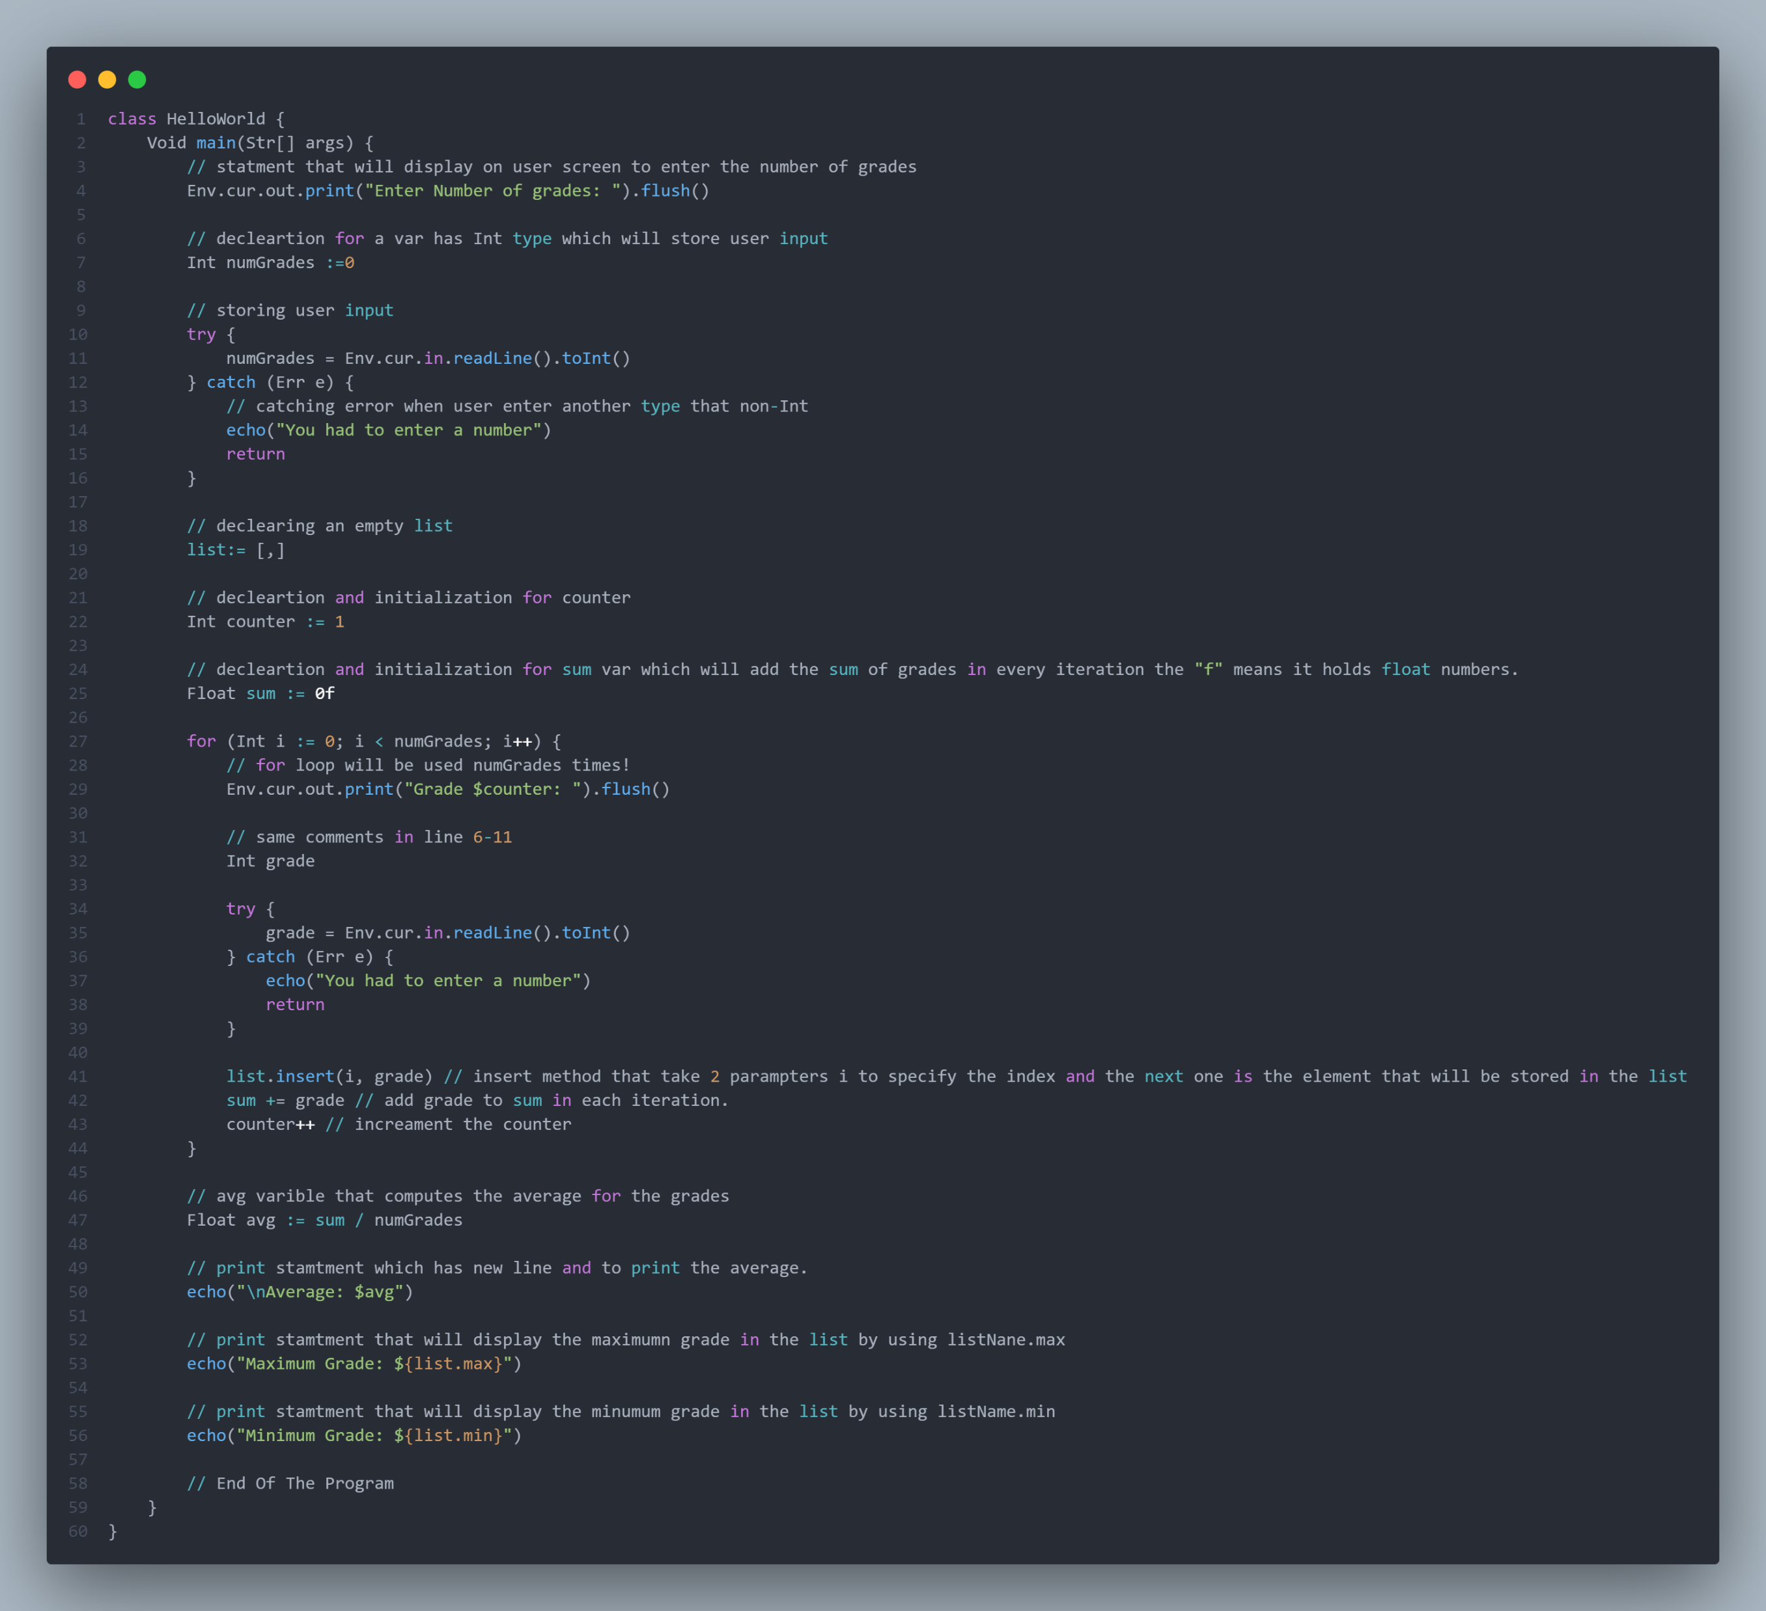
Fantom PL
Home
Introduction
1
Domains
2
Paradigm
3
Evaluation Criteria
4
Types & Declaration
5
Initialization
6
Scope & Lifetime
7
List & Map
8
Control Statements
9
Code
10

Slide 26

Fantom PL
Home
Introduction
1
Domains
2
Paradigm
3
Evaluation Criteria
4
Types & Declaration
5
Initialization
6
Scope & Lifetime
7
List & Map
8
Control Statements
9
Code
10

Slide 27
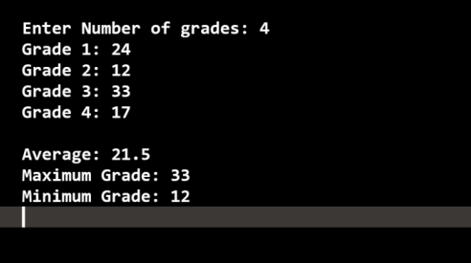
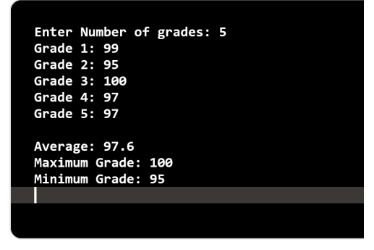
Fantom PL
Home
Introduction
1
Domains
2
Paradigm
3
Evaluation Criteria
4
Types & Declaration
5
Initialization
6
Scope & Lifetime
7
List & Map
8
Control Statements
9
Code
10

Slide 28
Fantom PL
Home
Method Scope
Introduction
1
Domains
2
Paradigm
3
Evaluation Criteria
Void myMethod() {
Str localVar := "Local variable"
// localVar is only accessible within this method
}
4
Types & Declaration
5
Initialization
6
Scope & Lifetime
7
List & Map
8
Control Statements
9

Slide 29
Fantom PL
Home
Class Scope
Introduction
1
Domains
2
Paradigm
3
Evaluation Criteria
4
Types & Declaration
5
class MyClass {
Int instanceVar := 10 // instance variable accessible in all methods
of MyClass
Void myMethod() {
// instanceVar is accessible here
}
}
Initialization
6
Scope & Lifetime
7
List & Map
8
Control Statements
9

Slide 30
Fantom PL
Home
Static Scope
Introduction
1
Domains
2
Paradigm
3
Evaluation Criteria
4
Types & Declaration
5
class MyClass {
static Int staticVar := 5 // static variable shared among all instances
Void myMethod() {
// staticVar is accessible here
}
}
Initialization
6
Scope & Lifetime
7
List & Map
8
Control Statements
9

Slide 31
Fantom PL
Global Scope
Home
Introduction
1
Domains
2
Paradigm
3
Evaluation Criteria
4
//Variables declared at the top level of a script or program have
global scope.
//They are accessible from any part of the program.
const Str globalVar := "Global variable"
Types & Declaration
5
Initialization
6
Scope & Lifetime
7
List & Map
8
Control Statements
9

