Slide 1
Online Retail Dashboard

Slide 2
Data Model
The data model used for this analysis includes the following key entities and relationships:
Customers
Products
Sales Transactions
Geographical Regions

Slide 3
Data Cleaning Steps
The key data cleaning and preparation steps taken include:
Handling missing data
Identifying and removing outliers
Ensuring data consistency and quality

Slide 4
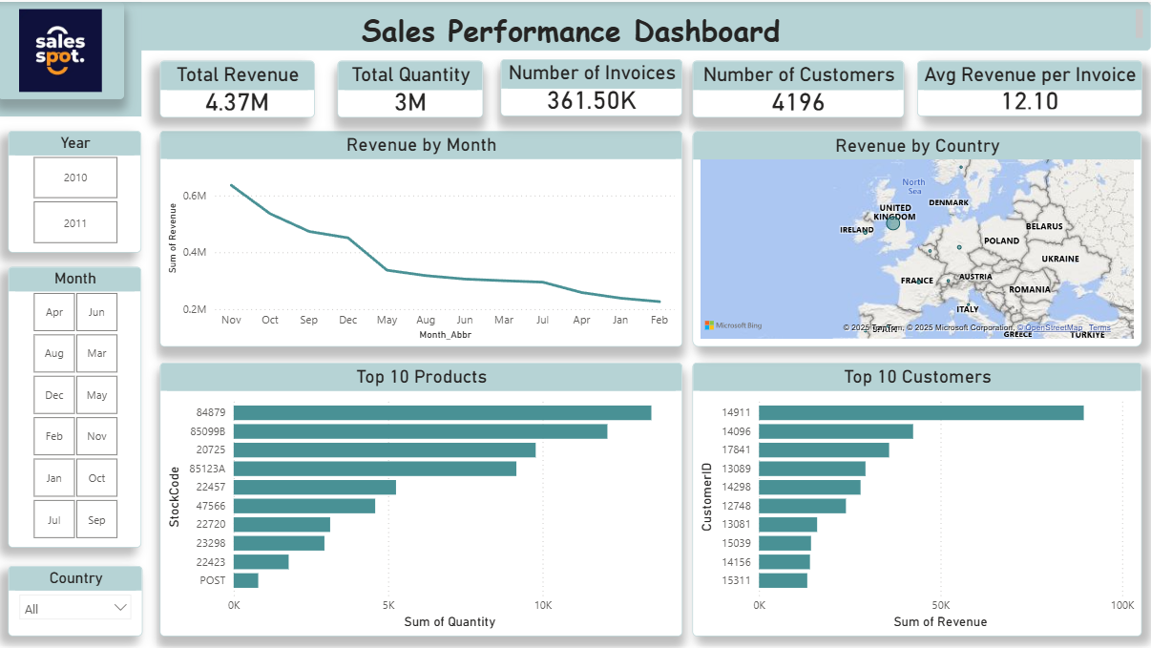
Dashboard Screenshots

Slide 5
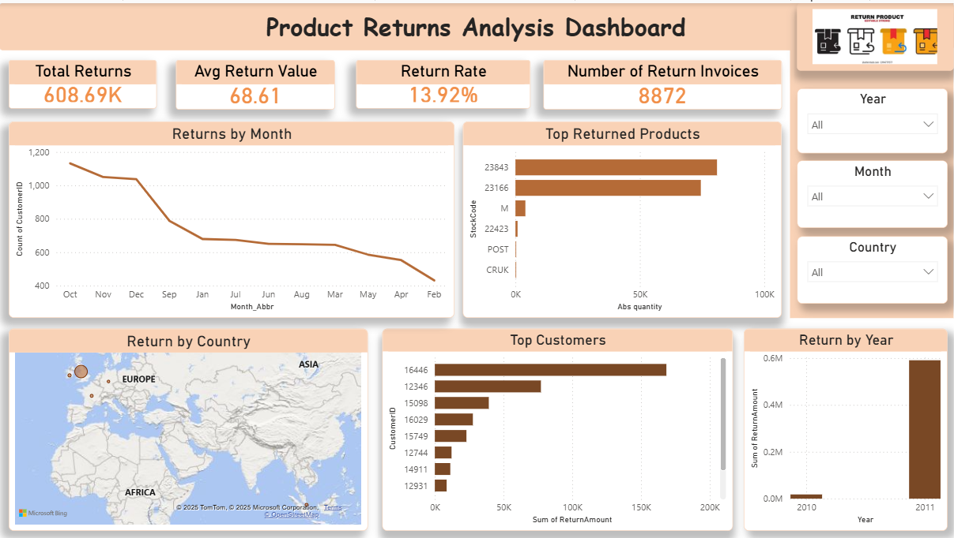

Slide 6
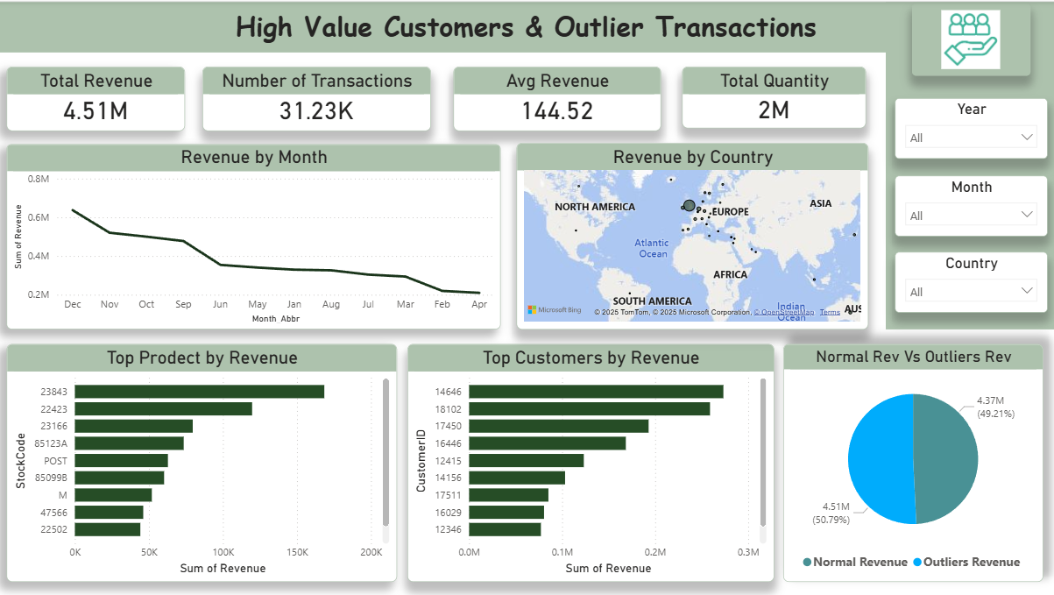

Slide 7
Insights
Top Customers
Top Products
The top 10 products account for 80% of the total revenue. These products are:
High-end clothing items
Seasonal and trendy products
Well-received by customers in the 18-35 age group
The top 5 customers contribute 65% of the total revenue. These customers are characterized by:
High average order value
Loyal and repeat buyers
Located in the Northeast region

Slide 8
Trends
The analysis of monthly and yearly trends reveals:
Significant seasonal fluctuations, with peak sales during the holiday season
Steady year-over-year growth, with a 12% increase in revenue last year

Slide 9
Recommendations
Based on the insights, the following recommendations are proposed:
Develop targeted marketing campaigns to retain and expand the top customer base
Optimize inventory management for the top-selling products to meet seasonal demand
Explore opportunities to diversify the product portfolio and reduce reliance on seasonal trends

