Slide 1


Crop choice optimization
Answering a farmer’s basic question

Slide 2
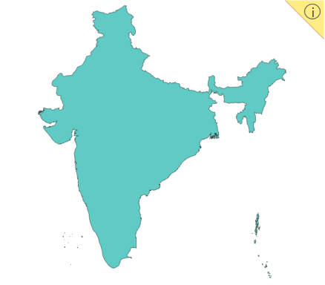
Introduction to the dataset
N : in mg of nitrogen content per kg soil
P : in mg of phosphorus content per kg soil
K : in mg of potassium content per kgs soil
Temperature : in degree Celsius
Humidity: relative humidity in %
Ph : ph value
Rainfall: in mm
Which crop to plant?
India
(replicable to other areas)

Slide 3
Multi-class logistic model prediction
Logistic Regression
Logistic Regression
Logistic Regression
Parameters:
Scaler: StandardScaler
Model: solver = 'lbfgs’
Parameters:
Scaler: StandardScaler
Model: solver = 'liblinear’ multi_class = 'ovr'
Parameters:
Scaler: MinMaxScaler
Model: solver = ‘sag’ multi_class = 'ovr'
Accuracy = 96 %
Kappa = 96%
F1 = 96%
Precision = 96%
Recall = 96%
Accuracy = 93 %
Kappa = 93%
F1 = 93%
Precision = 93%
Recall = 93%
Accuracy = 69 %
Kappa = 68%
F1 = 69%
Precision = 69%
Recall = 69%

Slide 4

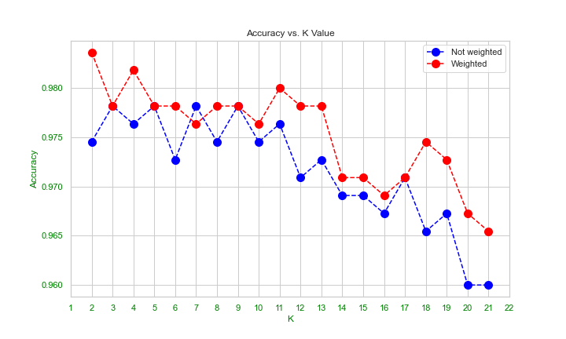
KNN model (THE WINNER!)
Elbow method
98%

Slide 5
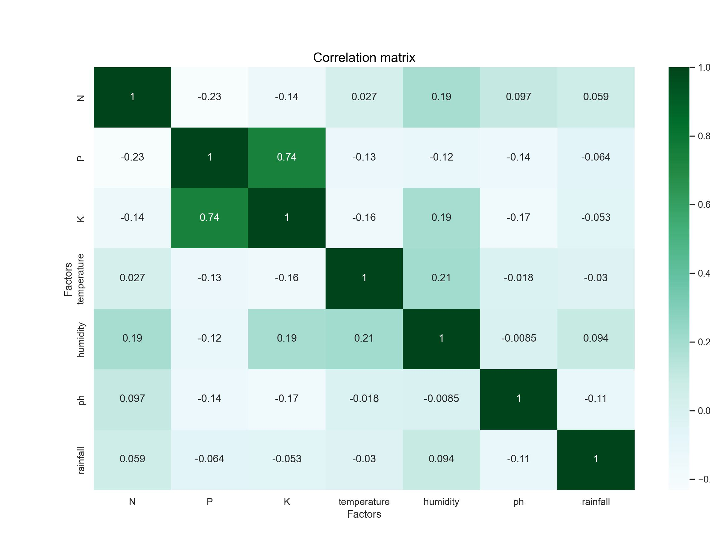
Correlation Matrix of the Factors
There are correlation between K and P.
Are they similar?

Slide 7
Thankyou! ¡Gracias! 谢谢你 Dankeschön
Questions?

