Slide 2
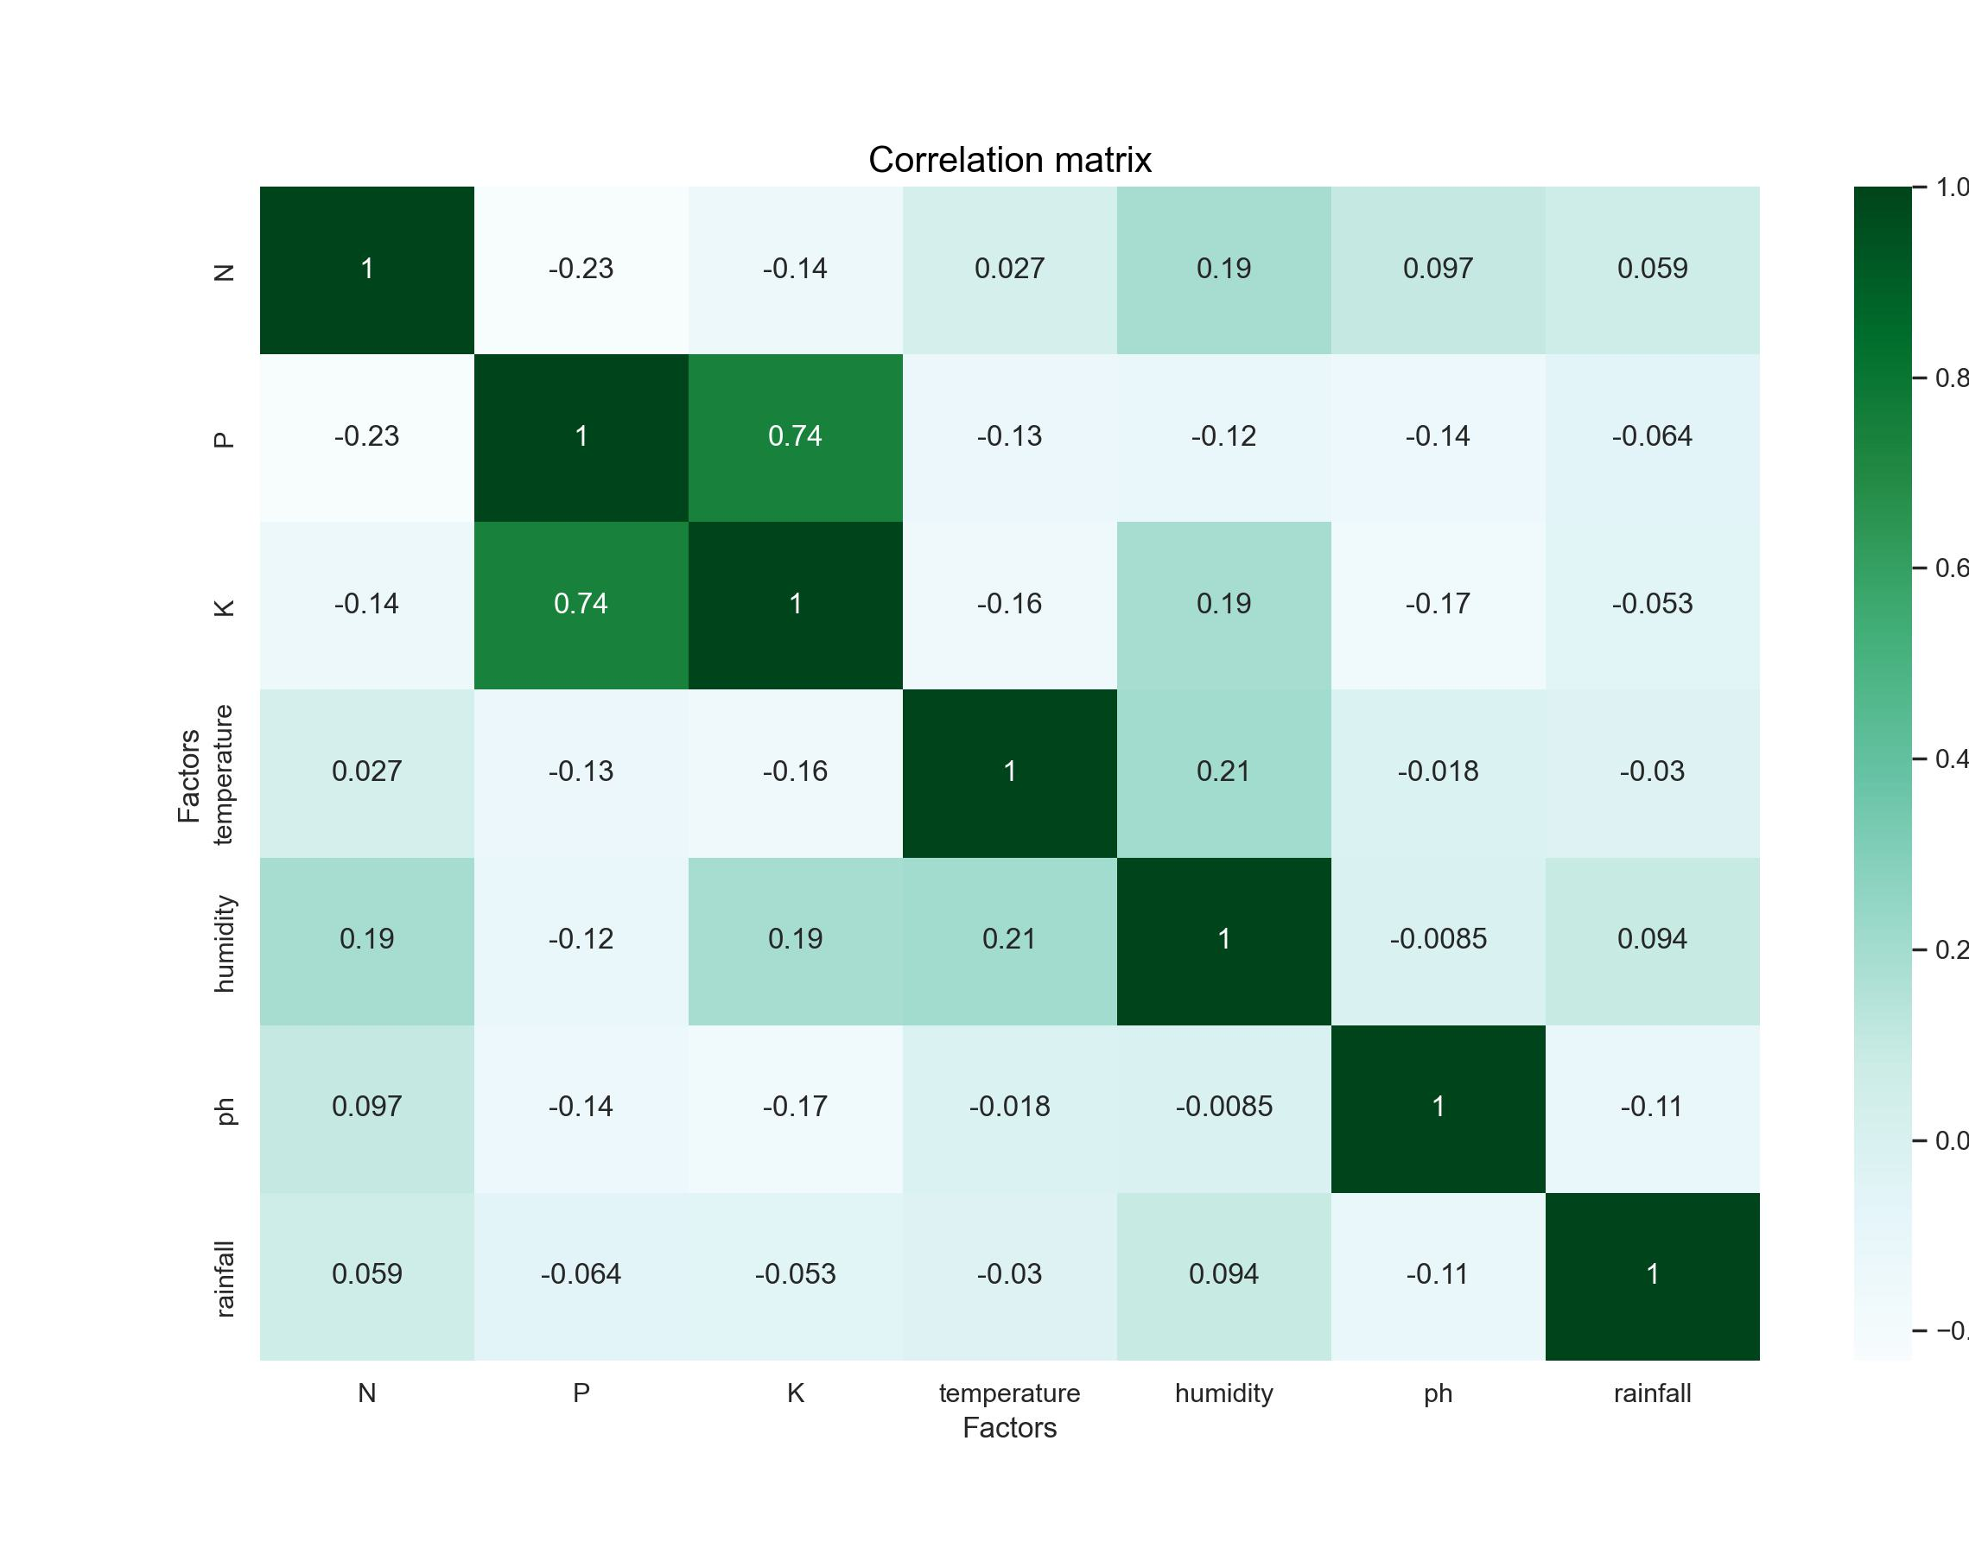
Correlation Matrix of the Factors
There are correlation between K and P.
Are they similar?

Slide 3
