Slide 1
Integration of LXC Based Node Type into CORE Network Emulator
Master Thesis
Presented By: Mahnaz Rahman
Matriculation No: 1189920
1

Slide 2
Discussion Topics
Introduction to LXC Container
CORE Network Emulator
Targeted Approach
Detail of Realisation
Conclusion and Future Scope

Slide 3
Introduction to LXC Container
LXC container is an operating system-level virtualisation method.
Runs full-fledged operating system isolated from host machine.
Provides a virtual environment consisting own CPU, memory, block I/O, network etc. space and resource control mechanism.
Uses templates to create different operating system containers
Cgroups or Control groups – limits and isolates resource usage (CPU, RAM) of processes.
Cgroups are listed in the directory /sys/fs/cgroup
3

Slide 4
CORE Network Emulator
Common Open Research Emulator (CORE) is a tool for building virtual network.
Consists of CORE GUI and CORE daemon.
CORE GUI is used to draw nodes and network on CORE Canvas.
CORE Daemon manages emulation sessions.
CORE GUI and CORE Daemon communicates via CORE API.

Slide 5
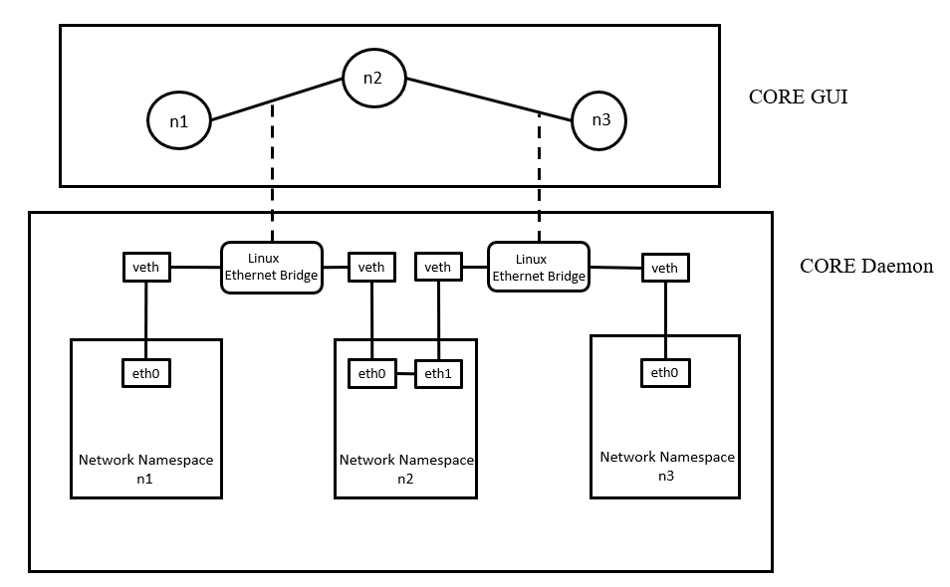
CORE Network Namespaces
Linux network namespace is the primary virtualisation technique used by CORE
Each node has individual network namespaces.
CORE combines each network namespaces with Linux Ethernet Bridging to form networks .
CORE uses namespace to create minimum necessary resources.

Slide 6
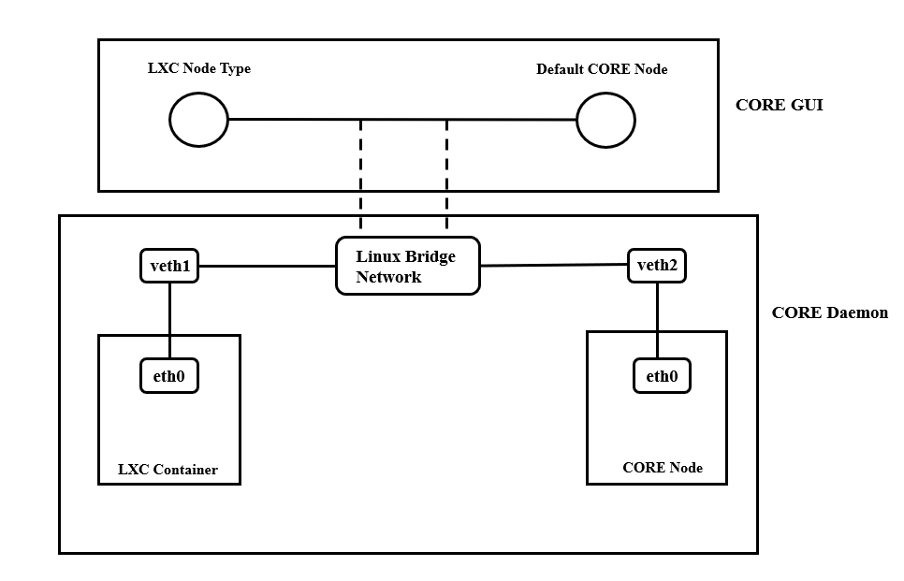
Targeted Approach
Integration of new node type into CORE to support LXC container
Extensions to the GUI
Implementation of communication between CORE GUI and CORE Daemon for the extension.
Implementation of some CORE functionalities to LXC node
Python for CORE Daemon and Tcl/Tk for CORE GUI

Slide 7
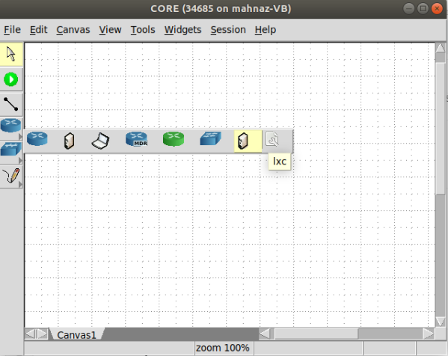
Example Output of Selecting Node
LXC notation added in CORE GUI
Selecting LXC node from the CORE toolbar

Slide 8
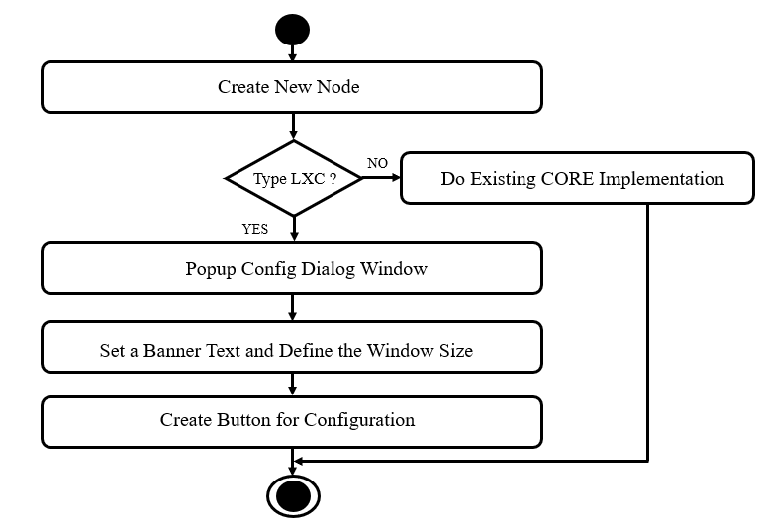
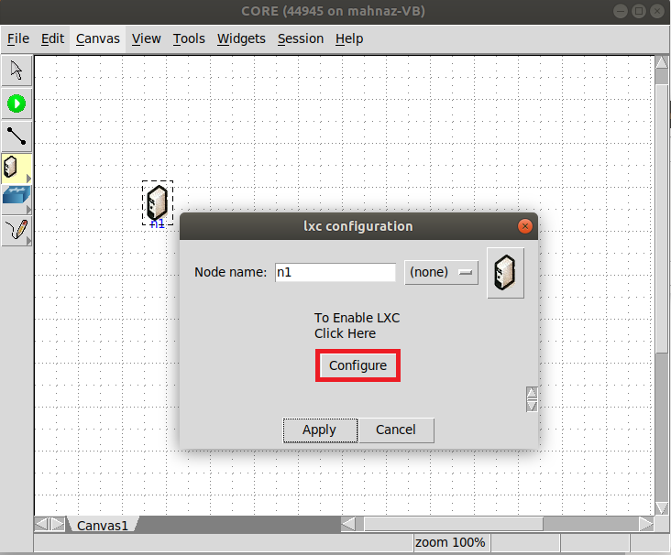
Create Button for Configuration in CORE GUI
Create button to configure LXC node
Example Output of button creation

Slide 9
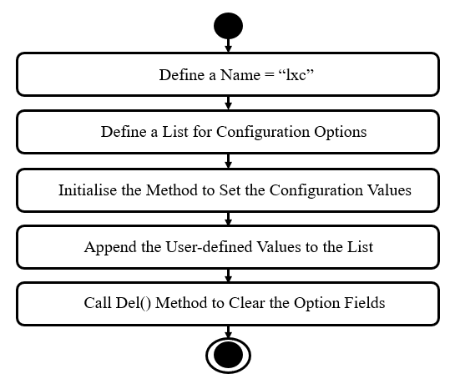
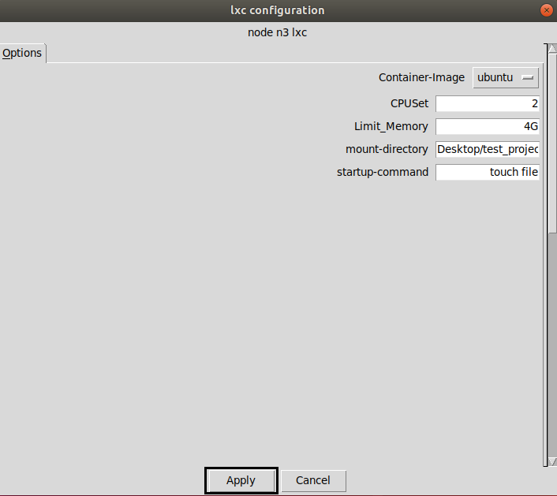
Implementation of LXC Configuration Manager
Example Output (Config Options)

Slide 10
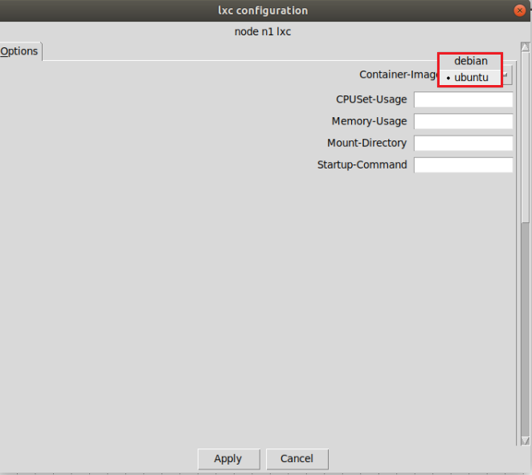
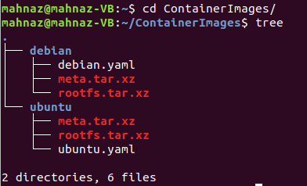
Container Image Allocation Example Output(Container Image List)
Image folder structure

Slide 11
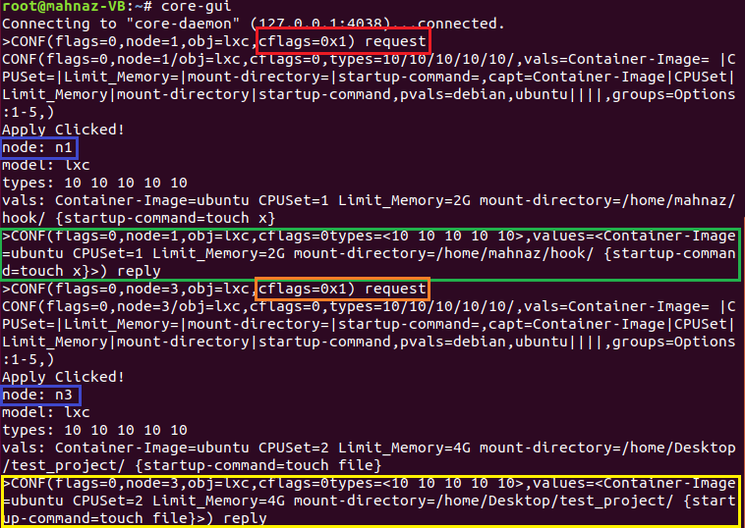
CORE API Message Flow for Configuration
Configuration Message between CORE GUI and CORE Daemon

Slide 12
Implementation Part of LXC Node in CORE Daemon
The LXC notation has been added in CORE Daemon
Required to interpret the received API message from CORE GUI for LXC node
Included in the list of node types to ensure the usage of correct implementation for received node type

Slide 13
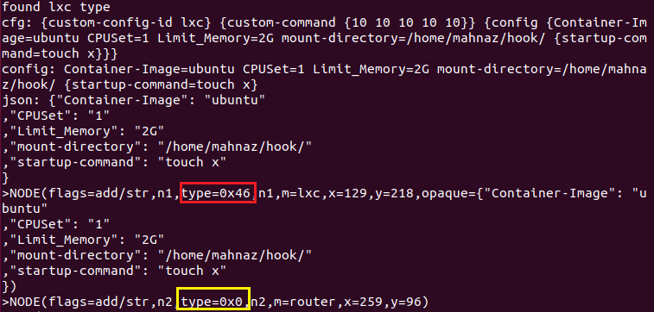
LXC Node Creation Example Console Output
Found LXC Type message shown
Type =0x46, is HEX format for LXC Node Type

Slide 14


Limiting CPU and RAM Usage
LXC-Python bindings - to specify the usage of a container.
set_cgroup_item() - define a value to limit the usage
get_cgroup_item() -to return the user-defined memory or CPU usage in bytes
Example Output of Limit CPU Usage
Example Output of Limit RAM Usage

Slide 15
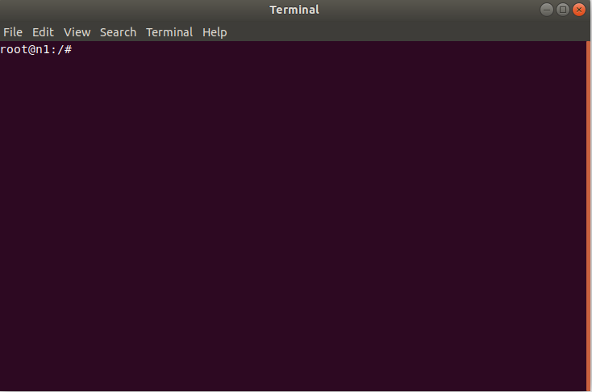
Enable Popup Shell Window on LXC Node
vcmd program offers to open a terminal for a CORE node.
Double-click on a node opens the shell window by invoking the vcmd shell command such as:
gnome-terminal -e vcmd -c /tmp/pycore.50160/n1 -- bash
Termcmdstring() method will be invoked and adapted to the LXC node type implementation.
This will create a terminal command string and attach a shell to execute command in it.
The command which will open the shell window for LXC node is given below.
gnome-terminal -x lxc-attach -n self.name

Slide 16
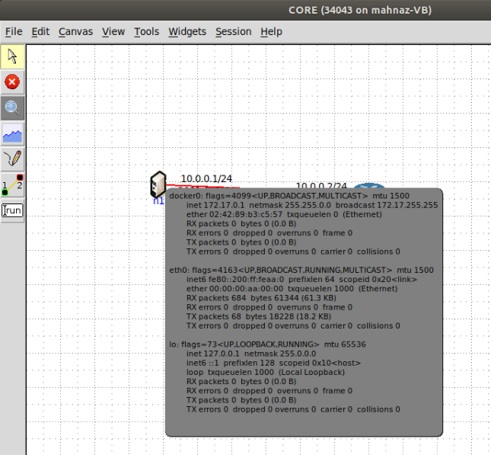
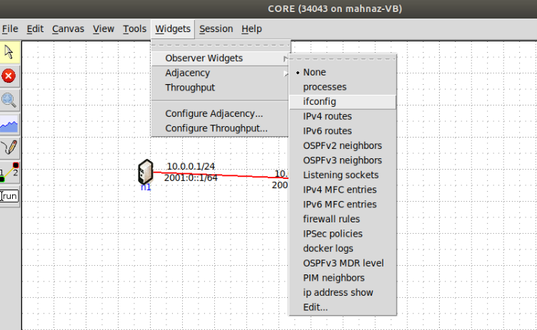
Example Output of Observer Widget
Hover over the node and observe
Selecting the widgets to execute on LXC node

Slide 17
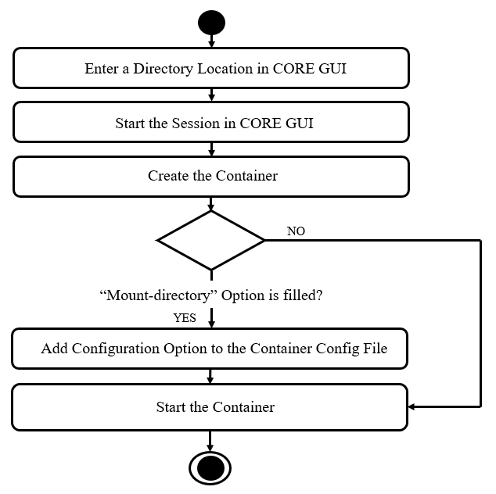
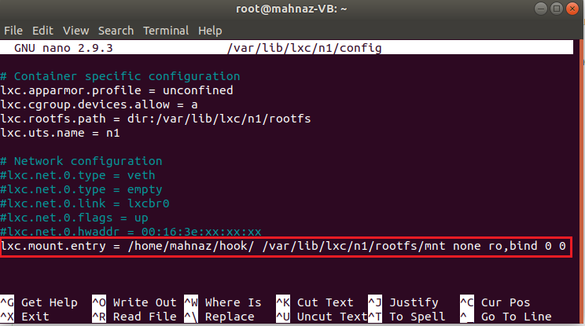
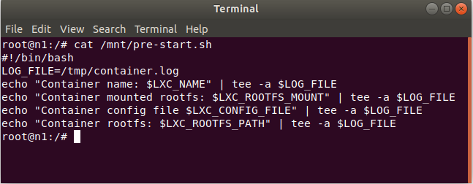
Mount Directory from Host Machine and Explore Filesystem

Slide 18
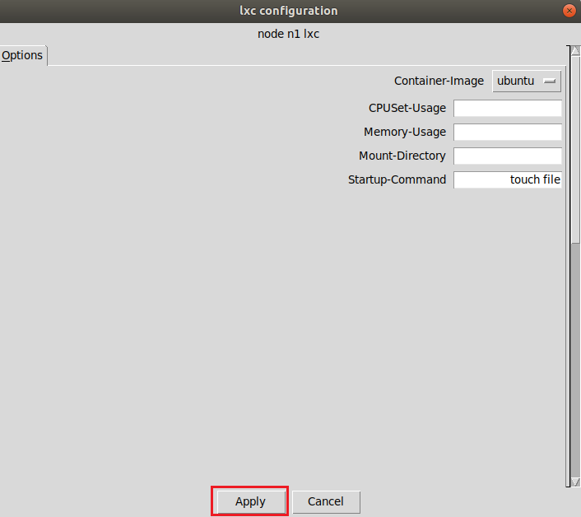
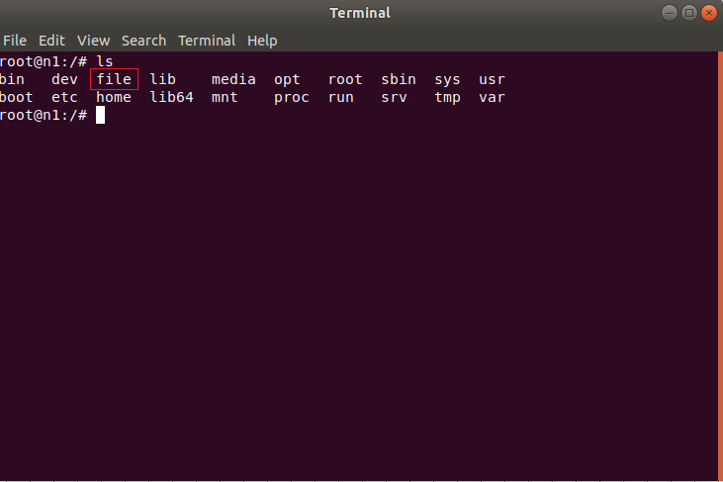
Start-up Script Implementation Example Output
User inputs the command
Command executed inside container

Slide 19
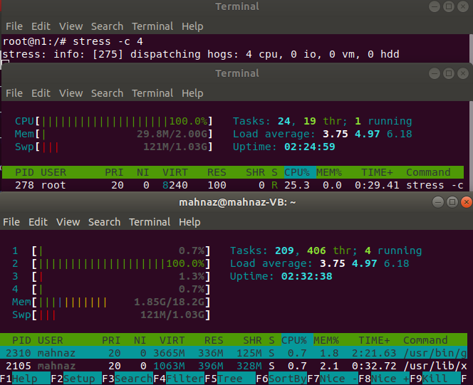
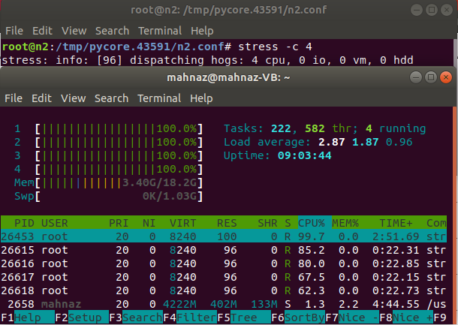
Stress Test on LXC Node and CORE Node (Monitoring CPU Utilization)
Stress test inside container and in host machine for LXC node
Stress test in host machine for CORE node

Slide 20
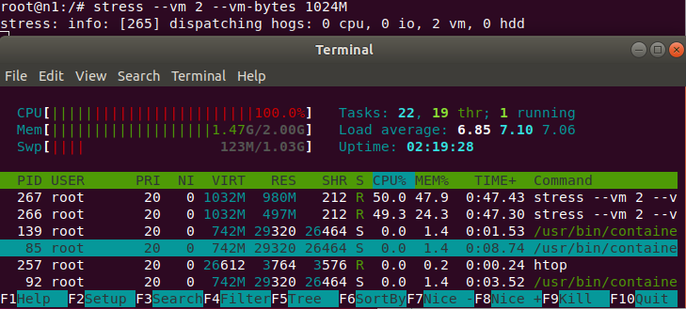
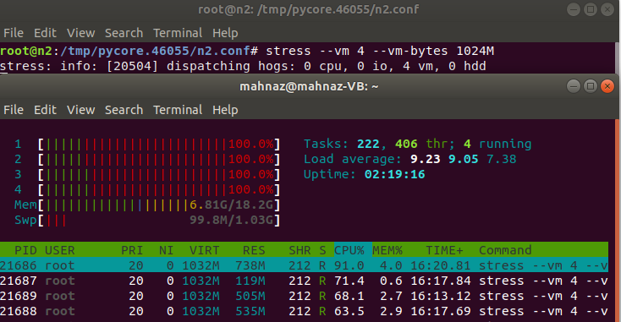
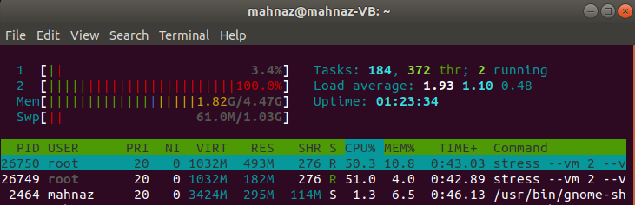
Stress Test on LXC Node and CORE Node (Monitoring Memory Utilization)
Stress test inside container and in host machine for LXC node
Stress test in host machine for CORE node

Slide 21
Summary & Future Perspectives
Summary:
New node type developed
Implemented LXC related configurable aspects
Built communication between CORE GUI and CORE Daemon using CORE API for LXC node
Integrated LXC container as a node type
Future Perspective:
- To make a container persistent
- Reusability for another CORE session
- To enable container nested virtualisation

Slide 22
Thank you

