Slide 1

COURIER MANAGEMENT SYSTEM

Slide 2

ACKNOWLEDGMENT
The first, we would like to express my special thanks of gratitude to my teacher << SIR HASSAN NAEEM >>, who helped us a lot in finalizing this project with in the limited time frame, valuable counseling and assistance for the accomplishment of this project. Secondly we would also like to thank the e-Project team at Aptech Head Oﬃce, who gave us the golden opportunity to do this wonderful project about Aura Watch. Thirdly, we also thank the e-Project team, some of the benefits are as under : Re-enforcement of skills happens in the experiential learning process . Amentor, ensuring that we do not get drifted, constantly guides us. It gives us a lot of confidence to face an interview as we have worked on a project. We can explain virtually everything on the subject we have learnt.

Slide 3
INTRODUCTION
CMS is a web-based Courier Management System that supports the high accessibility of courier services to the corporate and to the customer. The system is being used for day-to-day activities such as booking a courier, maintain hub details, maintain company details, process data of businesses, and many other things.

Slide 4
TASK SHEET
SNO. | ENROLMENT NO. | TEAMATES NAMES | TASK | STATUS
01. | Student1414991 | MAHNOOR&SHAYAN | HOME PAGE | DONE
02. | Student1395292 | MAHNOOR&SHAYAN | SERVICES | DONE
03. | Student1386806 | MAHNOOR&SHAYAN | FIND US | DONE
04. | Student1414903 | MAHNOOR&SHAYAN | TRACKING | DONE
05. | Student1396117 | MAHNOOR&SHAYAN | LOGIN | DONE
06. |  | MAHNOOR&SHAYAN | REGISTERED | DONE
07. |  | MAHNOOR&SHAYAN | DOCUMENTATION | DONE

Slide 5
SITEMAP
HOME
FAQ
ABOUT US
TRACKING
CONTACT US
LOGIN
IMAGE
IMAGE
COURIER SEARCHING
BUTTON
REGISTERED
BUTTON

Slide 6
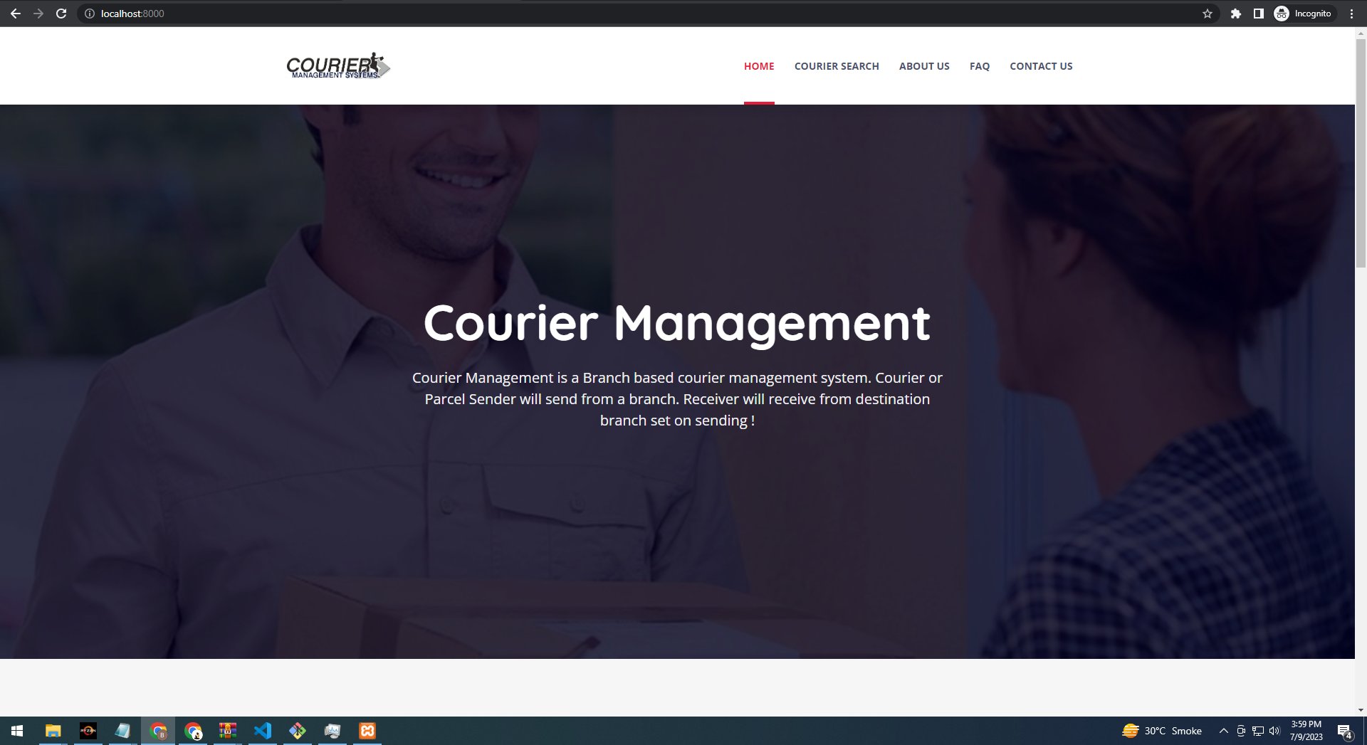
1-10 DAYS
TEMPLATE INTEGRATE

Slide 7
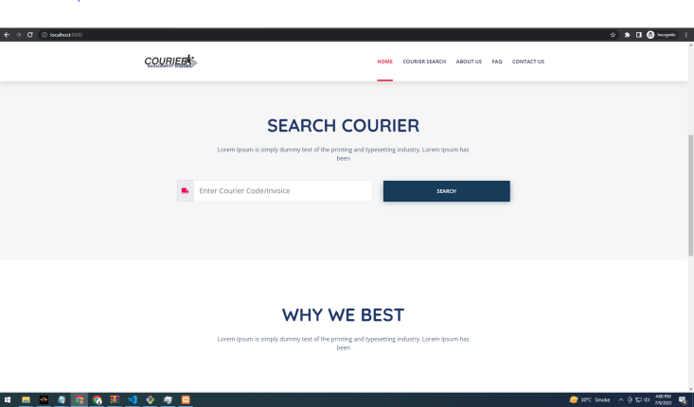
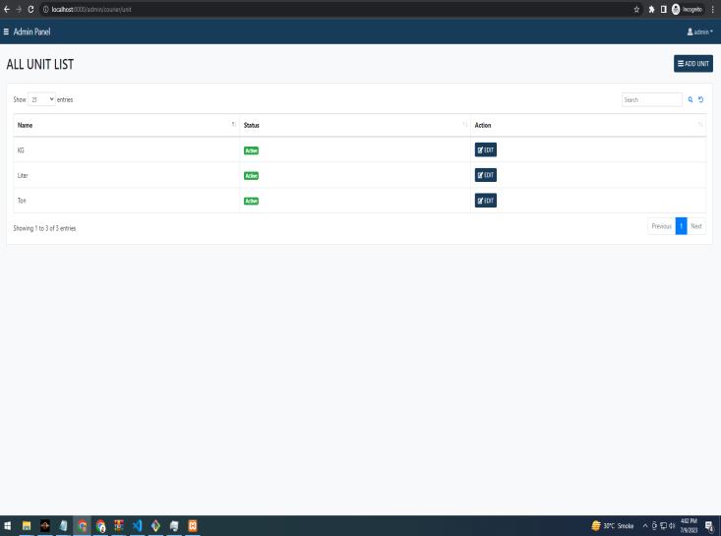
11-20 DAYS
SEARCHING WORK

Slide 8
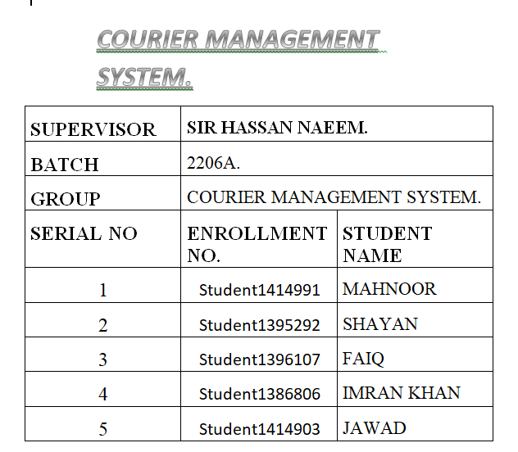
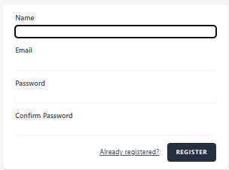
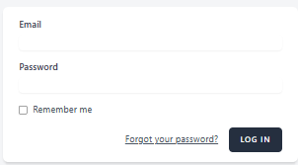
21-30 DAYS
DOCUMENTATION & LOGIN/REGISTERED

Slide 9
THANK YOU

