Slide 1
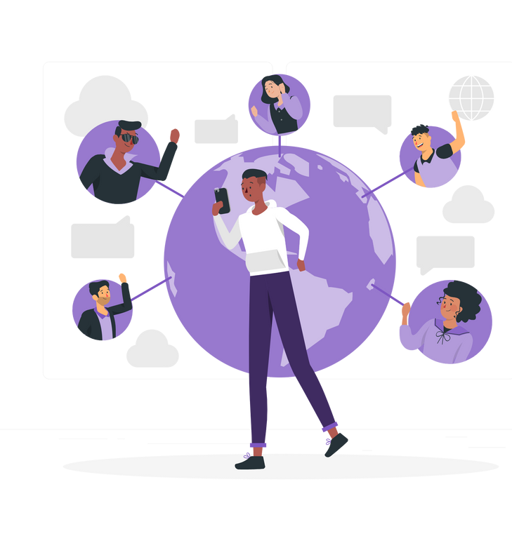
SOCIAL CONNECT
May 2024
Prepared By:
Mahnoor Younas Arqam Nasir
Saira Somal

Slide 2
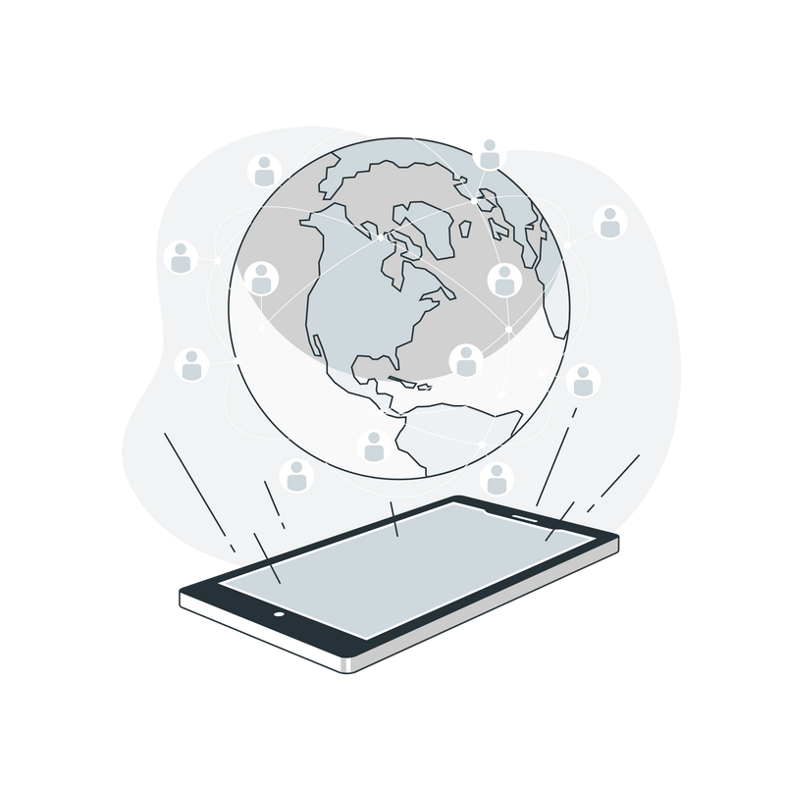

Content
01
02
03
Introduction of System
User Stories
Conclusion

Slide 3



INTRODUCTION
The SocialConnect project is a dynamic platform designed to facilitate meaningful connections and foster community engagement in the digital age.
Facilitating Connections: SocialConnect prioritizes effortless connection- building, allowing users to establish across geographical boundaries through intuitive features and user-friendly interfaces.
Community Engagement and Content Exploration: SocialConnect goes beyond traditional social networking by offering users access to diverse communities tailored to their interests and passions. Users explore a rich tapestry of member-curated blogs, fostering intellectual discourse and inspiration.

Slide 4


Slide 5
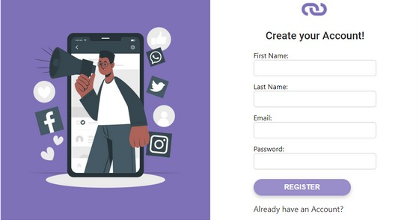
As a User I want to easily Sign Up to SocialConnect

Slide 6
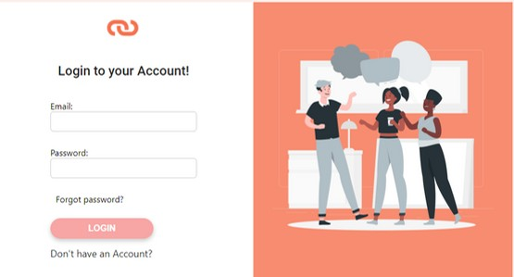
As a User I want to easily Login to SocialConnect

Slide 7
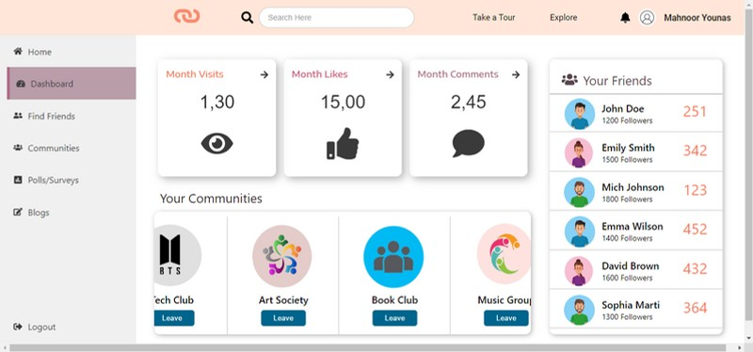
As a User I want to easily view my Dashboard showing my friends and Communities I’ve joined

Slide 8
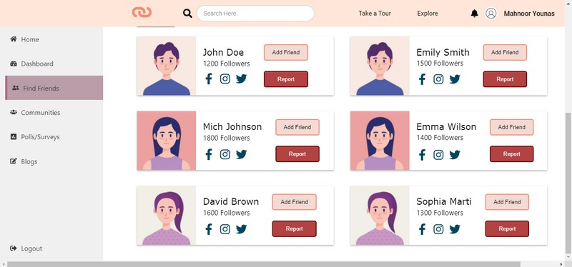
As a User I want to view other profiles to Add friends

Slide 9
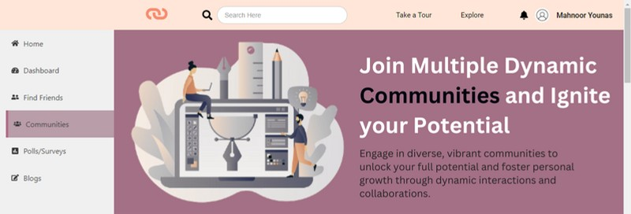
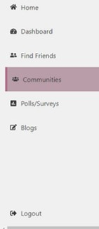
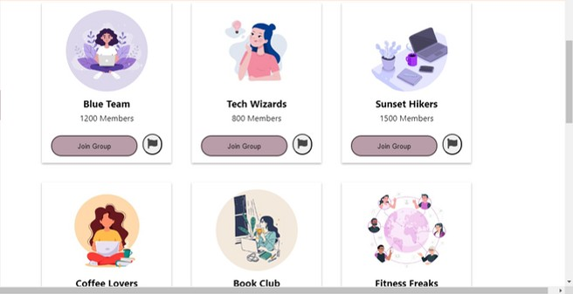
As a User I want to view Communities and Join them

Slide 10
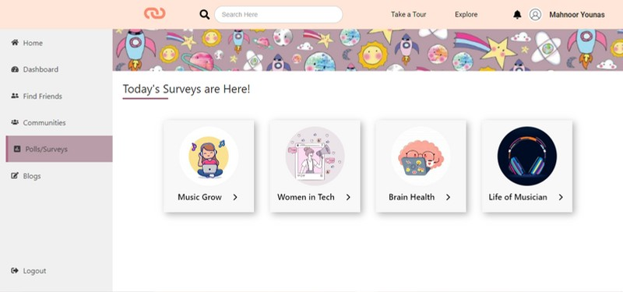
As a User I want to view Multiple surveys and take part in them

Slide 11
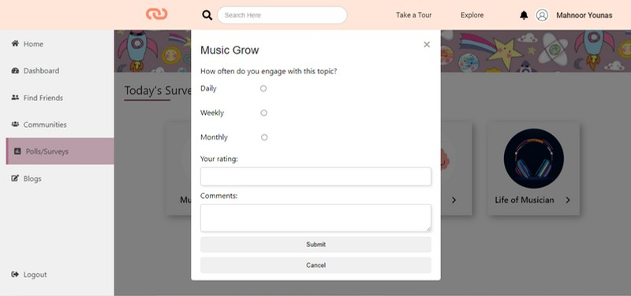
As a User I want to view Multiple surveys and take part in them

Slide 12
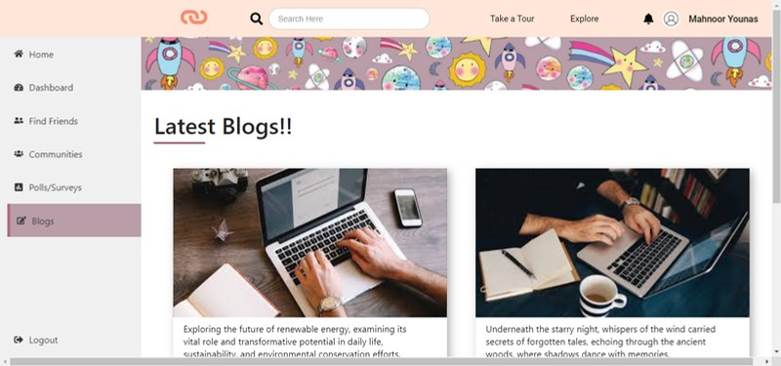
As a User I want to view Different Blogs.

Slide 13


THANK YOU

