Slide 1
Steganography
The art of hidden communication
Presented by :
Mahnoor Fatima________________F24609043
Gulam abbas___________________F24609026
Hajra Shehzad__________________F24609025
Muhammad Tayyab_____________F25609035
Muhammad Usman______________F24609022

Slide 2

“
Introduction
Steganography is the practice of concealing messages within other media types. It hides the existence of the message itself by embedding it within another file. These tools work by modifying insignificant bits of the media, such as altering pixel values in an image or modifying frequency components in an audio file.

Slide 3
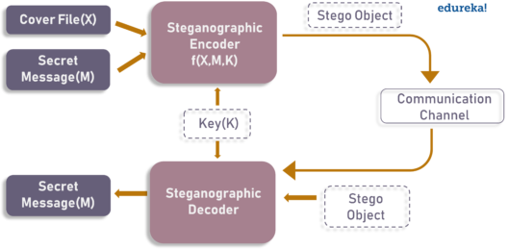
How it works?
The art of hidden communication

Slide 4



Types of steganography
Image Steganography
Audio Steganography
Video steganography

Slide 5
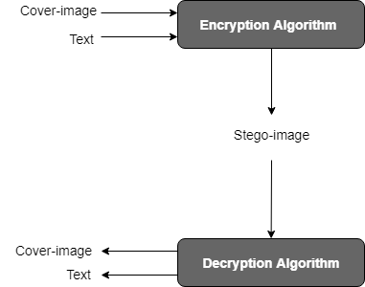
IMAGE STEGANOGRAPHY
Image steganography is the technique of hiding secret data within an image without altering its visible appearance.
WORKING :
The secret information is embedded by modifying the pixel values of the image in a way that is imperceptible to the human eye.
TECHNIQUE USED:
LSB (Least Significant Bit) Encoding: Modifies the least significant bits of pixel values to store hidden data.

Slide 6
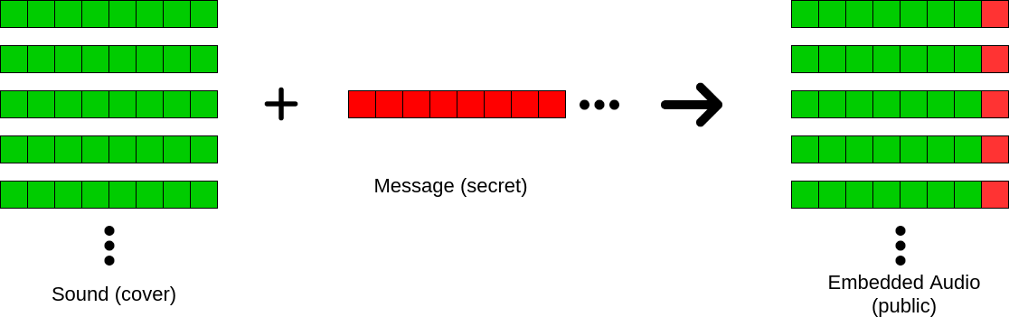
AUDIO STEGANOGRAPHY
Audio steganography is the technique of concealing secret information within an audio file without altering its perceptible quality.
WORKING :
Hidden data is embedded by subtly modifying audio signals in a way that remains undetectable to the human ear.
APPLICATIONS:
Secure communication and covert messaging.
Watermarking for copyright protection.
Hiding confidential data in forensic investigations.

Slide 7
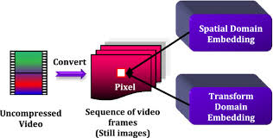
VIDEO STEGANOGRAPHY
Video steganography is the process of hiding secret data within a video file by subtly modifying its frames, pixels, or audio signals without affecting perceptible quality.
WORKING :
Data is embedded within frames, motion vectors, or audio signals to ensure hidden information remains undetectable.
APPLICATIONS:
✔ Secure Communication – Transmitting confidential data covertly. ✔ Digital Watermarking – Protecting copyrights by embedding ownership details. ✔ Stealth Data Storage – Hiding sensitive information within video files. ✔ Forensic & Intelligence Use – Concealing critical data for secure investigations.

Slide 8

Encryption and error-checking
1
Enhancing Security
2
Error detection
Encrypted data can still attract attention from attackers. By embedding encrypted messages within a seemingly innocuous file (image, audio, or text), steganography ensures that the existence of the message remains hidden.
It can contribute to error detection by embedding hidden data that helps verify the integrity of transmitted or stored information.
3
Dual Protection
Combining encryption with steganography offers double security—even if the stego object is discovered, an attacker would still need to decrypt the message.

Slide 9

KEY ADVANTAGES OF STEGANOGRAPHY TECHNIQUES
Concealment:
Steganography effectively hides the presence of a message , ensuring that only intended recipients are aware of its existence
Capacity:
This technique allows for the embedding of large volumes of data within carriers, such as images , without causing noticeable alterations.
Integration:
Integrity in steganography is achieved using hashing, digital watermarking, error correction codes, and key-based verification. These techniques ensure that the hidden message remains secure, unaltered.

Slide 10

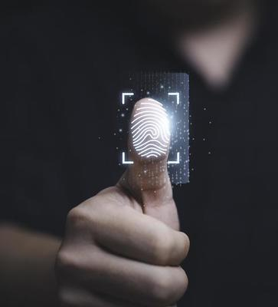
Challenges faced in steganography techniques
Data losses
Overwriting data during the embedding process may lead to irreversible loss of original information
Limited embedding capacity
If too much data is embedded, it may cause distortions or noticeable artifacts, making it easier to detect.
Complexity
Effective implementation often requires a high level of technical expertise. This can slow down processing making it impractical for real-life.

Slide 11
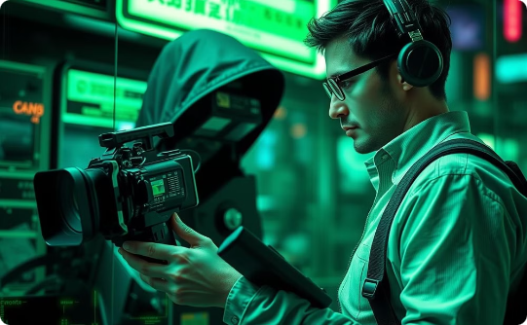


Real-World Use Cases and Applications
Journalism
Healthcare
Legal
Protect sources in censored regions.
Securely share patient data.
Protect sensitive legal document

Slide 12
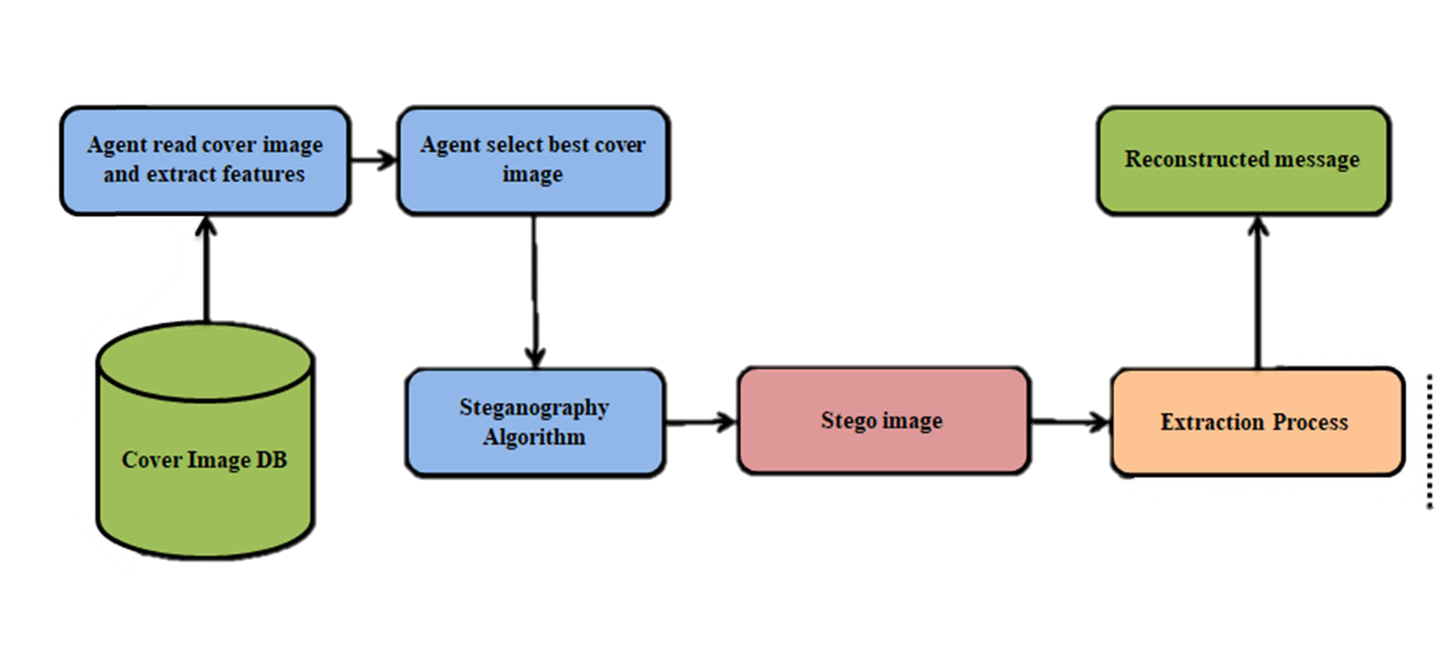
CONCLUSION:
In summary, steganography offers a versatile approach to data protection through various media types, enhancing security through techniques like password protection and encryption. Understanding its applications can help in effectively safeguarding sensitive information

Slide 13

FUTURE WORKS IN STEGANOGRAPHY
ADVANCEMENTS IN STEGANOGRAPHY:
Future advancements in steganography will focus on making hidden messages even harder to detect. Researchers are exploring AI-based methods, quantum computing, and new embedding techniques to improve security and capacity while reducing distortions in digital media like images, videos, and audio.
Evolving Steganalysis Techniques
As steganography improves, so do detection methods. Future steganalysis will use machine learning and deep learning to identify hidden data more accurately. Advanced algorithms will help detect even the most subtle modifications in digital content, making covert communication more challenging.
Security and Privacy Considerations
Future steganography must balance secrecy with ethical concerns. While it helps protect sensitive data, it can also be misused for illegal activities. Researchers are working on regulations and secure frameworks to ensure responsible use while maintaining privacy in communications.

Slide 14
THANK YOU !

