Slide 1
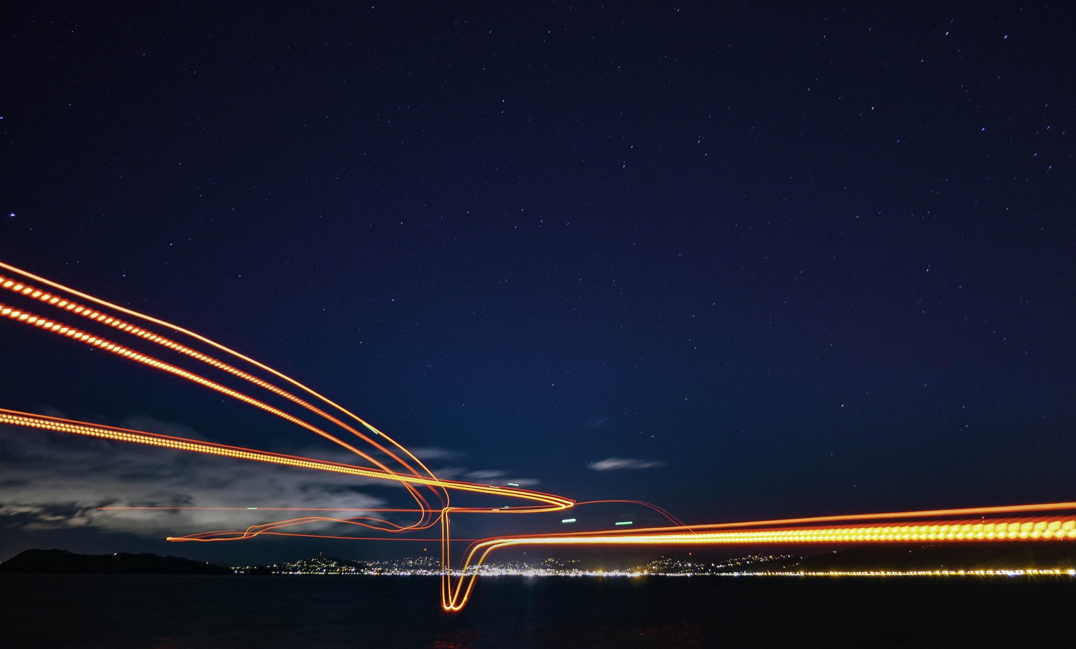
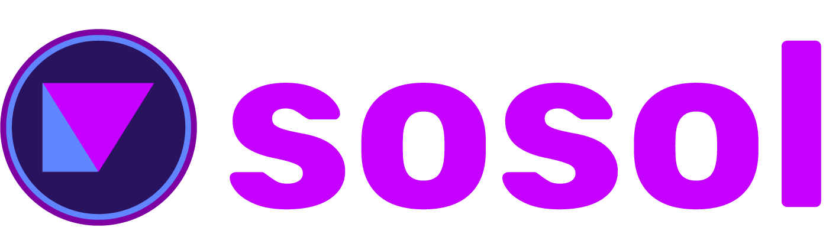

Slide 2
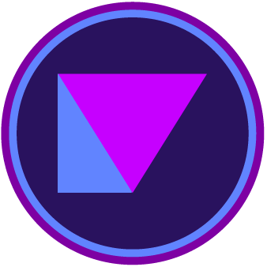
Sosol is built on Solana. We can match the performance of legacy social media, with up to 6,000 transactions per second.
Content creators, users, and advertisers get paid or transact for what they create, and how they share it.
Monetized, decentralized social media

Slide 3
Solana’s speed and affordability make Sosol possible
User micropayments pay for storage, platform maintenance and development, and ensure long-term data persistence in a decentralized Web3 environment.

Slide 4
Creators get paid
Sosol’s model allows long-form and rich media content, all on one platform.
Artists and musicians can drop new creations, and their fans can pay them directly for it - all on sosol.

Slide 5
Open source API, token-powered economy
Creators choices and revenue models are limited only by their imagination!

Slide 6
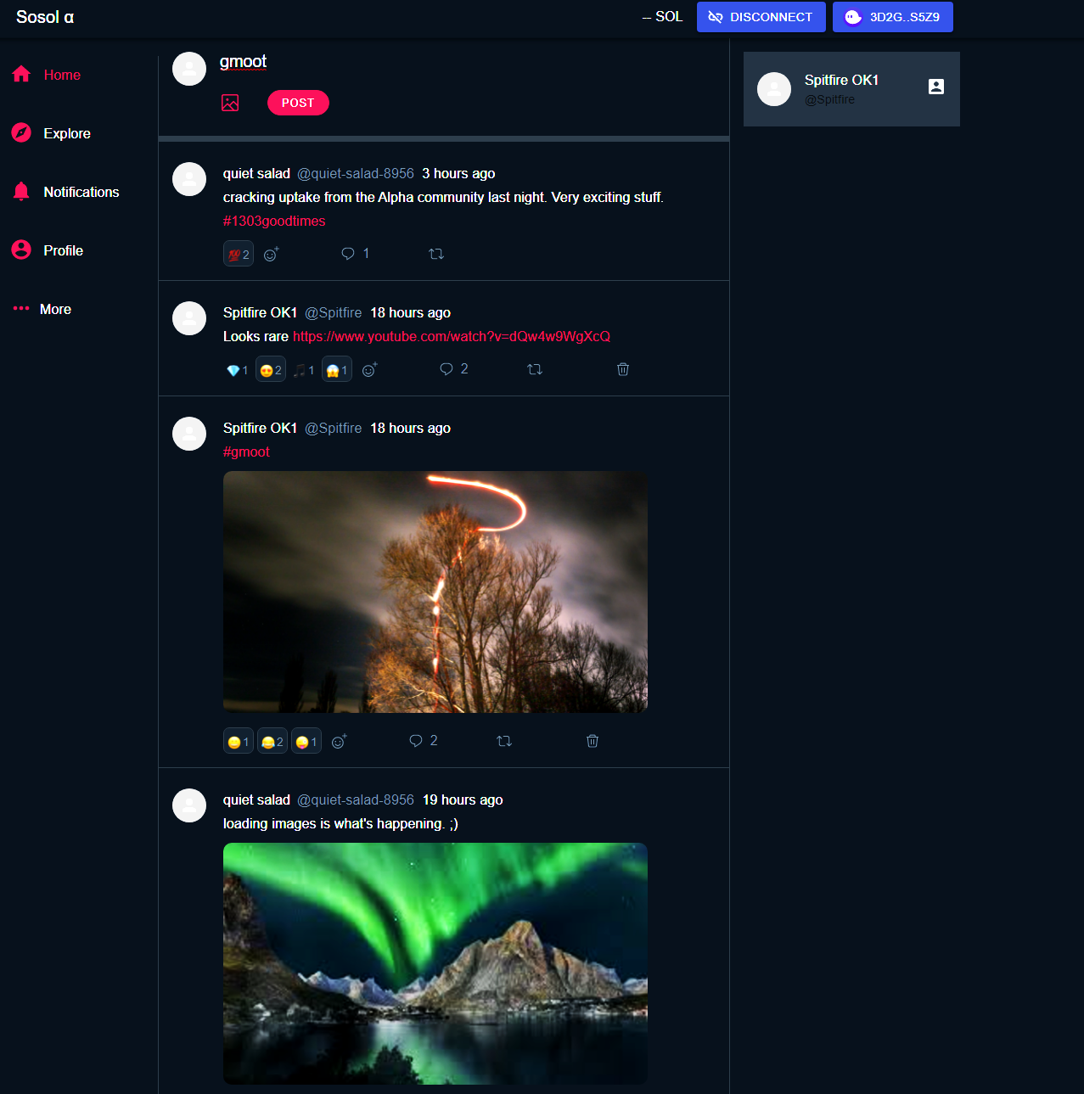
We’re live!
Come say gm - my.sosol.app
Functional alpha build on testnet.
“Basic twitter” functionality.
Posts (tweets), hashtags, image uploads, rickrolls, emojis, and http links work.
Log-in with Phantom.
Visit @harkl_ on Twitter or sosol.app for more info.
Limited alpha tester slots open.
“The first 1303 alpha testers may be eligible for an exclusive NFT drop; looks rare!” - Anonymous source 👀

Slide 7
You are not the product.
Our users are customers and content creators.
We’re people; not a product for Central Corp™ to exploit!
You drive the Sosol platform. You, your friends, and followers gain value from the content you create, and from the community that you build.

Slide 8
Advertisers
We want advertisers too!
Brands can spread awareness by loading a campaign with value. Their advertising spend then gets distributed to Sosol users who interact with their campaign.
Just like everything on Sosol, the $SSL token makes the magic happen.

Slide 9
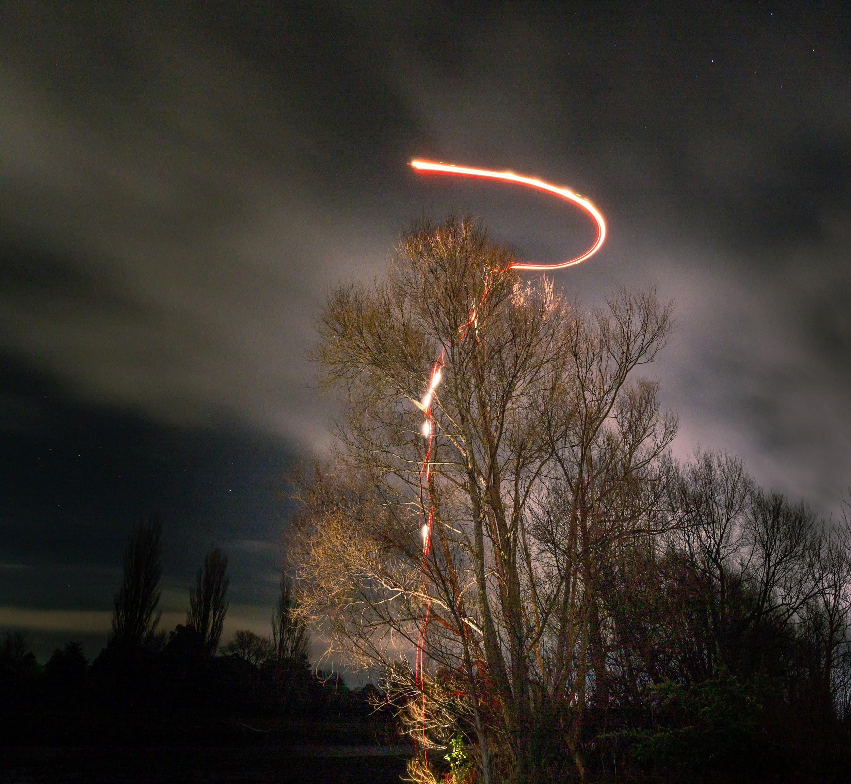
$SSL Token
I hoped my drone would avoid that tree.
You hoped to avoid a slide on tokenomics.
Life is hard, so let’s keep this brief.
The SSL token is what makes the magic happen. From tiny fractions of a cent to post a message, through to global advertising campaigns, it’s all possible, and we’ve kept it simple.
You can read more about it here.
Just like that drone crash, this slide wasn’t so bad after all.

Slide 10
The market
The future is decentralised; you know that, that’s why you’re reading this.
Over 3.6 billion people use centralised social media. The total number of social media users is projected to grow to 4.4 billion by 2025 (statistia).
Getting first-mover advantage means capturing the lion’s share of the decentralized Web3 social media market.
Let’s do it. WAGMI. GM. Sosol.

Slide 11
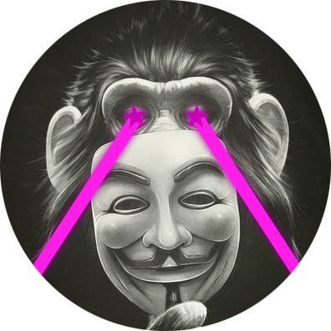
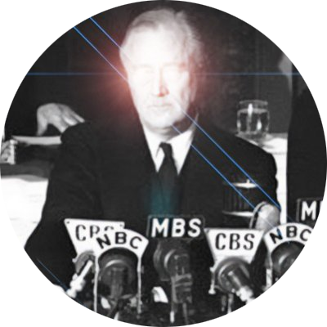
Thanks!
W/ sosol.app
⍺/ my.sosol.app
G/ github.com/sosol-gmi
T/ @sosol_app
Harkl - Founder,
Code.
Spitfire - Design,
marketing.

