Slide 1
Sequence-Based Prediction Using Enformer

Slide 2
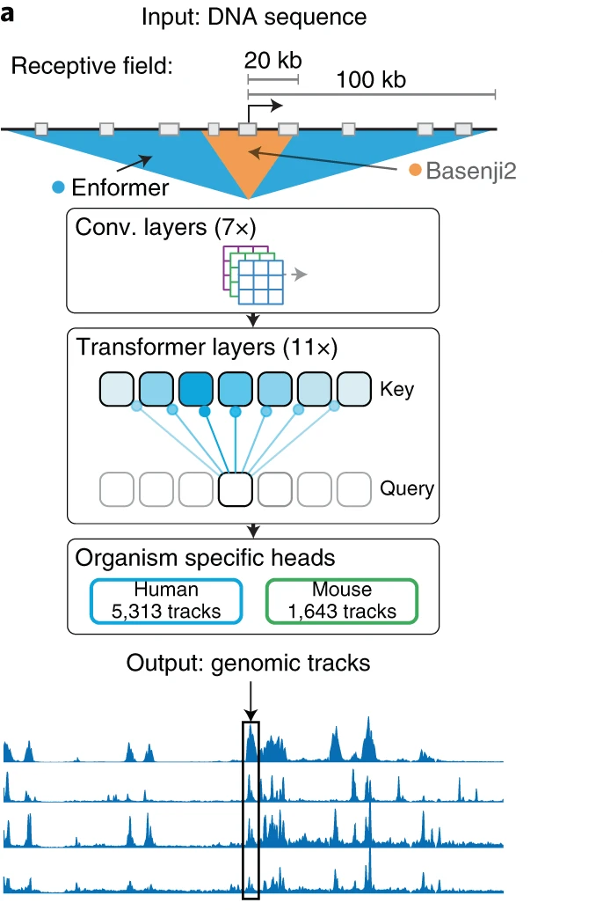
Enformer Model
Enformer is a neural network architecture trained to predict gene expression and chromatin states in humans and mice from DNA sequences.
Training Data: Basenji: Kelley et al 2018
Inputs: 200 kb DNA sequence (reference genome)
Outputs: genome length of 896 corresponding to 114,688 bp aggregated into 128-bp bins
Human
5,313 genomic tracks
Mouse
1,643 genomic tracks

Slide 3
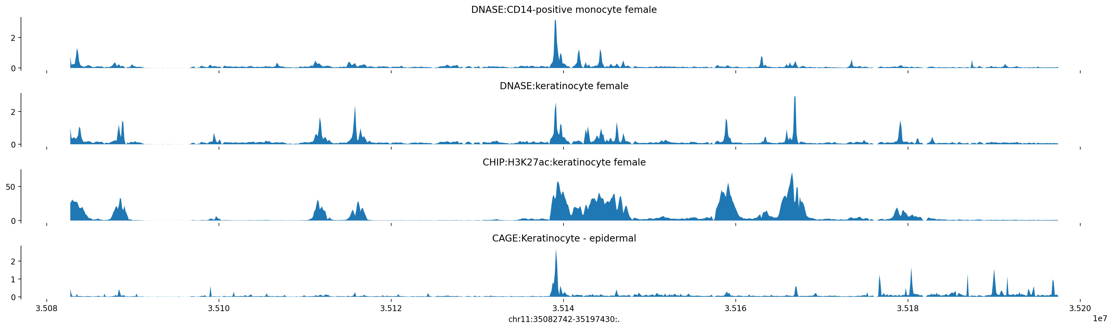
Apply Enformer on pseudogenomes for 8 founders
Inputs:
Pseudo reference for 8 founder strains in m39 based on Sanger snp and indel set :
/projects/omics_share/mouse/GRCm39/genome/sequence/imputed/rel_2112_v8/
Pseudo reference coordinates from GTF files:
/projects/compsci/omics_share/mouse/GRCm39/transcriptome/annotation/imputed/rel_2112_v8/
We cut a sequence of 200kb around the starting site for each gene: 100kb away to the left and the right of the start location. Feed the sequence to Enformer, use the max score within 10 bins away from the starting site as the predicted expression.

Slide 4
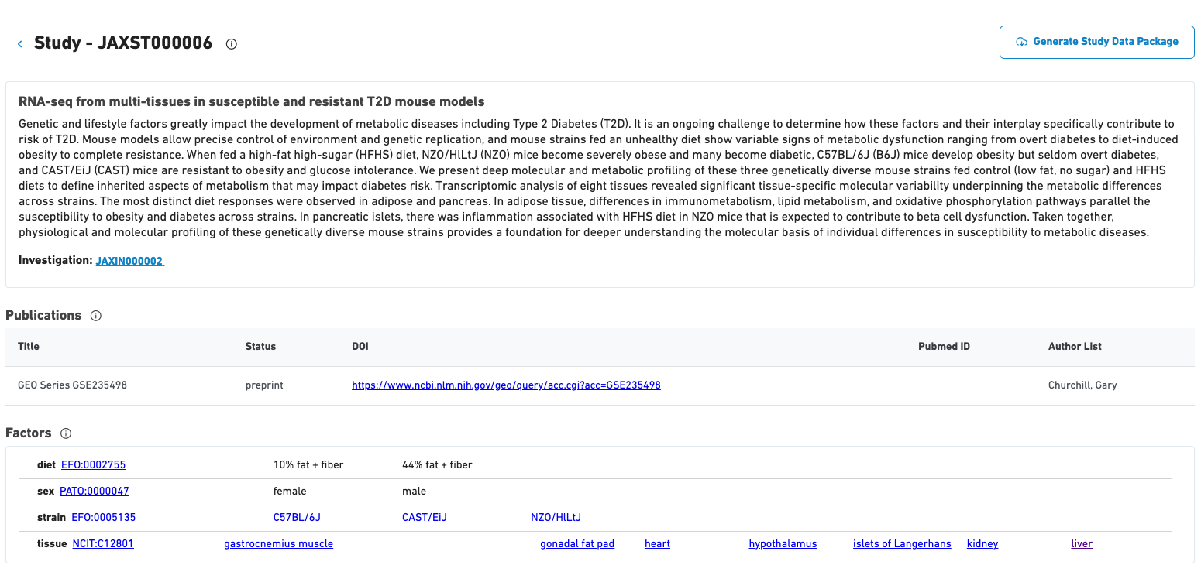
Compare Enformer predictions with RNA-seq data from NZO_HlLtJ, CAST_EiJ, C57BL_6J liver tissue
Strain | # of Samples (10%fat + fiber) | # of Samples (44% fat + fiber)
C57BL/6J | 8 | 8
CAST/EiJ | 7 | 8
NZO/HlLtJ | 8 | 8
https://bioconnect.jax.org/metadata-search/detail-view/study/431

Slide 5
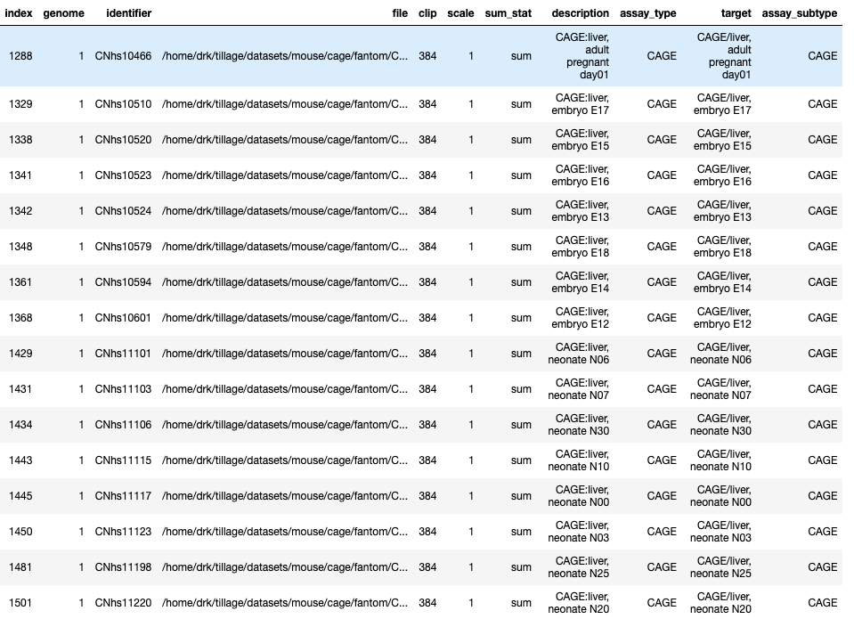
Enformer model was trained on 1643 tracks for mouse, we use track 1288:
CAGE/liver, adult pregnant day01 for comparison

Slide 6
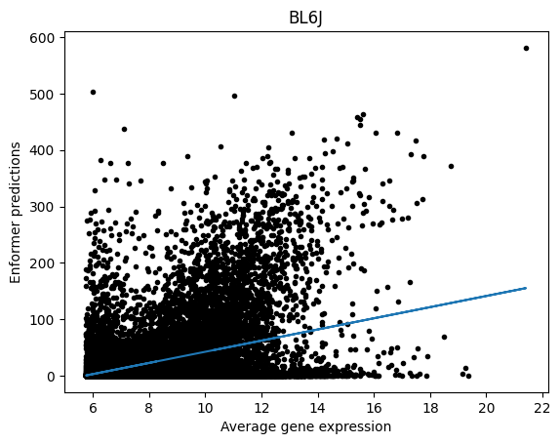
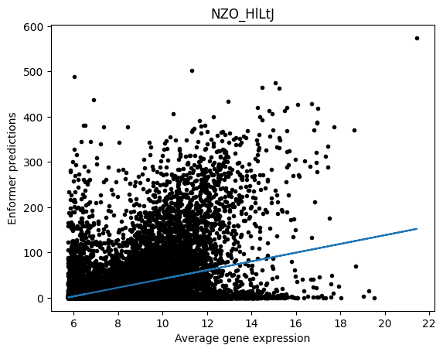
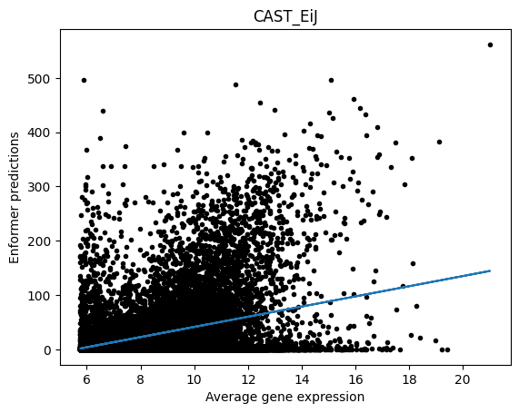
Compare Enformer predictions with RNA-seq expression for liver

Slide 7
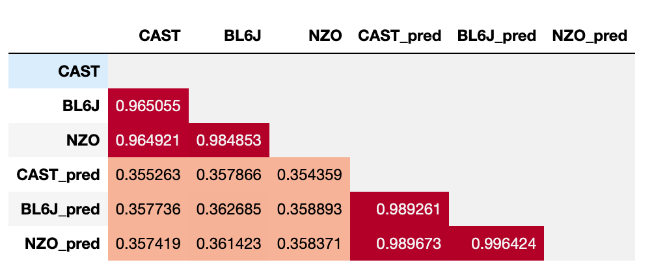
Correlation coefficients between Enformer predictions and RNA-seq expression for liver

Slide 8
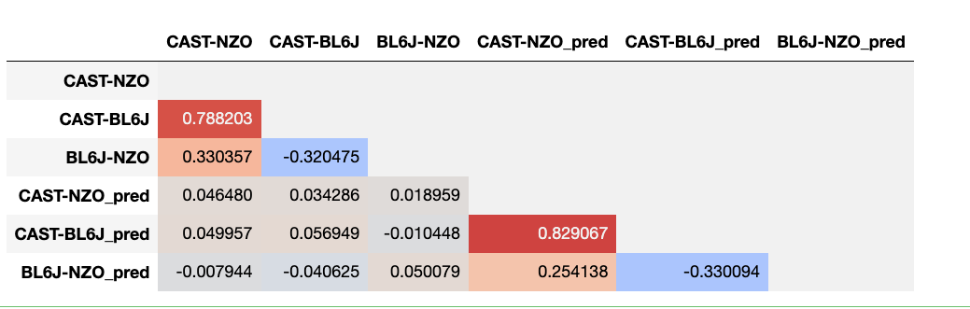
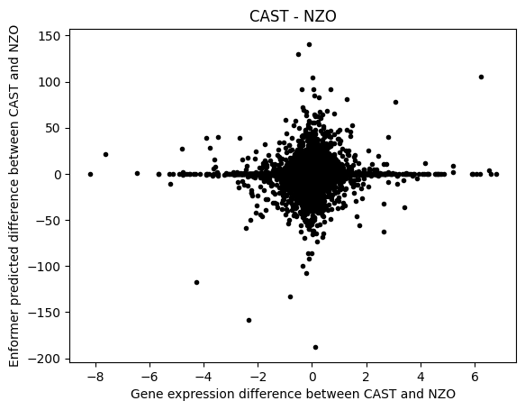
Look into expression differences between strains and corresponding Enformer predictions

Slide 9
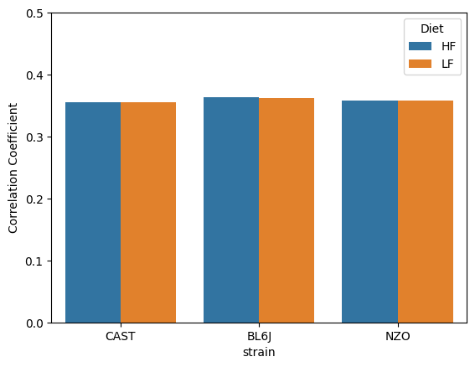
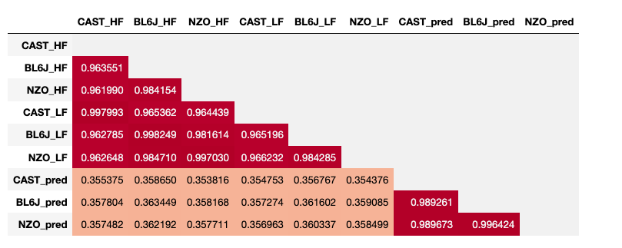
High fat vs low fat

Slide 10
Compare Enformer predictions with QTL allele effects
Dataset: DO.CUBE.liver.Rdata
481 DO mice
HFHS
For each gene, we compute correlation coefficient between Enformer predictions from eight founders and the QTL allele effects.

Slide 11
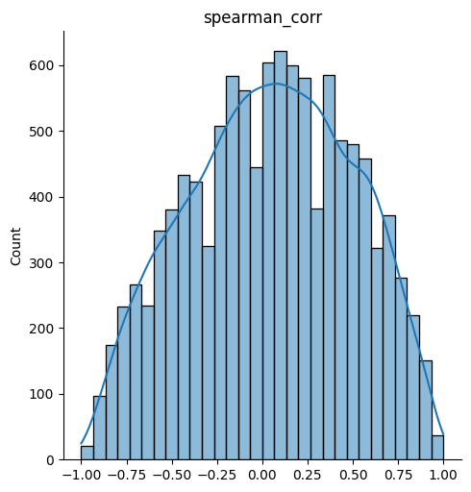
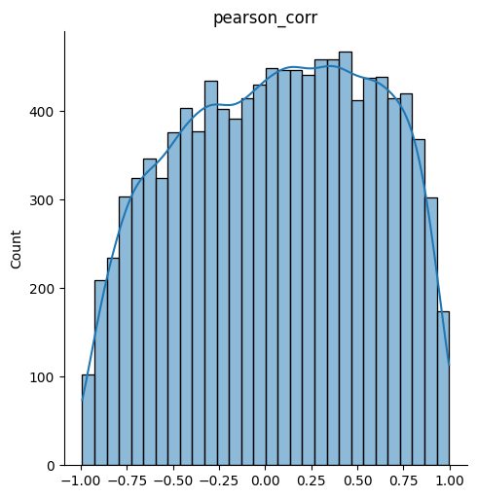
Correlation coefficient distribution
CAGE/liver, adult pregnant day01
Skew (spearman_corr): -0.09745610589943103
Skew (pearson_corr): -0.11024658761874533

Slide 12
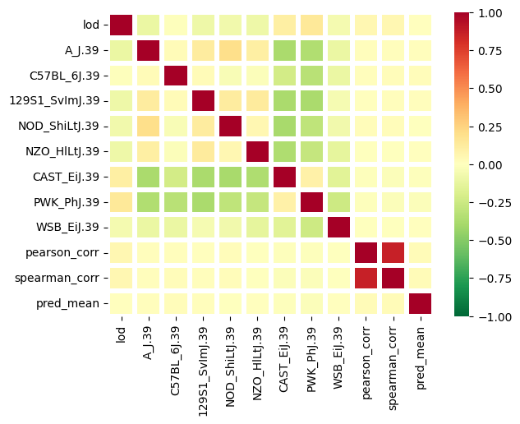
Correlation heatmap for lod score, QTL allele affects, and average predictions from 8 founders.

Slide 13
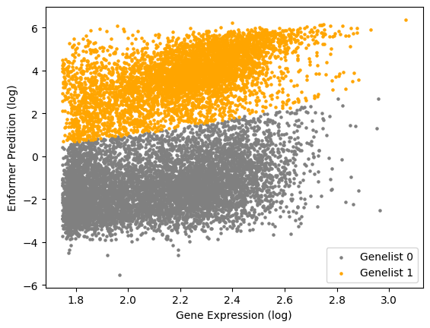
Cluster genes into two groups using Gaussian Mixture model
1) Remove pseudo genes
2) Log-transformation

