Slide 1
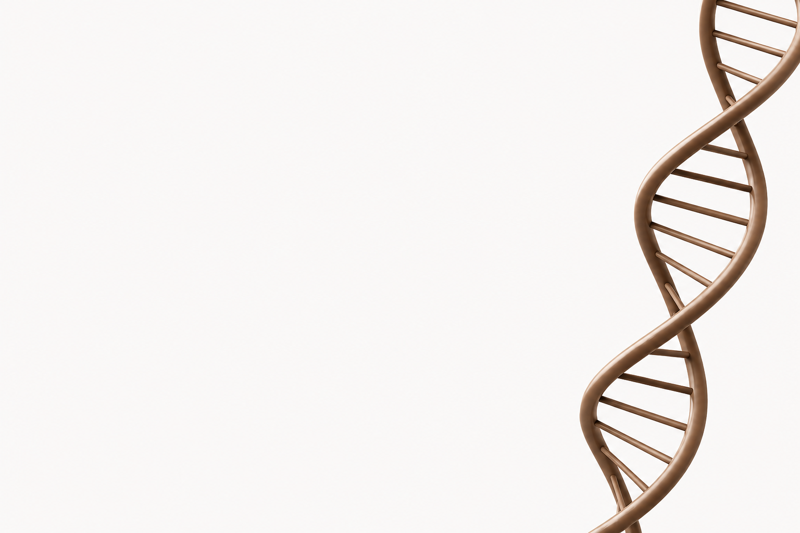

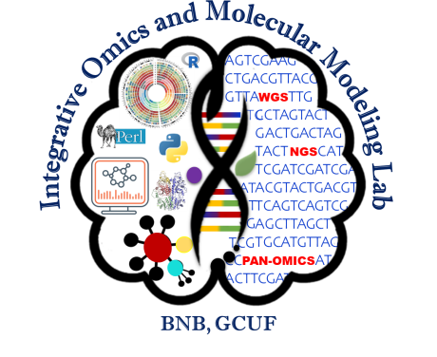
Mutant-Specific Structure Prediction, Molecular Docking, and ADMET Profiling of Candidate Inhibitors Against Oncogenic KRAS G12D
Presented by: Mah Rukh Jamil
Department of Bioinformatics GCUF Faisalabad

Slide 2
Background
Objective
KRAS G12D drives pancreatic adenocarcinoma.
KRAS cycles between GDP and GTP states.
Switch-II pocket is a therapeutically relevant allosteric binding site.
Construct and validate a KRAS G12D mutant model.
Identify potential Switch-II pocket inhibitors through molecular docking.
Evaluate shortlisted ligands using ADMET prediction
Methodology
Template Selection (4OBE), structural comparison with 6VJJ and introduced G12D mutation
Model Validation using MolProbity, ERRAT and Verify 3D and binding site definition using litrerature
Molecular Docking in 2 runs with same ligand and protein using Pyrx and identified the ligands lowest binding affinity
Pose Reproducibility using PyMol
ADMET Prediction

Slide 3
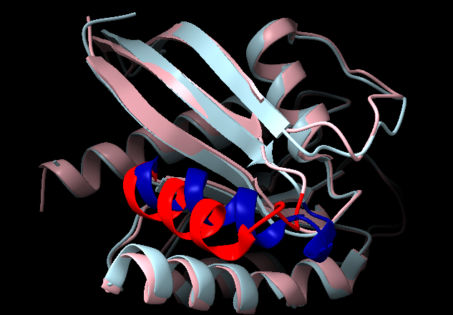
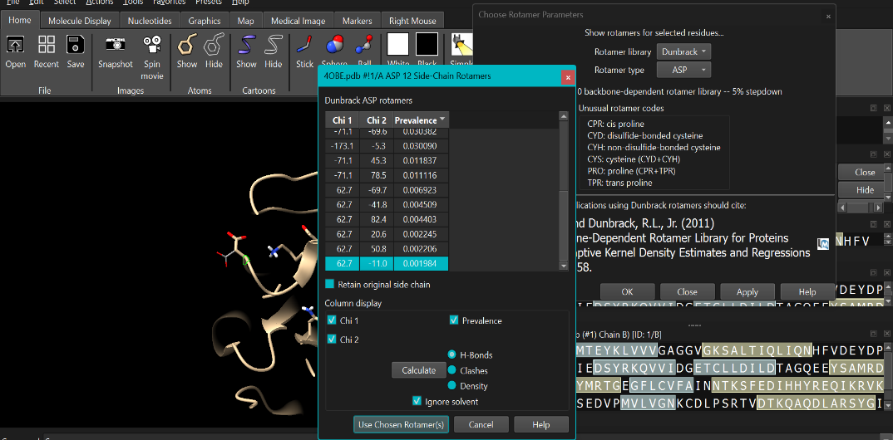
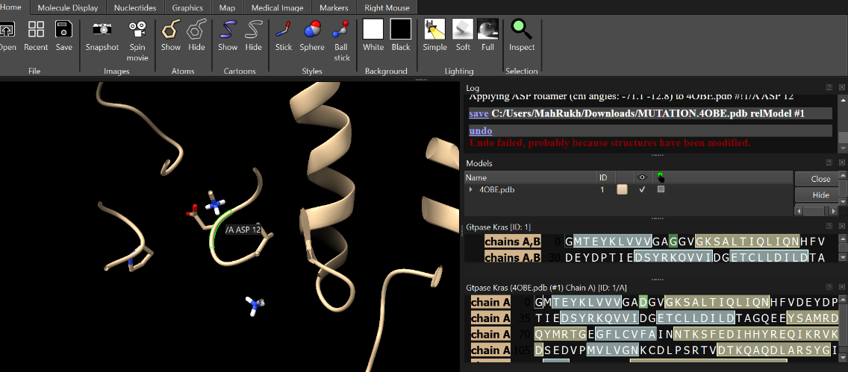
Structural Overlay
Template Selection:
Why 4OBE?
PDB ID | Nucleotide State | Resolution | Reason Considered / Rejected
4OBE | GDP-bound | 1.24 Å | Selected as GDP-state template for G12D mutagenesisbecause the Switch-II pocket is accessible.
6VJJ | GTP-bound (active state) | 1.40 Å | Used as comparison structure to confirm switch-II conformational divergence via structural overlay
Figure:4OBE (pink) vs 6VJJ (light blue), Chain A only. Switch-II highlighted red (4OBE)/dark blue (6VJJ).
Comparison | RMSD | Meaning
Overall backbone | 0.769 Å | Structure largely unchanged
Switch-II region | 4.421 Å | Localized, significant shift
Change concentrated in switch-II — confirms 4OBE (open pocket) as the correct template
Mutation: Gly12 → Asp12 (Chain A)
Rotamer: χ1 = 62.7°, χ2 = -11.0°
Steric: contacts 2.2–3.2 Å (no clash), Cβ dev 0.07 Å
Electrostatic: negative charge added to P-loop → repels phosphate → impairs GTP hydrolysis

Slide 4
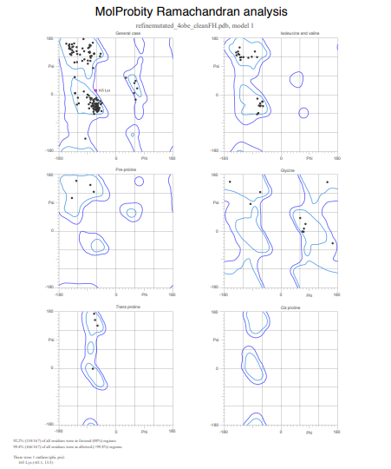
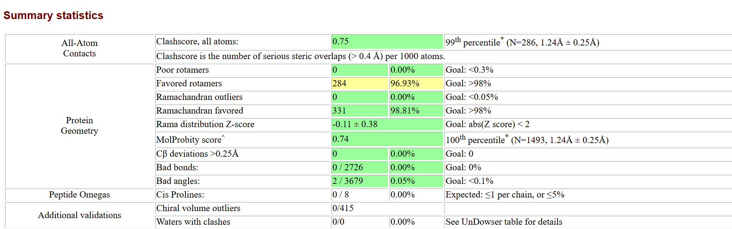
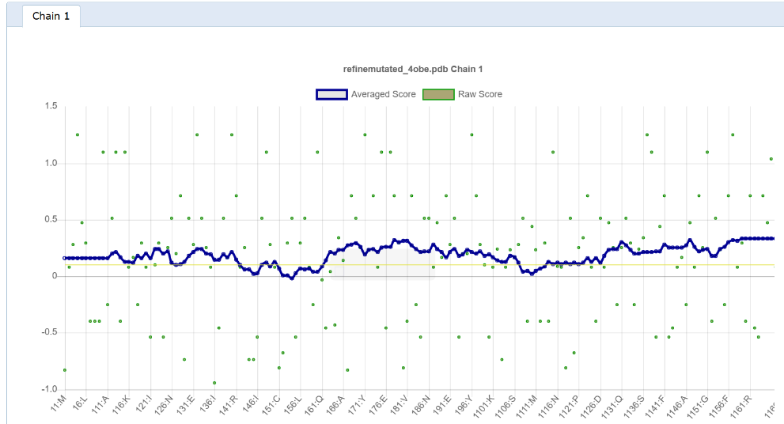
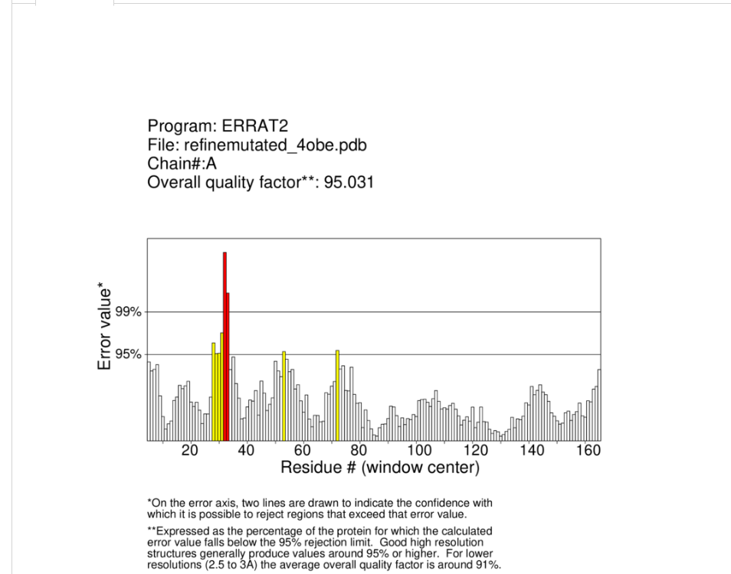
Structural Validation
Validation Method | Score | Interpretation
MolProbity Score | 0.74 | Excellent overall geometry (100th percentile)
Clashscore | 0.75 | Minimal steric clashes (99th percentile)
ERRAT | 95.031 | High-quality non-bonded interaction pattern
Verify3D | 86.98% residues ≥0.1 | Passed structural environment validation
Ramachandran Favored | 98.81% | Backbone geometry within allowed limits
Ramachandran Outliers | 0.00% | No residues in disallowed regions
.
ERRAT
MolProbity summary statistics
Verify3D

Slide 5
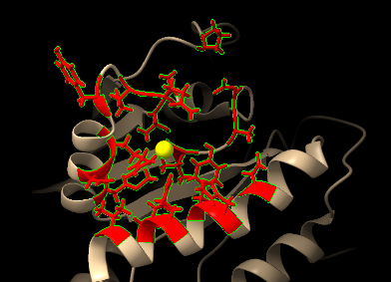
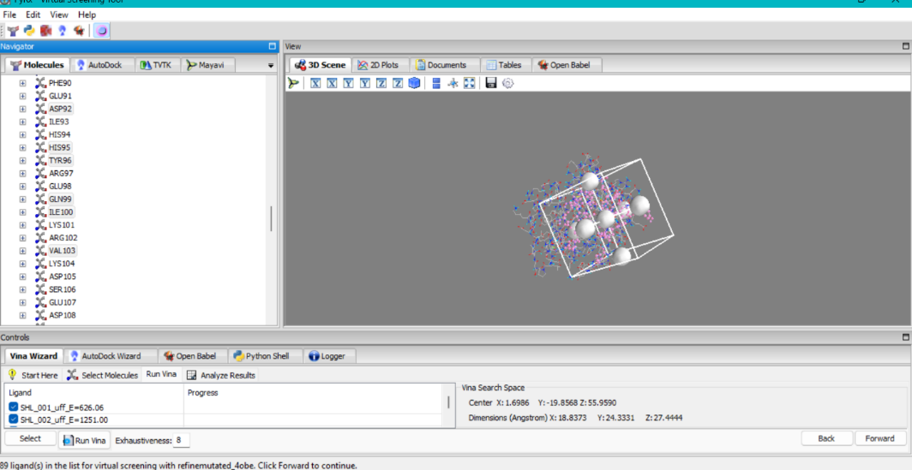
Switch-II Pocket & Grid Box
According to a systematic analysis of KRAS-ligand interaction modes (bioRxiv, 2023), the Switch-II pocket is formed by the following 18 residues:
Val9, Ala11, Asp12, Pro34, Thr58, Ala59, Gln61, Glu62, Tyr64, Arg68, Asp69, Met72, Asp92, His95, Tyr96, Gln99, Ile100, and Val103.
Parameter | Value
Center X | 1.6986 Å
Center Y | 19.8569
Center Z | 55.9590 Å
Size X | 18.8373 Å
Size Y | 24.3331 Å
Size Z | 27.4444 Å
Switch-II residues are highlighted
Why Not the GTP Pocket
Orthosteric GTP Site Excluded
GDP/GTP binds KRAS with extremely high (picomolar) affinity
No small-molecule drug can realistically outcompete endogenous GTP at this site
This is why KRAS was long considered "undruggable" via the orthosteric site

Slide 6
Molecular Docking
100 ligands screened.
Two independent docking runs.
Binding energies recorded.
Top candidates shortlisted
Ligand PubChem ID | Run 1 Affinity (kcal/mol) | Run 2 Affinity (kcal/mol) | ΔAffinity
5321864 | -8.5 | -8.5 | 0.0
26213324 | -8.2 | -8.3 | 0.1
25202111 | -8.1 | -8.0 | 0.1
12302502 | -8.0 | -7.9 | 0.1
5281670 | -7.9 | -7.9 | 0.0
5281801 | -7.9 | -7.9 | 0.0
5321865 | -7.8 | -7.8 | 0.0
5280445 | -7.8 | -7.9 | 0.1
5281665 | -7.8(Not in Top 10) | -7.9 | 0.1
5281614 | -7.8 | -7.7(Not in Top 10) | 0.1

Slide 7
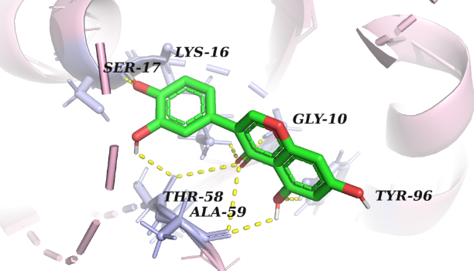
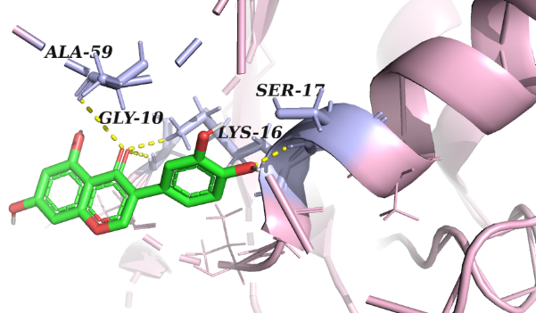
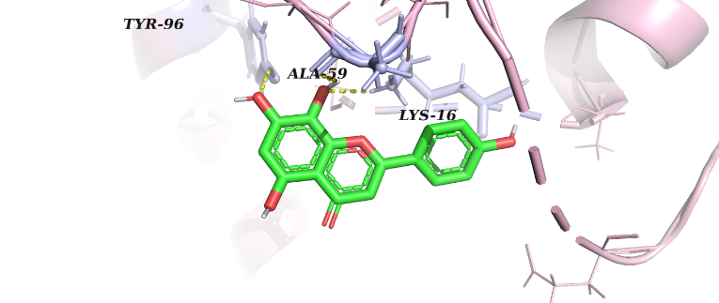
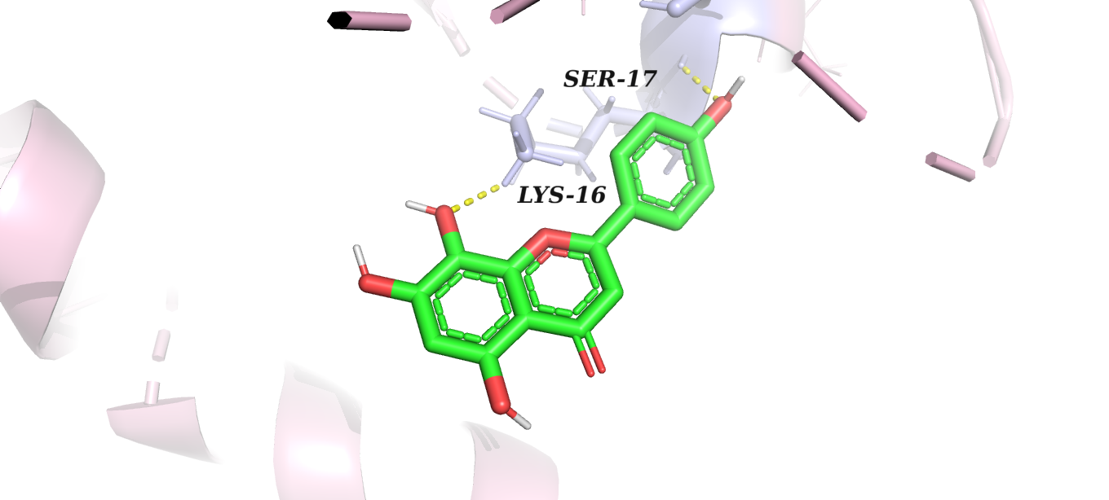
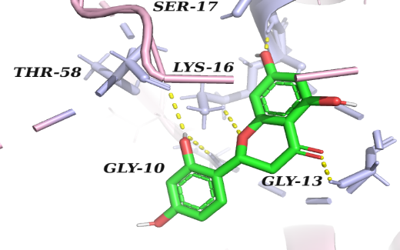
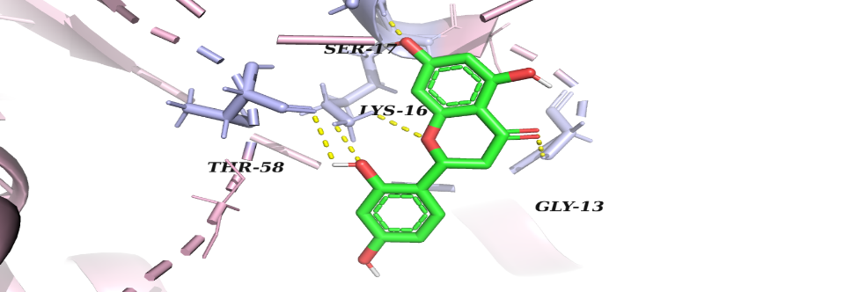
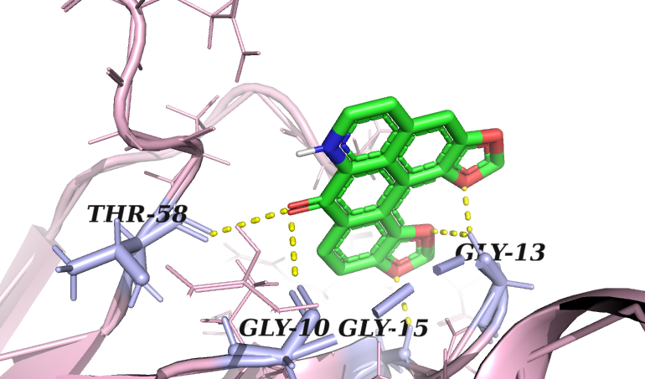
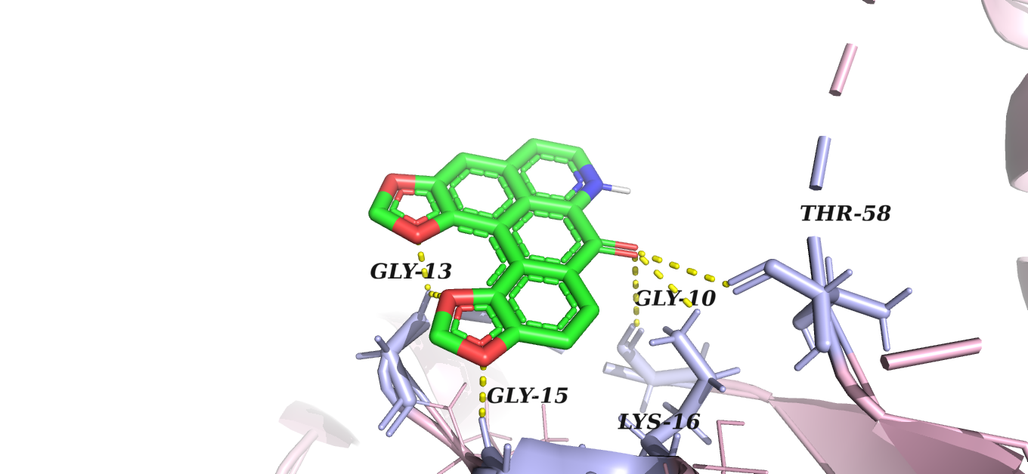
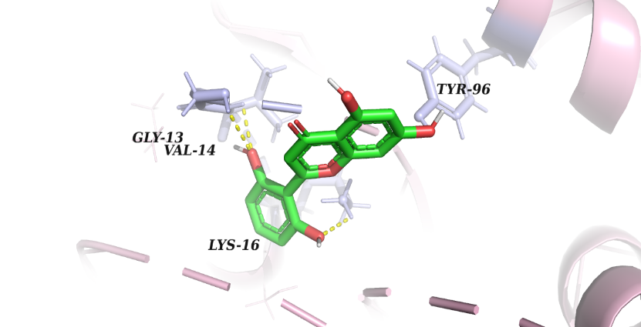
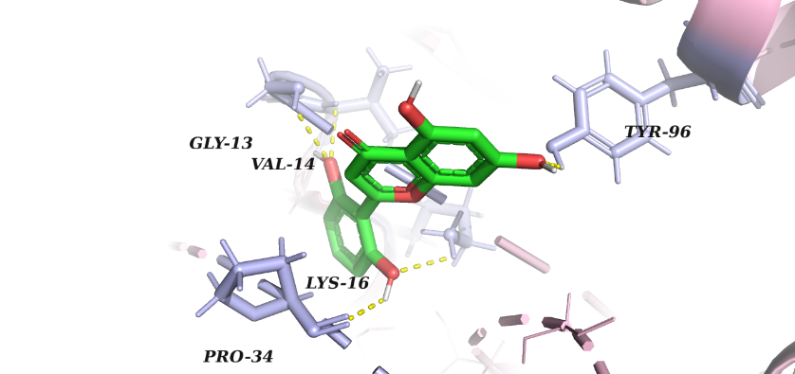
Interaction Analysis
Ligand 5281801
Run 1: Run 2:
Top ligands visualized in PyMOL.
Binding poses compared across runs.
Only 5 showed interactions with at least one Switch-II residue.
Pose reproducibility assessed.
Ligand 5281665
Run 1: Run 2:
Ligand 26213324
Run 1: Run 2:
Ligand 12302502
Run 1: Run 2:
Ligand 5321865
Run 1: Run 2:

Slide 8
ADMET Results
Parameter | 5321865 | 26213324 | 5281665 | 12302502 | 5281801
Water solubility | -3.107 | -3.253 | -3.162 | -3.452 | -3.229
Caco2 permeability | 0.151 | -0.094 | -0.296 | 1.144 | -0.096
Intestinal absorption | 75.803 | 74.687 | 71.923 | 100 | 80.253
Fu | 0.17 | 0.106 | 0.171 | 0.234 | 0.113
BBB permeability | -0.907 | -0.827 | -1.206 | -0.4 | -0.883
CYP2D6 substrate | No | No | No | No | No
CYP3A4 substrate | No | No | No | Yes | Yes
CYP2D6 inhibitor | No | No | No | No | No
CYP3A4 inhibitor | No | No | No | Yes | No
Total Clearance | 0.263 | 0.405 | 0.466 | 0.466 | 0.068
hERG1 inhibitor | No | No | No | No | No
hERG2 inhibitor | No | No | No | No | No
AMES toxicity | No | No | No | No | No

Slide 9
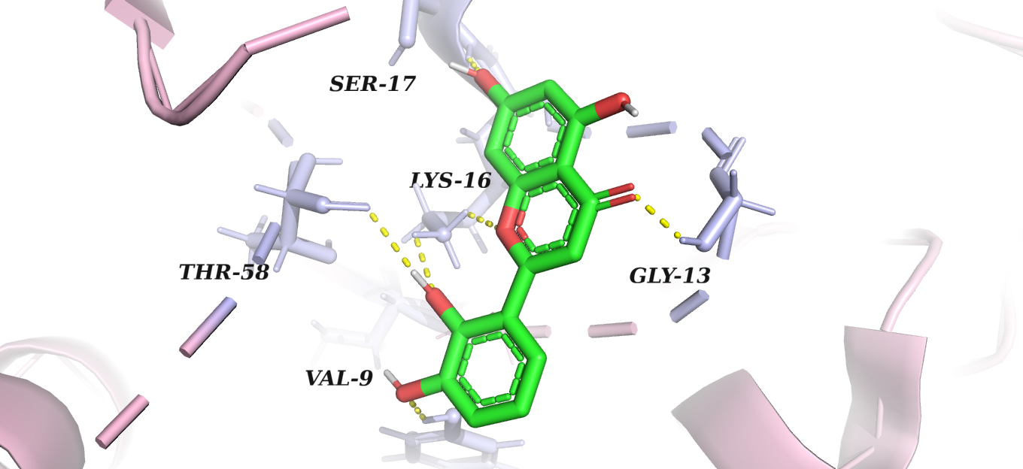
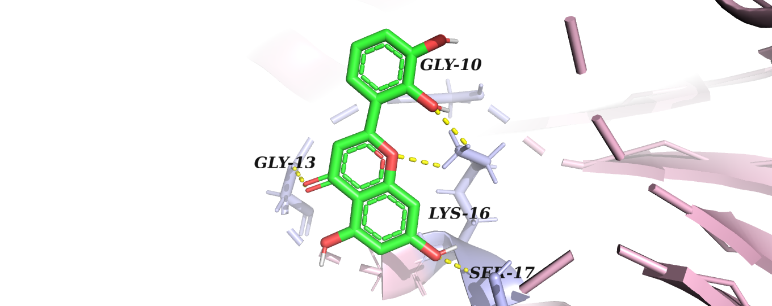
Best Ligand vs Top Ligand
ADMET Analysis Pass/Fail
5321865
Showed Switch-II interactions in both runs
Reproducible binding(best ligand)
Passed all parameters of ADMET
It showed interactions with switch 2 residues in both runs on the other hand the ligand 5321864
was with the lowest binding energy(-8.5 kcal/mol)in both runs but it made bond with the residue THR-58 of switch 2 pocket in just 1 run
That is why the ligand with lowest binding affinity is not always the best ligand.
Ligand PubChem ID | Caco2 Permeability | Hepatotoxicity | Overall ADMET
5321865 | 0.151 (moderate) | No | Clean pass
26213324 | -0.094 (low) | No | Clean pass
5281665 | -0.296 (lowest) | No | Clean pass
12302502 | 1.144 (best) | Yes | Fail(hepatotox)
5281801 | -0.096 (low) | Yes | Fail (hepatotox)
Ligand 5321865
Run 1: Run 2:

Slide 10
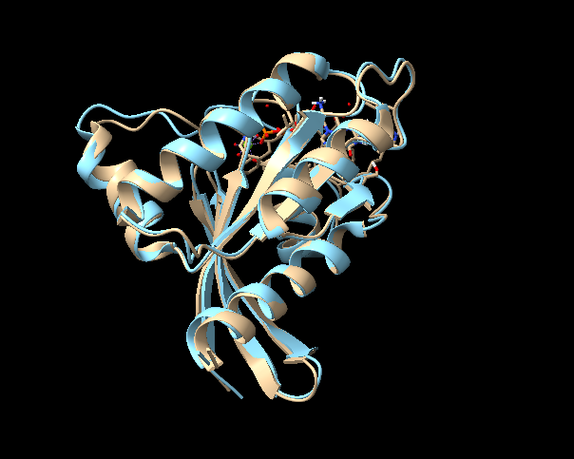
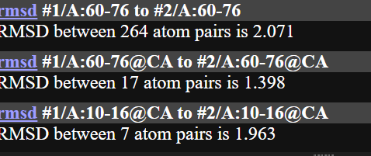
Critical Analysis: Rebutting the AI's Claim
KRAS G12D can be reliably docked using any standard PDB structure of KRAS, since the mutation only changes one amino acid and does not significantly affect the rest of the protein's conformation or pocket geometry.
Claim 1: Any structure works
Comparison | RMSD
Global (4OBE vs 6VJJ) | 0.769 Å
Switch-II region (4OBE vs 6VJJ) | 4.421 Å
Claim 2: Mutation has no significant conformational effect
Mutant model of 4OBE (Chain A) structurally aligned to wild-type 4OBE (unmutated) using ChimeraX.
Region | Type | RMSD
P-loop (10–16) | Cα | 1.963 Å
Switch-II (60–76) | Cα | 1.398 Å
Switch-II (60–76) | All-atom | 2.07 Å
Measurable deviation in regions distal to residue 12.
Contradicts claim of "no significant effect on rest of protein.

Slide 11
Conclusions
GDP-bound 4OBE selected for Switch-II accessibility.
High-quality KRAS G12D mutant generated.
Docking identified reproducible Switch-II binders.
MPD3_01369 selected as the most biologically relevant candidate.
ADMET supported further investigation
Future Perspectives
Experimental testing of MPD3_01369 to confirm its activity against KRAS G12D.
Molecular dynamics simulations to check whether the ligand remains stable in the Switch-II pocket.
Compare with normal KRAS to check whether the ligand is more selective for KRAS G12D.
Cell-based studies to see whether the candidate can reduce KRAS-related cancer signaling.
Further ligand optimization to improve binding and drug-like properties

Slide 12
References
Vatansever, S., et al. (2020). Crystal Structure of GDP-bound Human KRas. PDB ID: 4OBE. RCSB Protein Data Bank. https://doi.org/10.2210/pdb4OBE/pdb
RCSB PDB. Crystal Structure of wild-type KRAS4b (GMPPNP-bound) in complex with RAS-binding domain (RBD) of RAF1/CRAF. PDB ID: 6VJJ. https://doi.org/10.2210/pdb6VJJ/pdb
Pettersen, E. F., et al. (2021). UCSF ChimeraX: Structure visualization for researchers, educators, and developers. Protein Science, 30(1), 70–82.
Trott, O., & Olson, A. J. (2010). AutoDock Vina: Improving the speed and accuracy of docking with a new scoring function, efficient optimization, and multithreading. Journal of Computational Chemistry, 31(2), 455–461.
O'Boyle, N. M., et al. (2011). Open Babel: An open chemical toolbox. Journal of Cheminformatics, 3, 33.
Williams, C. J., et al. (2018). MolProbity: More and better reference data for improved all-atom structure validation. Protein Science, 27(1), 293–315.
Daina, A., Michielin, O., & Zoete, V. (2017). SwissADME: A free web tool to evaluate pharmacokinetics, drug-likeness and medicinal chemistry friendliness of small molecules. Scientific Reports, 7, 42717.
Cox, A. D., Fesik, S. W., Kimmelman, A. C., Luo, J., & Der, C. J. (2014). Drugging the undruggable RAS: Mission possible? Nature Reviews Drug Discovery, 13(11), 828–851.

