Slide 1



















$$2$$
$$A:2$$
$$B:4$$
$$4$$
A
A
$$A:2$$
$$B:4$$
B
$$4$$
$$2$$
B
Blockchain
$$B$$
$$A$$
Channel Creation
$$4$$
$$2$$
Off-chain Transaction
$$2$$
$$4$$
Channel Closure
$$2$$
$$4$$

Slide 2
Tx:0xf462f6…
inputs
outputs
#1
#1
Tx:0xf02bf4…
Tx:0x45a67…
#2
ScriptSig_0
inputs
outputs
Value : 2
ScriptPubKey_1
#1
#1
#2
Value : 1
ScriptPubKey_4
Tx:0xf462f6
#1
ScriptSig_1
#2
Value: 0.3
ScriptPubKey_2
#2
Tx:0xb568a…
#6
ScriptSig_01
#3
Value : 0.99
ScriptPubKey_5
Value: 0.1
ScriptPubKey_3

Slide 3
ScriptPubKey: locked with <PubKey_A>
ScriptSig: Signature of A
ScriptPubKey: locked with <PubKey_A> & <PubKey_B>
ScriptSig: Signature of A & signature of B

Slide 4
Tx2
State_0 Transaction
Tx1
Channel Creation Transaction
outputs
outputs
inputs
Value : 2
pubKey_A
Tx:0xf223a…
inputs
outputs
Value : 2
pubKey_A
Tx:0xf223a…
Sig_A
&
Sig_B
ScriptSig_A
Value : 6
pubKey_A
&
pubKey_B
outputs
Value : 4
pubKey_B
Value : 4
pubKey_B
ScriptSig_B
Valid from Dec 31
Value : …
…

Slide 5
Tx4
State_2 Transaction
Tx3
State_1 Transaction
inputs
outputs
inputs
outputs
Value : 5
pubKey_A
Value : 3
pubKey_A
Tx:0xf223a…
Sig_A
&
Sig_B
Tx:0xf223a…
Sig_A
&
Sig_B
Value : 1
pubKey_B
Value : 3
pubKey_B
Valid from Dec 29
Valid from Dec 30

Slide 6
Tx1
Channel Creation Transaction
Tx4
State_2 Transaction
outputs
Value : 2
pubKey_A
Tx:0xf223a…
inputs
outputs
inputs
outputs
Value : 5
pubKey_A
Tx:0xf223a…
Sig_A
&
Sig_B
ScriptSig_A
Value : 6
pubKey_A
&
pubKey_B
outputs
Value : 1
pubKey_B
Value : 4
pubKey_B
ScriptSig_B
Valid from Dec 29
Value : …
…

Slide 7


A-B channel
inputs
outputs
Value : 1
pubKey_A
$Before$ $t_{0}$
Value : 5
pubKey_B
Provide r| H(r)=h
Tx:0xf223a…
Sig_A
&
Sig_B
Valid from …
$After$ $t_{0}$
Value : 2
pubKey_A
Value : 4
pubKey_B
inputs
outputs
Tx:0xf223a…
Sig_B
&
Sig_C
Value : 5
pubKey_B
Value : 1
pubKey_C
Provide r| H(r)=h
Valid from Dec 29

Slide 8
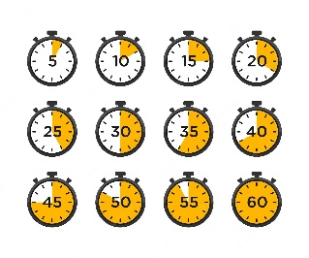


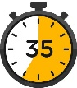









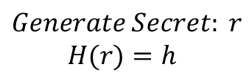






$$B$$
$$2$$
$$3$$
$$4$$
$$7$$
Unlocks if B provides r such that H(r)=h before the timeout
Unlocks if C provides r such that H(r)=h before the timeout
$$A$$
$$C$$
$$Generate Secret: r$$
$$H(r)=h$$
$$1 BTC$$
$$3$$
$$1 BTC$$
$$h$$
$$2$$
$$4$$
$$7$$

Slide 9















$$1 BTC$$
$$2$$
$$1 BTC$$
$$2$$
$$r$$
$$4$$
$$8$$
$$1 BTC$$
$$2$$
$$1 BTC$$
$$3$$
$$r$$
$$3$$
$$8$$

Slide 10








$$1 BTC$$
$$2$$
$$1 BTC$$
$$3$$
$$3$$
$$r$$
$$8$$

