Slide 1
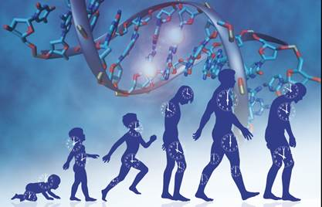
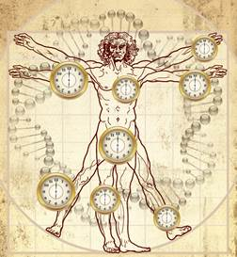
DNA methylation age of human tissues and cell types.
Genome Biol. 2013 14(10):R115 PMID: 24138928

Slide 2
Statistical goal and challenge
Goal: Build an age prediction method based on tens of thousands of variables
  dependent variable y= transformed version of chronological age (in years)
  covariates= CpGs
  Approach: Penalized regression (elastic net)
Challenge: how to combine multiple training data generated by different labs etc

Slide 3
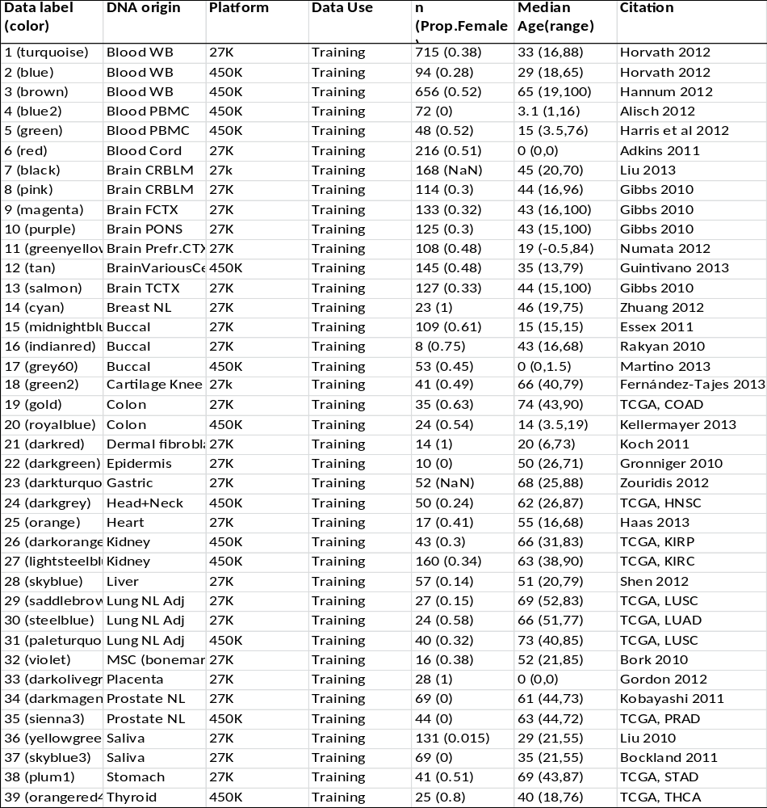
Training data sets

Slide 4
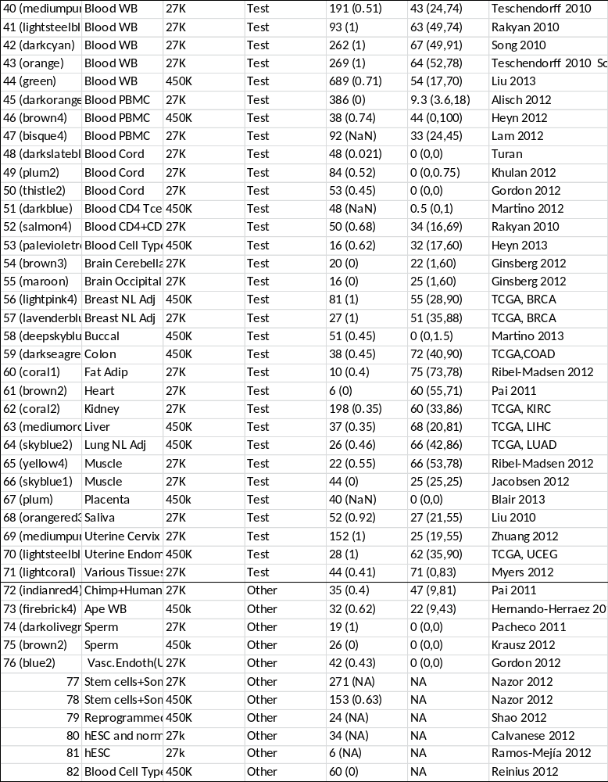
Test data sets

Slide 5
Construction of the epigenetic clock
assembled a large DNA methylation data set by combining publicly available individual data sets measured on the Illumina 27K or Illumina 450K array platform.
training+test data involved n=7844 non-cancer samples from 82 individual data sets which assess DNA methylation levels in 51 different tissues and cell types.
Although many data sets were collected for studying certain diseases, they largely involved healthy tissues.
  In particular, cancer tissues were excluded

Slide 6
Illumina data sets
The first 39 data sets were used to construct ("train") the age predictor.
Data sets 40-71 were used to test (validate) the age predictor.
Data sets 72-82 served other purposes e.g. to estimate the DNAm age of embryonic stem and iPS cells.
Training data were chosen i) to represent a wide spectrum of tissues/cell types, ii) to involve samples whose mean age (43 years) is similar to that in the test data, and iii) to involve a high proportion of samples (37%) measured on the Illumina 450K platform since many on-going studies use this recent Illumina platform.
Only studied 21369 CpGs (measured with the Infinium type II assay) which were present on both Illumina platforms (Infinium 450K and 27K) and had fewer than 10 missing values across the data sets.

Slide 7
Age predictor
To ensure an unbiased validation in the test data, only used the training data to define the age predictor.
A transformed version of chronological age was regressed on the CpGs using a penalized regression model (elastic net).
The elastic net regression model automatically selected 353 CpGs.
I refer to the 353 CpGs as (epigenetic) clock CpGs since their weighted average (formed by the regression coefficients) amounts to an epigenetic clock.

Slide 8
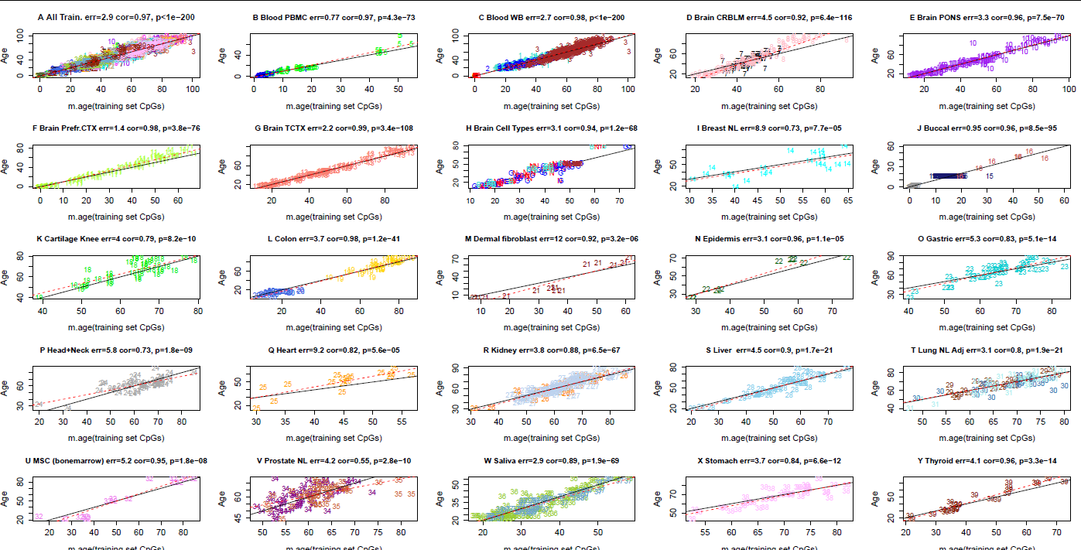
Accuracy across tissues and cell types (training)

Slide 9
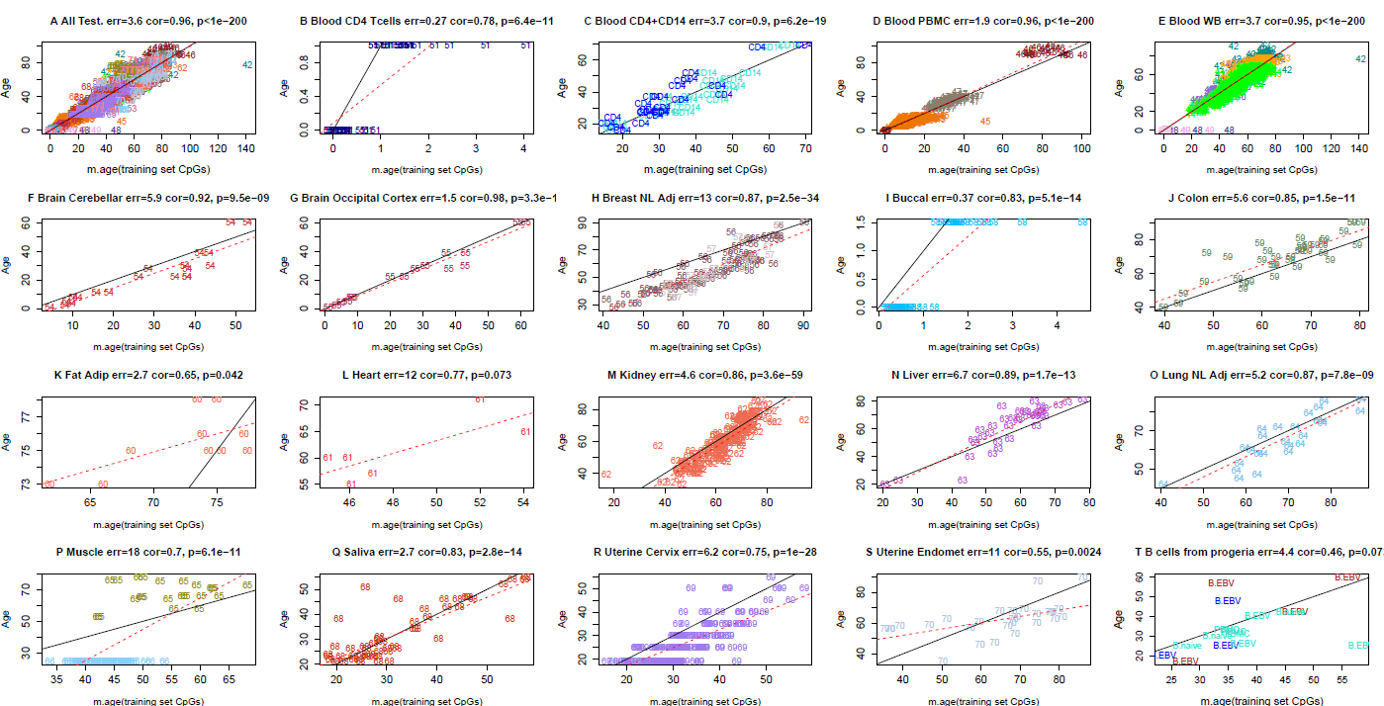
Accuracy across test data

Slide 10
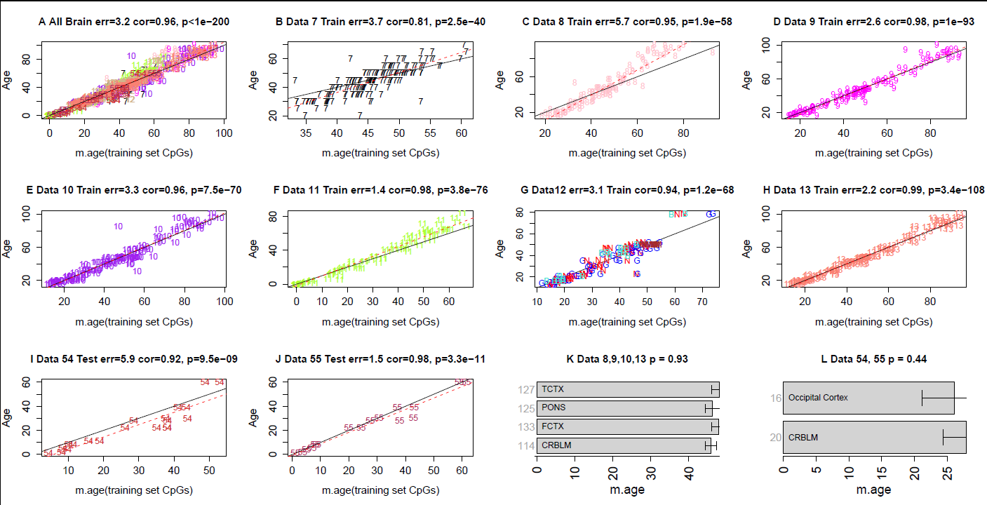
Accuracy in brain tissue

Slide 11
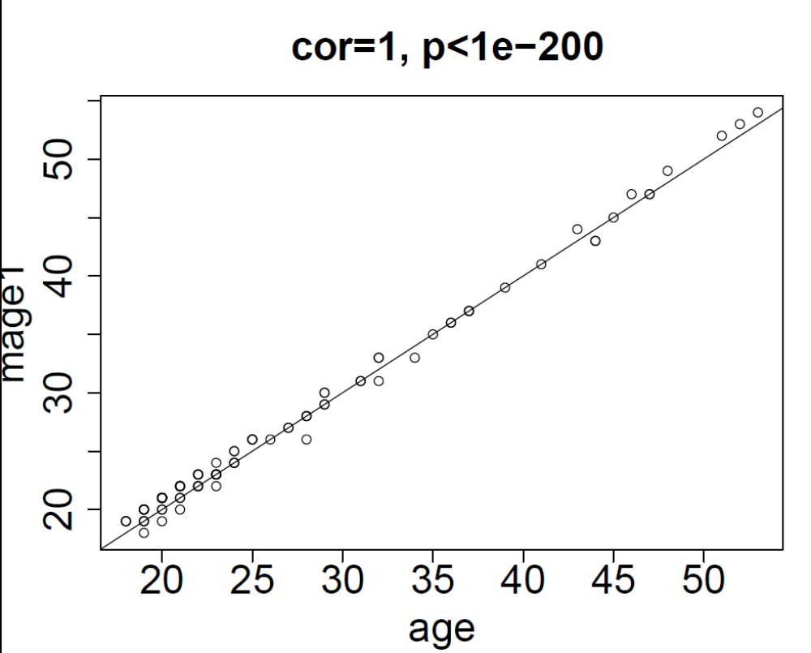
Results send to me via email
Blood data from Marco Boks Jan 2014

Slide 12
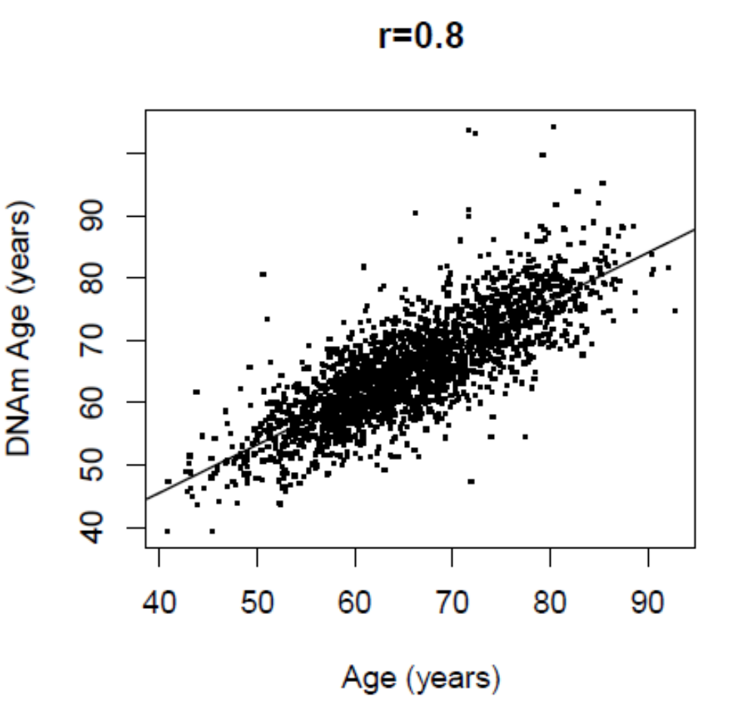
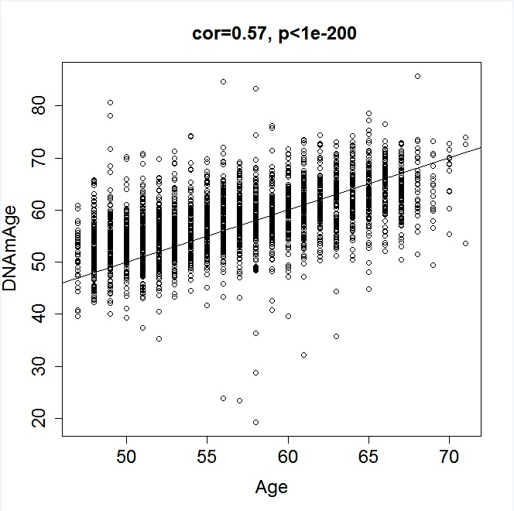
Excerpts from emails
Epigenetic clock applied to large cohort studies
Median error is less than 3.5 years.

Slide 13
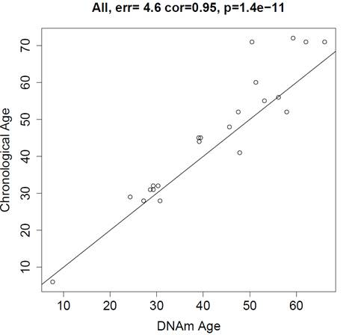
Aging clock applied to urine
This figure, created by bioinformatician Wei Guo at Zymo Research

Slide 14
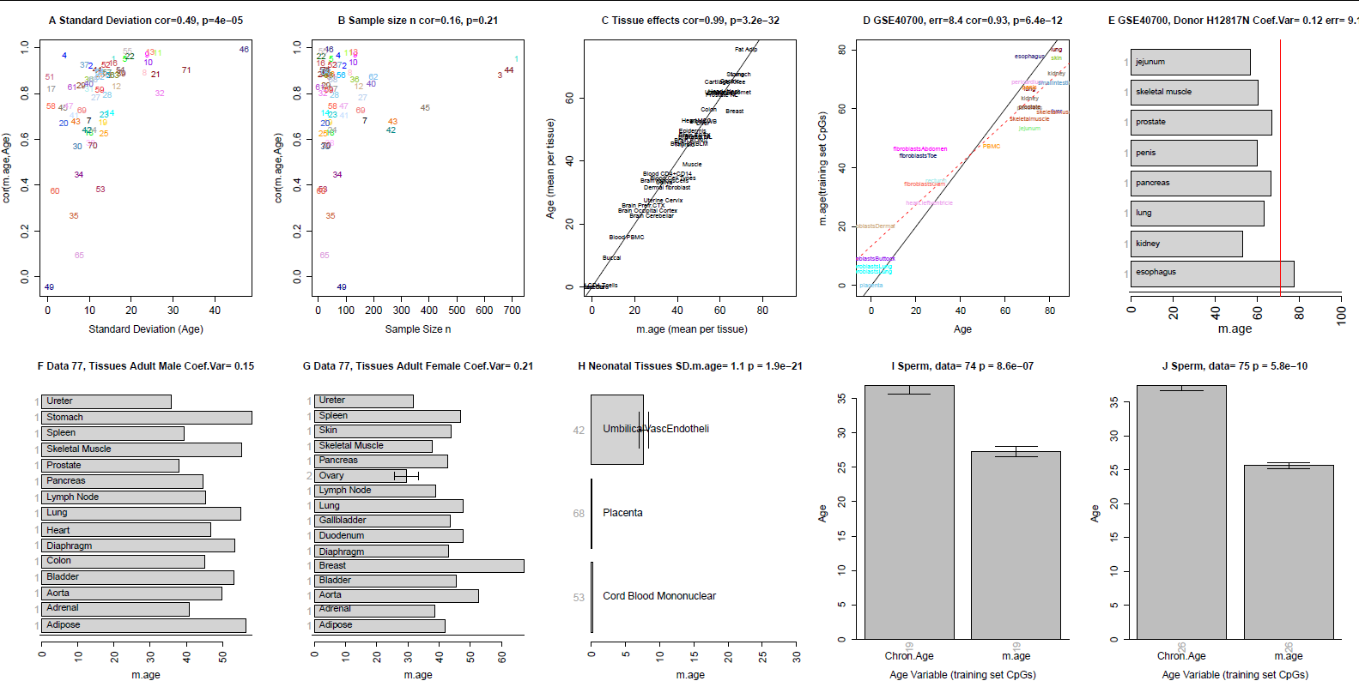
Factors influencing accuracy: standard deviation of age, tissue

Slide 15
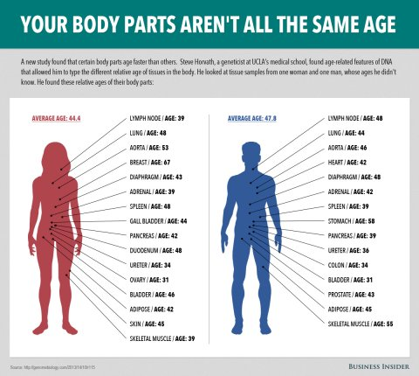
Using the clock for measuring the age of different parts of the body

Slide 16
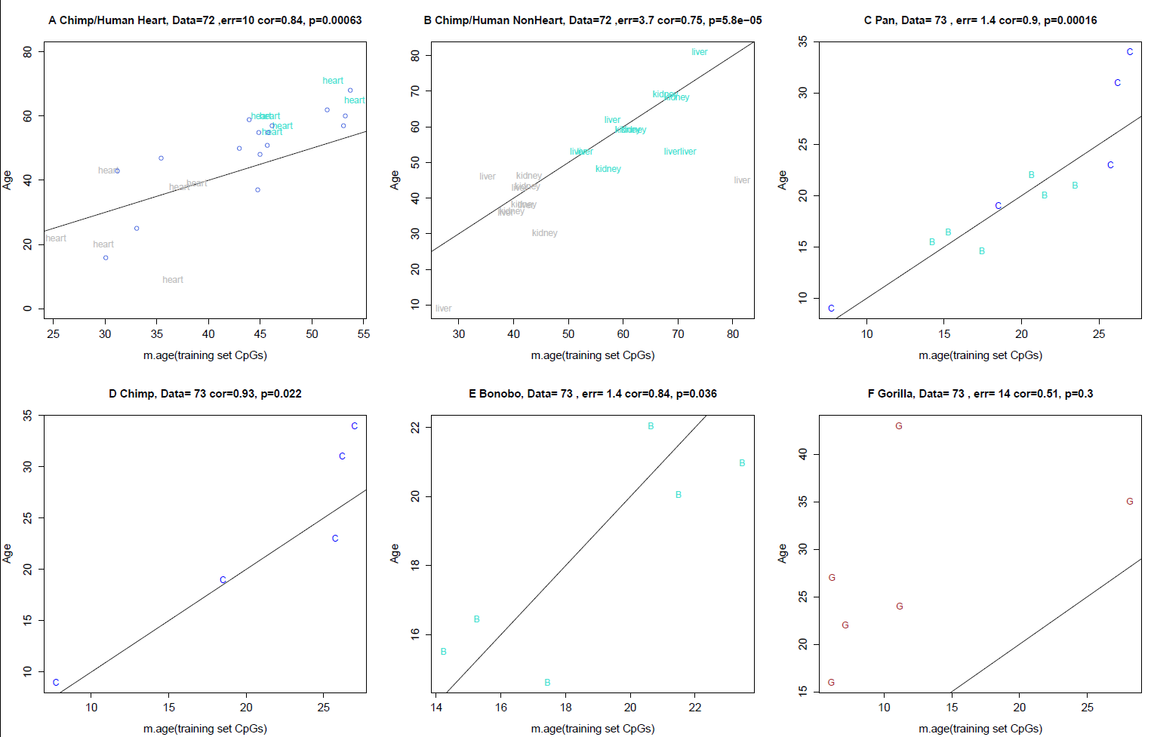
The clock works in the genus pan: common chimpanzees+bonobos

Slide 17
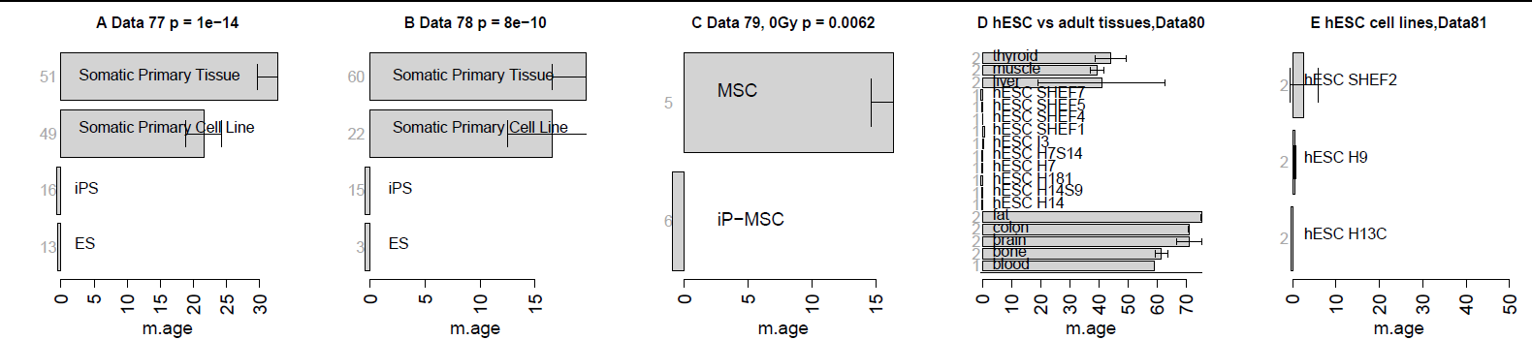
ES cells and iPS cells are perfectly young

Slide 18
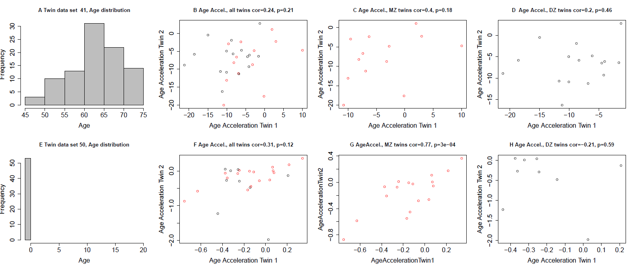
Heritability (based on twin studies) of age acceleration is 40% in older subjects and 100% in newborns
Rows correspond to 2 different twin data sets
Red dots=monozygotic twin pair
Black dots=dizygotic twin pair

Slide 19
Conclusions
Most studies that involved telomere length and other biomarkers can be revisited
User friendly software can be found on my webpage
  I recommend the online age calculator since it outputs a host of array quality statistics that can be used to identify samples where the age prediction may not be accurate.
    Data get deleted right after you upload them.
  Don't pre-process data too much. Don't remove batch effects, etc. Raw beta values will be fine.
I am always happy to collaborate.

