Slide 1
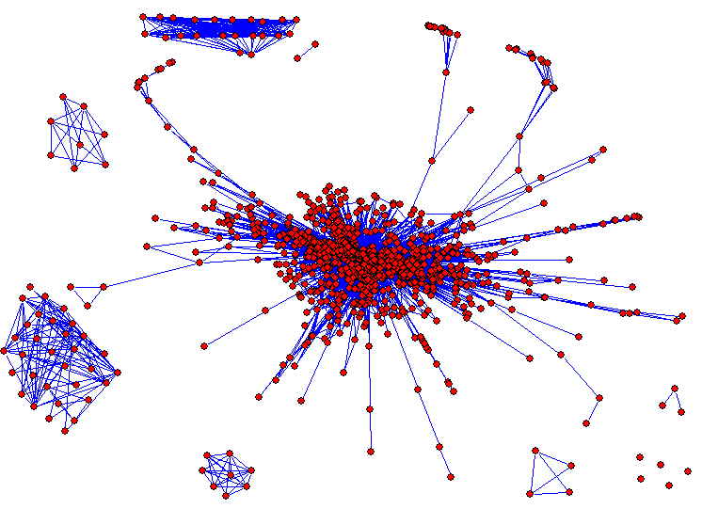
Hierarchical Clustering and Dynamic Branch Cutting
Peter Langfelder
Dept. of Human Genetics, UCLA
Notes:
Thank you, thank you all for coming, it's great to be here. As my title says, I'll try to convince you that, strange as it may sound, studying millions, actually closer to a billion, correlations is a good way to learn about biology.

Slide 2
Outline
What is clustering?
Brief overview of various clustering methods
Hierarchical clustering
Cluster identification in hierarchical clustering trees
  Fixed-height tree cut
  Adaptive-height tree cut (Dynamic Tree Cut)
Notes:
Before we all get tangled in massive gene networks, here's the outline of my talk so you know where we're going. I'll start with a brief overview of Weighted Gene Co-expression Network Analysis, WGCNA, and I'll show you an example application to brain cancer data. I will only talk about gene expression data but the methods are applicable to many other types of data as well.
I will then describe statistics for quantifying preservation of network modules between two independent data sets, and I'll illustrate them on the example of modules that relate to HDL cholesterol.
And lastly I will talk about methods for finding consensus modules, that is modules present in each of a given series of input data sets. I will show you an example where the consensus modules help study functional categories associated with survival time in lung cancer patients.

Slide 3
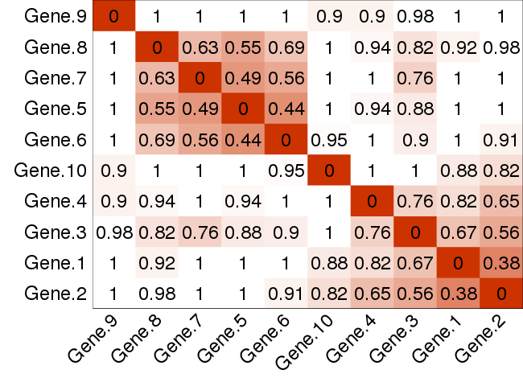
What is clustering?
Input: pair-wise dissimilarities between objects
Notes:
I'll start with a few general words about weighted network analysis. It is best to think of WGCNA as a set of tools to analyze high-dimensional data, meaning thousands of variables across a given number of samples, ideally at least 20 but more is better.

Slide 4
What is clustering?
Input: pair-wise dissimilarities between objects
Aim: find clusters (groups) of objects that are closely related according to the given (dis-)similarity measure
Notes:
I'll start with a few general words about weighted network analysis. It is best to think of WGCNA as a set of tools to analyze high-dimensional data, meaning thousands of variables across a given number of samples, ideally at least 20 but more is better.

Slide 5
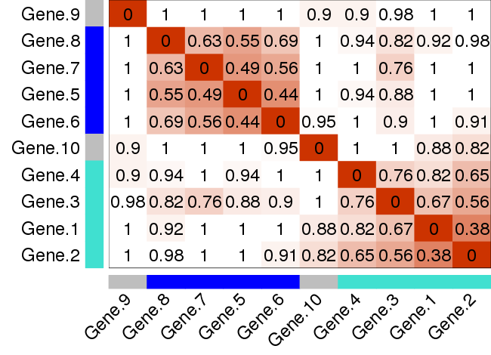
What is clustering?
Input: pair-wise dissimilarities between objects
Aim: find clusters (groups) of objects that are closely related according to the (dis-)similarity measure
Output: a cluster label for each object
Notes:
I'll start with a few general words about weighted network analysis. It is best to think of WGCNA as a set of tools to analyze high-dimensional data, meaning thousands of variables across a given number of samples, ideally at least 20 but more is better.

Slide 6
Clustering example for non-experts
Example:
  Objects = people living in California
  Dissimilarity = geographical distance of their homes
Resulting clusters = groups of people who live close to one another : cities, towns, neighborhoods
Question: how to assign people who live outside of towns and cities?
Notes:
I'll start with a few general words about weighted network analysis. It is best to think of WGCNA as a set of tools to analyze high-dimensional data, meaning thousands of variables across a given number of samples, ideally at least 20 but more is better.

Slide 7
How to deal with objects that are far from clusters?
Three possible answers:
  Create a separate cluster for each outlying object
  Assign them to the nearest cluster
  Leave them “unassigned”
Most clustering methods produce a partition in which every object is assigned to a cluster
Sometimes this is desirable: for example, assigning people to the nearest town is good for the mail delivery service
In biomedical applications it is often a bad idea
Notes:
I'll start with a few general words about weighted network analysis. It is best to think of WGCNA as a set of tools to analyze high-dimensional data, meaning thousands of variables across a given number of samples, ideally at least 20 but more is better.

Slide 8
Applications of clustering in biomedical research
Clustering of patients
  Discovery of subtypes of heterogeneous diseases such as cancer, neurological diseases, etc
Clustering of high-throughput molecular phenotypes (measurements) such as gene expression, methylation, proteomic, metabolomic etc.
  Part of network analysis techniques (WGCNA)
  Discovery of transcriptional, methylation organization of genome, protein complexes, etc.
Notes:
I'll start with a few general words about weighted network analysis. It is best to think of WGCNA as a set of tools to analyze high-dimensional data, meaning thousands of variables across a given number of samples, ideally at least 20 but more is better.

Slide 9
There are many clustering methods!
K-means, Partitioning Around Medoids (PAM), Self-Organizing Maps (SOM), Model-based clustering approaches, multitude of other methods
Hierarchical clustering: good method for exploratory data analysis because it works well with high-dimensional data, provides visualization, does not require specifying number of clusters beforehand
Notes:
I'll start with a few general words about weighted network analysis. It is best to think of WGCNA as a set of tools to analyze high-dimensional data, meaning thousands of variables across a given number of samples, ideally at least 20 but more is better.

Slide 10
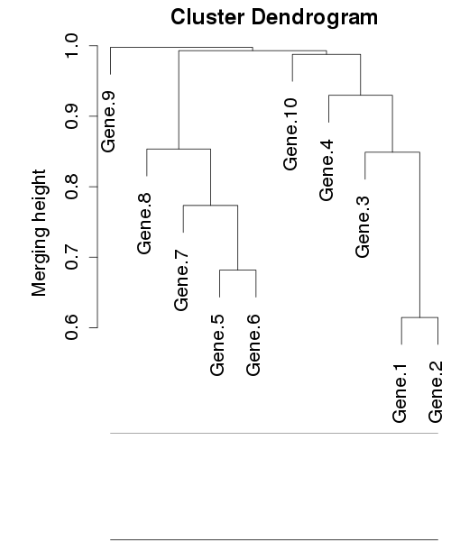
Cluster identification using hierarchical clustering
Two-step process:
  Construct a hierarchical clustering tree (dendrogram) that provides information on how objects are iteratively merged together
Notes:
I'll start with a few general words about weighted network analysis. It is best to think of WGCNA as a set of tools to analyze high-dimensional data, meaning thousands of variables across a given number of samples, ideally at least 20 but more is better.

Slide 11
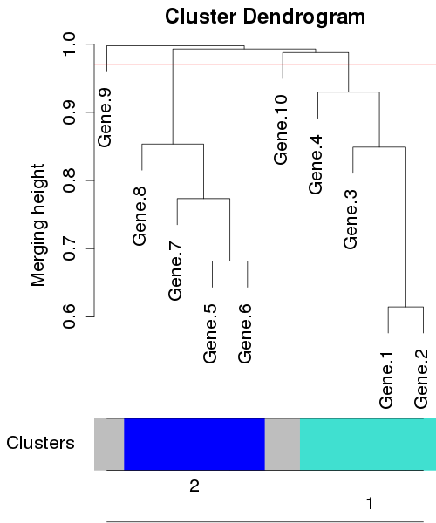
Cluster identification using hierarchical clustering
Two-step process:
  Construct a hierarchical clustering tree (dendrogram) that provides information on how objects are iteratively merged together
  Identify branches that correspond to clusters
  Label branches by numbers or colors
Notes:
I'll start with a few general words about weighted network analysis. It is best to think of WGCNA as a set of tools to analyze high-dimensional data, meaning thousands of variables across a given number of samples, ideally at least 20 but more is better.

Slide 12
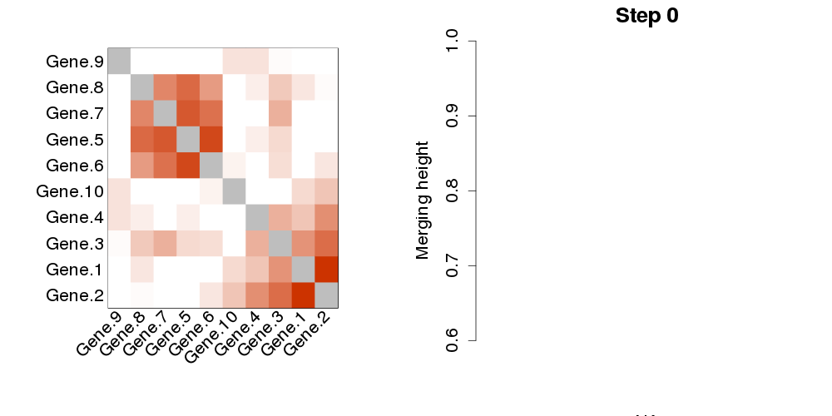
Hierarchical clustering cartoon
Clustering of 10 simulated objects (say gene expression profiles)
Start with (dis-)similarity matrix
White: distant (dissimilar) objects
Red: close (similar) objects
Notes:
I'll start with a few general words about weighted network analysis. It is best to think of WGCNA as a set of tools to analyze high-dimensional data, meaning thousands of variables across a given number of samples, ideally at least 20 but more is better.

Slide 13
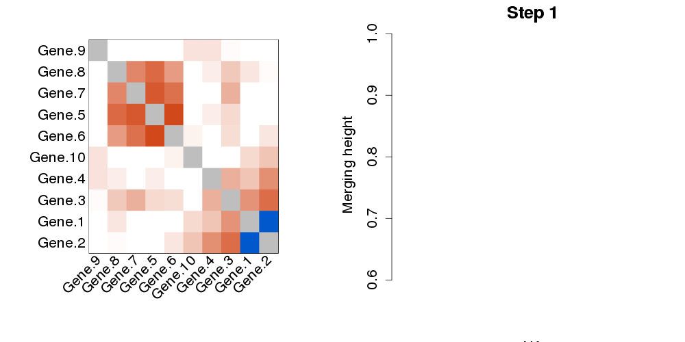
Hierarchical clustering cartoon
Find the two closest objects (here Gene.1 and Gene.2)...
Notes:
I'll start with a few general words about weighted network analysis. It is best to think of WGCNA as a set of tools to analyze high-dimensional data, meaning thousands of variables across a given number of samples, ideally at least 20 but more is better.

Slide 14
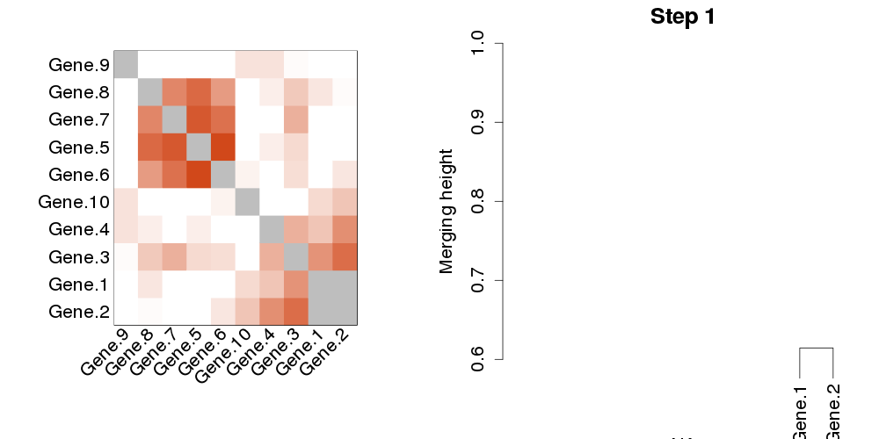
Hierarchical clustering cartoon
Find the two closest objects (here Gene.1 and Gene.2)...
...and merge them
Notes:
I'll start with a few general words about weighted network analysis. It is best to think of WGCNA as a set of tools to analyze high-dimensional data, meaning thousands of variables across a given number of samples, ideally at least 20 but more is better.

Slide 15
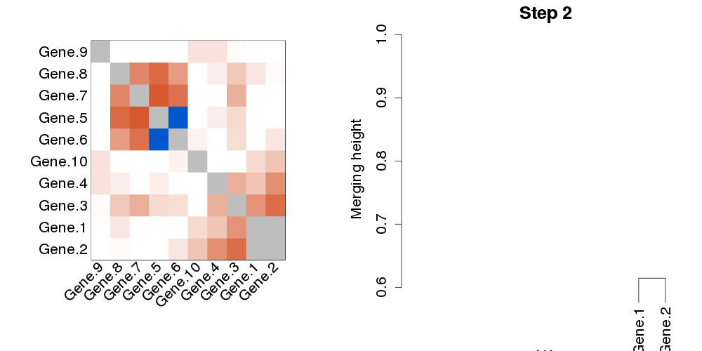
Hierarchical clustering cartoon
Find the next two closest objects...
Notes:
I'll start with a few general words about weighted network analysis. It is best to think of WGCNA as a set of tools to analyze high-dimensional data, meaning thousands of variables across a given number of samples, ideally at least 20 but more is better.

Slide 16
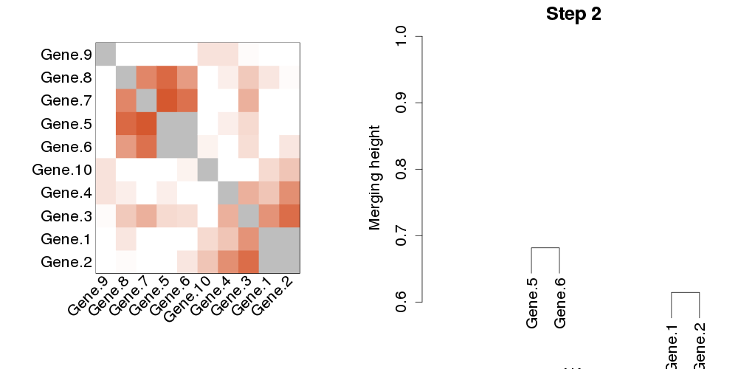
Hierarchical clustering cartoon
Find the next two closest objects... ...and merge them
Notes:
I'll start with a few general words about weighted network analysis. It is best to think of WGCNA as a set of tools to analyze high-dimensional data, meaning thousands of variables across a given number of samples, ideally at least 20 but more is better.

Slide 17
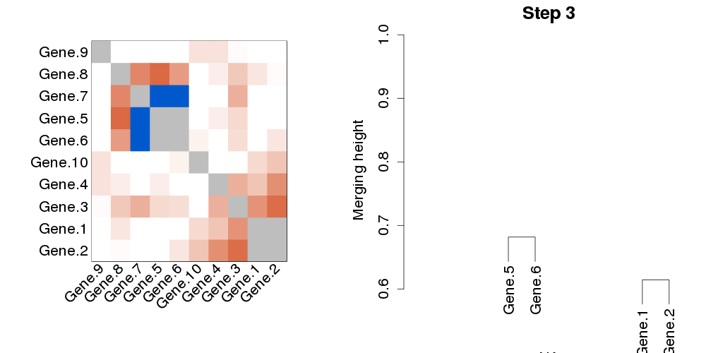
Hierarchical clustering cartoon
Two closest objects again: Gene.7 and the 5-6 cluster
Notes:
I'll start with a few general words about weighted network analysis. It is best to think of WGCNA as a set of tools to analyze high-dimensional data, meaning thousands of variables across a given number of samples, ideally at least 20 but more is better.

Slide 18
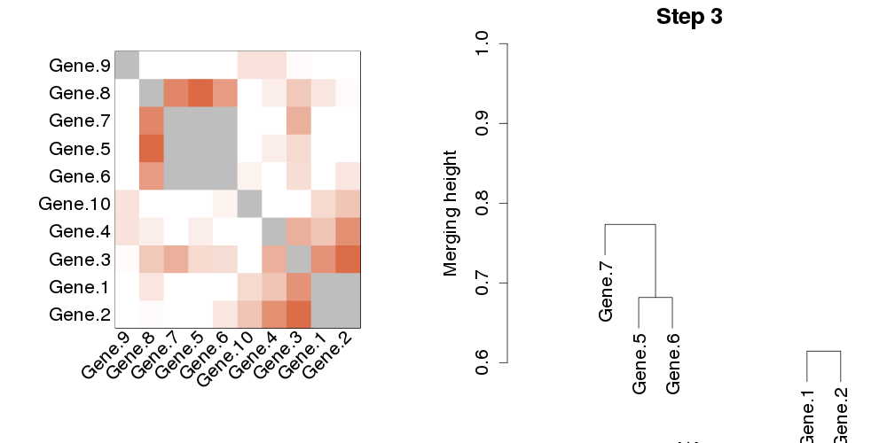
Hierarchical clustering cartoon
Merge Gene.7 with the 5-6 branch
Notes:
I'll start with a few general words about weighted network analysis. It is best to think of WGCNA as a set of tools to analyze high-dimensional data, meaning thousands of variables across a given number of samples, ideally at least 20 but more is better.

Slide 19
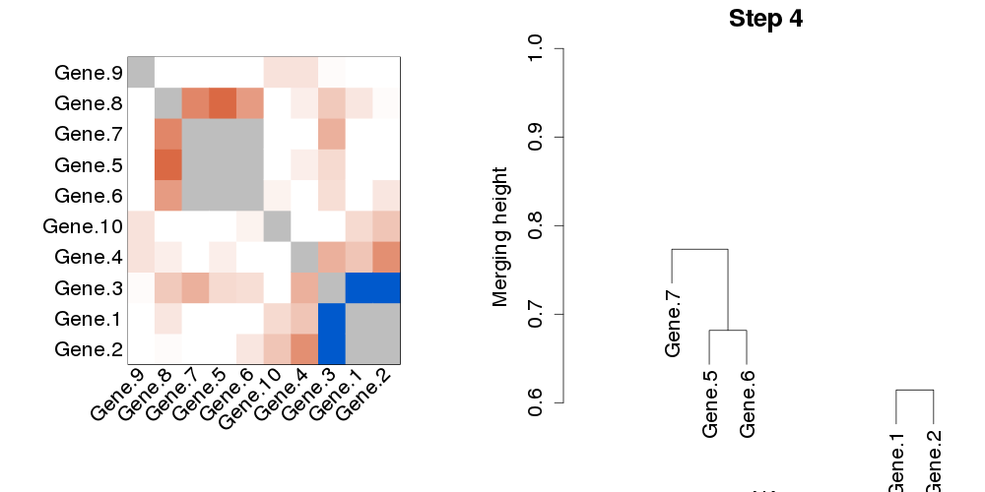
Hierarchical clustering cartoon
Next: Gene.3 and 1-2 cluster
Notes:
I'll start with a few general words about weighted network analysis. It is best to think of WGCNA as a set of tools to analyze high-dimensional data, meaning thousands of variables across a given number of samples, ideally at least 20 but more is better.

Slide 20
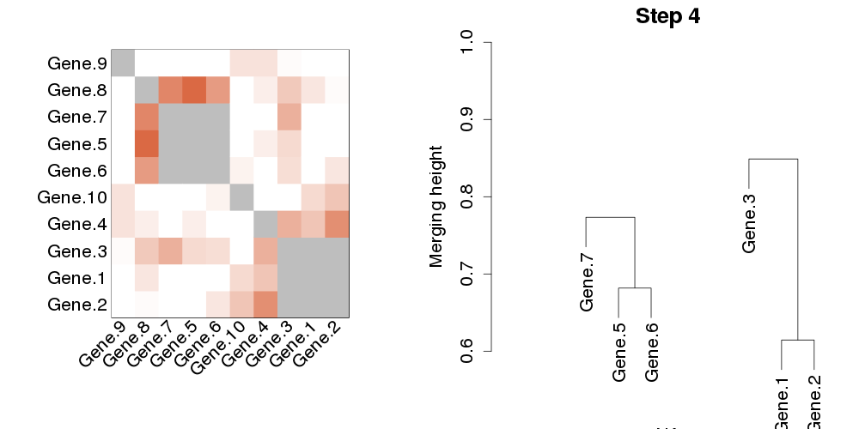
Hierarchical clustering cartoon
Next: Gene.3 and 1-2 cluster
Notes:
I'll start with a few general words about weighted network analysis. It is best to think of WGCNA as a set of tools to analyze high-dimensional data, meaning thousands of variables across a given number of samples, ideally at least 20 but more is better.

Slide 21
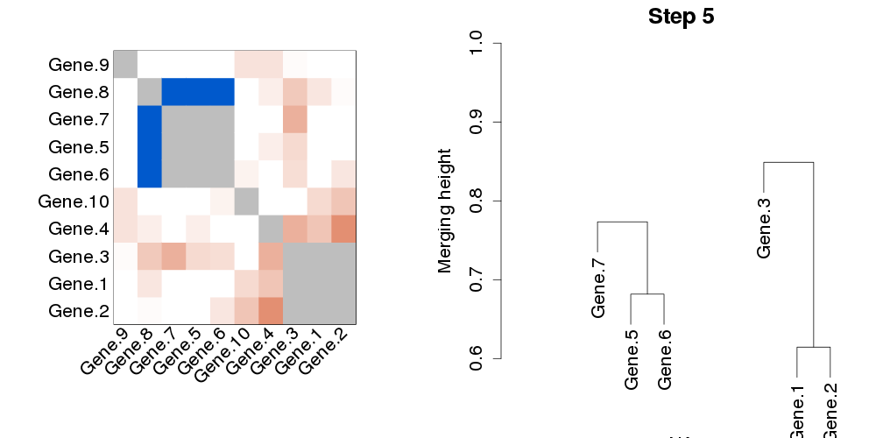
Hierarchical clustering cartoon
Closest: Gene.8 and 5-6-7 cluster
Notes:
I'll start with a few general words about weighted network analysis. It is best to think of WGCNA as a set of tools to analyze high-dimensional data, meaning thousands of variables across a given number of samples, ideally at least 20 but more is better.

Slide 22
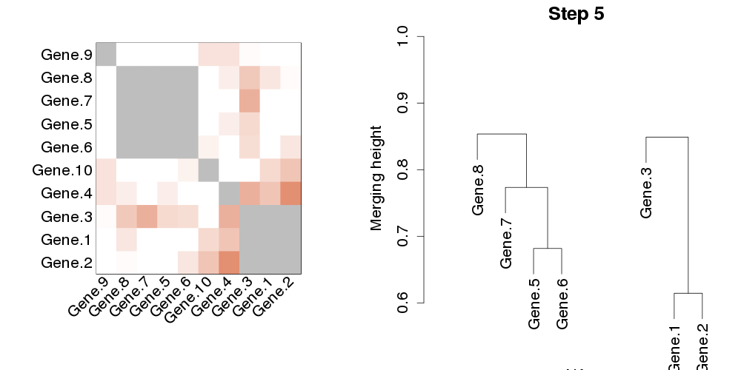
Hierarchical clustering cartoon
Gene.8 and 5-6-7 cluster
Notes:
I'll start with a few general words about weighted network analysis. It is best to think of WGCNA as a set of tools to analyze high-dimensional data, meaning thousands of variables across a given number of samples, ideally at least 20 but more is better.

Slide 23
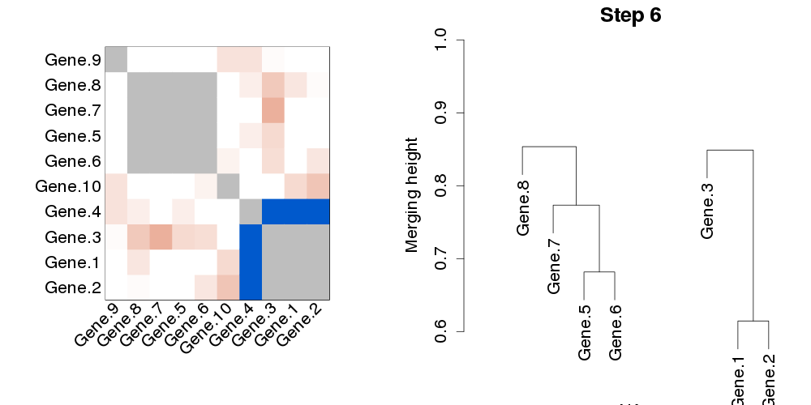
Hierarchical clustering cartoon
Closest: Gene.4 and 1-2-3 cluster
Notes:
I'll start with a few general words about weighted network analysis. It is best to think of WGCNA as a set of tools to analyze high-dimensional data, meaning thousands of variables across a given number of samples, ideally at least 20 but more is better.

Slide 24
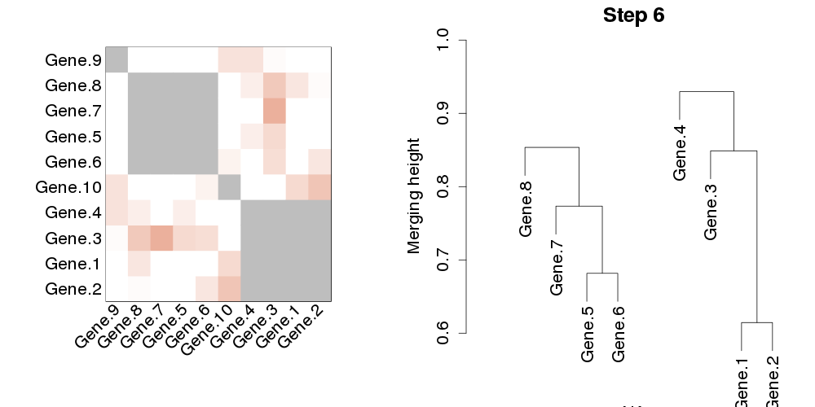
Hierarchical clustering cartoon
Merge Gene.4 and 1-2-3 cluster
Notes:
I'll start with a few general words about weighted network analysis. It is best to think of WGCNA as a set of tools to analyze high-dimensional data, meaning thousands of variables across a given number of samples, ideally at least 20 but more is better.

Slide 25
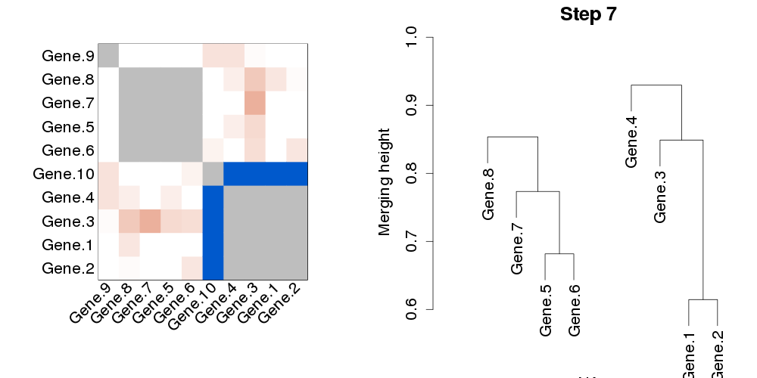
Hierarchical clustering cartoon
Closest: Gene.10 and 1-2-3-4 cluster
Notes:
I'll start with a few general words about weighted network analysis. It is best to think of WGCNA as a set of tools to analyze high-dimensional data, meaning thousands of variables across a given number of samples, ideally at least 20 but more is better.

Slide 26
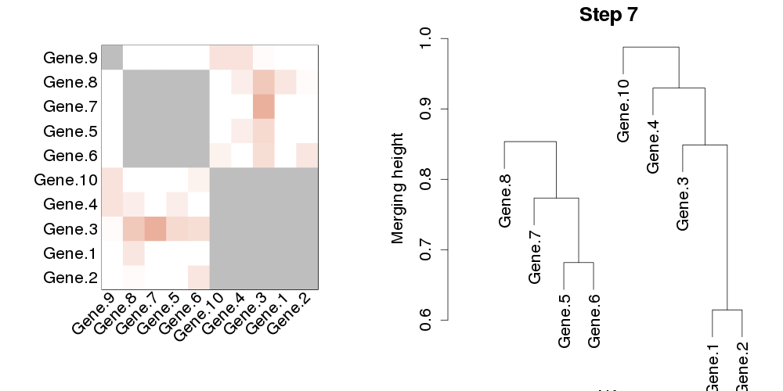
Hierarchical clustering cartoon
Merge Gene.10 and 1-2-3-4 cluster
Notes:
I'll start with a few general words about weighted network analysis. It is best to think of WGCNA as a set of tools to analyze high-dimensional data, meaning thousands of variables across a given number of samples, ideally at least 20 but more is better.

Slide 27
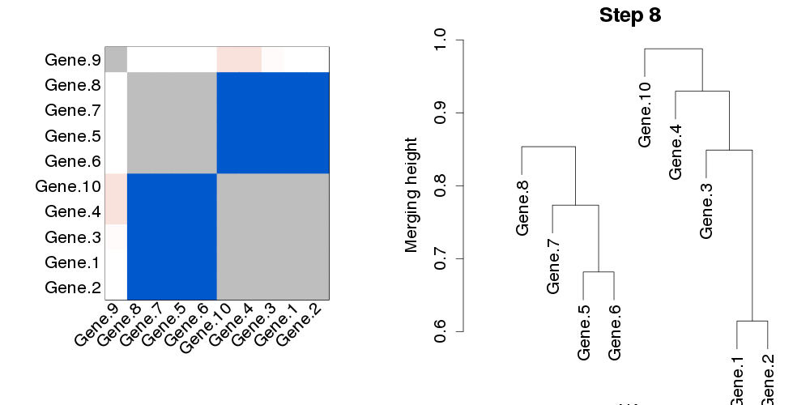
Hierarchical clustering cartoon
Closest: Clusters 1-2-3-4-10 and 5-6-7-8
Notes:
I'll start with a few general words about weighted network analysis. It is best to think of WGCNA as a set of tools to analyze high-dimensional data, meaning thousands of variables across a given number of samples, ideally at least 20 but more is better.

Slide 28
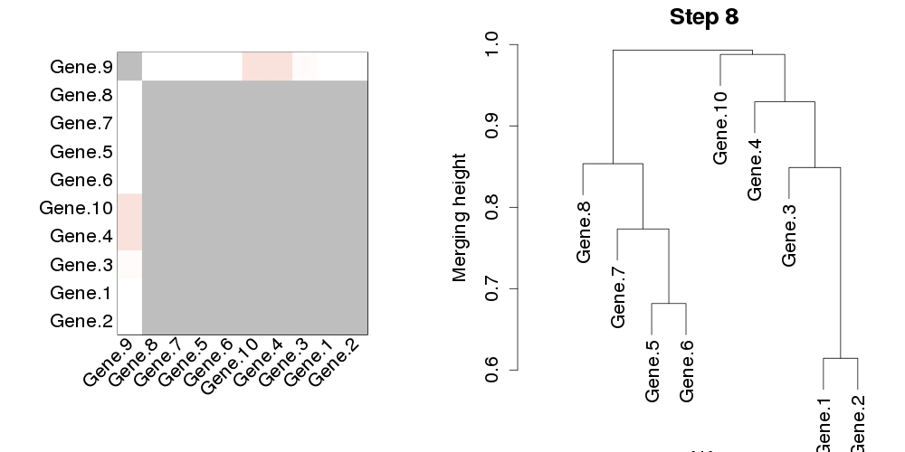
Hierarchical clustering cartoon
Merge Clusters 1-2-3-4-10 and 5-6-7-8
Notes:
I'll start with a few general words about weighted network analysis. It is best to think of WGCNA as a set of tools to analyze high-dimensional data, meaning thousands of variables across a given number of samples, ideally at least 20 but more is better.

Slide 29
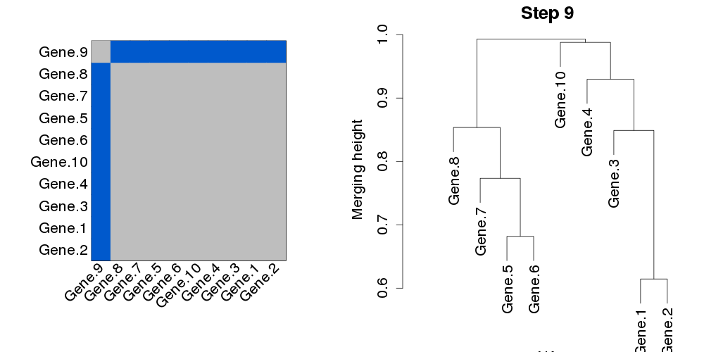
Hierarchical clustering cartoon
Closest: Gene.9 and the large cluster (1-2-3-4-5-6-7-8-10)
Notes:
I'll start with a few general words about weighted network analysis. It is best to think of WGCNA as a set of tools to analyze high-dimensional data, meaning thousands of variables across a given number of samples, ideally at least 20 but more is better.

Slide 30
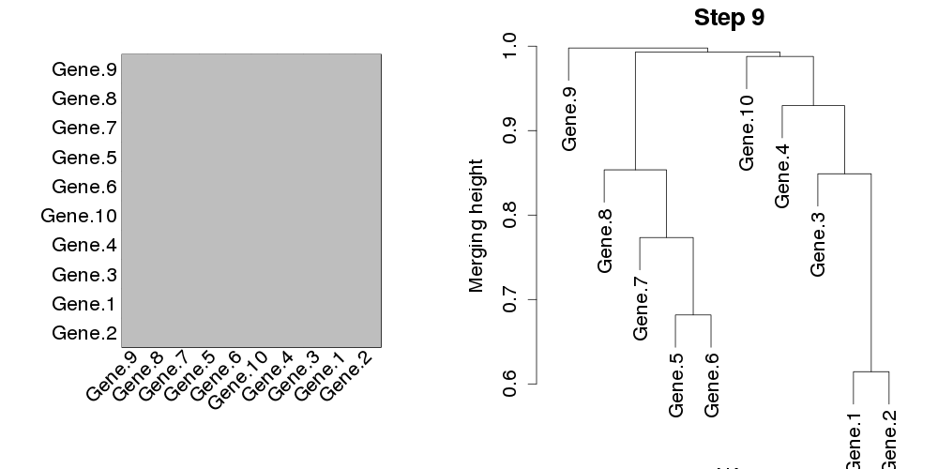
Hierarchical clustering cartoon
Merge Gene.9 and the large cluster (1-2-3-4-5-6-7-8-10)
The clustering ends, we have a complete tree
Notes:
I'll start with a few general words about weighted network analysis. It is best to think of WGCNA as a set of tools to analyze high-dimensional data, meaning thousands of variables across a given number of samples, ideally at least 20 but more is better.

Slide 31
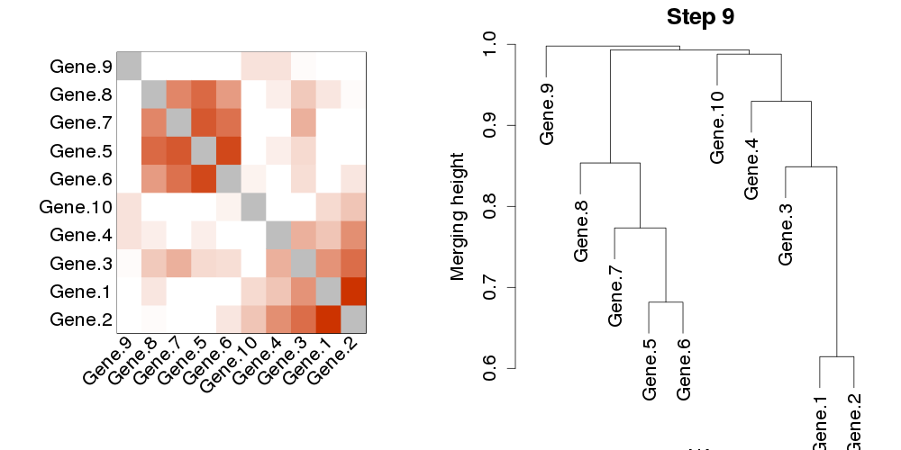
Final hierarchical clustering tree a.k.a. dendrogram
Notes:
I'll start with a few general words about weighted network analysis. It is best to think of WGCNA as a set of tools to analyze high-dimensional data, meaning thousands of variables across a given number of samples, ideally at least 20 but more is better.

Slide 32
Multiple versions of hierarchical clustering
Different version of hierarchical clustering differ in how they measure dissimilarity between an object and a cluster
Average linkage: average the dissimilarities between all objects
Single linkage: take the minimum dissimilarity
Complete linkage: take the maximum dissimilarity
Other choices are available
Notes:
I'll start with a few general words about weighted network analysis. It is best to think of WGCNA as a set of tools to analyze high-dimensional data, meaning thousands of variables across a given number of samples, ideally at least 20 but more is better.

Slide 33
Hierarchical clustering in R
Function hclust in (standard) package stats
Two important arguments:
  d: distance structure representing dissimilarities between objects
  method: hierarchical clustering version. We usually use "average".
Result: a hierarchical clustering tree that can be displayed using plot(...) or used as input to other functions such as tree cutting functions
Alternative for very large data sets: hclust from package fastcluster
Notes:
I'll start with a few general words about weighted network analysis. It is best to think of WGCNA as a set of tools to analyze high-dimensional data, meaning thousands of variables across a given number of samples, ideally at least 20 but more is better.

Slide 34
How to identify clusters in hierarchical clustering trees?
"Tree cutting", "Branch pruning" of hierarchical clustering trees
Notes:
I'll start with a few general words about weighted network analysis. It is best to think of WGCNA as a set of tools to analyze high-dimensional data, meaning thousands of variables across a given number of samples, ideally at least 20 but more is better.

Slide 35
Identifying clusters in dendrograms
Visual impression: there are two clusters (branches of the hierarchical tree)
Notes:
I'll start with a few general words about weighted network analysis. It is best to think of WGCNA as a set of tools to analyze high-dimensional data, meaning thousands of variables across a given number of samples, ideally at least 20 but more is better.

Slide 36
Simple solution for simple trees
Pick a suitable constant height
Notes:
I'll start with a few general words about weighted network analysis. It is best to think of WGCNA as a set of tools to analyze high-dimensional data, meaning thousands of variables across a given number of samples, ideally at least 20 but more is better.

Slide 37
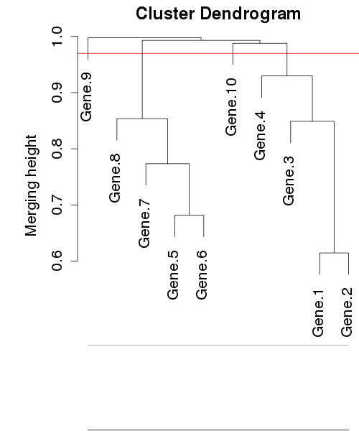
Simple solution for simple trees
Pick a suitable constant height (here 0.97)
Notes:
I'll start with a few general words about weighted network analysis. It is best to think of WGCNA as a set of tools to analyze high-dimensional data, meaning thousands of variables across a given number of samples, ideally at least 20 but more is better.

Slide 38

Simple solution for simple trees
Pick a suitable constant height (here 0.97)
Cut branches at the height
Notes:
I'll start with a few general words about weighted network analysis. It is best to think of WGCNA as a set of tools to analyze high-dimensional data, meaning thousands of variables across a given number of samples, ideally at least 20 but more is better.

Slide 39
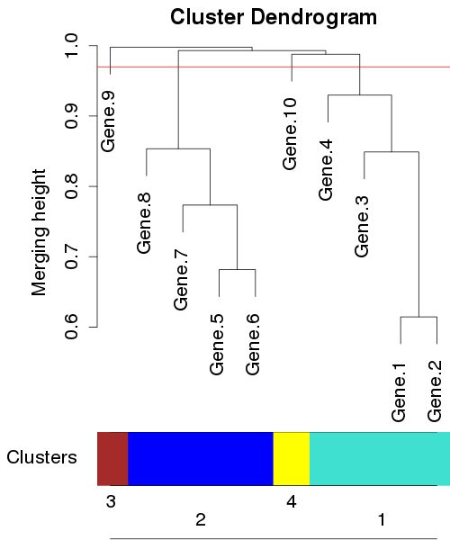
Simple solution for simple trees
Pick a suitable constant height (here 0.97)
Cut branches at the height
Each individual branch is a cluster
Notes:
I'll start with a few general words about weighted network analysis. It is best to think of WGCNA as a set of tools to analyze high-dimensional data, meaning thousands of variables across a given number of samples, ideally at least 20 but more is better.

Slide 40
Simple solution for simple trees
Pick a suitable constant height (here 0.97)
Cut branches at the height
Each individual branch is a cluster
Enforce a minimum cluster size to avoid very small clusters
Notes:
I'll start with a few general words about weighted network analysis. It is best to think of WGCNA as a set of tools to analyze high-dimensional data, meaning thousands of variables across a given number of samples, ideally at least 20 but more is better.

Slide 41
Cut height must be chosen carefully!
Different cut heights lead to very different results
Proper cut height setting requires an intelligent operator
In general, each application will require a different cut height
This is a major disadvantage of constant-height tree cut
Notes:
I'll start with a few general words about weighted network analysis. It is best to think of WGCNA as a set of tools to analyze high-dimensional data, meaning thousands of variables across a given number of samples, ideally at least 20 but more is better.

Slide 42
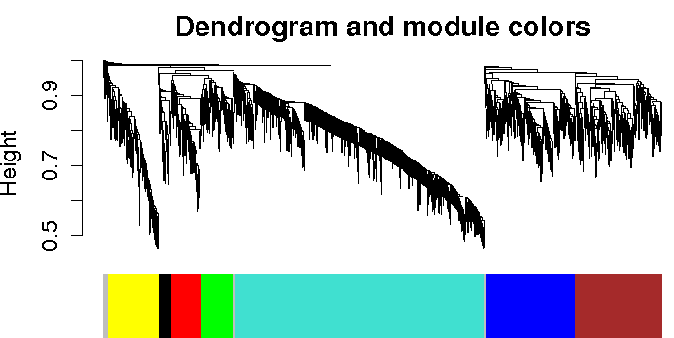
Example genomic application
Human brain expression data (Oldham et al 2006)
Modules group together genes expressed in specific brain regions
Notes:
I'll start with a few general words about weighted network analysis. It is best to think of WGCNA as a set of tools to analyze high-dimensional data, meaning thousands of variables across a given number of samples, ideally at least 20 but more is better.

Slide 43
Static tree cut in R
WGCNA functions cutreeStatic and cutreeStaticColor, based on function cutree
cutreeStatic returns numeric labels (1,2,3,...; unassigned label is 0)
cutreeStaticColor returns color labels (turquoise, blue, ...; unassigned color is grey)
Both function take as input a hierarchical cluster tree, cut height and minimum cluster size
Use help("cutreeStatic") to see more details
Notes:
I'll start with a few general words about weighted network analysis. It is best to think of WGCNA as a set of tools to analyze high-dimensional data, meaning thousands of variables across a given number of samples, ideally at least 20 but more is better.

Slide 44
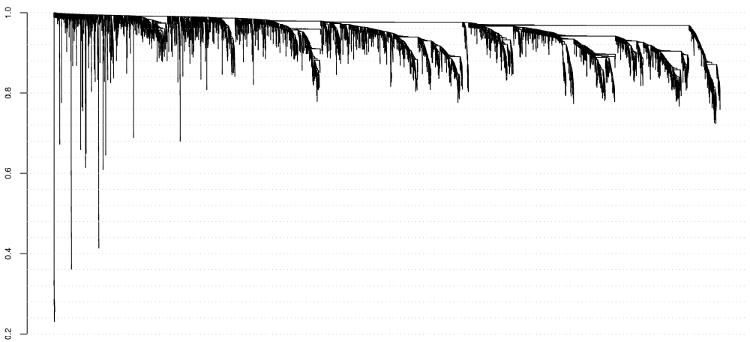
The simple solution does not always work for complicated trees
Clustering of mouse adipose expression data: no single cut height captures the prominent branches
Notes:
I'll start with a few general words about weighted network analysis. It is best to think of WGCNA as a set of tools to analyze high-dimensional data, meaning thousands of variables across a given number of samples, ideally at least 20 but more is better.

Slide 45
Solution: make the cut height adaptive
Dynamic Tree Cut
Langfelder P, Zhang B, Horvath S (2008), Defining clusters from a hierarchical cluster tree: the Dynamic Tree Cut package for R, Bioinformatics 24:719
Notes:
I'll start with a few general words about weighted network analysis. It is best to think of WGCNA as a set of tools to analyze high-dimensional data, meaning thousands of variables across a given number of samples, ideally at least 20 but more is better.

Slide 46
Dynamic Tree Cut
Branches are followed bottom to top
When two branches merge, they are evaluated using shape criteria such as minimum number of objects (genes), their core scatter and the gap between the branches
If the branches meet criteria for being a module, they are called separate modules, otherwise they are merged
Notes:
Here's a brief description of how the algorithm works: branches are followed from bottom to the top;
where two branches merge, they are tested using certain shape criteria. They must have a certain minimum number of objects. Their core scatter must be below a certain maximum, and their gap must be at least a prescribed minimum. What this really means is that the branches are well-defined, at least on the dendrogram. There's also a final cut height, above which everything is deemed too dissimilar to belong to a module, but this height is now far less important than it is for the static method.
If two branches meet the criteria for being a module, they are kept separate, otherwise they are merged and the process continues up.

Slide 47
Start a new branch
Notes:
I'll start with a few general words about weighted network analysis. It is best to think of WGCNA as a set of tools to analyze high-dimensional data, meaning thousands of variables across a given number of samples, ideally at least 20 but more is better.

Slide 48
Start a second branch
Notes:
I'll start with a few general words about weighted network analysis. It is best to think of WGCNA as a set of tools to analyze high-dimensional data, meaning thousands of variables across a given number of samples, ideally at least 20 but more is better.

Slide 49
Add object to branch 2
Notes:
I'll start with a few general words about weighted network analysis. It is best to think of WGCNA as a set of tools to analyze high-dimensional data, meaning thousands of variables across a given number of samples, ideally at least 20 but more is better.

Slide 50
Add object to a branch 1
Notes:
I'll start with a few general words about weighted network analysis. It is best to think of WGCNA as a set of tools to analyze high-dimensional data, meaning thousands of variables across a given number of samples, ideally at least 20 but more is better.

Slide 51
Add objects to a branches 1 and 2
Notes:
I'll start with a few general words about weighted network analysis. It is best to think of WGCNA as a set of tools to analyze high-dimensional data, meaning thousands of variables across a given number of samples, ideally at least 20 but more is better.

Slide 52
Two branches merge
Notes:
I'll start with a few general words about weighted network analysis. It is best to think of WGCNA as a set of tools to analyze high-dimensional data, meaning thousands of variables across a given number of samples, ideally at least 20 but more is better.

Slide 53
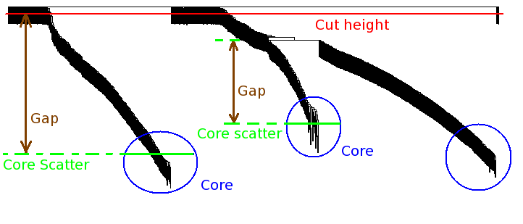
Dynamic Tree Cut
Branches are followed bottom to top
When two branches merge, they are evaluated using shape criteria such as minimum number of objects (genes), their core scatter and the gap between the branches
If the branches meet criteria for being a cluster, they are called separate clusters, otherwise they are merged into a single cluster
Notes:
Here's a brief description of how the algorithm works: branches are followed from bottom to the top;
where two branches merge, they are tested using certain shape criteria. They must have a certain minimum number of objects. Their core scatter must be below a certain maximum, and their gap must be at least a prescribed minimum. What this really means is that the branches are well-defined, at least on the dendrogram. There's also a final cut height, above which everything is deemed too dissimilar to belong to a module, but this height is now far less important than it is for the static method.
If two branches meet the criteria for being a module, they are kept separate, otherwise they are merged and the process continues up.

Slide 54
The good, the bad, and the flexible
Bad news: shape criteria are heuristic and somewhat arbitrary
Good news for general users: they often work well in finding meaningful clusters
Good news for power users who would like to use their own criteria: cutreeDynamic is flexible!
“plug-in” system allows users to use their own branch similarity criteria whenever 2 branches merge
Notes:
Here's a brief description of how the algorithm works: branches are followed from bottom to the top;
where two branches merge, they are tested using certain shape criteria. They must have a certain minimum number of objects. Their core scatter must be below a certain maximum, and their gap must be at least a prescribed minimum. What this really means is that the branches are well-defined, at least on the dendrogram. There's also a final cut height, above which everything is deemed too dissimilar to belong to a module, but this height is now far less important than it is for the static method.
If two branches meet the criteria for being a module, they are kept separate, otherwise they are merged and the process continues up.

Slide 55
Examples of external branch similarity criteria
For genomic data: one often wants to merge modules whose expression profiles are very similar (“correlation of eigengenes is too high”): this is easily accomplished with an external criterion
One may want to merge branches whose split disappears when one perturbs the data (e.g., in a resampling study)
Notes:
Here's a brief description of how the algorithm works: branches are followed from bottom to the top;
where two branches merge, they are tested using certain shape criteria. They must have a certain minimum number of objects. Their core scatter must be below a certain maximum, and their gap must be at least a prescribed minimum. What this really means is that the branches are well-defined, at least on the dendrogram. There's also a final cut height, above which everything is deemed too dissimilar to belong to a module, but this height is now far less important than it is for the static method.
If two branches meet the criteria for being a module, they are kept separate, otherwise they are merged and the process continues up.

Slide 56
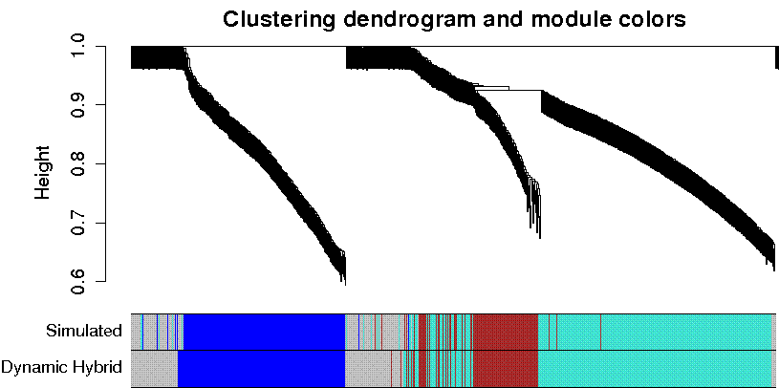
Optional assignment of outlying objects to nearest branch
Optionally the method can include a Partitioning Around Medoids (PAM)-like step to assign outlying objects
  Clustering tree is not sufficient to assign those objects
Notes:
One important point that is often overlooked is that once two modules merge on a tree, genes above the merge cannot be assigned based solely on the tree. This is simply a property of hierarchical clustering and I can explain it after the talk. The result is simply that to assign these genes here past the merge of these two branches, one has to use something else than the tree. I have tried a few things and the best appears to be a PAM-type step in which each of these genes is assigned to the closest already existing cluster.
All in all, the result is a flexible method that is capable of dealing with complicated situations and is also suitable for automation.

Slide 57
Dynamic Tree Cut
Optionally the method can include a Partitioning Around Medoids (PAM)-like step to assign outlying objects
  Assign those objects to nearest cluster
Notes:
One important point that is often overlooked is that once two modules merge on a tree, genes above the merge cannot be assigned based solely on the tree. This is simply a property of hierarchical clustering and I can explain it after the talk. The result is simply that to assign these genes here past the merge of these two branches, one has to use something else than the tree. I have tried a few things and the best appears to be a PAM-type step in which each of these genes is assigned to the closest already existing cluster.
All in all, the result is a flexible method that is capable of dealing with complicated situations and is also suitable for automation.

Slide 58
Using Dynamic Tree Cut in R
Function cutreeDynamic in the R package dynamicTreeCut
library(dynamicTreeCut)
help("cutreeDynamic")
Input:
  clustering tree
  dissimilarity matrix that was used to produce the tree
  multiple options to fine-tune cluster criteria and PAM stage
Most important options:
  DeepSplit (0-4): controls how finely clusters will be split
  pamStage (FALSE or TRUE): turns PAM stage off/on
Notes:
To give you a flavor of what the method can do, I'll show you the results of module detection in a simulated example, in which the underlying truth is known. I simulated 10 clusters, some of which lie close to one another.
The dendrogram structure is rather complicated, but notice that 1. the branches do correspond to the modules I simulated, 2. the dynamic tree cut methods get the modules basically right, and 3. the hybrid tree cut that includes the PAM stage gets the outliers better than a simpler tree cut that basically makes a poor guess as to where to assign the outliers. If you would like to try the dynamic tree cut methods for yourself, I invite you to look at our paper in Bioinformatics that contains the description and a complete R package that implements the methods.

Slide 59
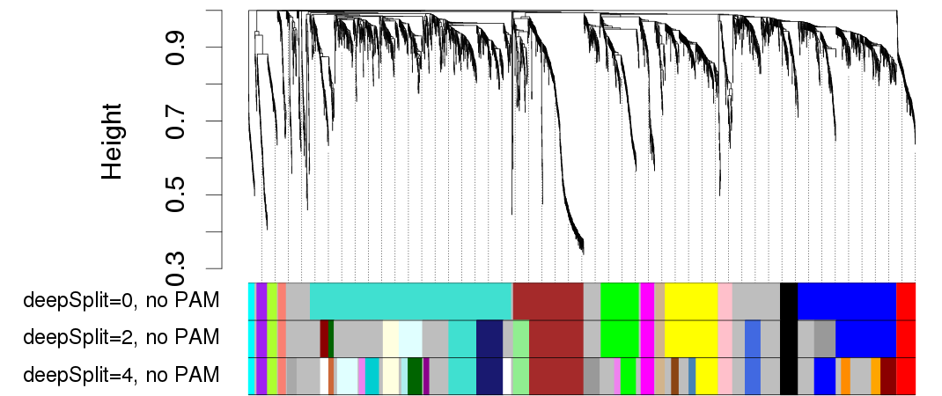
Effect of deepSplit
deepSplit controls how finely the branches should be split
Higher values give more smaller modules, low values (0) give fewer larger modules
Notes:
To give you a flavor of what the method can do, I'll show you the results of module detection in a simulated example, in which the underlying truth is known. I simulated 10 clusters, some of which lie close to one another.
The dendrogram structure is rather complicated, but notice that 1. the branches do correspond to the modules I simulated, 2. the dynamic tree cut methods get the modules basically right, and 3. the hybrid tree cut that includes the PAM stage gets the outliers better than a simpler tree cut that basically makes a poor guess as to where to assign the outliers. If you would like to try the dynamic tree cut methods for yourself, I invite you to look at our paper in Bioinformatics that contains the description and a complete R package that implements the methods.

Slide 60
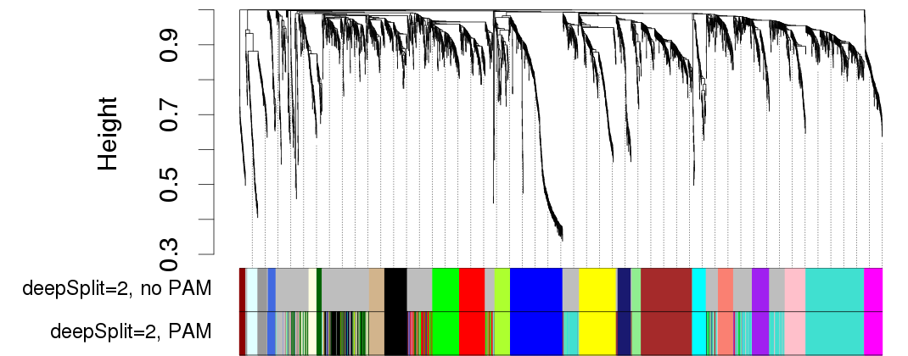
PAM stage: assigning more distant objects to clusters
Optional, by default enabled, PAM stage allows the user to assign more outlying objects to clusters
Without PAM stage, sometimes there are many "grey" genes
With PAM stage the dendrogram is sometimes more difficult to interpret
Notes:
To give you a flavor of what the method can do, I'll show you the results of module detection in a simulated example, in which the underlying truth is known. I simulated 10 clusters, some of which lie close to one another.
The dendrogram structure is rather complicated, but notice that 1. the branches do correspond to the modules I simulated, 2. the dynamic tree cut methods get the modules basically right, and 3. the hybrid tree cut that includes the PAM stage gets the outliers better than a simpler tree cut that basically makes a poor guess as to where to assign the outliers. If you would like to try the dynamic tree cut methods for yourself, I invite you to look at our paper in Bioinformatics that contains the description and a complete R package that implements the methods.

Slide 61
Highlights
Hierarchical clustering is a useful method for finding groups of similar objects
It produces a hierarchical clustering tree that can be visualized
Clusters correspond to branches of the tree; cluster identification is also known as tree cutting or branch pruning
Simple methods for cluster identification are not always suitable, especially in complicated clustering trees
Dynamic Tree Cut is capable of identifying clusters is complicated clustering trees
Most important arguments are deepSplit and pamStage
A single setting works well and produces comparable results in many applications: Dynamic Tree Cut is suitable for automation
Notes:
To give you a flavor of what the method can do, I'll show you the results of module detection in a simulated example, in which the underlying truth is known. I simulated 10 clusters, some of which lie close to one another.
The dendrogram structure is rather complicated, but notice that 1. the branches do correspond to the modules I simulated, 2. the dynamic tree cut methods get the modules basically right, and 3. the hybrid tree cut that includes the PAM stage gets the outliers better than a simpler tree cut that basically makes a poor guess as to where to assign the outliers. If you would like to try the dynamic tree cut methods for yourself, I invite you to look at our paper in Bioinformatics that contains the description and a complete R package that implements the methods.

Slide 62
Limitations
Hierarchical clustering is heuristic - does not optimize a cost (penalty) function
Hierarchical clustering is not "stable": relatively small changes in data can produce different trees
  This can be remedied using a resampling or other perturbation study
Visualization is imperfect (all visualizations of high-dimensional data are imperfect); users should not rely too much on the dendrogram
  This applies especially when PAM stage is used
Dynamic Tree Cut uses heuristic criteria for deciding whether a branch is a cluster; the criteria are by no means unique
Notes:
To give you a flavor of what the method can do, I'll show you the results of module detection in a simulated example, in which the underlying truth is known. I simulated 10 clusters, some of which lie close to one another.
The dendrogram structure is rather complicated, but notice that 1. the branches do correspond to the modules I simulated, 2. the dynamic tree cut methods get the modules basically right, and 3. the hybrid tree cut that includes the PAM stage gets the outliers better than a simpler tree cut that basically makes a poor guess as to where to assign the outliers. If you would like to try the dynamic tree cut methods for yourself, I invite you to look at our paper in Bioinformatics that contains the description and a complete R package that implements the methods.

Slide 63
Usage in R
Hierarchical clustering: function hclust
Constant height tree cut: cutreeStatic, cutreeStaticColor in package WGCNA
Dynamic Tree Cut: cutreeDynamic in package dynamicTreeCut
Further reading
Langfelder P, Zhang B, Horvath S
Defining clusters from a hierarchical cluster tree: the Dynamic Tree Cut package for R.
Bioinformatics 2008 24(5):719-720
http://labs.genetics.ucla.edu/horvath/CoexpressionNetwork/BranchCutting/
Notes:
To give you a flavor of what the method can do, I'll show you the results of module detection in a simulated example, in which the underlying truth is known. I simulated 10 clusters, some of which lie close to one another.
The dendrogram structure is rather complicated, but notice that 1. the branches do correspond to the modules I simulated, 2. the dynamic tree cut methods get the modules basically right, and 3. the hybrid tree cut that includes the PAM stage gets the outliers better than a simpler tree cut that basically makes a poor guess as to where to assign the outliers. If you would like to try the dynamic tree cut methods for yourself, I invite you to look at our paper in Bioinformatics that contains the description and a complete R package that implements the methods.

