Slide 1
Populations, Samples, and Stats
Matthew J. Martinez, PhD
Notes:
https://www.youtube.com/watch?v=lnc0FNvUZ7o

Slide 2
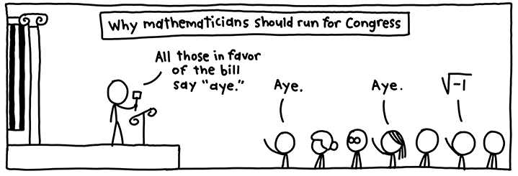
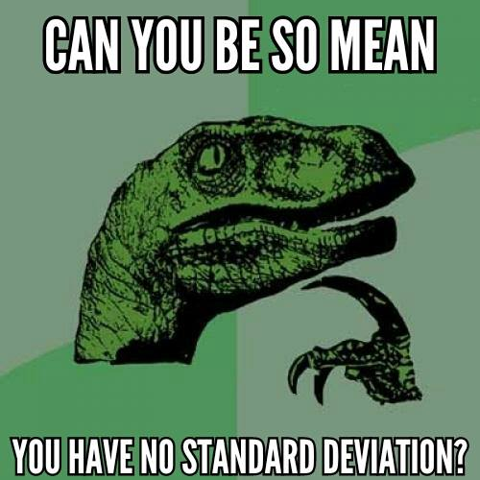

Slide 3
Population and Samples
Population
Complete Count
United States Census
Samples
Random
Stratified Random
Probability

Slide 4
Questions to Consider
Can we ever know the true population?
When would a sample be better?

Slide 5
Demonstration

Slide 6
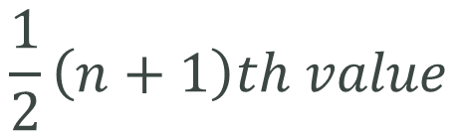
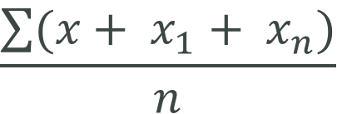
Describing Populations & Samples: Central Tendency
Mean
Median
Mode
$$\frac{\sum{(x+ x_{1}+ x_{n})}}{n}$$
$$\frac{1}{2}\left(n+1\right)th value$$

Slide 7
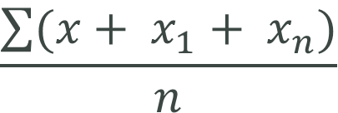
Mean
Arithmetic mean (or average):
Properties of the mean
Quantitative data only
Highly susceptible to outliers
$$\frac{\sum{(x+ x_{1}+ x_{n})}}{n}$$

Slide 8
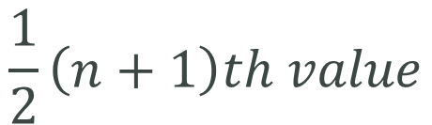
Median
The Median – the observation that divides an ordered data set in half; 50th percentile
Properties of the median
Quantitative or ordinal data required
In symmetric distributions, median=mean
In skewed distributions, the mean resides between the median and the tail of the distribution
The median is unaffected by outliers or by distances between measurements
$$\frac{1}{2}\left(n+1\right)th value$$

Slide 9
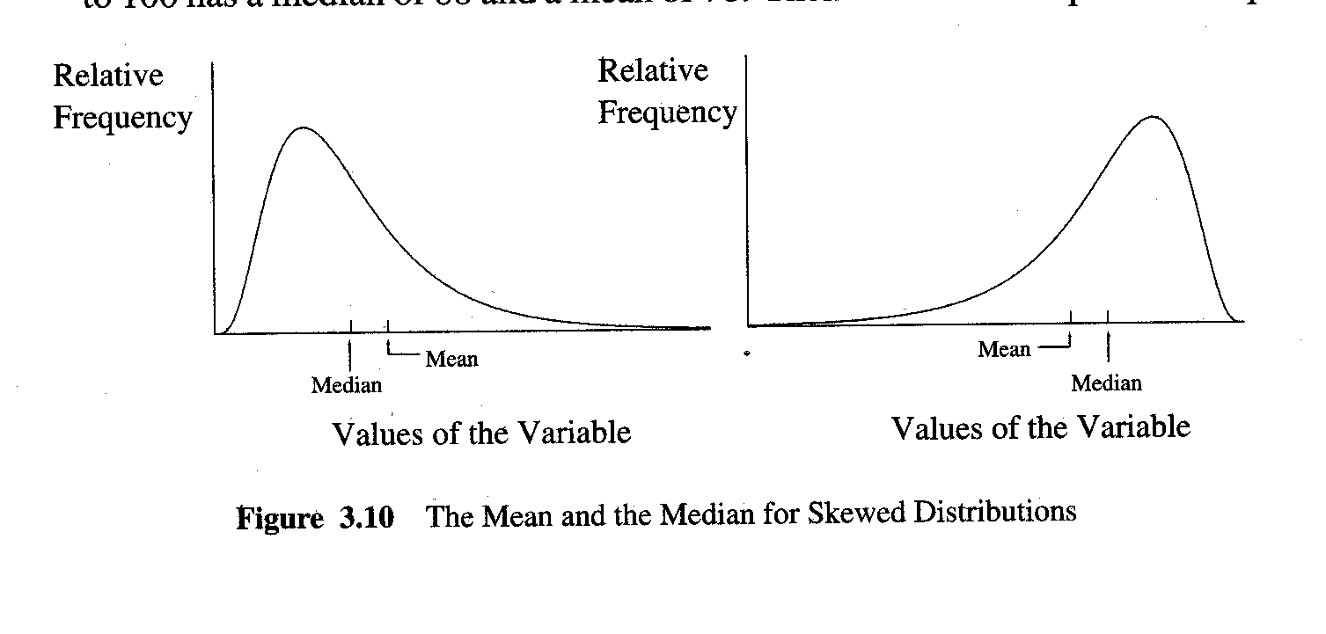
Mean and Median

Slide 10
Mode
Defined: the most frequent value in a data set
Properties
Works will all types of variables
Uni-, bi- and trimodality
In a unimodal, symmetric distribution,
Mean = median = mode

Slide 11
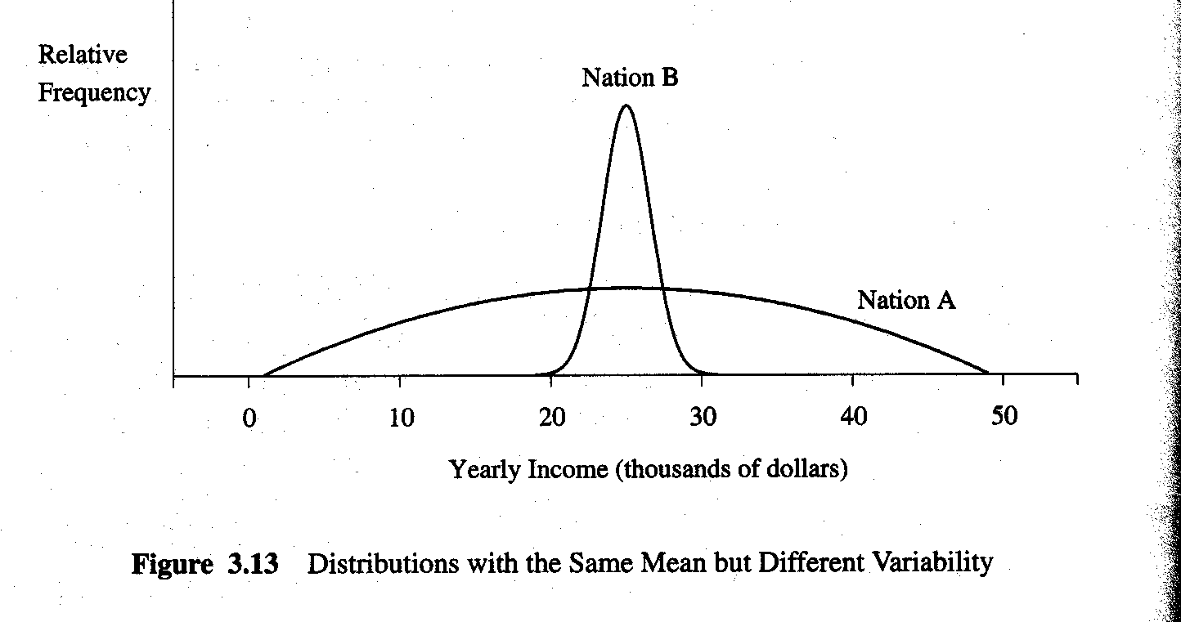
Why Variation Matters

Slide 12
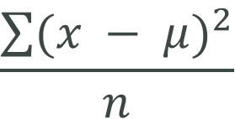
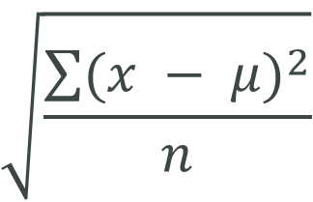

Describing Populations & Samples: Variation
Range
Variance
Standard Deviation
$$Upper Limit −Lower Limit$$
$$\frac{\sum{{(x − μ)}^{2}}}{n}$$
$$\sqrt{\frac{\sum{{(x − μ)}^{2}}}{n}}$$

Slide 13
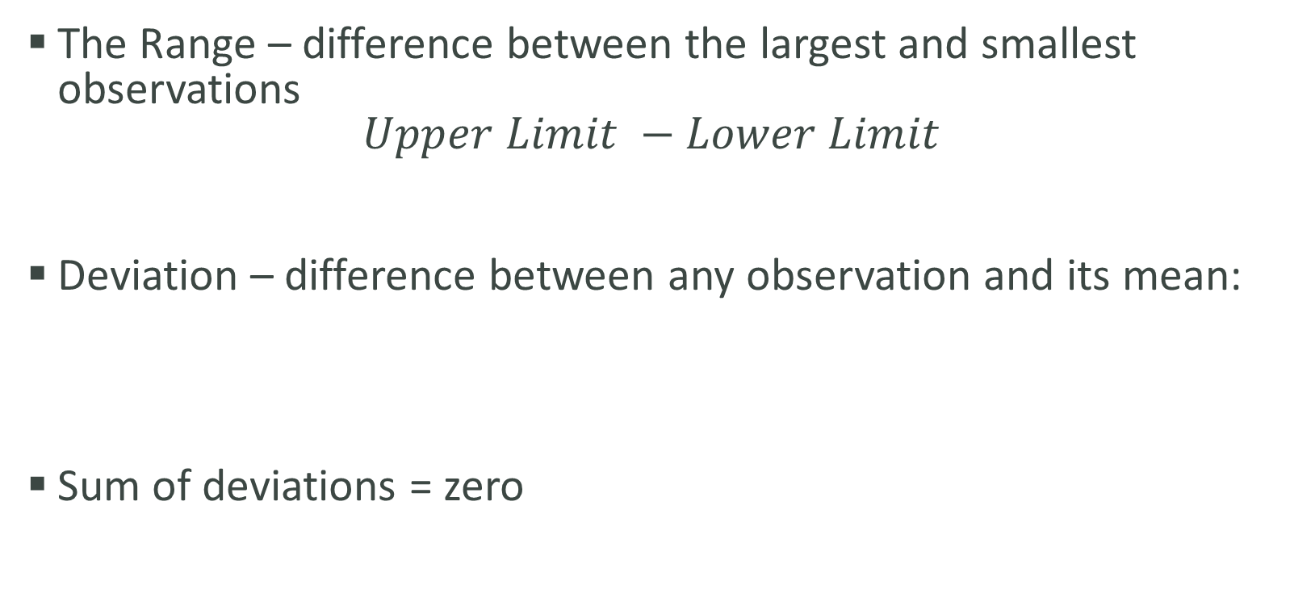
Variation
The Range – difference between the largest and smallest observations
$$Upper Limit −Lower Limit$$
Deviation – difference between any observation and its mean:
Sum of deviations = zero

Slide 14
Variation
Sum of squares – These are squared in order to compute a non-zero value.
Variance – The average of the squared differences from the mean. How far a variable is spread out.

Slide 15
Variation
Standard Deviation – Standard deviation measures the spread of a data distribution. The more spread out a data distribution is, the greater its standard deviation. Square root of the variance.
Step 1: Find the mean.
Step 2: For each data point, find the square of its distance to the mean.
Step 3: Sum the values from Step 2.
Step 4: Divide by the number of data points. (n-1 if sample)
Step 5: Take the square root.

Slide 16
Properties of the Standard Deviation
Always nonzero unless all observations are equal
The greater the variation about the mean, the larger is the value of s.

Slide 17
Interpreting Standard Deviation
Roughly the average distance of observations about the mean
Empirical rule for approximately symmetric (bell-shaped) distributions:
Mean ± 1s = 68% of data
Mean ± 2s = 95% of data
Mean ± 3s = 99% of data

Slide 18
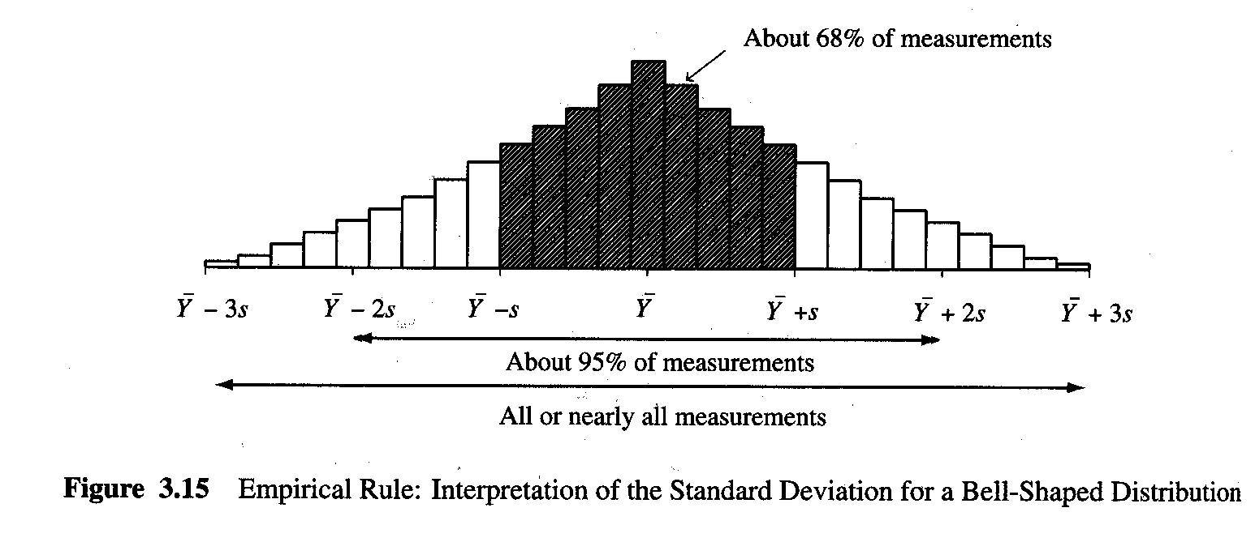

Slide 19
Measures of Position in a Distribution: Quartiles and Other Percentiles
Percentile defined: the p^{th} percentile is a number such that p% of the scores fall below it and ( 100 - p% ) fall above it.
Common percentiles
Median: 50th percentile
Lower quartile: 25th percentile
Upper quartile: 75th percentile
Interquartile range = upper quartile - lower quartiles; middle 50% of a distribution

Slide 20
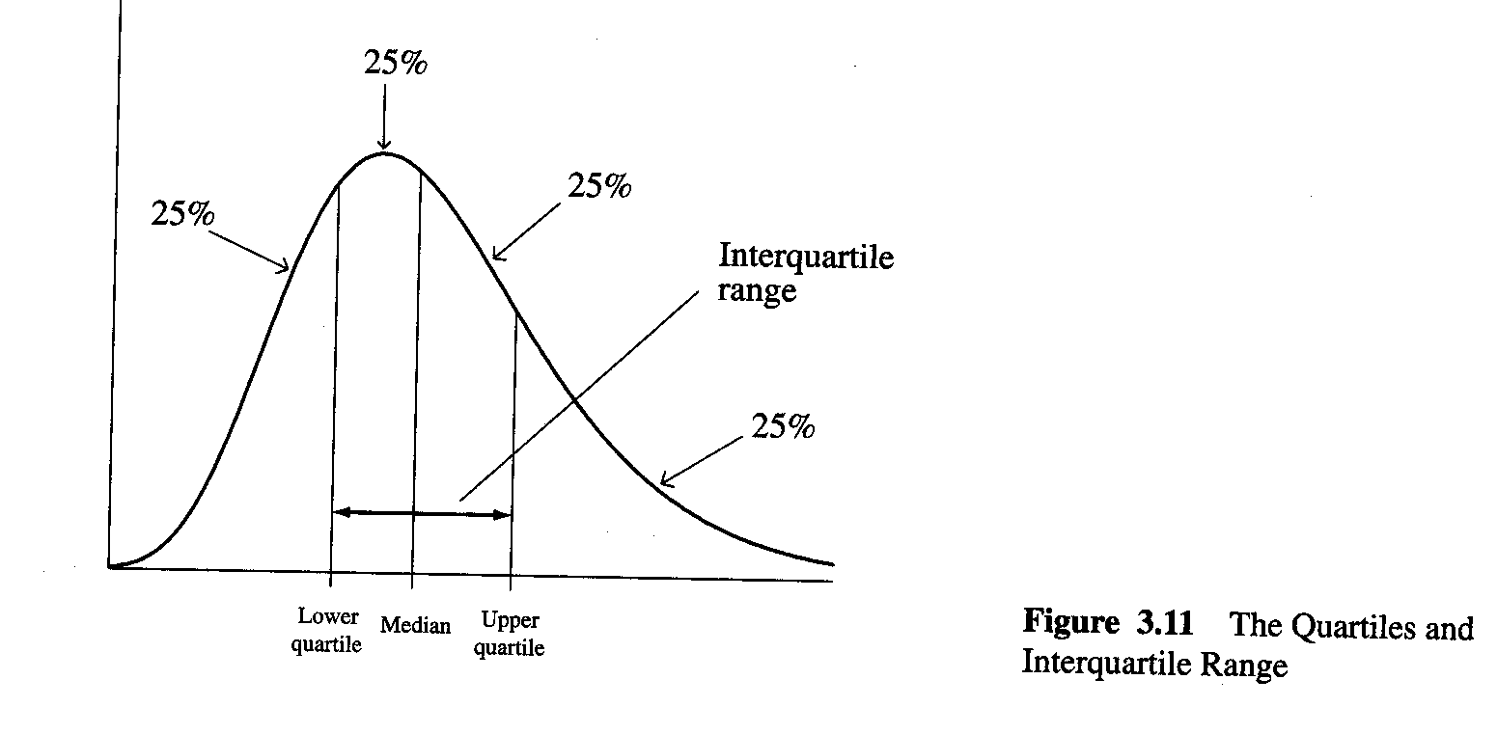

Slide 21
Interquartile Range as Measure of Variation
Defined:
Not sensitive to outliers (a problem with the range and with the standard deviation)

Slide 22
More Examples
Sampling and Normal Distribution
http://www.hhmi.org/biointeractive/sampling-and-normal-distribution
http://media.hhmi.org/biointeractive/click/sample-distribution/?_ga=1.229734676.983006972.1480921538
Variance and Normal Distribution
https://projects.fivethirtyeight.com/2018-midterm-election-forecast/house/?ex_cid=rrpromo

Slide 23
Reminder
Sample statistics and population parameters
Statistics: describe a sample;
e.g.,
Parameters: describe a population;
e.g.

Slide 24
Further Study
“Mr. Willis of Ohio” from The West Wing
“Two Cheers for the 2000 Census”. http://www.prb.org/Publications/Articles/2000/TwoCheersforthe2000Census.aspx
“Better Data, Better Decisions: How the U.S. Census Bureau's American Community Survey Benefits Business and Government”. http://www.prb.org/Multimedia/Video/2011/acs-benefits-business-government.aspx
“Understanding and Using 5-Year Estimates From the ACS”. http://www.prb.org/Multimedia/Video/2010/acs-webinar.aspx

