Slide 1
Analyzing Facebook Dataset
Mahsa Sharifi
Master of Computer Science
Old Dominion University
Data Incubator Fellowship
Summer 2021

Slide 2
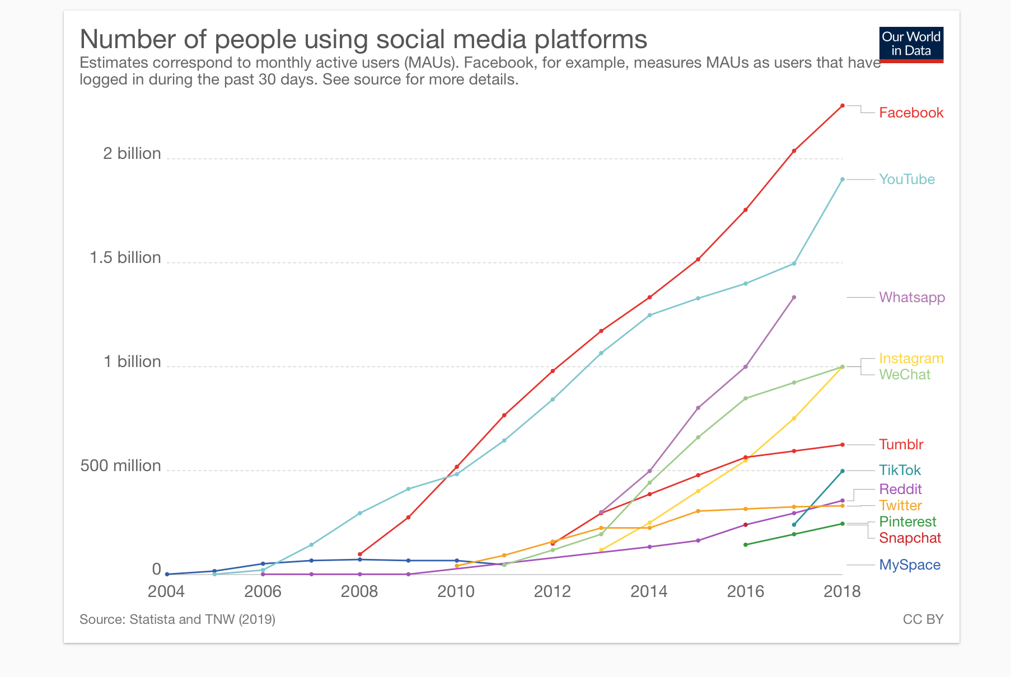
Why Facebook?
Marketing Strategies
A worldwide popular social networking site
This project might be interesting and useful for
Companies who use Facebook as their social media marketing

Slide 3
DataSet Information
DataSet Size
3621391 x 9
Important features
dataset_id/username
time
checkins
likes
talking_about_count

Slide 4
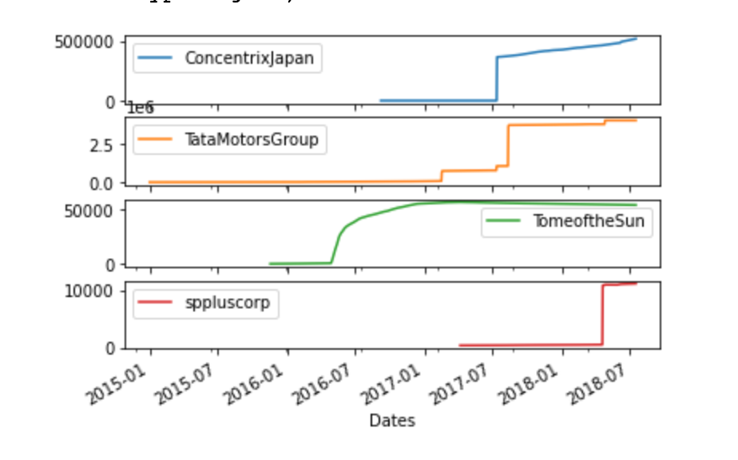
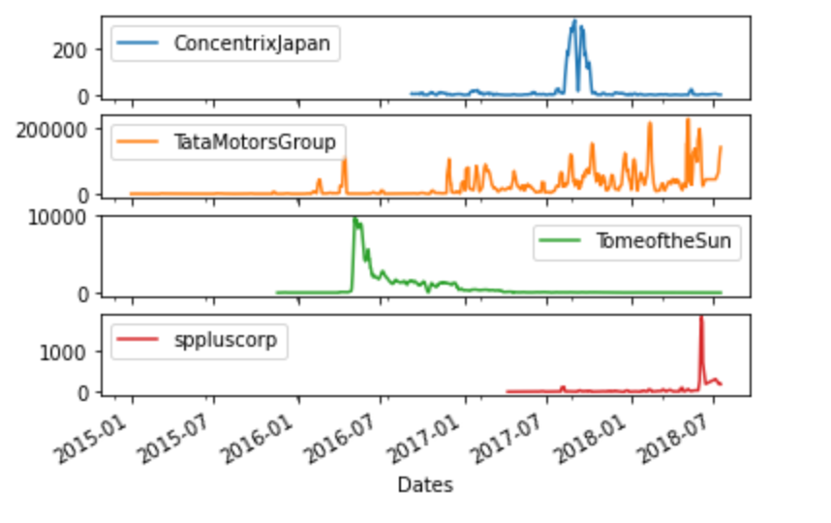
Winners in social media traction/engagement
“likes” as a feature to measure this
The average for each year
The percentage change for each company
Highest percentage change

Slide 5
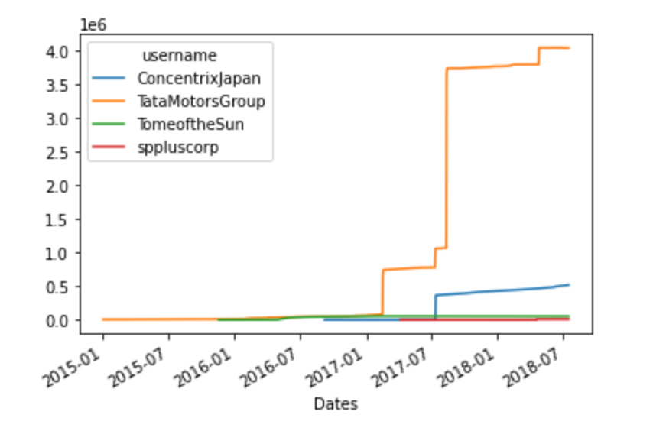
Big jump in TataMotorsGroup - March 2017
Started partnership with Volkswagen.
https://auto.economictimes.indiatimes.com/news/industry/tata-motors-volkswagen-sign-an-mou-to-explore-partnership-or-joint-venture/57548810
ConcentrixJapan - July 2017
Expanded digital services.
ConcentrixJapan had acquired Tigerspike company.
https://www.prnewswire.com/news-releases/concentrix-expands-digital-services-with-acquisition-of-tigerspike-300491524.html

Slide 6
Future work
To build a model to predict each company’s “checkin” for the next days
checkins = likes*B1 + talking_about_count*B2 + delay
To combine the Stock Market Data set and Facebook Data set
To predict the future companies’ stock price based on people engagement on social media

Slide 7
Thank you!
Questions?

