Slide 1
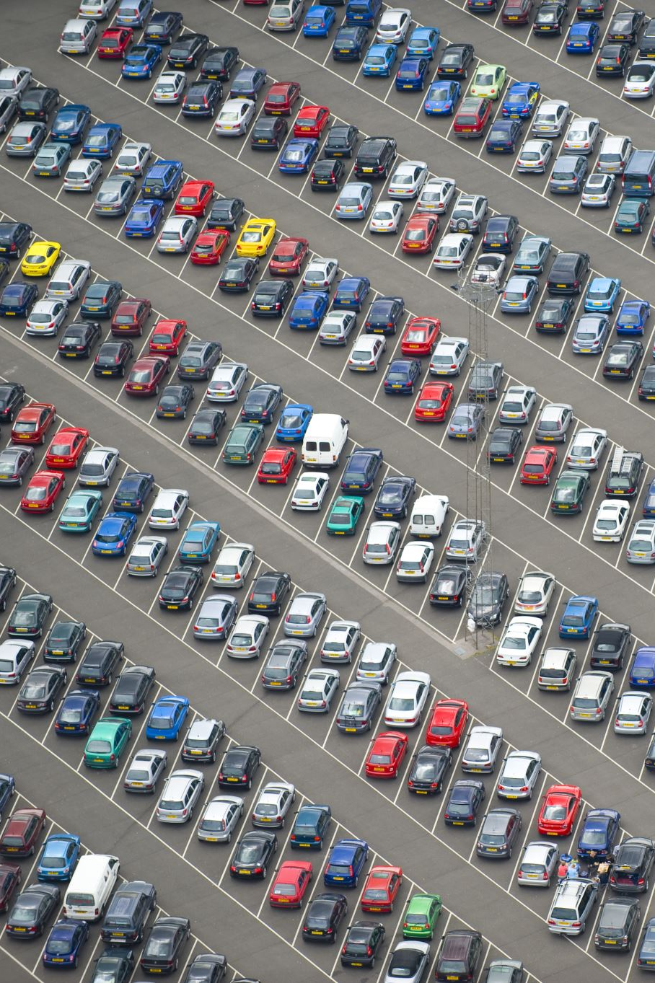
Predicting and Optimizing Used Car Prices
Data Science Project on Competitive Vehicle Pricing
Mahsa Mihandoust | May 2025

Slide 2

Business Challenge
Used vehicle pricing often relies on guesswork.
Overpriced cars stay unsold; underpriced cars lose profit.
Goal: Build a data-driven pricing model and dashboard to guide decisions.

Slide 3

Dataset & Tools
426,000+ listings from Craigslist
42 manufacturers | Year range: 1900–2022
Tools: Python, SQL, SQLite, Scikit-learn, XGBoost, Power BI, Google Colab

Slide 4
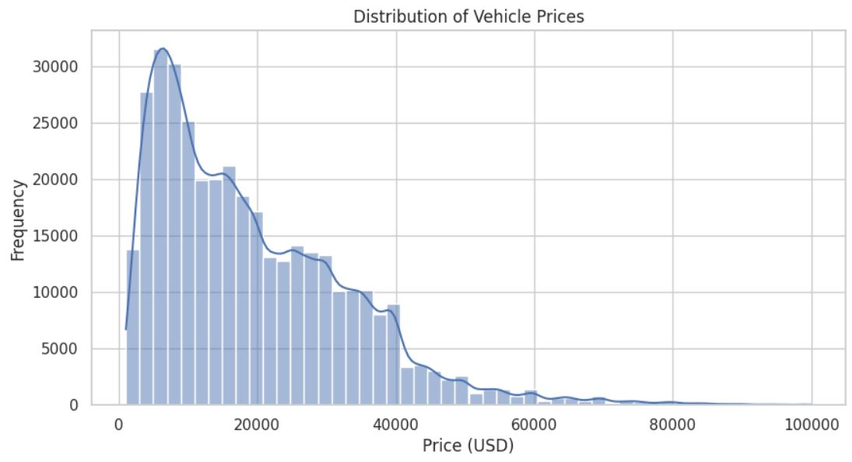
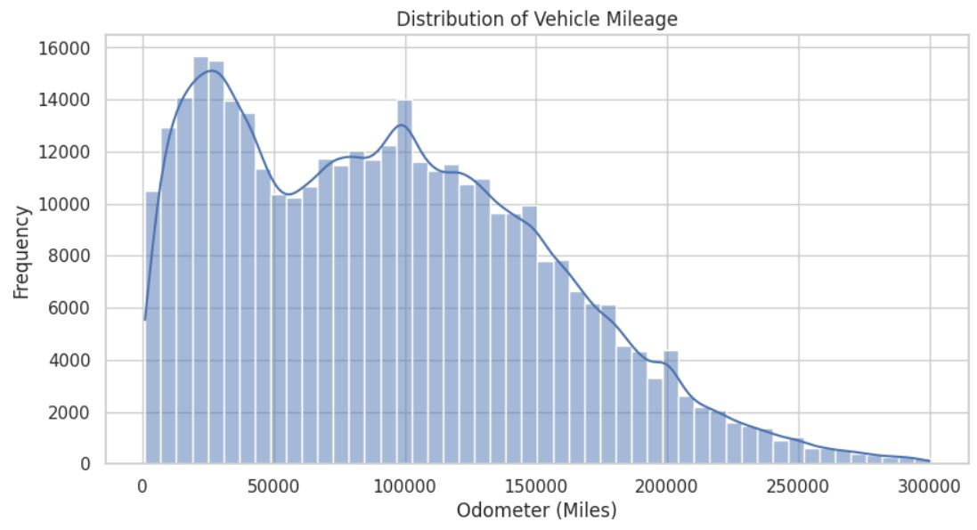
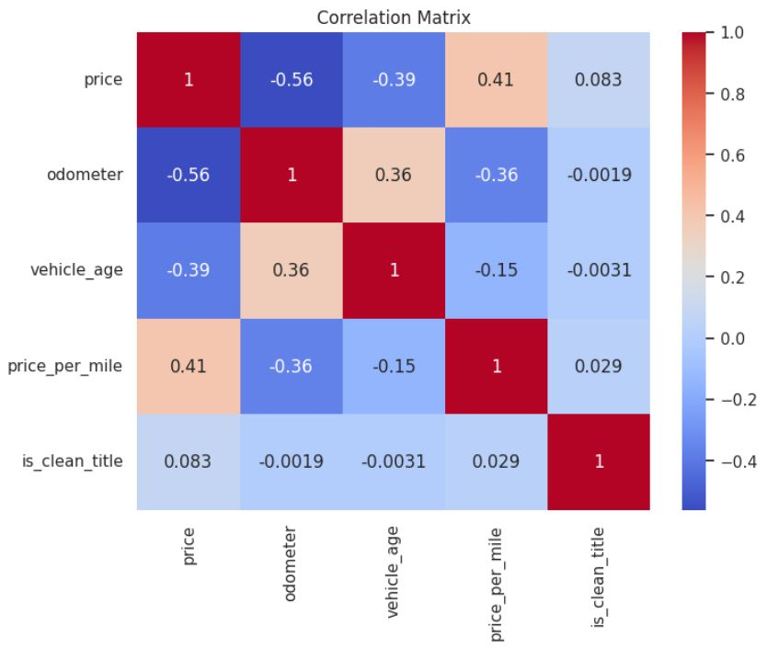
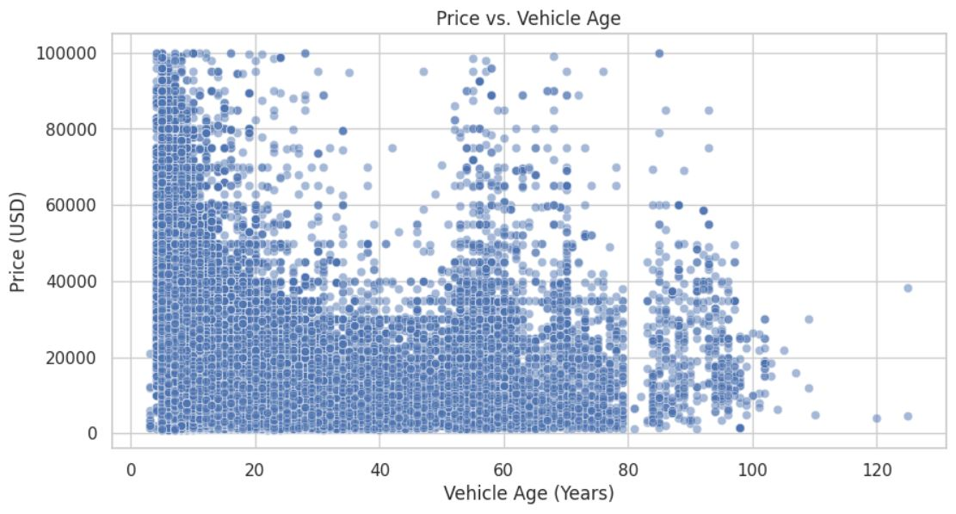
Key Data Insights
Most listings priced under $30,000
Odometer peaks at ~50k and 100k
Strongest correlations:
Price ↔ Odometer & Age
Older vehicles consistently priced lower

Slide 5
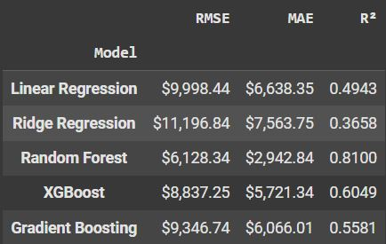
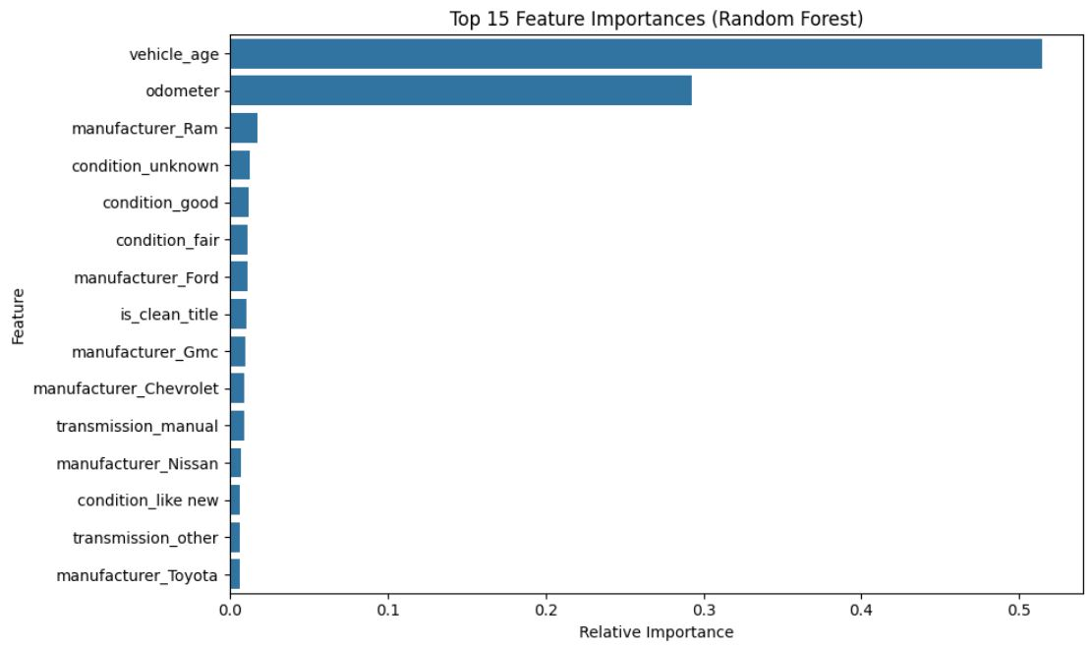
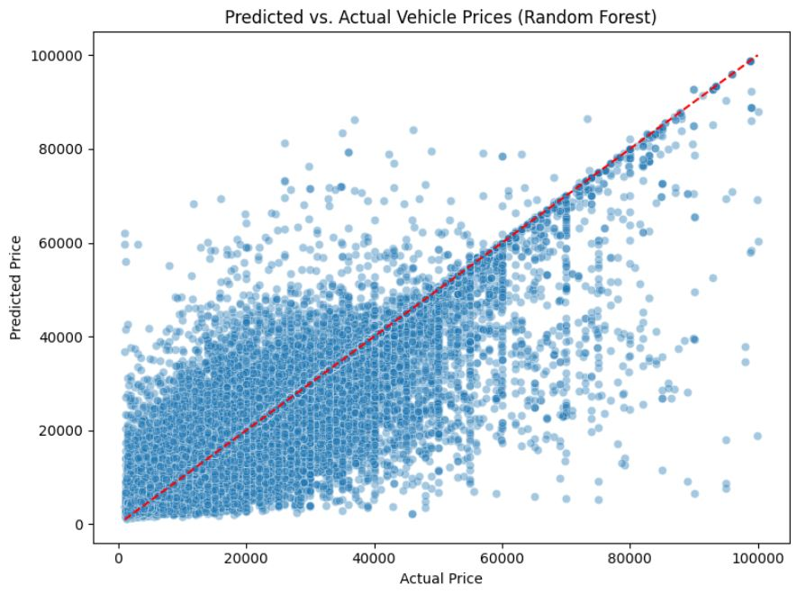
Model Training & Evaluation
Models tested: Linear, Ridge, Random Forest, XGBoost, Gradient Boosting
Best: Random Forest (RMSE ~$6,128, R² = 0.81)
Strong feature importance: Vehicle Age, Odometer

Slide 6
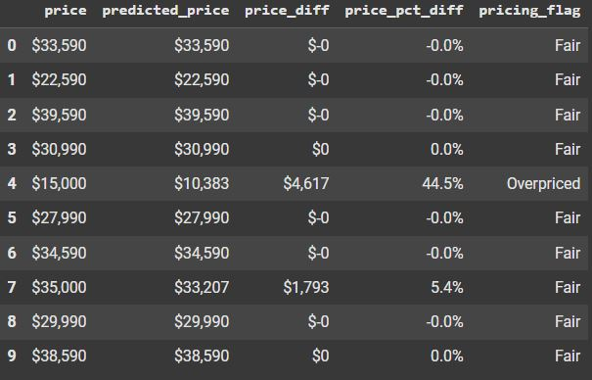
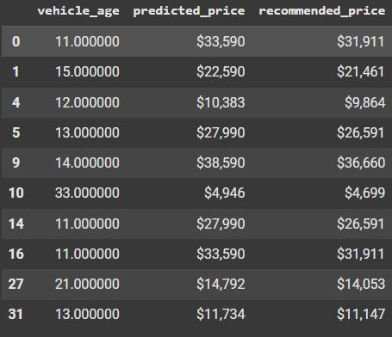
Intelligent Pricing Rules
Sample Table of Actual vs. Predicted Prices and Pricing Flag
Fair = within ±10% of predicted price
Overpriced = 10%+ above prediction
Underpriced = 10%+ below prediction
Aged vehicles (10+ yrs): Recommend 5% discount
Discount Logic for Aged Vehicles

Slide 7
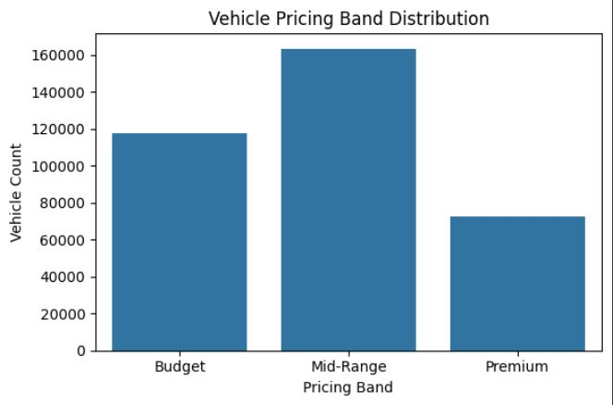
Pricing Bands
Budget: < $10K
Mid-Range: $10K–$30K
Premium: > $30K

Slide 8
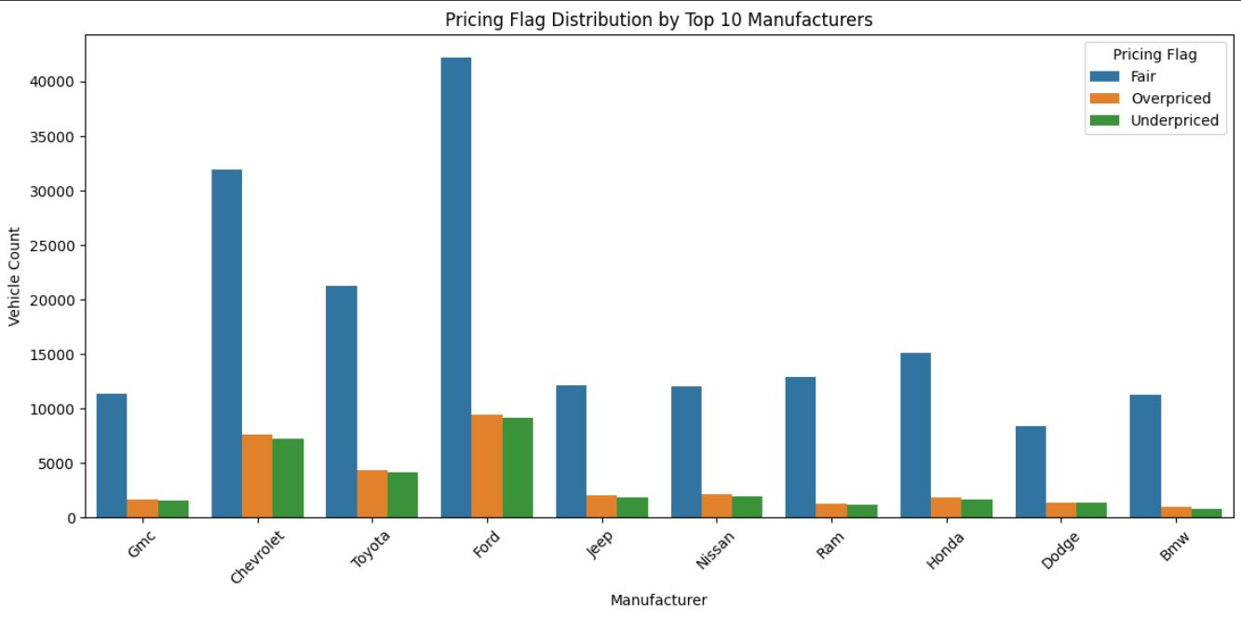
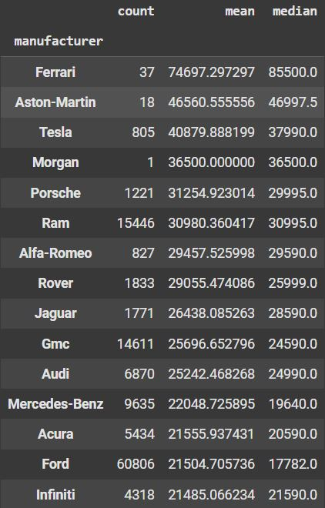
Top Brands – Price & Accuracy
Analysis of predicted vs. listed prices
Some brands like Ford are frequently overpriced
Useful for inventory markdown strategy
Average Price by Top 10 Manufacturers

Slide 9
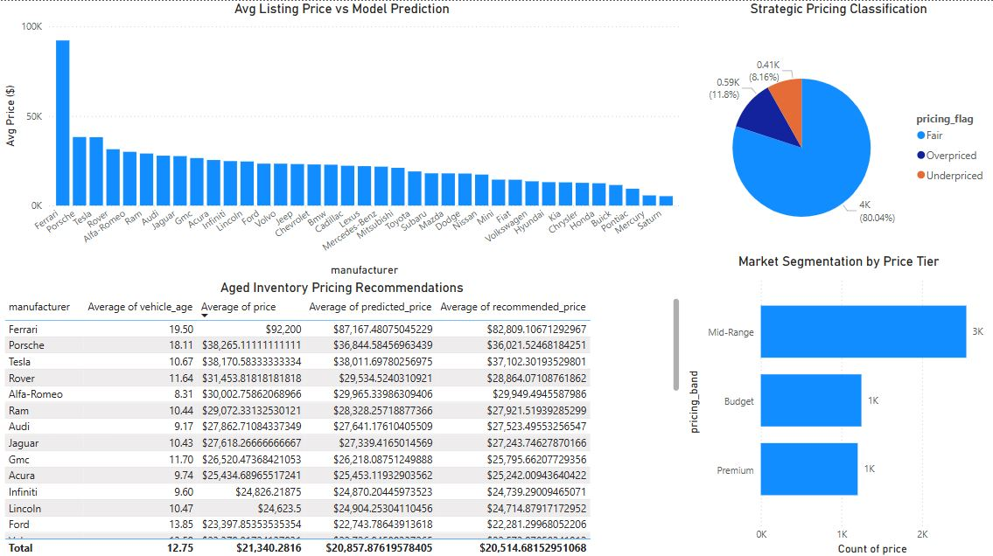
Executive Dashboard
Interactive visuals built in Power BI
Slice by pricing flag, manufacturer, age band
Helps align pricing decisions with strategy

Slide 10

Key Takeaways
Reprice overpriced listings for quicker turnover
Apply markdowns to aged inventory
Focus marketing on mid-range segments
Use monthly model-driven pricing updates

Slide 11
Future Enhancements
Real-time pricing integration
Add more features: market trends, dealer markup
Build API link with inventory management systems

