Slide 1

Heart Risk Project; Data Analysis
By: Mahsa Nafei, Jesús Hernández, Fernando Lopez, and Alexandru Arnautu

Slide 2

Heart Risk Data Analysis
Overview
Our repository combines two data sources and API Coordinates to predict heart attack risk using machine learning and visualization analysis. It features a Flask-based web application for risk prediction, a data processing script using Postgresql in Amazon RDS, and employs Spark for data cleaning and preparation. We employed data Plotly, Pandas and Folium for visualization and analysis.
Objective
This project focuses on using a dataset to create a predictive model for assessing an individual's risk of having a heart attack. It aims to understand how specific lifestyle factors influence the probability of heart risk
Age
Blood Pressure
Cholesterol Levels
Diabetic Status
Hours of Sleep
Medication Use
Obesity
Physical Activity
Smoking
Triglycerides
Our project seeks to examine the data outlined above to help insurance companies provide more detail specific health programs for patients affected by heart risk, by looking at related factors. A critical aspect of the project is ensuring fairness and reducing bias in predictions across different demographic groups, and instead focused on creating a global pattern rather than continent/country specific ones. Our goals throughout the making of this analysis, was to focus on improving risk assessment accuracy through supervised machine learning to support informed decision-making in heart attack risk evaluation.

Slide 3
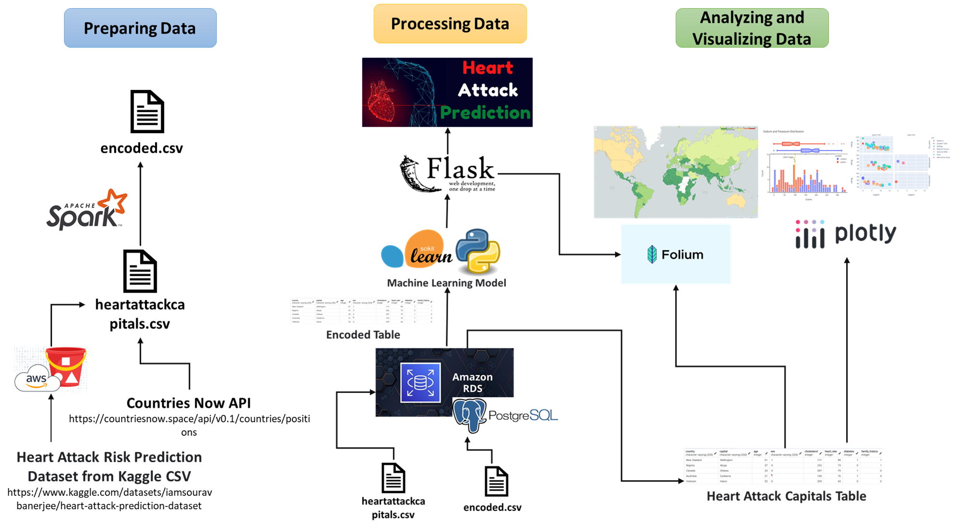
Data Collection and Preprocessing
Preparing the Data
Processing the Data
Analyzing and Visualizing the Data
The heart Attack Risk Prediction dataset was sourced from Kaggle in CSV format. Geographical coordinates were obtained via Now API. Data is encoded using Amazon RDS and processed with Apache Spark.
Refined datasets, including Heart Attack Capitals and Encoded CSV, were analyzed using PostgreSQL on Amazon RDS and an optimal machine learning model for Flask's Heart Attack Prediction app..
Analytical conclusions are communicated through detailed visualizations crafted with Folium, Pandas, and Plotly.

Slide 4


Slide 5
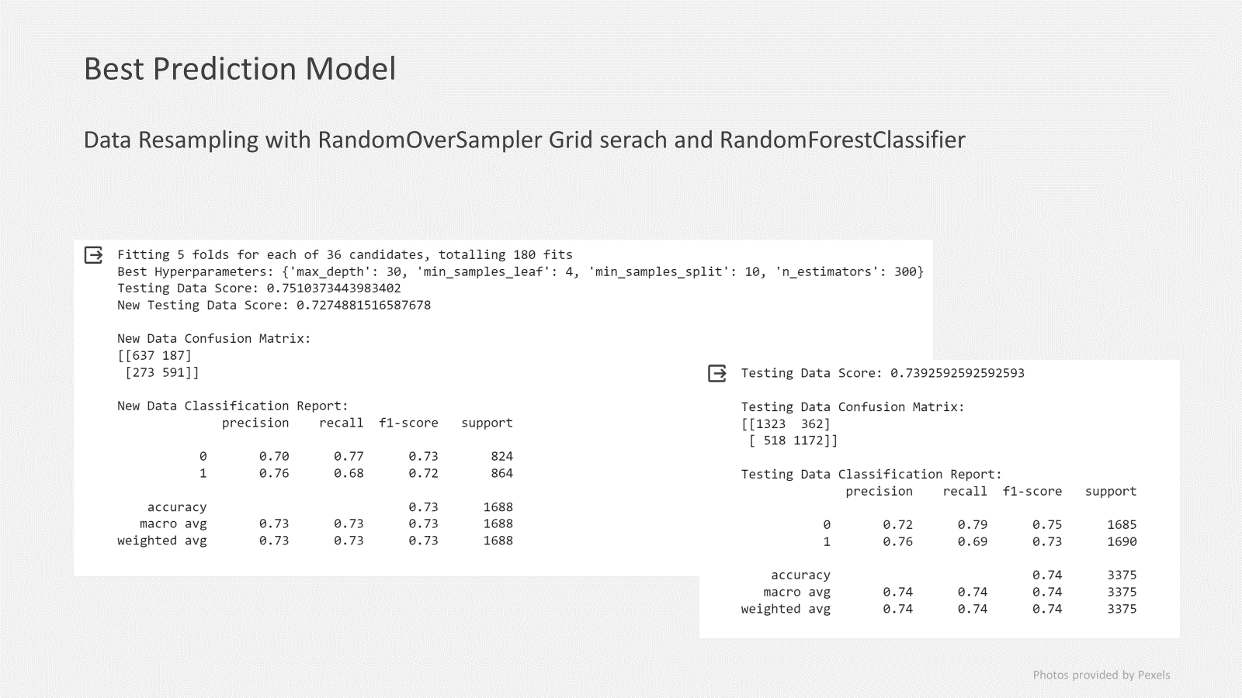

Slide 6
Demo
Heart Attack Risk Prediction App

Slide 7
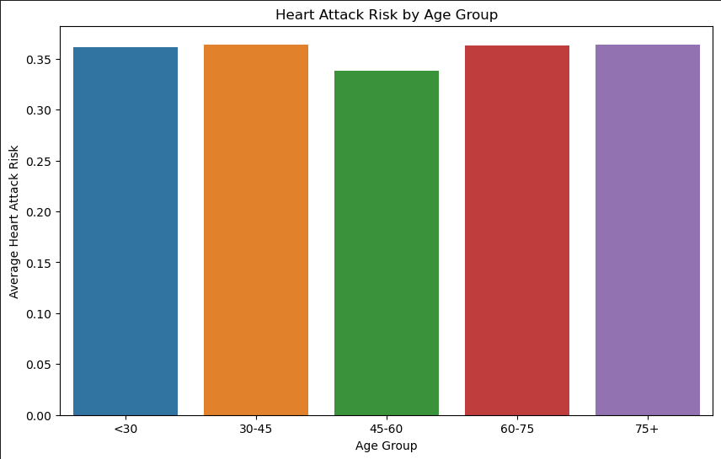
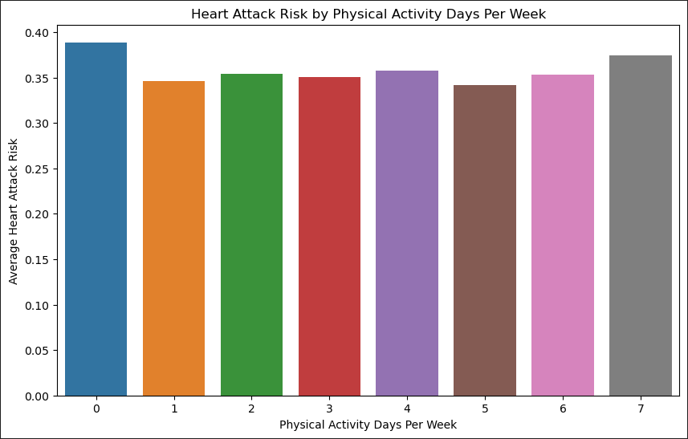
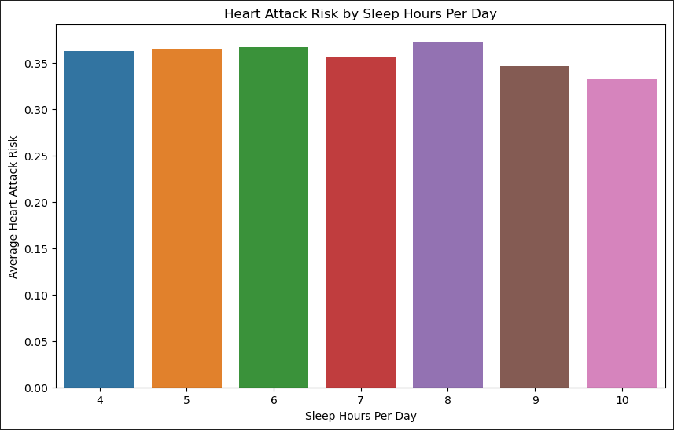
Data Analysis and Visualizations
Heart Attack Risk by Age Group
Heart Attack Risk by Physical Activity Days Per Week
Heart Attack Risk by Hours of Sleep per day
The bar graph provided illustrates a comparative analysis of heart attack risk across different age groups. It highlights that individuals aged 75 and above are at an elevated risk of experiencing a heart attack. Conversely, the graph also indicates that people between the ages of 45 to 60 exhibit the lowest risk of such cardiac events.
The bar chart indicates that individuals inactive throughout the week face the highest heart attack risk, while those active daily are also at a notable risk. People with five active days per week show the least risk for heart attacks.
The bar graph suggests that a daily rest of 10 hours minimizes the risk of heart attacks. It also notes that an 8-hour sleep duration appears to have the highest associated risk, potentially attributable to it being the most common sleep duration.

Slide 8
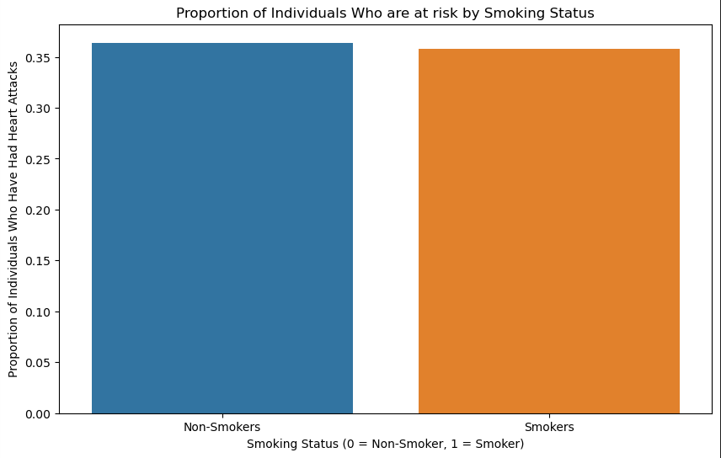
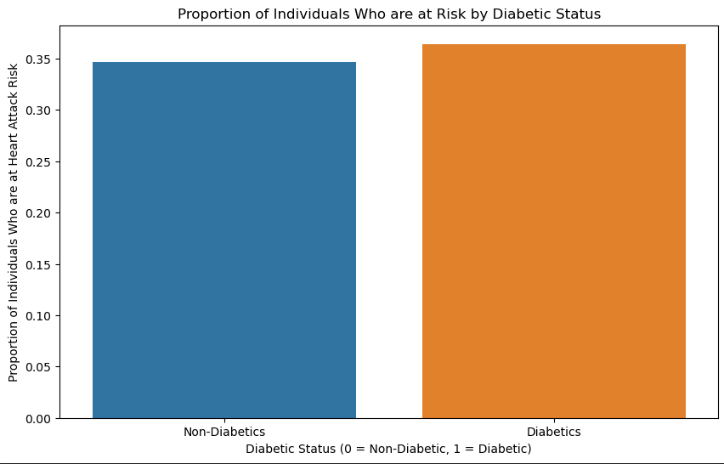
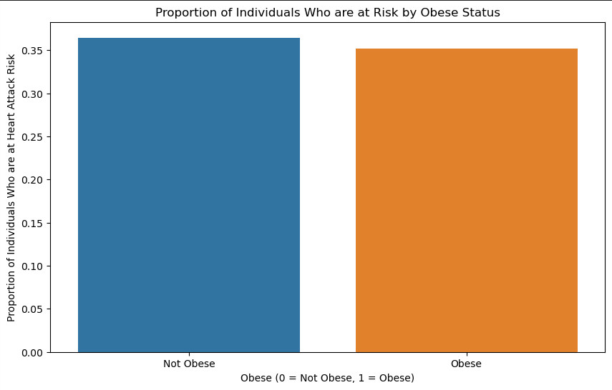
Data Analysis and Visualizations
Proportion of Individuals who are at risk by Smoking Status
Proportion of Individuals who are at risk by Diabetic Status
Proportion of Individuals who are at risk by Obesity Status
The graph displays a surprising trend: smokers seemingly have a reduced heart attack risk. This could be an instance of the "smoker's paradox," where smokers may exhibit a misleading resilience to heart attacks due to variables not captured in the data.
The graph demonstrates that individuals with diabetes have an elevated risk of experiencing heart attacks.
The graph indicates that obese individuals appear to have a lower risk of heart attacks, possibly due to protective factors or more intensive medical treatments often given to overweight patients.

Slide 9
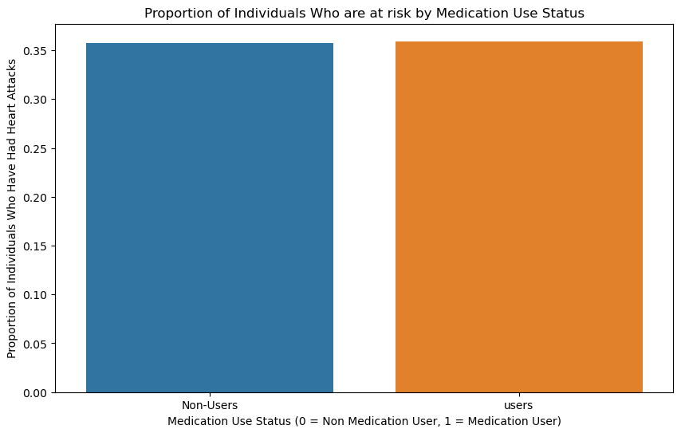
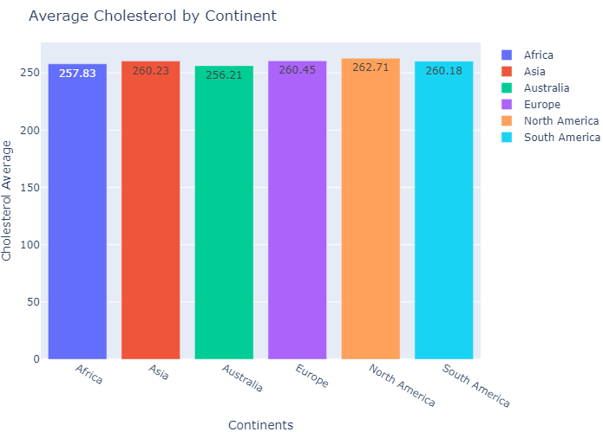
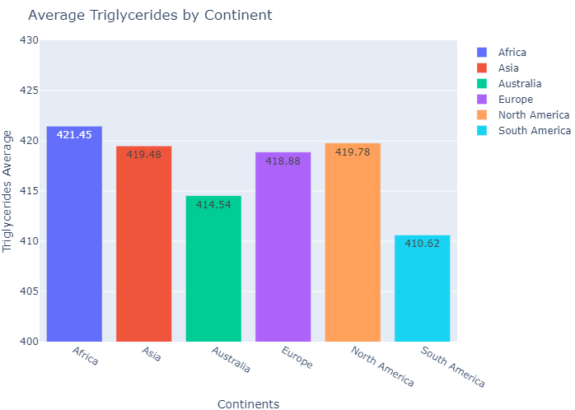
Data Analysis and Visualizations
Proportion of patients at risk who use Medication
Average Cholesterol Levels per Continent
Average Triglyceride Levels per Continent
The bar graph vividly conveys that individuals who adhere to a medication regimen exhibit a diminished risk of heart attacks.
The bar graph elegantly displays the comparative average cholesterol levels across continents, revealing North America as the region with the highest readings, while Australia boasts the lowest cholesterol figures.
The bar graph elegantly delineates the triglyceride levels by continent, pinpointing South America as the region with the minimal levels, while Africa emerges with the maximum.

Slide 10
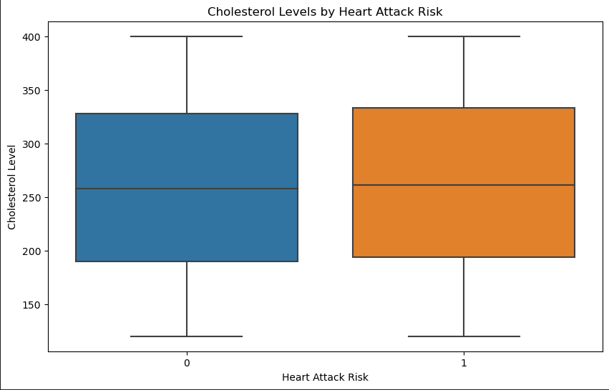
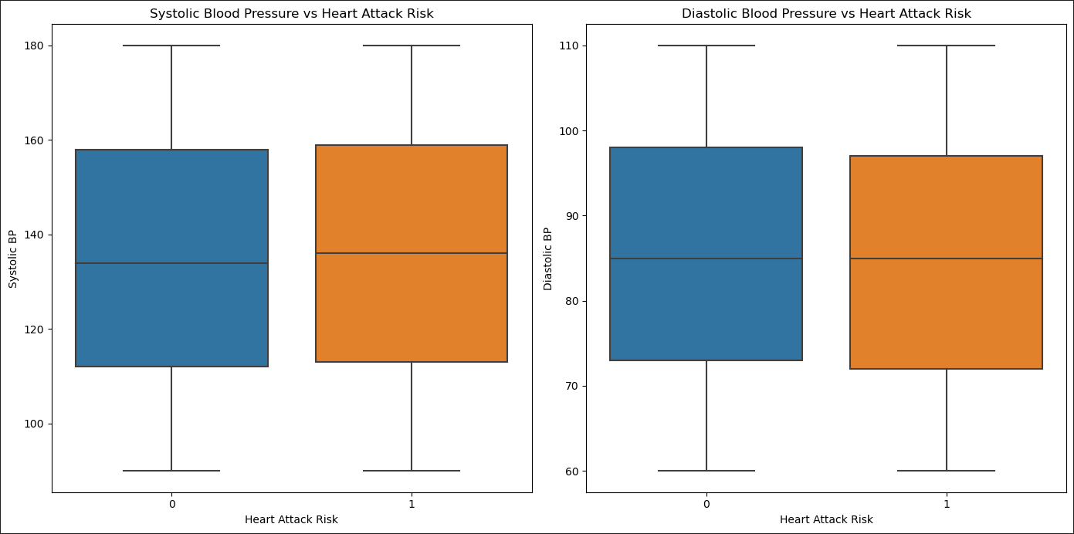
Data Analysis and Visualizations
Cholesterol Levels by Heart Attack Risk
Systolic and Diastolic Blood Pressure vs Heart Attack Risk
The box plot graph elegantly illustrates that elevated cholesterol levels are associated with an increased risk of cardiac events.
These box plots reveal a nuanced cardiovascular insight: individuals with elevated systolic blood pressure face an increased susceptibility to heart attacks, whereas those with higher diastolic blood pressure exhibit a surprisingly reduced risk.

Slide 11
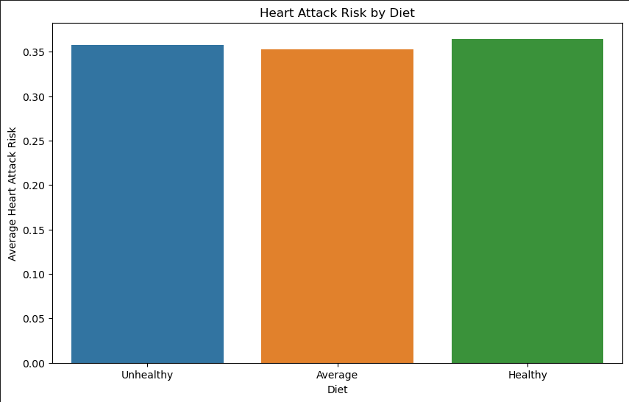
Insights and Findings
Key Insights
While the majority of the data collected aligns with expectations and demonstrates predictable patterns, certain unanticipated results have emerged due to key influence. Given that the data compilation spanned globally and accounted for numerous variable, it is conceivable that the sample size of 8,763 patients may not have been sufficiently large to encapsulate a definitive accuracy in the datas representation.
Trends and Patterns
The analysis reveals that adequate sleep and medication compliance are linked to a lower incidence of heart attacks. Moreover, it’s observed that people adhering to exceptionally healthy diets often register a higher risk of heart attacks. This counterintuitive result could be related to a phenomenon known as the “health-conscious worker effect,” where individuals who are proactive about their health are more likely to get regular check-ups. Such vigilance may lead to a higher reported incidence of heart issues simply because their conditions are more likely to be diagnosed then those less health-conscious

Slide 12

Conclusion
Actionable Steps
Potential Interventions
To minimize your heart attack risk, ensure ample sleep, adhere to a nutritious diet, maintain a five-day exercise regimen per week, comply with medication schedules, and keep cholesterol levels in check.
To achieve a representative dataset with global scope, and expanded sample size is necessitated.
Future Research Opportunities
Further examination could be conducted into the median age of individuals adhering to a nutritious diet and an in-depth analysis of familial heart disease history among both smokers and non-smokers, to glean additional insights in the occurrence of the “smoker paradox” phenomenon.

