Slide 1
A Digital Twin Framework for Amgen's Autoinjectors
Mahsa Raeisinezhad Mechanical Engineer/Data Engineer
Mahsaraeesinezhad@gmail.com
Notes:
It implies exploring new and improved ways of connecting autoinjectors to digital networks, devices, or platforms to enhance their functionality, data-sharing capabilities, or user experience. This phrase often indicates a forward-looking mindset and a willingness to explore advancements in technology to improve the performance and capabilities of autoinjectors.

Slide 2
Autoinjectors are designed to enhance convenience, patient adherence, and overall treatment experience
Amgen's Innovation: ENBREL Mini™ with AutoTouch™ in 2017
Patient-Centric Design:
Ergonomic handle for ease of use.
Hidden needle during injection for patient comfort.
Integration of a sensor for precise placement on the skin.
Innovative Features:
Speed switch with three injection speeds.
Progress bar for visual tracking.
Speaker for enhanced user guidance.
https://www.amgen.com/newsroom/press-releases/2017/11/amgen-launches-the-enbrel-mini-single-dose-prefilled-cartridge-with-autotouch-reusable-autoinjector-that-is-ergonomically-designed-for-patients
Notes:
It implies exploring new and improved ways of connecting autoinjectors to digital networks, devices, or platforms to enhance their functionality, data-sharing capabilities, or user experience. This phrase often indicates a forward-looking mindset and a willingness to explore advancements in technology to improve the performance and capabilities of autoinjectors.

Slide 3
Amgen's ENBREL Mini™ uses a sensor to detect placement on the skin
Incorporated sensors in the Amgen's autoinjectors system
represents a significant stride toward the integration of digital twin technology
Notes:
It implies exploring new and improved ways of connecting autoinjectors to digital networks, devices, or platforms to enhance their functionality, data-sharing capabilities, or user experience. This phrase often indicates a forward-looking mindset and a willingness to explore advancements in technology to improve the performance and capabilities of autoinjectors.

Slide 4
What are Digital Twins
Defining a Digital Twin (DT) can be subjective
Physical System (PS) ​
Digital Twin​ (DT)
Means to connect the Physical System to its Digital counter part​
Digital counter part of the Physical System
Notes:
Defining a Digital Twin (DT) can be subjective Digital Twins are where the two fields of Computer Science and Mechanical Engineering meet,nd capabilities of autoinjectors.
Definition:
DT it is a virtual counterpart to a physical product, with data and information flowing between them through IoT devices.
Every DT consists of:
Digital/Virtual realm
Physical counterpart
Set of relationships, means and connections between them

Slide 5
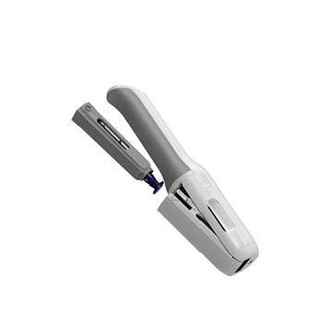
The digital twin serves as a virtual representation of the physical system
Physical System (PS) ​
In the context of a digital twin, a Physical System (PS) refers to the real-world, physical entity or system that is replicated, monitored, and controlled by its digital counterpart
Notes:
After I go through digital twins definition and why are they important in pharmecuetical industry I will go through the digital twin that I have created
Defining a Digital Twin (DT) can be subjective Digital Twins are where the two fields of Computer Science and Mechanical Engineering meet,nd capabilities of autoinjectors.
Definition:
DT it is a virtual counterpart to a physical product, with data and information flowing between them through IoT devices.
Every DT consists of:
Digital/Virtual realm
Physical counterpart
Set of relationships, means and connections between them

Slide 6
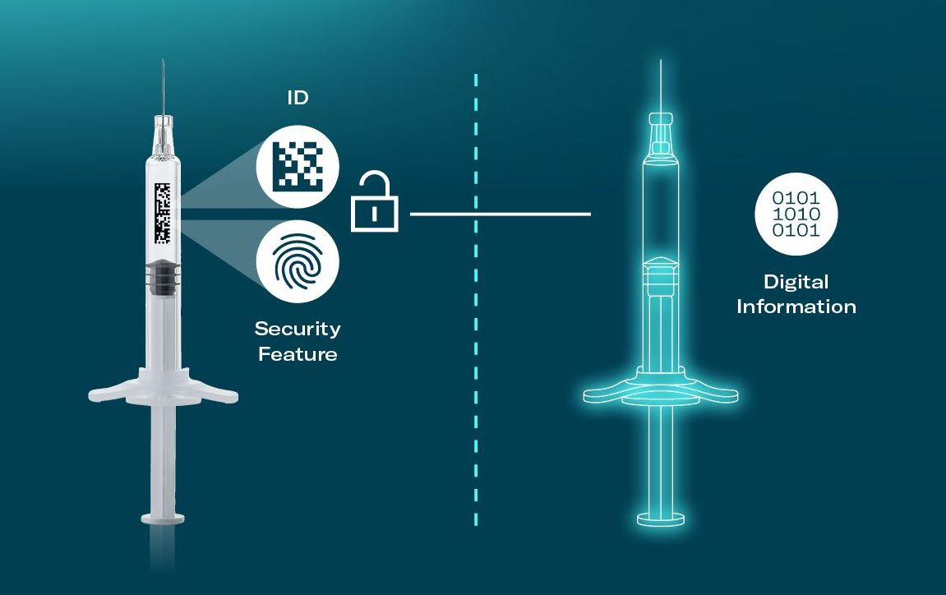
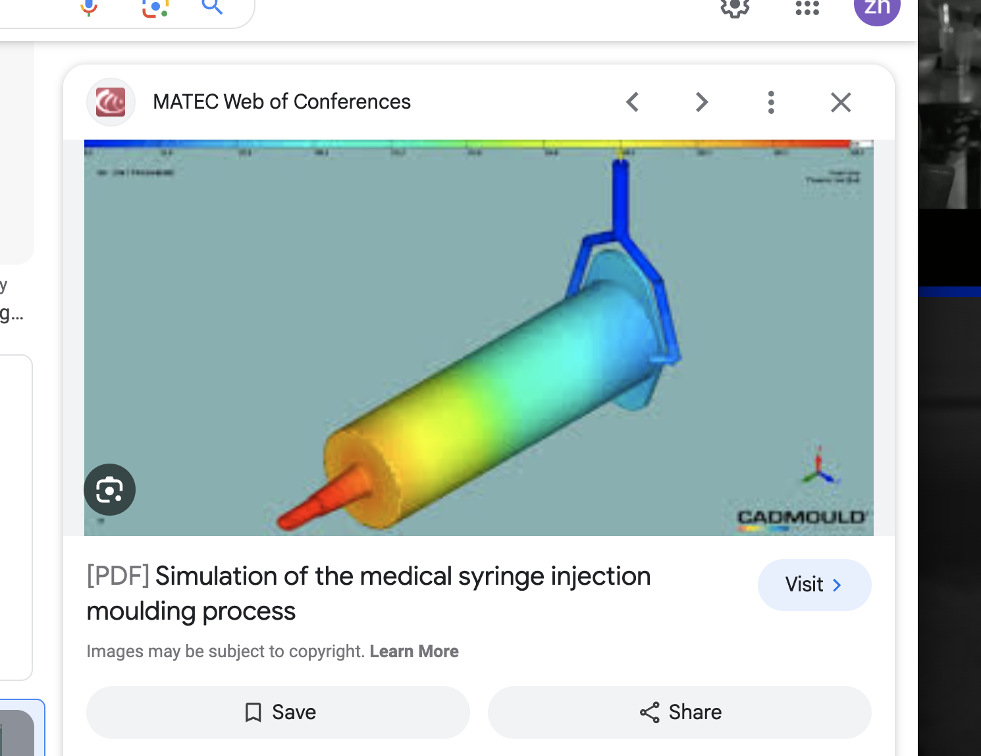
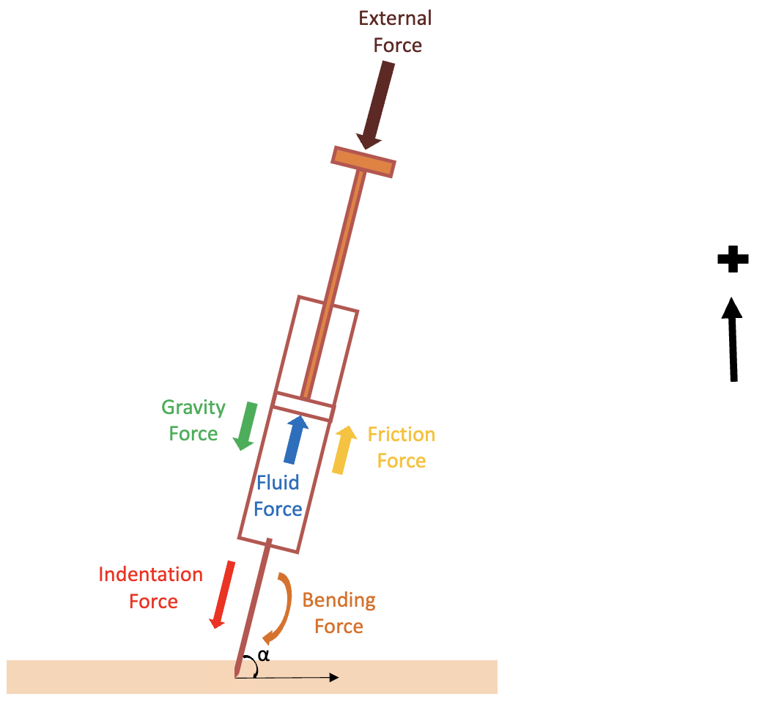

What is digital counterpart of the physical system
”Digital realm” includes one or more of the following: Data analytics, AI techniques, physics-based models from a simple block diagram to 3D CAD models.​
Digital counter part of the Physical System
ANSYS, LS-Dyna, ABAQUS, COMSOL simulations
First principal physics of the system
AI Algorithms
Notes:
Means to connect the two so that the digital system can update is states in real time

Slide 7
Sets of relationships, means and connections between the physical system and DT
Means to connect the Physical System to its Digital counter part​
IoT devices
or
advanced sensors ​
Historical
or
real time sensor data
Fed to the DT to update its states
Notes:
Defining a Digital Twin (DT) can be subjective Digital Twins are where the two fields of Computer Science and Mechanical Engineering meet,nd capabilities of autoinjectors.
Definition:
DT it is a virtual counterpart to a physical product, with data and information flowing between them through IoT devices.
Every DT consists of:
Digital/Virtual realm
Physical counterpart
Set of relationships, means and connections between them

Slide 8
DT in pharmaceutical industry: Clinical trials that use DTs are referred to as ‘twin randomized control trials’, or twin RCTs
Haoda Fu, Associate Vice President, Enterprise Lead Machine Learning and AI, Eli Lilly, asserts: “Digital twins are critical for pharmaceutical success.”
If the patient receives the active treatment within the trial and an observed outcome is received, the “difference between the observed treatment outcome and the predicted placebo outcome is an estimate for the individual treatment effect”, he explains. This can then be aggregated over the entire group of patients to get an average estimate of the drug’s treatment effect.
Speaking at Reuters Events: Pharma Clinical 2022, Charles Fisher, Founder and CEO, Unlearn.AI, elaborates on this technology.
Twin RCTs hold the potential for faster, more efficient clinical trials with fewer subjects, providing actionable insights into which patients achieve the greatest benefit of a treatment – all while ensuring comprehensive, reliable evidence with fewer barriers. As such,
https://www.emg-gold.com/post/the-emergence-of-digital-twins
Notes:
It implies exploring new and improved ways of connecting autoinjectors to digital networks, devices, or platforms to enhance their functionality, data-sharing capabilities, or user experience. This phrase often indicates a forward-looking mindset and a willingness to explore advancements in technology to improve the performance and capabilities of autoinjectors.

Slide 9

The data issue in pharmaceutical industry is that AI-based DTs need to be fueled by huge amounts of data
While DTs hold huge potential for clinical trials, unfortunately, “AI-based models don’t work by magic”.
“We can only predict things for which we have enough data to learn from,”
Data quality
Amount of data
Crucial for providing accurate AI predictions
$$+$$
https://www.emg-gold.com/post/the-emergence-of-digital-twins
Notes:
AI based models are extremely dependent on the quality of the data and amount of the data

Slide 10
Solution to data issue can be solved using physics-based AI models and Monte Carlo Simulation for effective solutions
DT framework for Amgen’s Auto Injector can be made using first principal physics of the system + AI
DT : First principal physics of the autoinjector and AI
Sensor measurements, such as Temperature, or Humidity levels, updates the states of the autoinjector’s DT
https://www.emg-gold.com/post/the-emergence-of-digital-twins
Notes:
It implies exploring new and improved ways of connecting autoinjectors to digital networks, devices, or platforms to enhance their functionality, data-sharing capabilities, or user experience. This phrase often indicates a forward-looking mindset and a willingness to explore advancements in technology to improve the performance and capabilities of autoinjectors.

Slide 11
DT framework for Amgen’s Auto Injector can be made by using first principal physics of the system + AI
Simulating the fault free behavior of the autoinjector through its first principal physics
Real time sensor data
Raise an alarm in case of discrepancy between auto injector’s sensor measurements and physics-based model’s results
Compare sensor data with physics-based model’s data
Predict if anything would go wrong in the future (AI)

Slide 12
Fault free behavior of the autoinjector simulation through first principal physics
External
Force
Net forces that act on the syringe
Net syringe force = external force – fluid force – friction force + gravity force * sin(α)
Net forces that act on skin
Gravity Force
Net force = Indentation force - (cutting force + friction force skin)
Friction Force
Fluid Force
Indentation
Force
Bending Force
α
Friction Force
Cutting Force
Bending force = gravity force * cos(α)
Indentation force = net syringe force
Notes:
Lets say based on different factors such as temperature or humidity levels

Slide 13
Fault free behavior of the autoinjector simulation through first principal physics
def simulate_syringe_skin_penetration(
external_force, humidity, temperature, needle_length=0.05, tissue_coeficient_friction = 0.33, needle_diameter = 5e-3,
time_step=0.001, total_time=0.03, fluid_mass=0.08, bending_force_max=10.98, injection_type = "Intramuscular"
):
# Constants
needle_diameter = needle_diameter*1e-2
needle_area = 1e-6 # Cross-sectional area of the needle (m^2)
base_skin_resistance = 500 # Base skin resistance to penetration (N/m)
temperature_factor = 1.0 + 0.01 * (temperature - 25) # Linear temperature effect (adjust as needed)
syringe_area = 0.0001 # Cross-sectional area of the syringe needle (m^2)
fluid_pressure_remaining = 127323.95 # Fluid pressure inside the syringe (Pa)
friction_coefficient = 0.2 # Friction coefficient between syringe walls and rubber
gravity = 9.81 # Acceleration due to gravity (m/s^2)
empty_syringe_mass = 0.08
rubber_mass = 0.2 * empty_syringe_mass
fluid_remaining = syringe_area * needle_length # Initial fluid remaining
syringe_mass = fluid_mass + empty_syringe_mass
fluid_density = fluid_mass / fluid_remaining
Notes:
Lets say based on different factors such as temperature or humidity levels

Slide 14
Fault free behavior of the autoinjector simulation through first principal physics
# Variables
time_points = np.arange(0, total_time, time_step)
displacement = 0 # Initial displacement
velocity = 0 # Initial velocity
vel_rubber = 0 # Initial rubber velocity
disp_rub = 0
# Lists to store data for plotting
penetration_depths = []
velocities = []
needle_angle_rad_ = []
vel_rubbs = []
disp_rubs = []
Notes:
Lets say based on different factors such as temperature or humidity levels

Slide 15
Fault free behavior of the autoinjector simulation through first principal physics
# Variables
time_points = np.arange(0, total_time, time_step)
displacement = 0 # Initial displacement
velocity = 0 # Initial velocity
vel_rubber = 0 # Initial rubber velocity
disp_rub = 0
# Lists to store data for plotting
penetration_depths = []
velocities = []
needle_angle_rad_ = []
vel_rubbs = []
disp_rubs = []
Notes:
Lets say based on different factors such as temperature or humidity levels

Slide 16
Future work
Monte Carlo Simulation
Define Input Parameters:
Identify the key input parameters of the digital twin model.
Determine Probability Distributions:
Assign probability distributions to each input parameter
Generate Random Samples:
Use a random number generator to generate random samples for each input parameter based on its assigned probability distribution. You may generate many samples (e.g., thousands) to capture the full range of possible scenarios.
Injection force samples = np.random.uniform(min_injection_force, max_injection_force, num_samples)
Run Simulations:
For each set of input parameters, run the digital twin simulation to obtain the corresponding output.
Collect Output Data:
Collect the output data from each simulation run
Analyze Results:
Analyze the collected output data to understand the variability and uncertainty in the model. You can calculate statistics like mean, standard deviation, percentiles, or create probability density functions.
Visualize Results:
Create visualizations to present the results effectively.
Sensitivity Analysis:
Perform sensitivity analysis to identify which input parameters have the most significant impact on the model output.
Iterate and Refine:
Based on the insights gained, iterate and refine the model or its input parameter distributions.

Slide 17
# Simulation loop
for time in time_points:
penetration_depths.append(displacement)
velocities.append(velocity)
vel_rubbs.append(vel_rubber)
disp_rubs.append(disp_rub)
fluid_force = fluid_pressure_remaining * syringe_area # Force due to fluid pressure
friction_force = friction_coefficient * vel_rubber # Friction force
gravity_force = syringe_mass * gravity # Force due to gravity
# Net force
net_syringe_force = external_force - fluid_force - friction_force + gravity_force
acc_rubber = net_syringe_force / rubber_mass
vel_rubber -= acc_rubber * time_step
disp_rub += vel_rubber * time_step
# Modified skin resistance based on humidity and temperature
skin_resistance = base_skin_resistance * humidity * temperature_factor # approximate: for more accurate results use Ogden material model
needle_angle_rad = np.arccos(bending_force_max / net_syringe_force)
bending_force_avg = gravity_force * np.cos(needle_angle_rad)
# Calculate friction coefficient
mu = calculate_friction_coefficient(tissue_coeficient_friction, needle_diameter)
indentation_force = net_syringe_force
cutting_force = skin_resistance * 3.14 * (needle_diameter**2) # Needle perimeter
friction_force_skin = mu * velocity # Example friction force
# Net force
net_force = indentation_force - (cutting_force + friction_force_skin)
# Acceleration is needles acc
acceleration = net_force / syringe_mass
# Update velocity and displacement using numerical integration (Euler's method)
# This vel is needle's vel
velocity -= acceleration * time_step
displacement += velocity * time_step # this disp is needles
needle_angle_rad_.append(needle_angle_rad)
fluid_pressure_remaining -= fluid_density * gravity * disp_rub
fluid_remaining -= syringe_area * disp_rub
if injection_type == "Intramuscular":
max_needle_penetration = 0.03
if injection_type == "Subcutaneous":
max_needle_penetration = 0.02
elif injection_type == "Intradermal":
max_needle_penetration = 0.003
if abs(displacement) >= max_needle_penetration or fluid_remaining <= 0 or abs(disp_rub) >= needle_length:
velocity = 0 # Needle has stopped, set velocity to zero
vel_rubber = 0
acceleration = 0
acc_rubber = 0
fluid_remaining = 0
fluid_pressure_remaining = 0
disp_rub = - needle_length
displacement = -max_needle_penetration
# Store data for plotting
if net_force <=0:
velocity = 0 # Needle has stopped, set velocity to zero
vel_rubber = 0
acceleration = 0
acc_rubber = 0
fluid_remaining = 0
fluid_pressure_remaining = 0
disp_rub = 0
displacement = 0
# print(fluid_pressure_remaining)
fluid_mass = fluid_density * fluid_remaining
return time_points, penetration_depths, velocities, needle_angle_rad_, vel_rubbs, disp_rubs
Notes:
Based on max allowable bending force we can calculate the range of angles that the syringe can be applied
It implies exploring new and improved ways of connecting autoinjectors to digital networks, devices, or platforms to enhance their functionality, data-sharing capabilities, or user experience. This phrase often indicates a forward-looking mindset and a willingness to explore advancements in technology to improve the performance and capabilities of autoinjectors.

Slide 18
net_syringe_force = external_force - fluid_force - friction_force + gravity_force
What Are DTs
External Force
Gravity Force
Friction Force
Fluid Force
Indentation Force
Bending Force
α
Notes:
Based on max allowable bending force we can calculate the range of angles that the syringe can be applied
Dts are where computer science meets mechanical engineering
There are so many definitions out there for defining what a digital twin is, but after all my research and reading so many papers I would say when you combine first physics of your system with a user interface and AI you have created a digital twin
Digital version here is physics of the system combined with AI, and a mean to maintain the connection between them
Here our mechanical engineering counterpart of the system is the physics of the autoinjector
And

Slide 19
net_syringe_force = external_force - fluid_force - friction_force + gravity_force
indentation_force = net_syringe_force * np.cos(needle_angle_rad_avg)
External Force
Gravity Force
Friction Force
Fluid Force
Indentation Force
Bending Force
α
Notes:
It implies exploring new and improved ways of connecting autoinjectors to digital networks, devices, or platforms to enhance their functionality, data-sharing capabilities, or user experience. This phrase often indicates a forward-looking mindset and a willingness to explore advancements in technology to improve the performance and capabilities of autoinjectors.

Slide 20

net_syringe_force = external_force - fluid_force - friction_force + gravity_force
indentation_force = net_syringe_force * np.cos(needle_angle_rad_avg)
External Force
Gravity Force
Friction Force
Fluid Force
Indentation Force
Bending Force
Notes:
It implies exploring new and improved ways of connecting autoinjectors to digital networks, devices, or platforms to enhance their functionality, data-sharing capabilities, or user experience. This phrase often indicates a forward-looking mindset and a willingness to explore advancements in technology to improve the performance and capabilities of autoinjectors.

Slide 21
Physical System (PS) ​
Digital Twin​ (DT)
Means to maintain real time relationship between Physical System and Digital counter part​
Digital counter part of the Physical System
14

Slide 22
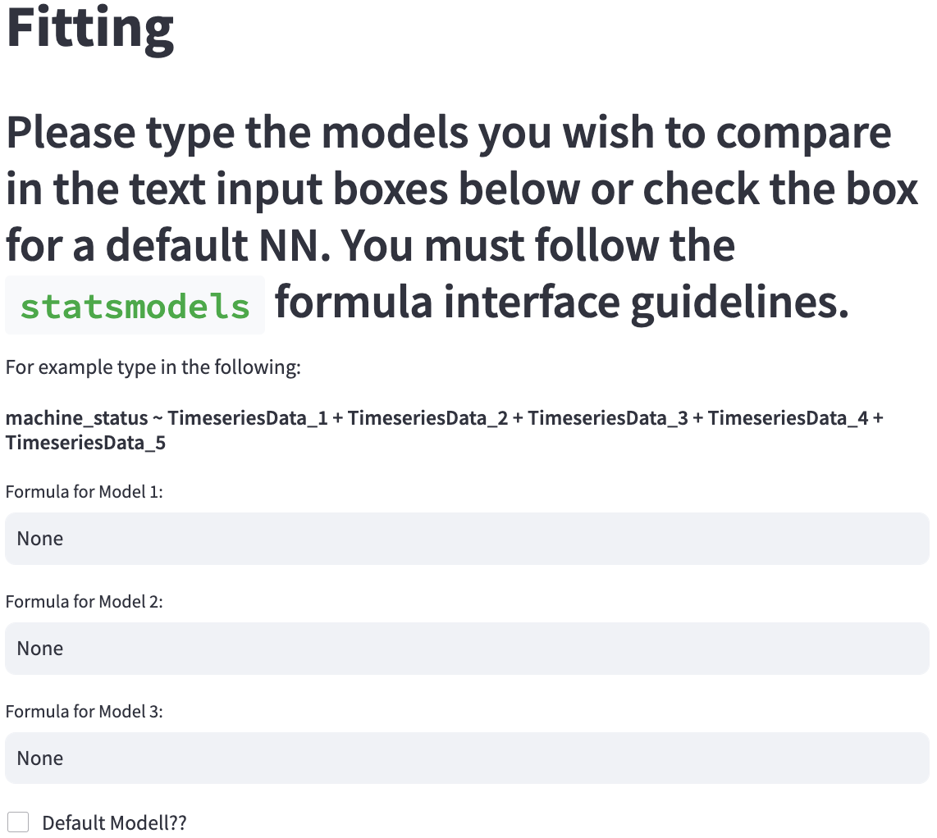
Fitting User-Selected/Default AI Models
Results of Simulink/MATLAB Model
+
User-Interface (UI)
IoT sensor Data
There’s no Platform or toolset that explores the range of ML algorithms for nuclear-specific applications
18
Notes:
But, what is this user interface, what is the digital twin, what is IoT?
Ill explain all in the upcoming sections
If DT go to page number: 11?
If UI open the UI and page 10
If IOT go to DT

Slide 23
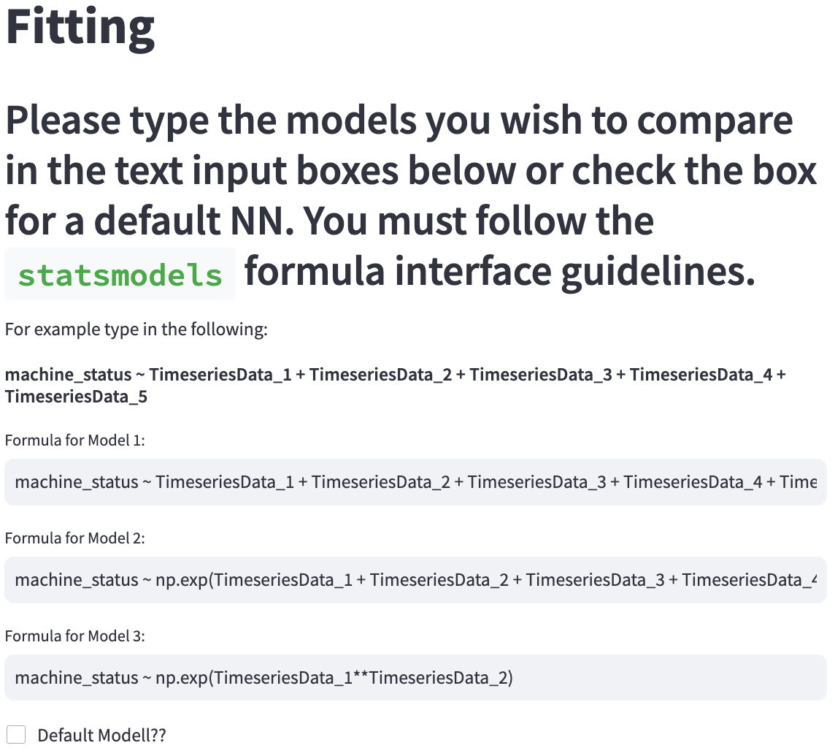
Fitting User-Selected/Default AI Models
Results of Simulink/MATLAB Model
+
User-Interface (UI)
IoT sensor Data
There’s no Platform or toolset that explores the range of ML algorithms for nuclear-specific applications
18
Notes:
But, what is this user interface, what is the digital twin, what is IoT?
Ill explain all in the upcoming sections
If DT go to page number: 11?
If UI open the UI and page 10
If IOT go to DT

Slide 24
UI application is the solution to both existing challenges and gaps in DT adoption in nuclear industry
Simulink/MATLAB Model
IoT sensor Data
User-Interface (UI)
Basic data visualization for the purpose of model selection and data analysis
Fitting User-Selected/Default AI Models
Error Rates & Model Assessment
XAI Techniques
19
Notes:
To overcome these barriers, what is needed is a well-constructed explainable fault detection and diagnosis model to be used in the nuclear power plants digital twins that can use current and historical data about the plant’s condition and generate understandable information about the future and current state of the plant
We will create a framework for a digital twin of a pump which can be extended to other parts of the power plant system. We will get the real-time sensor measurements through IoT devices such as sensors and the DT simulations then we will
feed it into the UI interface and then machine learning models for the purpose of FDD will be applied on them, then explainable AI models will be applied to make them explainable with short instructions on how to interpret each eXplainable AI (XAI) plots.
JUST GO TRHOUGH THE PROPOSALS SECTIONS
DRAW SIMPLE BLOCK DIAGRAM OF SIMULINK, AI, SHAP =>>
This is what I am proposing to build and analyze and
START WIITH THE NEED AND BACK GROUND
PUT A SLIDE FOR OBJECTIVES (IN THIS RESEARCH I’M GOING TO ACCOMPLISH THESE OBJECTIVES THAT I AM GOING TO ACCOMPLISH HERE: 3 THINGS IN THE G&O)
PROBLEM 1
SOLUTION DEALING WITH GAP 1(PROBLEM 1)
PROBLEM 2 DEALING W GAP 2
SOLUTION
EXPLAIN DT, THE PROBLEM WITH IT EXPLANABILITY
AND SHAP,
AND UI AT THE END
THEN EXPLAIN THE RESEARCH APPROACH ( SIMULINK + SENSOR MEASUREMENTS + AI MODEL WHAT AI MODEL +SHAP)
FIRST EXPLAIN EVERYTHING
MY RESEARCH IS TRYING TO EXPLAIN
OVERAL GOAL IS …. 1,2, 3
PUT A SMALL FIGURE COLLOR THE OJECTIVE PART IN EACH SLIDE
MAKE A FIGURE ABOUT OBJECTIVE (IS SOLUTION )
WHAT MEASUREMENTS AM I GOING TO MAKE AND HOW AM I GOING TO MAKE IT

