Slide 1
Voice-Based Patient Call System

Slide 2
Introduction
Problem Statement
Communication delays in hospitals lead to inefficient patient care.
Traditional systems lack interaction and priority handling.
Proposed Solution
Voice-based AI system for natural patient communication.
AI analyzes and prioritizes patient requests.
Nurses receive real-time alerts via a mobile app.

Slide 3
Project Objectives
Seamless voice communication between patients and nurses.
AI-powered request analysis and prioritization.
Integration of Speech Services (Speech-to-Text & Text-to-Speech).
Real-time request display for nurses via a mobile app.
Faster response times for critical requests.

Slide 4
System Architecture
Voice Assistant: Captures patient requests.
Speech Services: Converts speech to text and vice versa.
AI & NLP Engine: Analyzes the request and determines priority.
Mobile App: Displays requests for nurses in real time.
Cloud Backend: Stores patient requests and system data.

Slide 5
Technologies Used
AI & NLP: Azure OpenAI, Autonomous AI Agents.
Speech Services: Azure Speech-to-Text, Text-to-Speech.
Mobile App: Developed using Android/iOS tools.
Backend & Database: Cloud-based storage and processing.

Slide 6
Workflow of the System
Patient speaks their request to the voice assistant.
AI converts speech to text and analyzes urgency.
System assigns a priority level (High, Medium, Low).
Request is sent to nurses via the mobile app.
Nurses respond based on priority and attend to the patient.

Slide 7
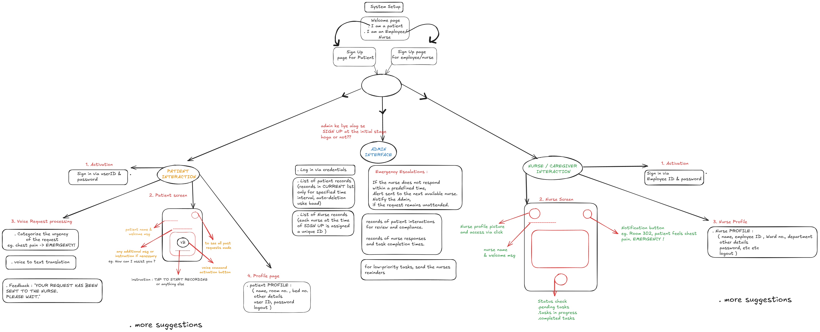

Slide 8
Features of the System
Voice-Based Communication: Patients communicate naturally.
AI-Powered Prioritization: Smart ranking of requests.
Real-Time Notifications: Instant alerts for nurses.
User-Friendly Interface: Easy request tracking.
Multi-Patient Handling: Supports multiple patients.

Slide 9
Implementation Modules
Voice Assistant & AI Agents: Captures voice requests.
Speech Services & NLP: Converts speech to text, assigns priority.
Nurse Mobile App: Displays real-time requests.
Testing & Deployment: Ensuring accuracy and security.

Slide 10
Benefits & Impact
Faster Nurse Response: Reduces patient waiting time.
Improved Patient Experience: Easier communication.
Prioritized Request Handling: Urgent needs addressed first.
Better Hospital Efficiency: Automates nurse call management.

Slide 11
Challenges & Solutions
Handling multiple patient requests→ AI manages queues.
Ensuring speech recognition accuracy → Training AI models.
Privacy and security concerns → Encryption implemented.
Integration with hospital systems → Using APIs for data exchange.

Slide 12
Future Enhancements
Multi-Language Support: Expanding language accessibility.
Integration with Hospital Systems: Sync with patient records.
AI Health Monitoring: Detecting distress in patient voices.
Wearable Device Integration: Smart accessibility.

Slide 13
Conclusion
AI-driven patient call system improves communication.
AI ensures urgent requests are prioritized.
Mobile app provides real-time updates.
Enhancing patient care efficiency in hospitals.

Slide 14
Thank You!
Q&A Session

