Slide 1


Exploring Black Friday & Cyber Monday Tweets
Springboard Data Science Bootcamp
Capstone Project 2
Mahshid Mohammadi
Feb 2018

Slide 2
Introduction
The project is about exploring Black Friday and Cyber Monday tweets and retweets (4.6 million tweets) that were collected between Nov 8 – Dec 1, 2017 through twitter streaming API.
The objective is to gain insight about popular times for tweeting, hot topics, and correlations between the number of retweets, number of followers, and other twitter account features.
I chose Twitter and Black Friday shopping because of my personal interest in the applications of data science in social media, business, and marketing. Defining this project gave me the opportunity to collect a very large and rich dataset and work on it.

Slide 3
Data
Size: ~110 GB in json format
Size after initial processing:
Tweet dataset size: ~ 570 MB (~1.7 million tweets/rows)
Retweet dataset size: ~ 1.4 GB (~2.9 million retweets/rows)
I collected the tweets through Twitter streaming API from Nov 8 to Dec 1, 2017, tracking the followings:
blackfriday | blackfriday2017 | cybermonday | cybermonday2017 | blackfridayshopping | blackfridaydeals | cybermondaydeals

Slide 4
Workflow
Data Collection
Data Mining
Follower Count (ML)
Hot Topics
Sentiment Analysis
Time Studies

Slide 5
Workflow
Collecting the data & splitting the large json files (up to 19 GB) to processable pieces
Data Mining: Selecting the needed attributes from the tweet dictionaries and building the tweets and retweets dataframes
Time Studies - Exploratory Data Analysis (EDA): Change in the tweet volume by time & the net neutrality spike
Hot Topics (EDA): Most frequent hashtags and user mentions
Sentiment Analysis: English tweets, Apple vs Samsung
Machine Learning – Linear Regression: Correlation between the number of followers and other accounts features

Slide 6
Python Libraries Used for This Project
Tweepy
Simplejson
Glob
Pandas
Numpy
Matplotlib
Seaborn
Pendulum
Collections (Counter)
Re
Textblob
Statmodels (ols)

Slide 7
Data Collection & Handling Large Files
Each tweet is a dictionary. I saved the raw tweets in json format without any processing upon collection. There were 73 json files with sizes ranging from 100 MB to ~19 GBs. All the files were broken to pieces of ~ 700 MB (100,000 lines) so that they can be easily processed on my PC.
I processed the json files individually and saved the resulting dataframes in CSV format. These CSV files which were significantly smaller (3-8 MB) were concatenated later to form two separate dataframes for tweets (570 MB) and retweets (1.4 GB).

Slide 8
Tweet Volume & Streaming Limitation
The collected tweets were a small fraction of the actual tweet volume containing the tracked keywords. Twitter streaming is limited to a small fraction of the total volume of tweets at any given moment when a popular topic is being tracked.
Therefore, the tweet volumes & the hashtag/ mention counts presented here should be only used in a relative sense for comparison purposes.

Slide 9
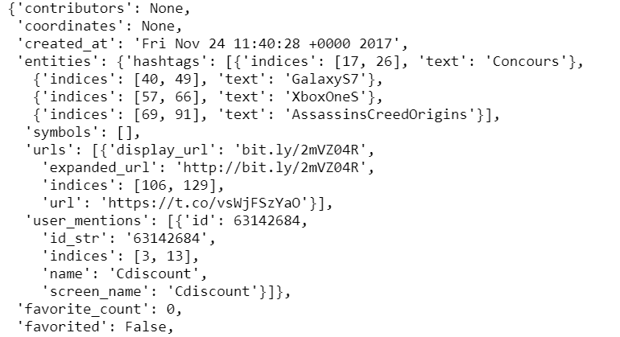
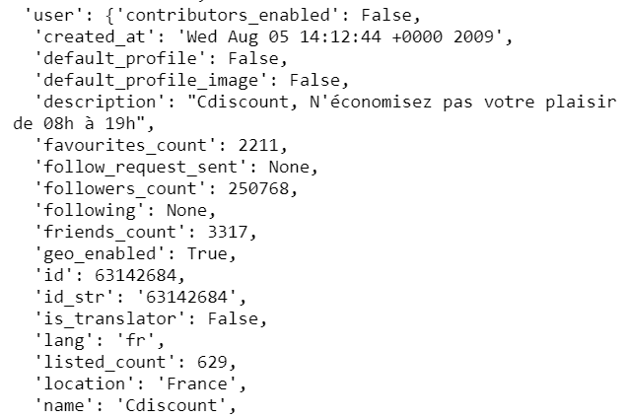
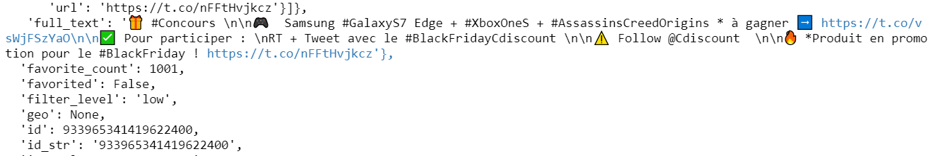
Pieces from a Sample Tweet Dictionary

Slide 10
Data Mining
The purpose of this step is to select the needed attributes from the tweet dictionaries to build the tweet and retweet dataframes.
Here are the tweet attributes that were saved:
Id | time of creation | coordinates | extended | user mentions | hashtags | fulltext | username | verified | user follower count | user friend count | user favorite count | user status count | user listed count | account creation date
Retweet dataframe contains information about the retweet id, creation time, and coordinate plus all the aforementioned attributes of the original tweet.

Slide 11
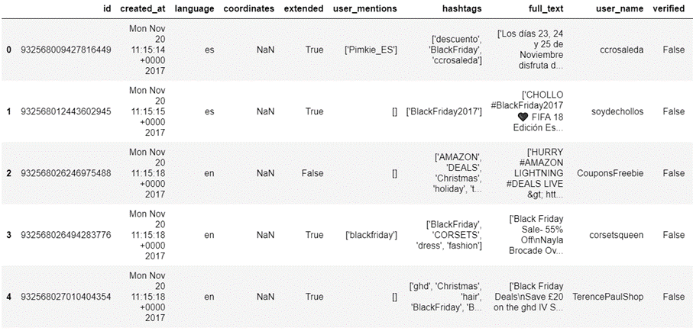
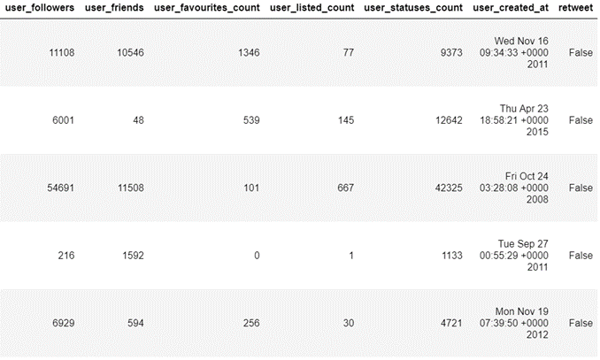
Final Tweet Data Frame (~1.7 million rows)

Slide 12
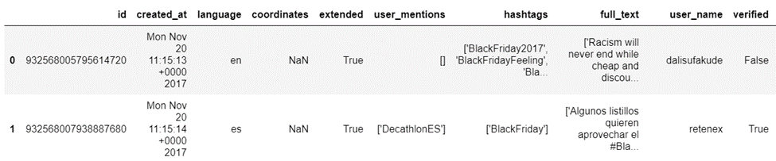
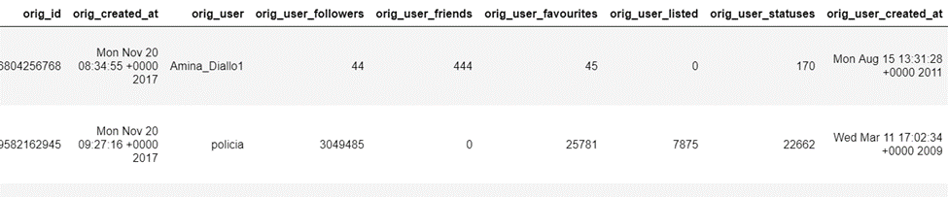
Final Retweet Data Frame (~2.9 million rows)

Slide 13
Tweet Volume over Time
Questions to think about:
How did the frequency of tweets change over time (over the course of three weeks around Black Friday)?
When did people’s enthusiasm spike for shopping?
Is there a best time to tweet to get the most exposure?

Slide 14
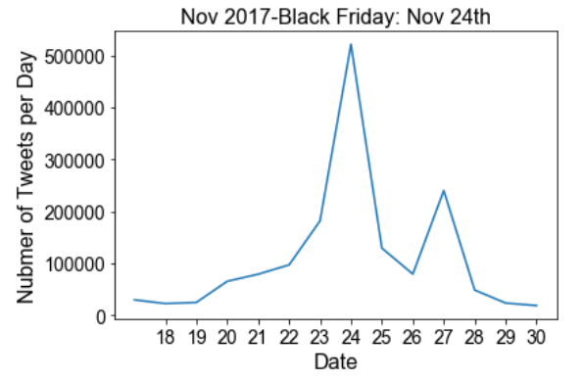
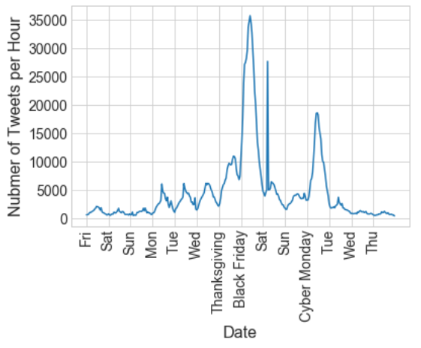
Tweets Daily & Hourly Volume (EDA)

Slide 15
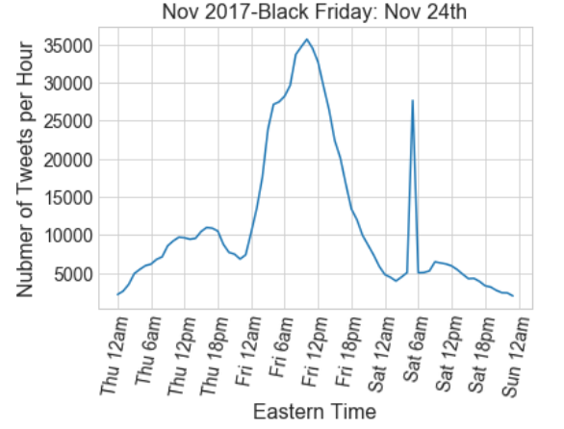

Tweets Daily & Hourly Volume (EDA)
Protest tweet right before 6 am Eastern on Small Business Saturday

Slide 16
Highest Hourly Tweet Volume
On a daily basis, the highest tweet volume occurs between 9 AM to 12 PM Eastern.
The highest hourly tweet volume:
Around 10 AM Eastern time on Black Friday (and the whole 6 AM – 12 PM span)
A sharp spike right before 6 AM Eastern time on Small Business Saturday (protest against the repeal of net neutrality)
Around 11 AM Eastern time on Cyber Monday

Slide 17
Hot Topics: Most Frequent Hashtags and Mentions
Questions to think about:
What were the hot topics around Black Friday?
What were the most popular hashtags?
Who are our business competitor that we do not know of? We can find this out by looking the most frequent retweets with the hashtags of interest or accounts which frequently post about those.
How do our competitors promote their products? We can answer this by looking at the content of the tweets with the most number of the retweets and the hashtags of interest.

Slide 18
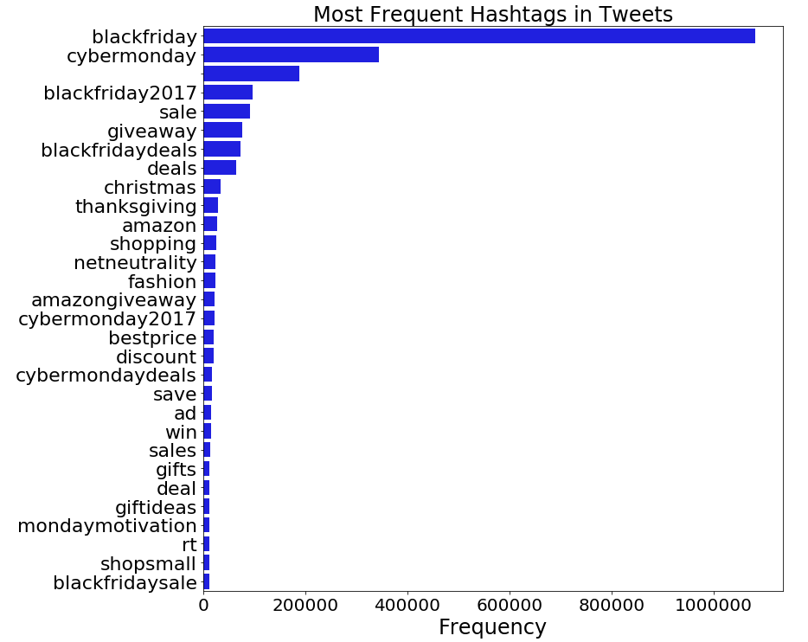
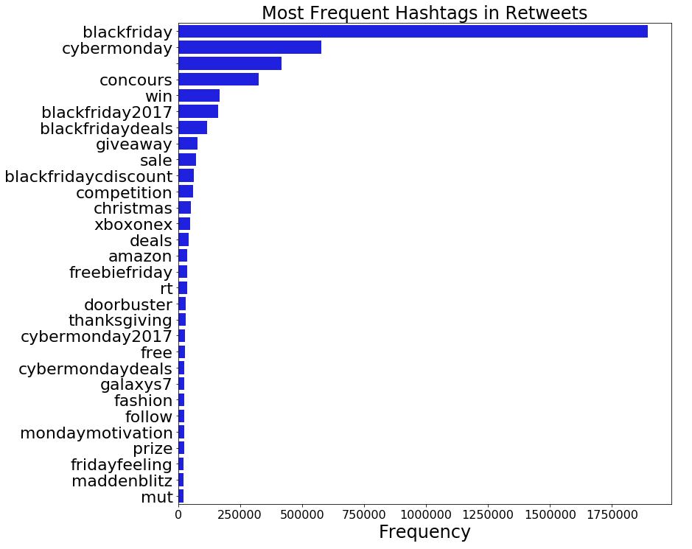
Most Frequent Hashtags
Tweets with No Hashtag

Slide 19
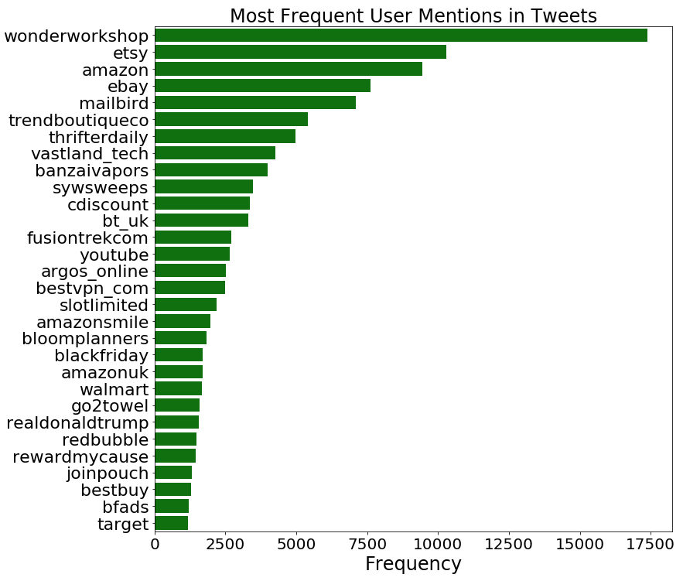
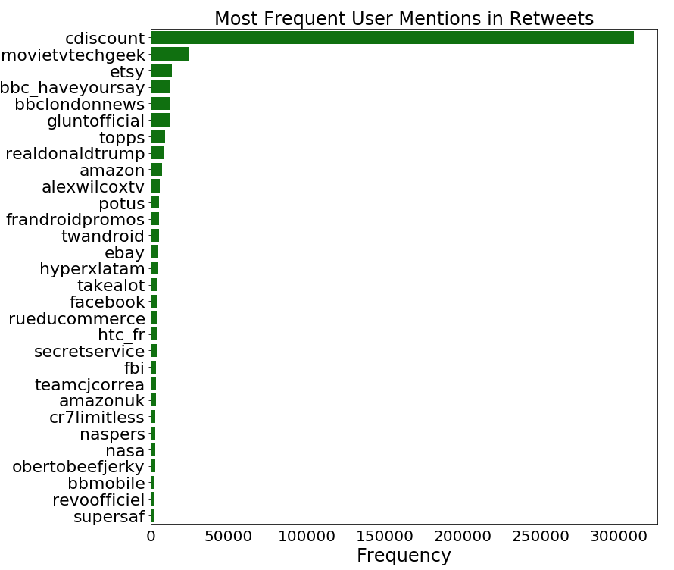
Most Frequent User Mentions e.g. @amazon

Slide 20
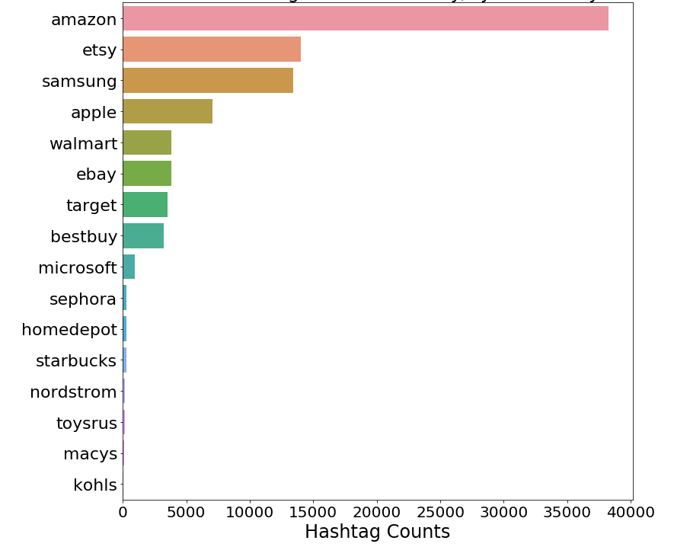
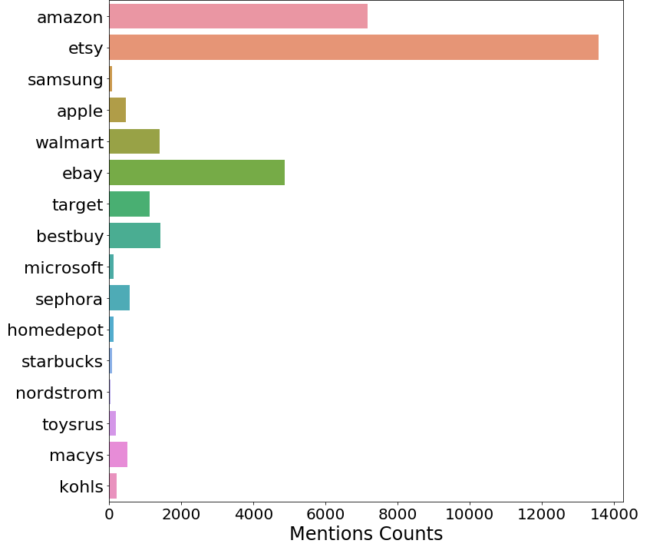
Comparison Between the Retailers
Winners: Amazon & Etsy

Slide 21
Sentiment Analysis
Questions to think about:
What was the public sentiment about our products?
What were the areas of concerns and dissatisfaction?
How to detect negative tweets automatically to address the customer’s concern early?

Slide 22
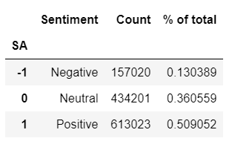
Sentiment Analysis for English Tweets
Simple sentiment analysis using TextBlob
51% positive
36% neutral
13% negative
From looking at the tweets content, it seemed that text blob False Negative rate is not trivial for the tweets about shopping, deals and discounts. However, we can still compare the sentiment about different companies with each other, assuming that the False Negative rate is the same for large samples.

Slide 23
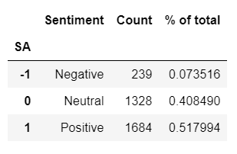
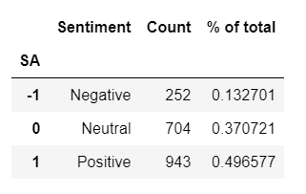
Sentiment Analysis: Apple vs. Samsung
I selected the tweets with #apple or @apple & #samsung or @samsung.
The sentiment of tweets about Apple around Black Friday & Cyber Monday was more positive than the sentiment of tweets about Samsung.
Apple
Samsung
 | Apple | Samsung
Positive | 52% | 50%
Neutral | 41% | 37%
Negative | 7% | 13%

Slide 24
Machine Learning – Linear Regression
Questions to think about:
Is there a correlation between the number of retweets and the number of followers or other account features?
What helps getting more followers? Do posting a lot of statuses, liking other tweets, or following a lot of accounts help?

Slide 25
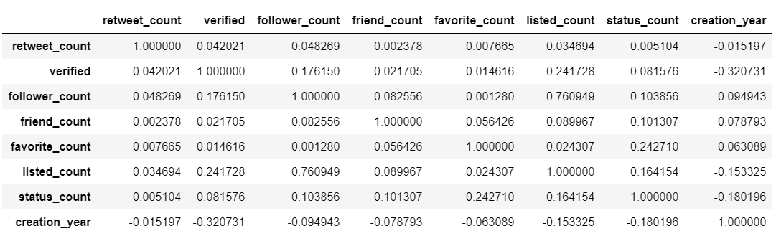
Correlations Between Retweet Count & Account Attributes
At first, I looked at each original tweet's features and the number of times that it was retweeted. It turned out that the retweet count (on the tracked topics: Blackfriday and CyberMonday) is not correlated to sender account features such as number of followers and friends, etc.

Slide 26
No Significant Correlation for Retweet Count
It seems having interesting tweet content is the factor that resulted in a high number of retweets, regardless of the features of the posting account. I think this is the beauty of Twitter that unknown users still can get a lot of attention and recognition when they post interesting content.

Slide 27
Correlations Between Follower Count & Other Account Features
Focusing on the twitter accounts, especially those that got more than 100 retweets on one of their tweets, we can detect some correlations between the number of followers and some of the account features. Linear regression has been used to describe these relationships.
Here are the features describing Twitter accounts:
verified: When true, indicates that the user has a verified account.
follower count: The number of followers the account currently has.
friend count: The number of users this account is following.
status count: The number of Tweets (including retweets) issued by the user
favorite count: The number of Tweets this user has liked in the account’s lifetime.
listed count: The number of public lists that this user is a member of.
account created at: Time that the account was created.

Slide 28
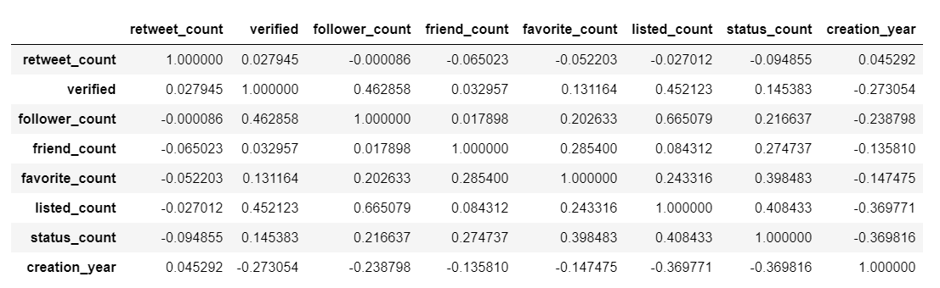
Correlation Matrix
Before Linear Regression the outliers have been removed and the variables have been scaled (min-max scaling). That weakened the correlations a little bit.

Slide 29
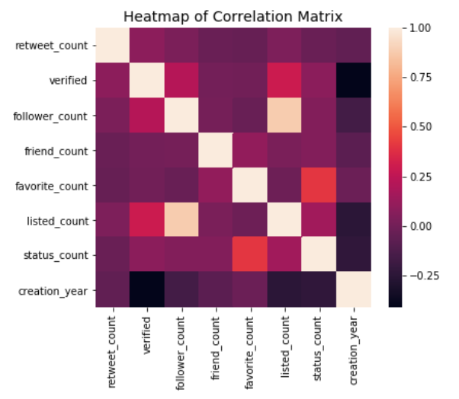
Heat Map of the Correlation Matrix
The strongest correlation is between follower count and the listed count.

Slide 30
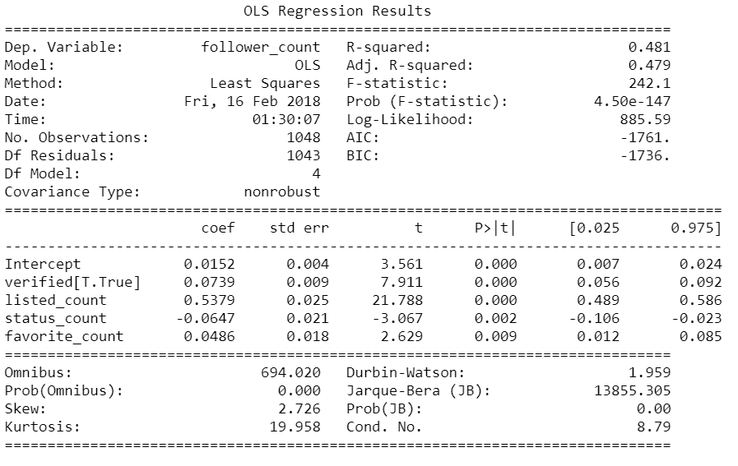
Linear Regression
Variables with p-values <0.05 are the significant variable in the linear relationship.

Slide 31
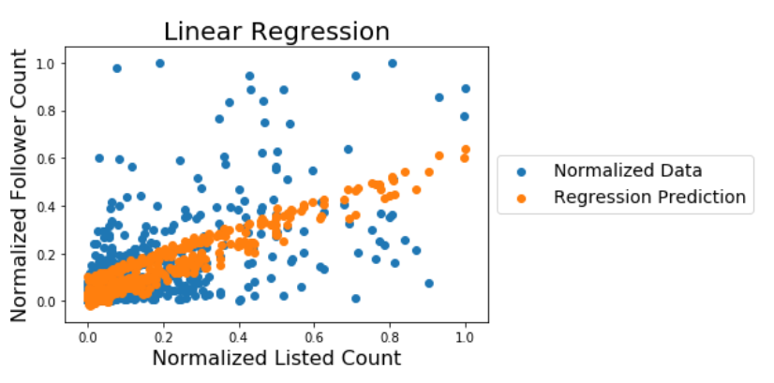
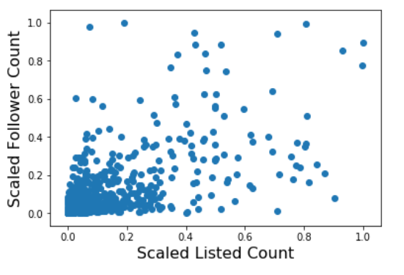
Linear Regression Prediction

Slide 32
Summary – Follower Count
Based on this study the number of followers is positively correlated with having a verified account, number of statuses, number of the public lists that the account is a member of, and the number of favorites. The number of followers is strongly correlated with the number of the public lists that the account is a member of. The correlation between the number of followers and the other three features is much less significant.
Accounts with more followers get more first hand exposure for their posted content. A lot of people may be reluctant to retweet about "Shopping Deals"; however, that does not mean those people were not interested in the deals. Getting more followers is the best way to promote advertising campaigns on Twitter, similar to having a rich mailing list for email advertising campaigns. The observed correlations in this study are valuable in that they provide insight to improve advertising campaigns.

