Slide 1
Exploring the Enron Email Dataset
Springboard Data Science Bootcamp
Capstone Project 1
Mahshid Mohammadi
Jan 2018

Slide 2
Enron
Enron was an American energy, commodities, and services company based in Houston, Texas. It was founded in 1985 and filed for bankruptcy on December 2, 2001.
Enron had approximately 20,000 employees with claimed revenues of ~$101 billion in 2000.
Fortune named Enron “America's Most Innovative Company” for six consecutive years.
At the end of 2001, it was revealed that Enron’s reported financial condition was sustained by institutionalized accounting fraud known as the Enron Scandal.

Slide 3
Enron Email Dataset
This data was originally made public by the Federal Energy Regulatory Commission during its investigation.
Data has been downloaded from www.Kaggle.com
Size: 1.3 GB
The data contains more than 500,000 emails, retrieved from the user folders of 150 Enron employees
These emails were sent by more than 20,000 unique email addresses.

Slide 4
Workflow
Data Cleaning and Wrangling
Exploratory Data Analysis (EDA)
Hypothesis Testing
Network Visualization
Inferential Statistics
Tokenization & Word Cloud
Machine Learning – Email Classifier

Slide 5
Python Libraries Used for This Project
Numpy
Pandas
Matplotlib
Seaborn
Scipy.stats
Networkx
Sklearn
Nltk.tokenize.regexp
Wordcloud
Collections.Counter

Slide 6
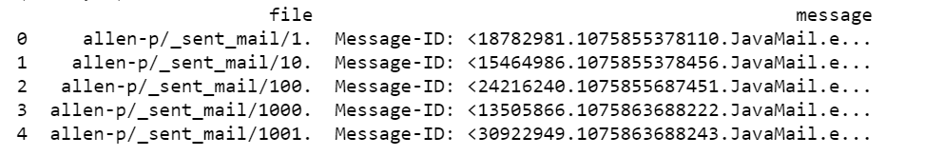
Raw Dataset
The Enron dataset is in .csv format with 517,401 rows and two columns.
The first column “File” contains the directory of the saved emails for each user and the column “message” contains the information for all the emails.

Slide 7
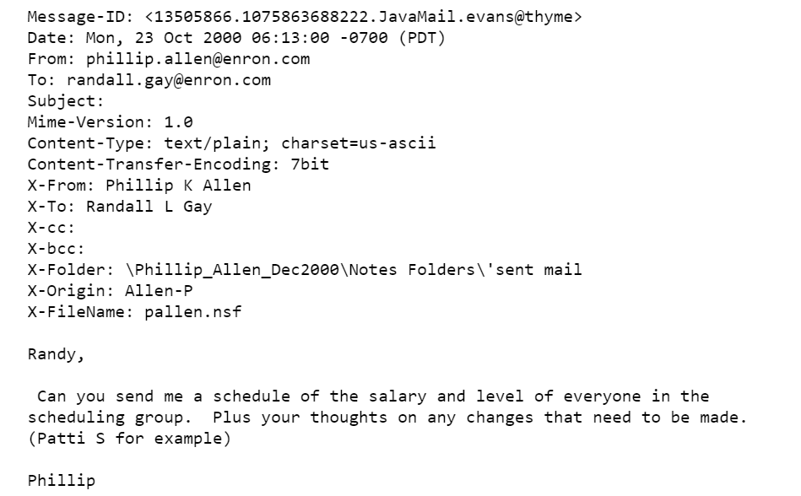
Contents of a Sample Message
Notes:
Nsf: file extension for database

Slide 8
Data Wrangling
The purpose of this step is to break down the message column into separate columns for each field in the message body.
Since the dataset is pretty large (1.3 Gb) it was not possible to read and process the data in one step. The data was read and processed in 20,000 row chunks and the results were merged at the end.
In the end of the process, the clean data with 14 columns including the index was stored in a .csv file.

Slide 9
Data Wrangling Highlights
Reading data in chunks of 20,000 rows
Using python email library for extracting the columns from message bodies
Extracting the user name from the original file column and adding a user column
Dropping 4 columns with useless data and keeping 14 columns
Appending the processed data frame chunks to a list
Concatenating the list to make a single connected data frame
Store the data frame in a .csv file

Slide 10
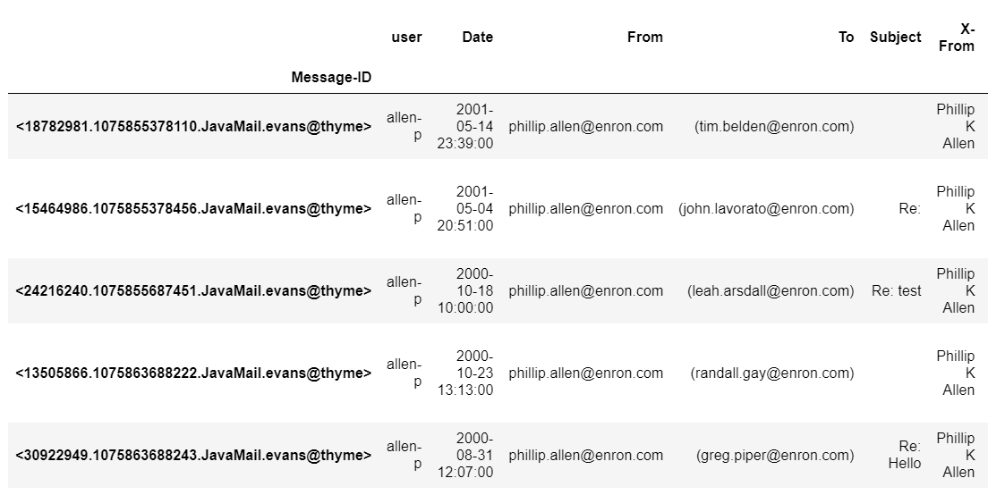
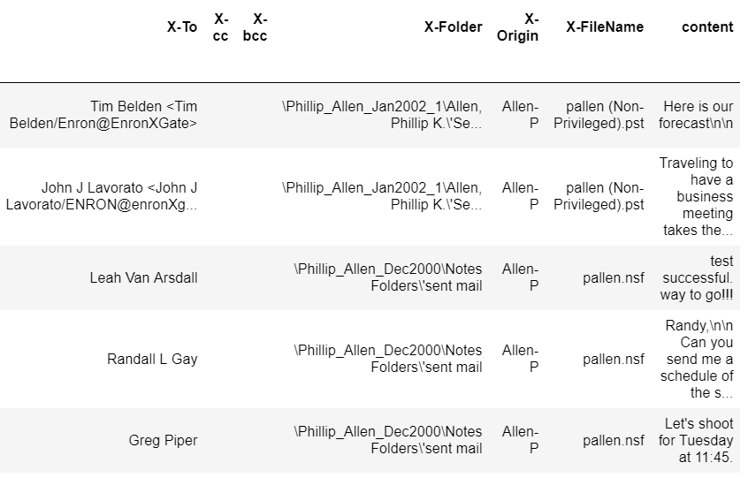
Final Data Frame

Slide 11
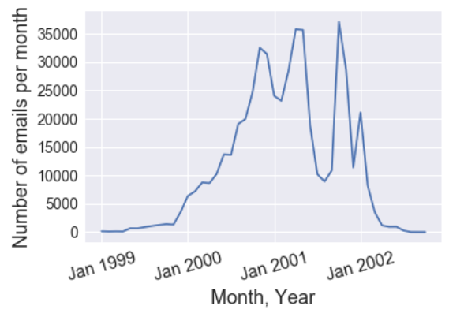
Exploratory Data Analysis (EDA)
The use of emails at Enron picked up in 1999 and increased steadily during 2000s.
In 2001, the year that Enron collapsed, there was a sudden drop in the volume of emails during summer months followed by a sharp peak in fall and a steady drop after the bankruptcy.

Slide 12
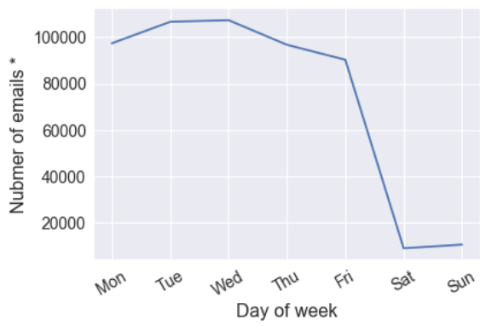
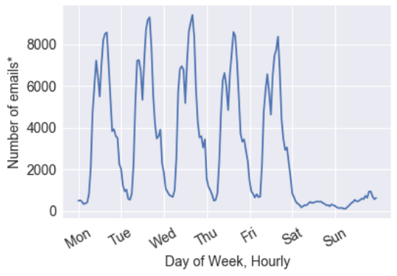
Exploratory Data Analysis (EDA)
Hourly and daily email volume
* The y axis represent the total email count during the livelihood of Enron, not the average daily volume

Slide 13
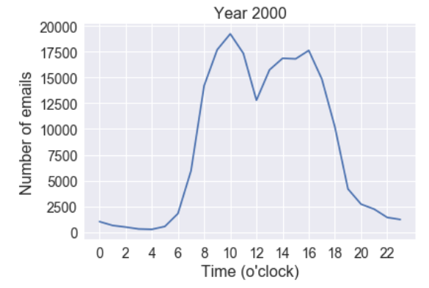
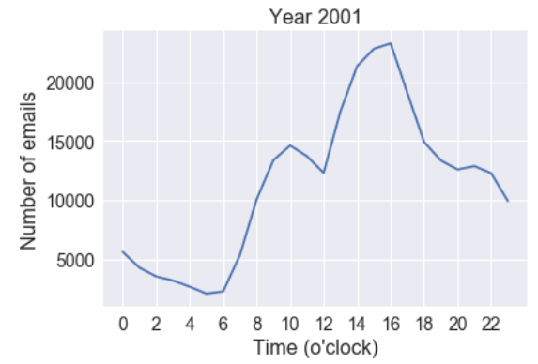
Hypothesis Testing
Question: Is there any significant difference in the email volume between 8 to 10 am and 3 to 5 pm in 2001, excluding weekends?
Motivation: By looking at the hourly email volume in 2000 and 2001 we can notice a difference between the volume of emails in the mornings and in the afternoons in 2001. 2001 is the year that Enron collapsed. One may interpret a higher volume of emails in the afternoons vs. mornings as a sign of procrastination or lack of interest by employees.

Slide 14
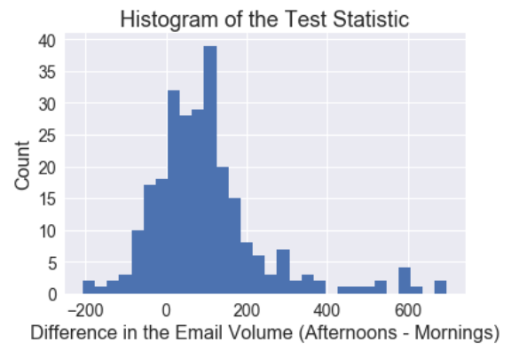
Hypothesis Testing
Hypothesis: In 2001, employees sent more emails right before leaving work late in the afternoon (3-5 pm) than when they arrived at work early in the morning (8-10 am).
Null: There is no significant difference between the number of emails sent between 8-10 am and 3-5 pm every day.
Test statistic: number of emails sent between 3-5 pm – number of emails sent between 8-10 am (weekdays).
Normal Distribution.
Suitable for one-sample t-test
Notes:
Cumulative distribution function, Q-Q plot
Design of experiment: daily comparison

Slide 15
Statistical Summary (one-sample t-test)
In 2001, Enron employees on average sent 71% more emails between 3-5 pm than 8-10 am on a daily basis (p-value: 3e-24).
The average difference between the number of emails sent in the morning and in the afternoon is 110 emails on a daily basis. The 95% confidence interval is (83.8, 119.0).

Slide 16
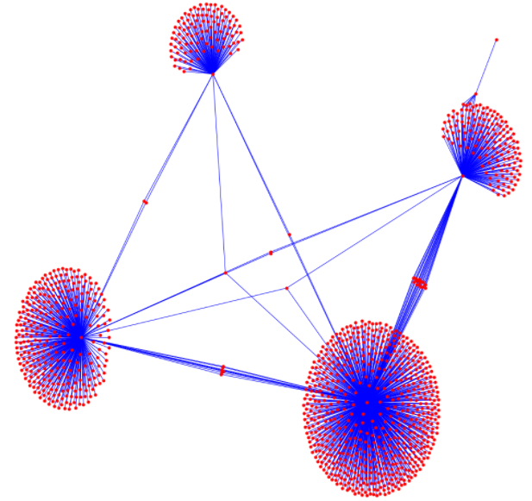
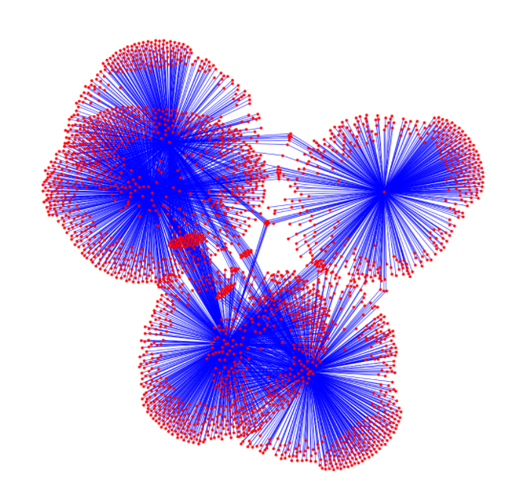
Network Visualization
Network of top 5 email senders
Network of the next 5 email senders

Slide 17
Interesting to know
From the list of most frequent emailers, the 8th email sender, sent 80% of his email to himself. The remaining 20% were cc’d to 11 people. That’s why he did not show up as a cluster kernel on the second network graph. He used email as a lab notebook to keep a log of his work.
The top email user had at least 6 different email addresses from enron.com and at least two personal email addresses from aol.com and stanford.edu. Out of 28,465 emails that he sent or received, 4,870 emails were sent to his personal email at aol.com and 14,368 emails were sent by one of his Enron emails.

Slide 18
Inferential Statistics (Word Count)
Questions I asked:
Did people who send a lot of emails write shorter emails?
Is there any correlation between the subject word count and body word count?
To answer these question the email subject and body need to be tokenized.

Slide 19
Data Wrangling before Tokenization
I decided to focus on one to one email communications between employees which can say more about the users' writing styles. I removed the followings from dataset:
emails with missing To field
emails with same From and To fields
emails with more than one recipient
emails which were not from enron.com accounts

Slide 20
Tokenization
RegexpTokenizer from the Natural Language Toolkit (nltk.tokenize.regexp) was used to tokenize the words with at least two alphanumeric characters in the subject and contents fields.
tokenizer = RegexpTokenizer(r'(?u)\b\w\w+\b’)
For each email, two columns with the word count of subject field and contents field were added to the data frame.

Slide 21
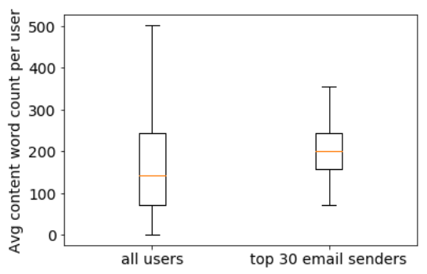
Inferential Statistics - Question 1:
Did people who send a lot of emails write shorter emails?
Comparing top 30 email senders with all email senders in terms of subject and contents word count. From the boxplot it is clear that there is no significant difference in the subject and contents word count in these two groups. A t-test was also performed to confirm the visual inference.

Slide 22
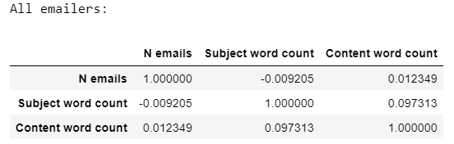
Inferential Statistics - Question 2:
Is there a correlations between number of email sent by each account, average subject word count, and average contents word count?
When we consider all the emails: No.
When we consider only the top 30 emailer: Yes (next slide)

Slide 23
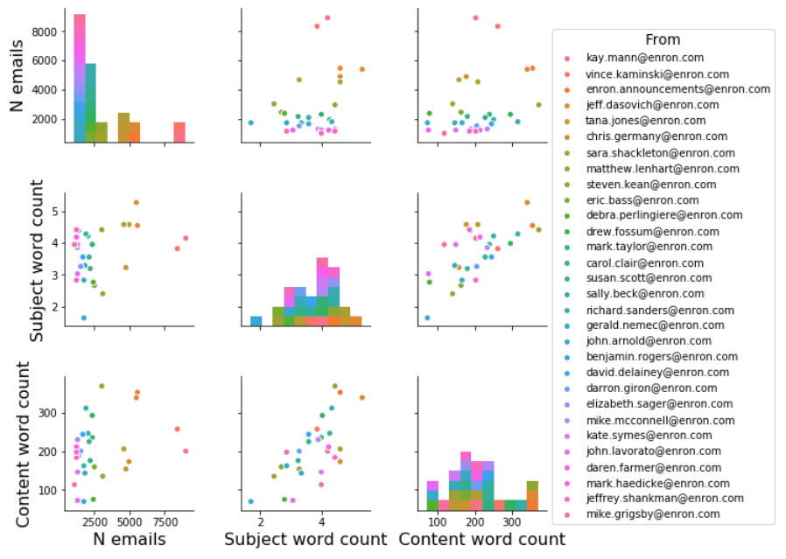
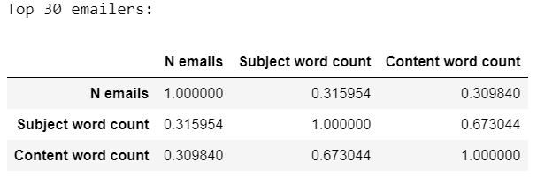
Correlation Between Subject & Content Word Count
There is a positive correlation between avg subject count and contents word count for top 30 email senders
Pair plots for top 30 emailers

Slide 24
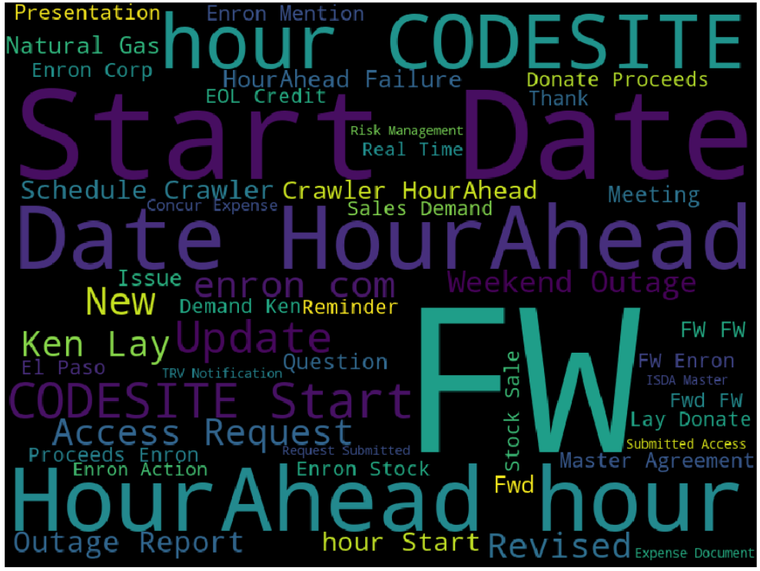
Word Cloud
The figure was produced using the Word Cloud library
The Stop Words to be removed were provided as an argument
Subject Line Word Cloud

Slide 25
The Most Frequent Words’ Counts
To find the most frequent words and their frequency in the subject fields.
Process:
Concatenating the columns to make a single long string
Tokenization
Lowercasing
Making a data frame from the tokens and their counts (using Collections.Counter)
Groupbying tokens
Removing the English stop words (318 common words from sklearn library)
It is much faster to make a data frame from the tokens and groupby them to eliminate the stop words. Otherwise every token in the list of 2,309,634 tokens has to be checked against stop words.

Slide 26
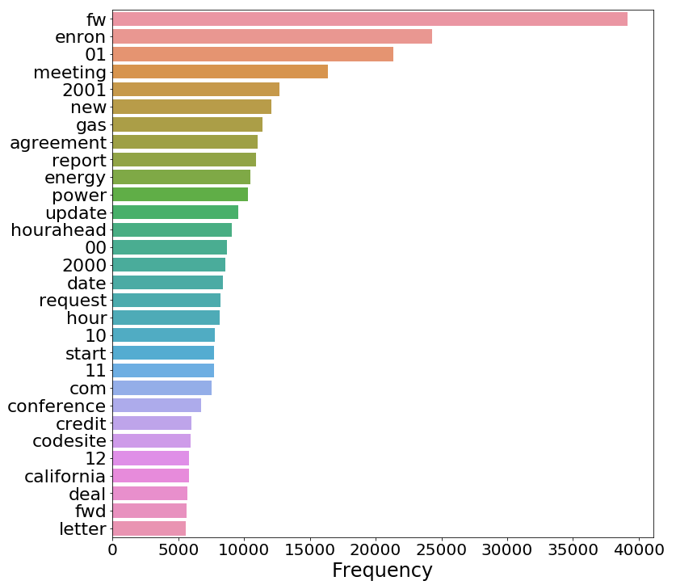
The Most Frequent Words in the Subject Field & Their Count in About 500,000 Emails

Slide 27
Machine Learning – Email Classifier
I built a classifier for emails owned by a single employee based on the labels that he used to classify his own emails. I chose to work on the emails owned by the very top email user. The steps taken are as follows:
Extracting labels from the emails
Selecting not very general labels with about 200 data points or more
Cleaning the concatenated email subject and body
Removing digits
Tokenization
Lowercasing
Removing Stop Words
Removing “_” characters used as empty spaces to fill in

Slide 28
Machine Learning – Email Classifier
I used the bag of words model for feature extraction from text. In the bag of words model, each document is treated as a vector. Each element in the vector contains frequency of a particular word in the text or another statistics representing the word frequency.
For classification I used Multinomial Naive Bayes with two different types of vectorization (count & TF-DIF), n-gram Naive Bayes, and Logistic Regression with TF-IDF featuring. Cross-validation to tune the regularization parameters was performed for all models.

Slide 29
Classification Highlights
To avoid having unbalanced training data and putting weight on more frequent labels I reduce the size of different categories to the minimum size which is 195 samples for each label.
Labels: conferences, ene_ect, London, management, projects, resumes, universities
There are 13,222 features (min-df = 1, keeping words with frequency >= 1)
Some of the words in this bag are in Polish, not English.

Slide 30
Email Classification Results
The accuracy score for training set for these four models varied between 93% and 97% while the accuracy score for the test set varied between 77% and 79%. Logistic Regression was the winner and had the highest accuracy score for the test set with a score of 79%.
Model | Bag of words featuring | Training Set Accuracy Score | Test Set Accuracy Score
Multinomial Naive Bayes | Count | 0.93 | 0.78
Multinomial Naive Bayes | TF-IDF | 0.93 | 0.77
Bigram Naive Bayes | Count | 0.97 | 0.78
Logistic Regression | TF-IDF | 0.94 | 0.79

Slide 31
Summary & Recommendation
An email classifier for labeling emails of a particular employee has been built. This classifier or extended versions of it could be used to label his emails automatically. Building the classifier for a whole company would require predefined labels and data from at least a few employees but the process for building the classifier will be the same.
Any of the followings could help to improve the performance of the classifier:
Getting access to more data points and well labeled data - labels that were assigned by the user more thoughtfully
Expanding the stop words list
Stemming or lemmazation
Working with data in one language, not two.
Notes:
Stemming usually refers to a crude heuristic process that chops off the ends of words in the hope of achieving this goal correctly most of the time, and often includes the removal of derivational affixes. Lemmatization usually refers to doing things properly with the use of a vocabulary and morphological analysis of words, normally aiming to remove inflectional endings only and to return the base or dictionary form of a word, which is known as the lemma . If confronted with the token saw, stemming might return just s, whereas lemmatization would attempt to return either see or saw depending on whether the use of the token was as a verb or a noun. The two may also differ in that stemming most commonly collapses derivationally related words, whereas lemmatization commonly only collapses the different inflectional forms of a lemma. Linguistic processing for stemming or lemmatization is often done by an additional plug-in component to the indexing process, and a number of such components exist, both commercial and open-source.

