Slide 1
SPL-1 Midterm Presentation, 2020
Project Name : Generating Abstract Syntax Tree
Course : Software Project Lab – 1
Course No : SE 305
Submitted By : M. Mahtab Hossain Jhalok
Roll : 1103
Supervised By : Abdus Satter
Designtion : Lecturer
Institute of Information Technology,
University of Dhaka

Slide 2
Introduction to my project
Abstract syntax tree is a representation of tokens generated from statements and expressions in a programming language. With the AST, the interpreter or the compiler can generate machine code or evaluate an instruction.
The goal of my project is to read a c program and show the properties of classes and functions of that program such as variables , parameters , conditions , loop , return type etc .

Slide 3
Objective of Abstract Syntax tree
An AST has several properties that aid the further steps of the compilation process :
An AST represent the logic/syntax of the code, which is naturally a tree
rather than lines of codes . It makes a compiler work easy .
Compared to the source code, an AST does not include inessential punctuation and delimiters (braces, semicolons, parentheses, etc.).
An AST usually contains extra information about the program, due to the consecutive stages of analysis by the compiler.
A compiler can do its functionality more efficiently by using the syntax tree which is produced in syntax analysis stage .

Slide 4
Motive of my project
Interested to know how compiler works more efficiently .
Wanted to learn such a big algorithm which helps
me to make great project in future .
3. To know how to handle large code .

Slide 5
Challenges
▪ Handling large code for the first time ▪ Learning and understanding algorithm ▪ Parsing a program
▪ Implementing the algorithm of Abstract Syntax Tree

Slide 6
Background Study
Lexical Analysis
Syntax
Semantics
Parse tree

Slide 7
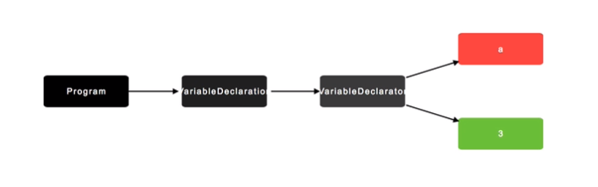
A view of Abstract Syntax tree
1 . A variable declaration : int a = 3 ;

Slide 8
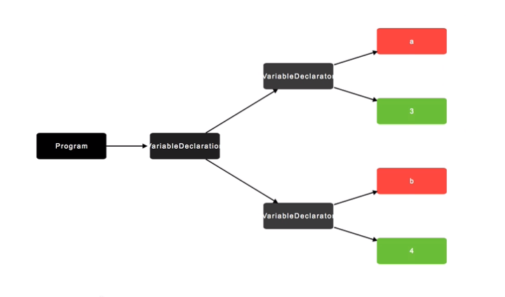
2 . If we write : int a = 3 , b = 4 ;

Slide 9
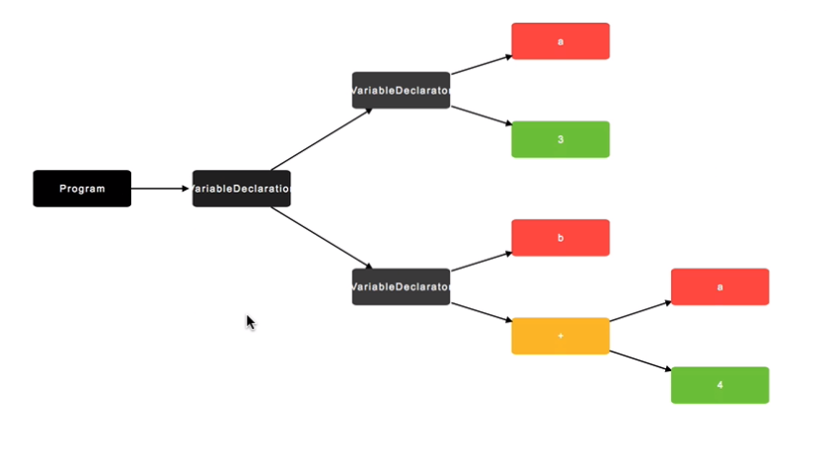
3 . If we write : int a = 3 , b = a + 4;

Slide 10
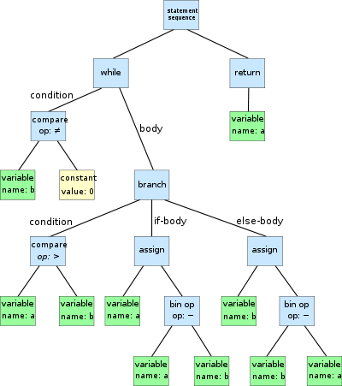
An AST of a program :

Slide 11
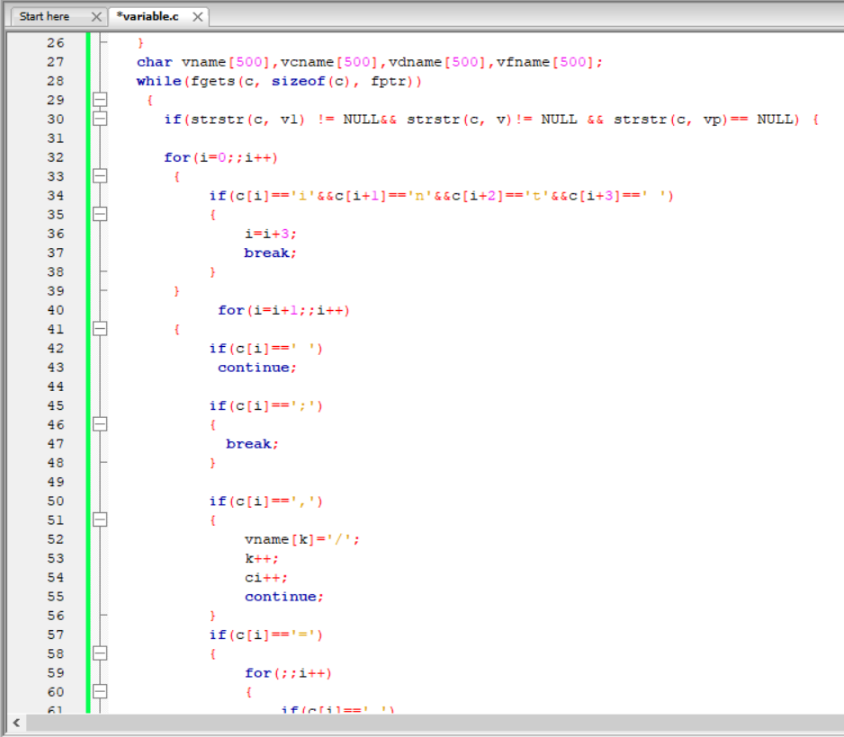
Progress of my project
A C-code to find out the variables of a C-program :

Slide 12
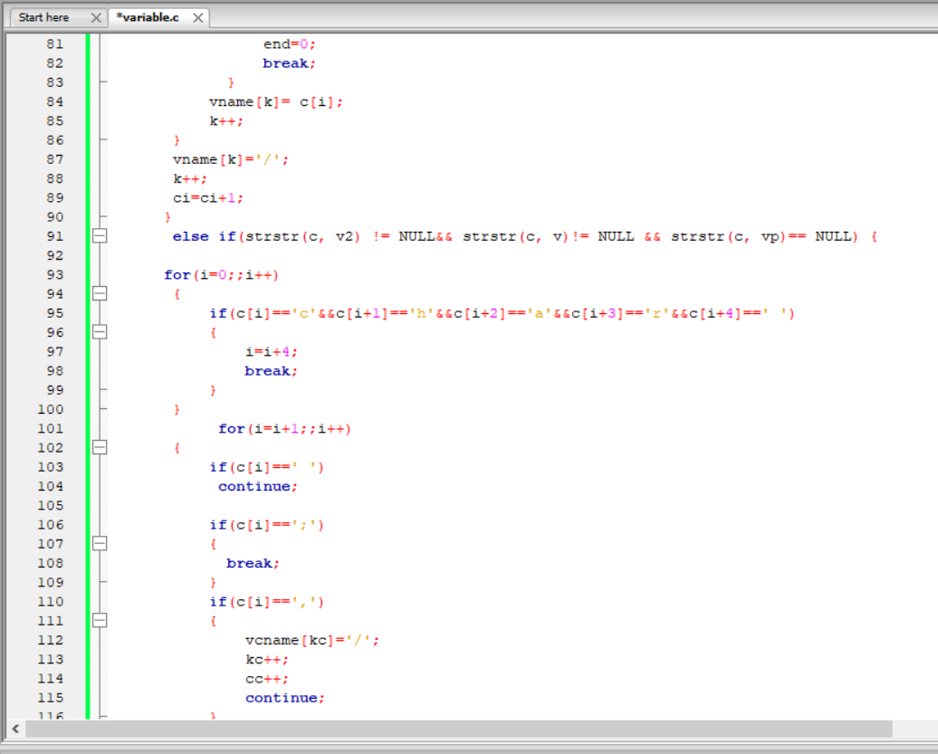
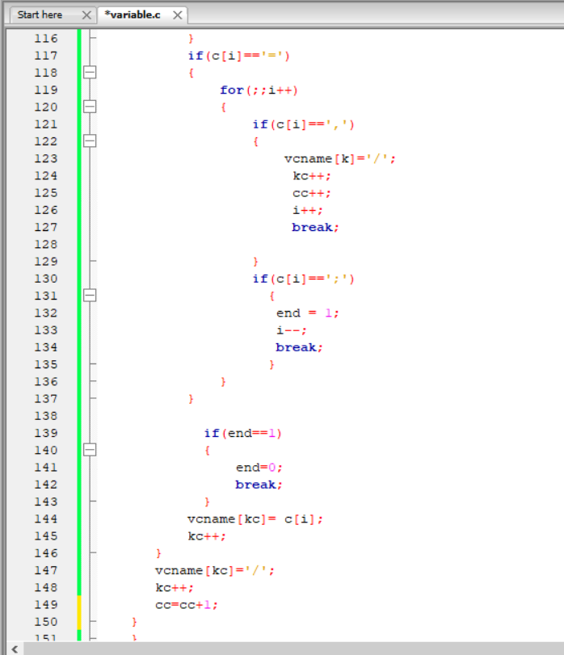

Slide 13
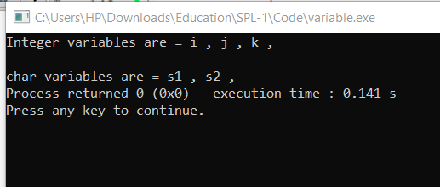
Input :
#include<stdio.h>
int main()
{
int i,j = 0,k=1;
char s1 , s2={"dddd"};
scanf("%d",i);
printf("%d",i);
}

Slide 14
Plan Of my project
Create a code to find functions of a c program
Create a code to find parameters and variables which is used in a function
Create a code to find conditions , loop of a program
Create a code to find those functions which are called from a function
Merge all code and use abstract syntax tree algorithm to make abstract syntax tree code

Slide 15
My Plan to show my project
Lets take a C-code :
#include<stdio.h>
int max(int n1,int n2)
{
if(n1>n2)
{
return n1;
}
else return n2;
}
int main()
{
int a, b, c;
printf("Enter two numbers to add\n");
scanf("%d %d",&a,&b);
c= max(a,b);
printf(“Maximum number is = %d”,c);
return 0;
}

Slide 16
Output :
function :
main : return type : int
: variable declaration : int a ,int b ,int c
: assigning value : c
: Call Function : max : rturn type : int
: Parameters : int n1 , int n2
: Condition : if : compare(>) : n1
: n2
: return n1
: else : return n2

Slide 17
Refferences
https://egghead.io/lessons/javascript-introduction-to-abstract-syntax-trees?pl=abstract-syntax-trees-3582efe5
https://en.wikipedia.org/wiki/Abstract_syntax_tree

Slide 18
Thanks to All

