Slide 1
SPl-1 Midterm Presentation, 2020
Project Name : Generating Abstract Syntax Tree
Course : Software Project Lab – 1
Course No : SE 305
Submitted By : M. Mahtab Hossain Jhalok
Roll : 1103
Supervised By : Abdus Satter
Designtion : Lecturer
Institute of Information Technology,
University of Dhaka

Slide 2
Introduction to my project
Abstract syntax tree is a representation of tokens generated from statements and expressions in a programming language. With the AST, the interpreter or the compiler can generate machine code or evaluate an instruction.
The goal of my project is to read a c program and show the properties of classes and functions of that program such as variables , parameters , conditions , loop , return type etc .

Slide 3
Background Study
Lexical Analysis
Syntax
Semantics
Syntax tree

Slide 4
Challenges
▪ Handling large code for the first time ▪ Learning and understanding algorithm ▪ Parsing a program
▪ Implementing the algorithm of Abstract Syntax Tree

Slide 5
Motivation of my project
An AST has several properties that aid the further steps of the compilation process :
An AST represent the logic/syntax of the code, which is naturally a tree
rather than lines of codes . It makes a compiler work easy .
Compared to the source code, an AST does not include inessential punctuation and delimiters (braces, semicolons, parentheses, etc.).
An AST usually contains extra information about the program, due to the consecutive stages of analysis by the compiler.
During the syntax analysis stage, a compiler produces a parse tree. This parse tree can be used to perform almost all functions of a compiler by means of syntax-directed translation. Although this method can lead to a more efficient compiler .

Slide 6
Plan Of my project
Create a code to find functions of a c program
Create a code to find parameters and variables which is used in a function
Create a code to find conditions , loop of a program
Create a code to find those functions which are called from a function
Merge all code and use abstract syntax tree algorithm to make abstract syntax tree code

Slide 7
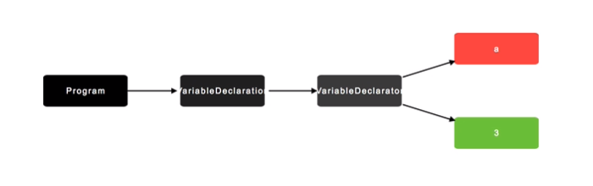
A view of Abstract Syntax tree
1 . A variable declaration : int a = 3 ;

Slide 8
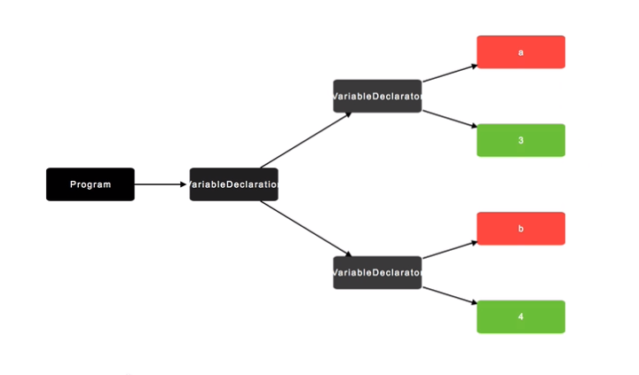
2 . If we write : int a = 3 , b = 4 ;

Slide 9
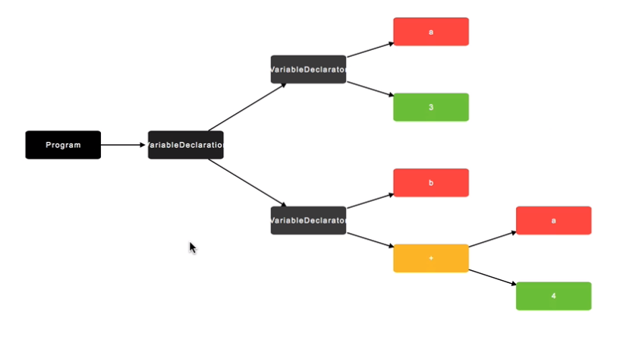
3 . If we write : int a = 3 , b = a + 4;

Slide 10
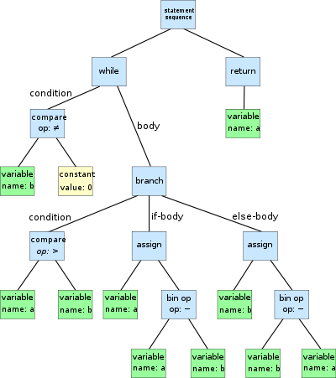
An AST of a program :

Slide 11
My Plan to show my project
Lets take a C-code :
#include<stdio.h>
int max(int n1,int n2)
{
if(n1>n2)
{
return n1;
}
else return n2;
}
int main()
{
int a, b, c;
printf("Enter two numbers to add\n");
scanf("%d %d",&a,&b);
c= max(a,b);
printf(“Maximum number is = %d”,c);
return 0;
}

Slide 12
Output :
function :
main : return type : int
: variable declaration : int a ,int b ,int c
: assigning value : c
: Call Function : max : rturn type : int
: Parameters : int n1 , int n2
: Condition : if : compare(>) : n1
: n2
: return n1
: else : return n2

