Slide 1
SPl-1 Midterm Presentation, 2020
Project Name : Generating Abstract Syntax Tree
Course : Software Project Lab – 1
Course No : SE 305
Submitted By : M. Mahtab Hossain Jhalok
Roll : 1103

Slide 2
Contents

Slide 3
Introduction
Abstract syntax tree is a representation of tokens generated from statements and expressions in a programming language. With the AST, the interpreter or the compiler can generate machine code or evaluate an instruction.
The goal of my project is to read a c program and show the properties of classes and functions of that program such as variables , parameters , conditions , loop , return type etc .

Slide 4
Background Study
Lexical Analysis
Lexical analysis, lexing or tokenization is the process of converting a sequence of characters (such as in a computer program or web page) into a sequence of tokens (strings with an assigned and thus identified meaning). A program that performs lexical analysis may be termed a lexer, tokenizer, or scanner, though scanner is also a term for the first stage of a lexer. A lexer is generally combined with a parser which together analyze the syntax of programming . A lexeme is a sequence of characters in the source program that matches the pattern for a token and is identified by the lexical analyzer as an instance of that token.
Common token names are
identifier: names the programmer chooses;
keyword: names already in the programming language;
separator (also known as punctuators): punctuation characters and paired-delimiters;
operator: symbols that operate on arguments and produce results;
literal: numeric, logical, textual, reference literals

Slide 5
Syntax
In programming, syntax refers to the rules that specify the correct combined sequence of symbols that can be used to form a correctly structured program using a given programming language. Programmers communicate with computers through the correctly structured syntax, semantics and grammar of a programming language.
Semantics
Semantics is a linguistic concept separate from the concept of syntax, which is also often related to attributes of computer programming languages. The idea of semantics is that the linguistic representations or symbols support logical outcomes, as a set of words and phrases signify ideas to both humans and machines.

Slide 6
Challenges
Implementing a new software solution carries with it a number of challenges. The process can be overwhelming, confusing and lenthy. Implementing this project there are lot of challenges that I have faced. Some of them are:-
▪ Handling large code for the first time ▪ Learning and understanding algorithm ▪ Parsing a program
▪ Implementing Abstract Syntax Tree

Slide 7
Motivation of my project
An AST has several properties that aid the further steps of the compilation process :
An AST can be edited and enhanced with information such as properties and annotations for every element it contains. Such editing and annotation is impossible with the source code of a program, since it would imply changing it.
Compared to the source code, an AST does not include inessential punctuation and delimiters (braces, semicolons, parentheses, etc.).
An AST usually contains extra information about the program, due to the consecutive stages of analysis by the compiler. For example, it may store the position of each element in the source code, allowing the compiler to print useful error messages.
During the syntax analysis stage, a compiler produces a parse tree. This parse tree can be used to perform almost all functions of a compiler by means of syntax-directed translation. Although this method can lead to a more efficient compiler .

Slide 8
Plan Of my project
Create a code to find functions of a c program
Create a code to find parameters and variables which is used in a function
Create a code to find conditions , loop of a program
Create a code to find those functions which are called from a function
Merge all code and use abstract syntax tree algorithm to make abstract syntax tree code

Slide 9
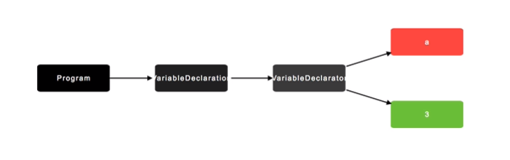
A view of Abstract Syntax tree
1 . A variable declaration : int a = 3 ;

Slide 10
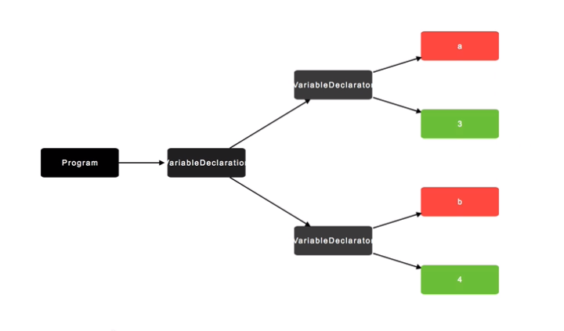
2 . If we write : int a = 3 , b = 4 ;

Slide 11
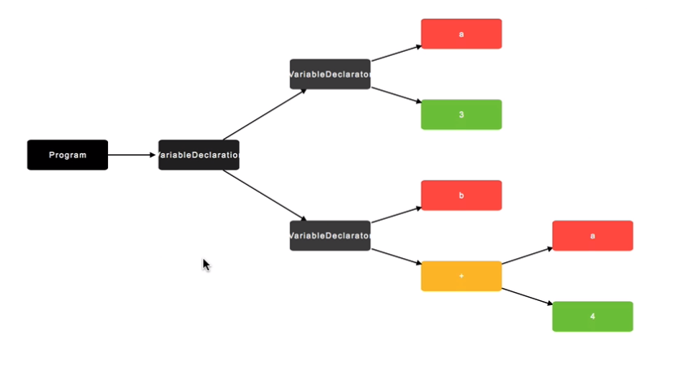
3 . If we write : int a = 3 , b = a + 4;

Slide 12
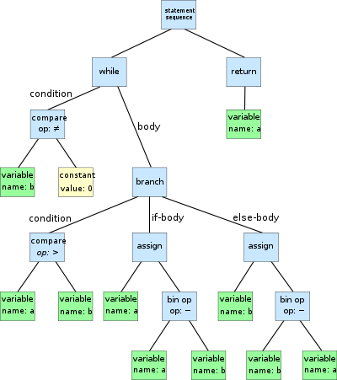
An AST of a program :

