Slide 1
SPL-1 Final Presentation, 2020
Project Name : Generating Abstract Syntax Tree
Course : Software Project Lab – 1
Course No : SE 305
Submitted By : M. Mahtab Hossain Jhalok
Roll : 1103
Supervised By : Abdus Satter
Designtion : Lecturer
Institute of Information Technology,
University of Dhaka

Slide 2
Introduction to my project
Abstract syntax tree is a representation of tokens generated from statements and expressions in a programming language. With the AST, the interpreter or the compiler can generate machine code or evaluate an instruction.
The goal of my project is to read a c program and show the properties of classes and functions of that program.

Slide 3
Return Type
Variable
Function
Call another function
Conditions
Loops
Parameter

Slide 4
Motive of my project
Interested to know how compiler works .
Wanted to learn such a good algorithm which helps me to make great project in future .
3. To know how to handle large code .

Slide 5
Background Study
Lexical Analysis
Syntax
Semantics
Parse tree

Slide 6
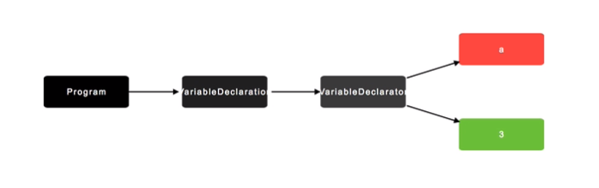
A view of Abstract Syntax tree
1 . A variable declaration : int a = 3 ;

Slide 7
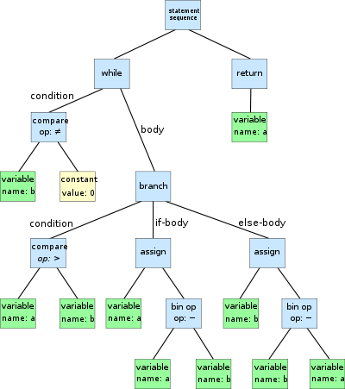
An AST of a program :

Slide 8
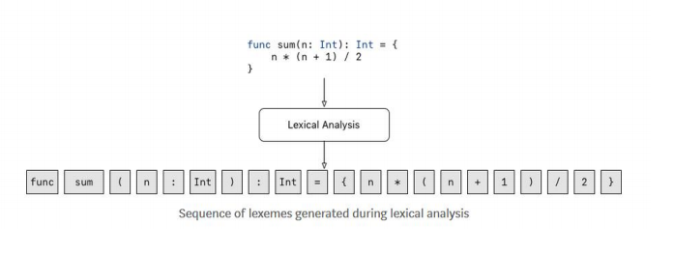
Project Overview
Lexical analysis :

Slide 9
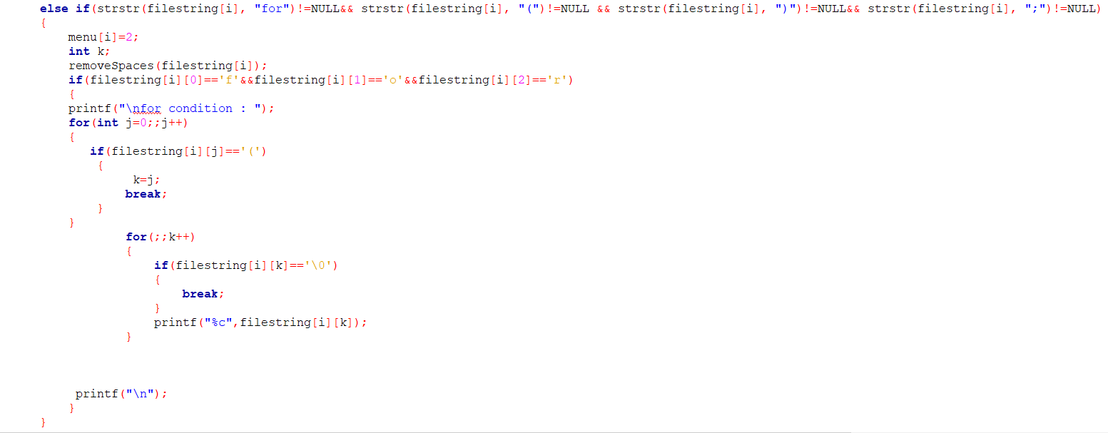
This Part of code find the for loop from a function by using some identifier

Slide 10
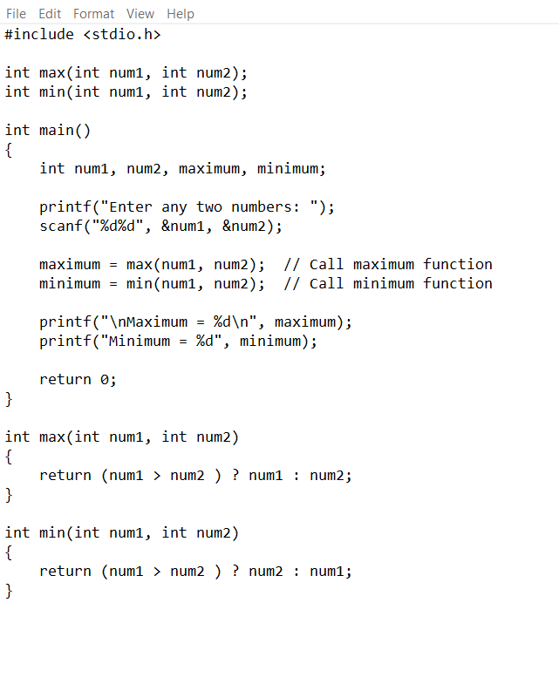
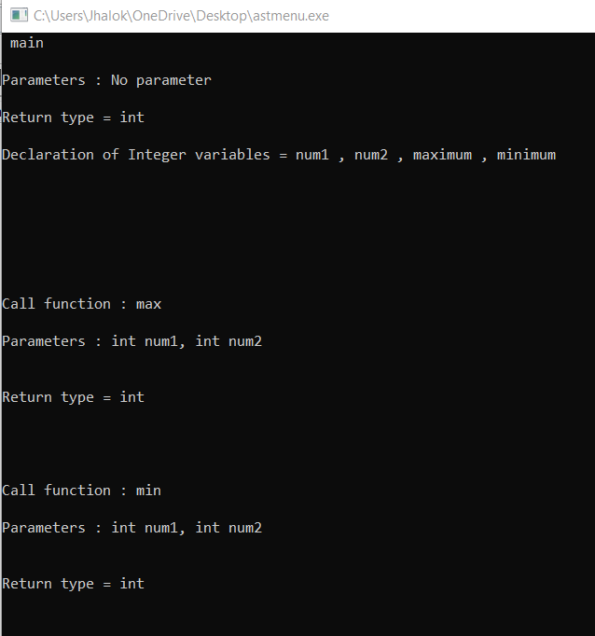
Output Presentation
Exsmple 1 : We take a c program which find maximum and minimum from two number

Slide 11
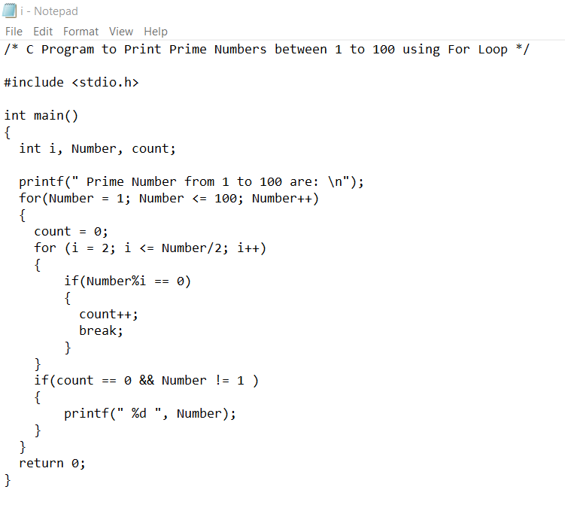
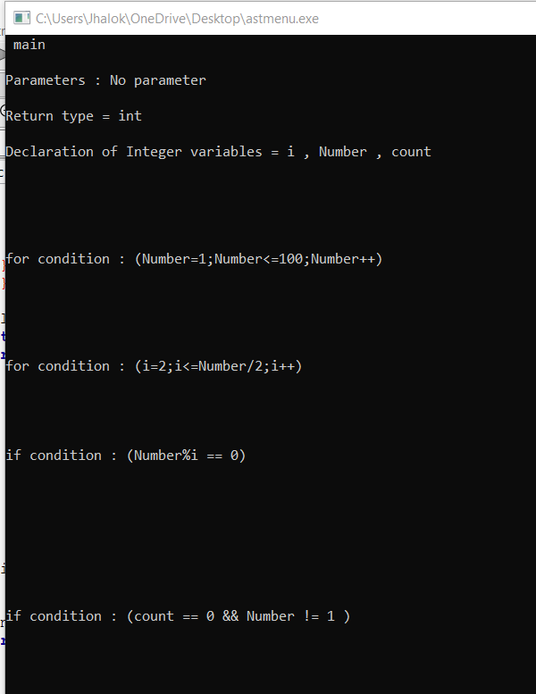
Example 2: We take a c program which show all the prime numbers from 1 to 100

Slide 12
Here is the code

Slide 13
Refferences
https://egghead.io/lessons/javascript-introduction-to-abstract-syntax-trees?pl=abstract-syntax-trees-3582efe5
https://en.wikipedia.org/wiki/Abstract_syntax_tree

Slide 14
Thanks to All

