Slide 1
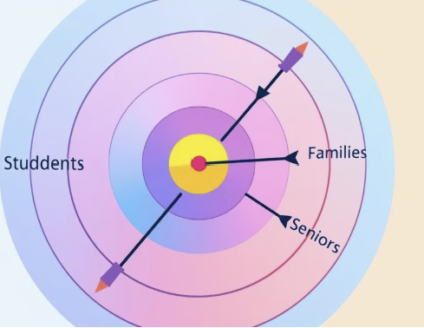
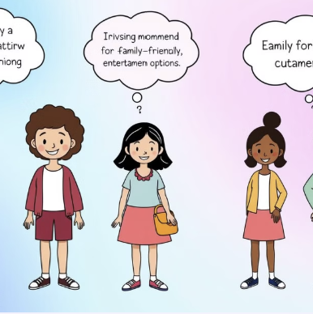

MARKET SEGMENTATION
Group Members
Mounika Ravella
Mahvish Kounain
Vishnu uday pavan Medidhi
Baanu vasundhara tumma

Slide 2
INTRODUCTION: THE POWER OF SEGMENTATION
Targeted Marketing | Resource Optimization | Enhanced Customer Satisfaction | Improved Business Performance
Segmentation allows for precisely tailored marketing messages that resonate with specific customer groups. | By focusing on specific segments, businesses can allocate resources more effectively and maximize their return on investment. | Meeting the unique needs of individual segments fosters higher customer satisfaction and loyalty. | Segmentation leads to a stronger understanding of customer expectations and enables businesses to align their offerings, ultimately driving better business outcomes.

Slide 3
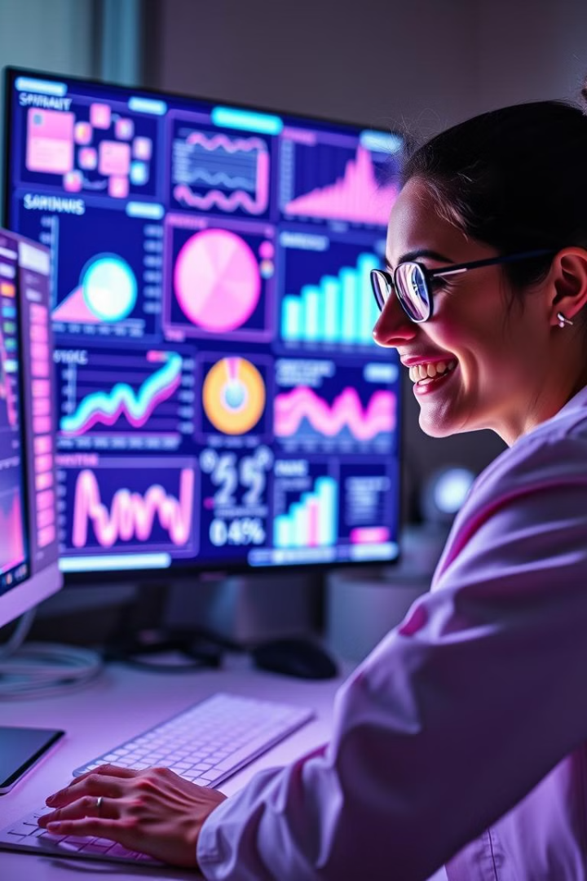
METHODOLOGY
1
Dataset Analysis
2
Data Transformation
The segmentation process involved analyzing customer data, including demographics, income, and purchasing patterns.
Age and income were converted to ordinal variables, creating categories for age and income levels.
3
Data Visualization
4
Actionable Insights
Pivot tables were utilized to summarize data, and bar charts were employed for visual representation.
This approach enabled effective grouping and analysis, generating valuable insights for targeted marketing strategies.

Slide 4
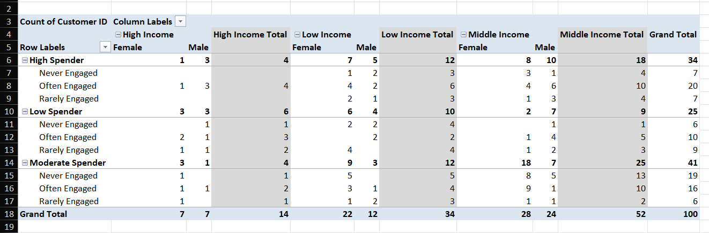
SEGMENT 1: MIDDLE INCOME - FEMALE - MODERATE SPENDER - OFTEN ENGAGE

Slide 5
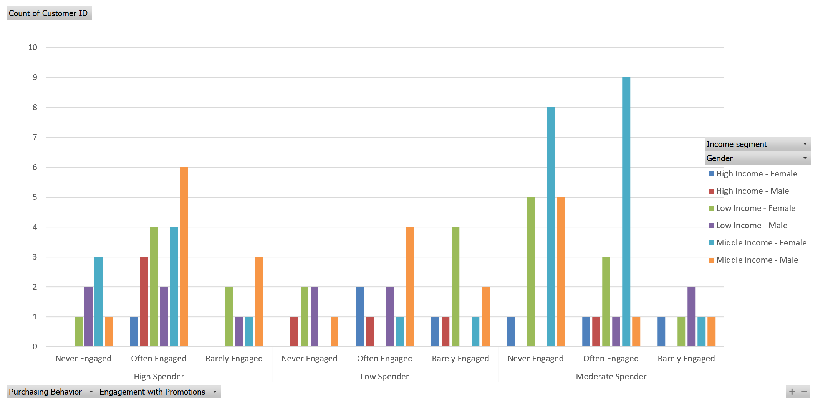
SEGMENT 1: MIDDLE INCOME - FEMALE - MODERATE SPENDER - OFTEN ENGAGE
Product:
Value-Focused Products
Bundle Offers
Exclusive Lines
Price:
Competitive Pricing
Loyalty Programs
Tiered Pricing
Place:
Omni-Channel Distribution
Retail Partnerships
E-Commerce
Mobile Apps
Promotion:
Targeted Email Marketing
Social Media Campaigns
Exclusive Offers
Storytelling in Ads

Slide 6
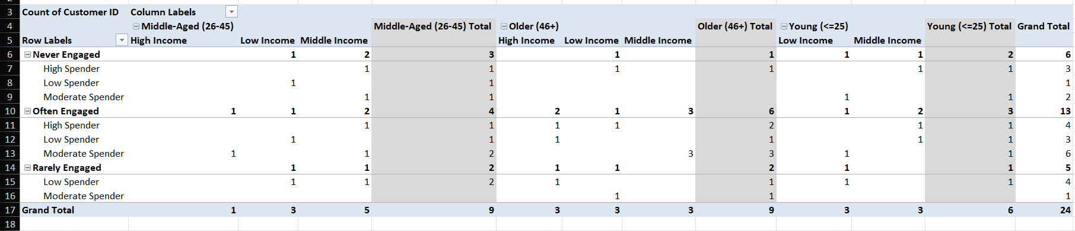
SEGMENT 2: MIDDLE INCOME -OLDER -MODERATE SPENDER-OFTEN ENGAGED

Slide 7
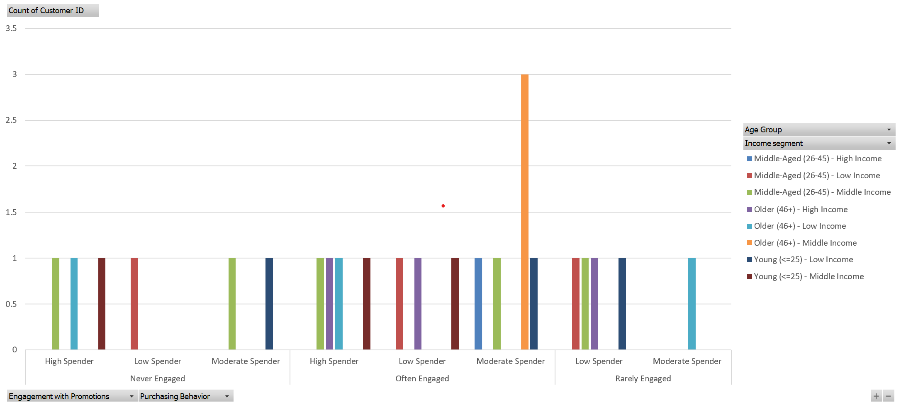
SEGMENT 2: MIDDLE INCOME -OLDER -MODERATE SPENDER-OFTEN ENGAGED
Product:
Health and Wellness
Travel Packages
Home Improvement
Price:
Value-Based Pricing
Loyalty Discounts
Bundled Deals
Place:
Omni-Channel
Retail Partnerships
E-Commerce
Promotion:
Targeted Campaigns
Exclusive Offers
Multi-Channel Marketing

Slide 8
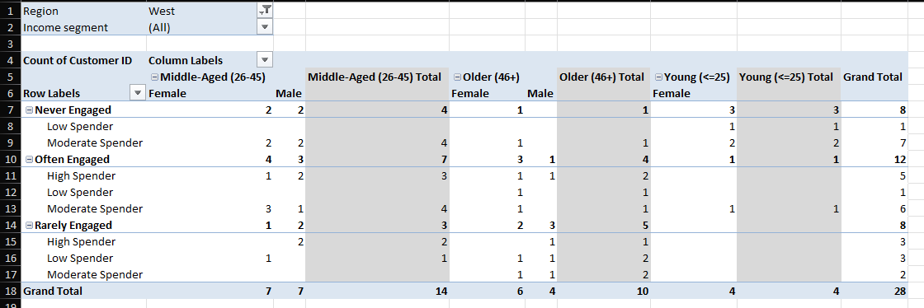
SEGMENT 3: WEST REGION - MIDDLE AGE-FEMALE-MODERATE SPENDER-OFTEN ENGAGED

Slide 9
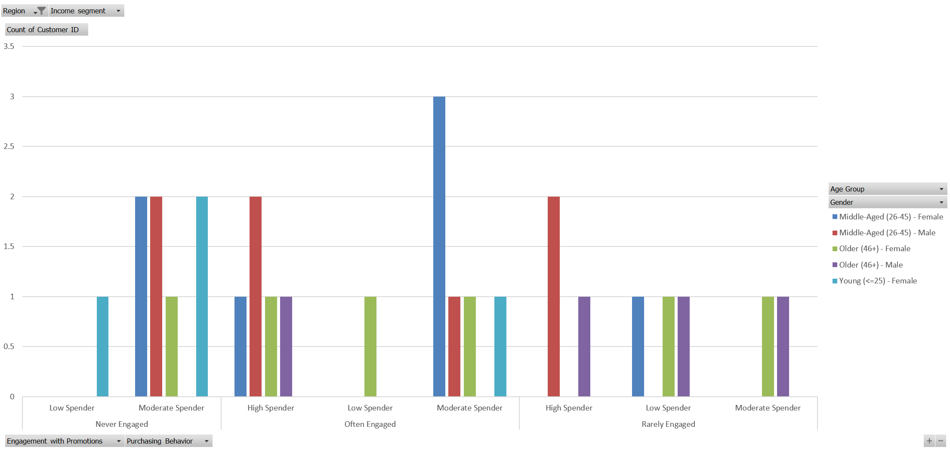
SEGMENT 3: WEST REGION - MIDDLE AGE-FEMALE-MODERATE SPENDER-OFTEN ENGAGED
Product:
Health and Wellness
Fashion Items
Household Goods
Price:
Value-Based Pricing
Occasional Discounts
Loyalty Programs
Place:
Omni-Channel
Local Stores
E-Commerce Platforms
Promotion:
Personalized Campaigns
Social Media Advertising
Email Marketing and Loyalty Programs

Slide 10
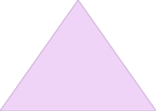



CONCLUSION: Actionable Insights
Understand Needs
Identify the unique needs and preferences of each segment
1
Tailor Strategies
Develop marketing campaigns tailored to specific characteristics of each segment
2
Boost Engagement
This can increase customer engagement and loyalty
3
Drive Sales
Targeted marketing can lead to higher conversion rates and increased sales
4

Slide 11
Thank You!

