Slide 1
Table of Contents
Introduction
Methodology
Analysis
Results and Conclusion
Dashboards
Personal Development plan
Feedback and Improvements

Slide 2
Introduction
Project Background
In this project I have analysed a pizza restaurant's sales data to identify key performance indicators (KPIs) that influence both general performance and specific aspects of the business. The analysis was performed using Python and Tableau, culminating in an interactive dashboard to assist the restaurant owners in making data-driven decisions.
Objectives
Analyse sales data and customer demographics of the pizza restaurant.
Identify trends and patterns to optimize business operations.
Provide actionable recommendations based on the analysis.

Slide 3
Methodology
Data Collection
The data used in this project includes sales records and customer feedback from the pizza restaurant. This data was collected over a year and includes information on sales transactions, orders time-table, customer demographics, and feedback ratings.
Tools Used
Python: Used for data cleaning, preprocessing, and initial analysis.
Tableau: Used for creating visualizations and dashboards to present the findings.
Data Cleaning and Preparation
The data cleaning process involved handling missing values, correcting inconsistencies, and ensuring the data was in a suitable format for analysis. This included:
Removing duplicate records.
Filling in missing values with appropriate estimates.
Standardizing data formats.

Slide 4
Analysis:
KPIs Identified:
Total Revenue: $817.9K
Average Order Value: $38.3
Total Orders: 21.35K
Total Pizzas Sold: 49.57K
Average Pizzas per Order: 2.32
Visualization with Tableau:
Top 5 Pizzas by Revenue, Orders, and Quantity: Identifying the most popular and profitable pizzas.
Bottom 5 Pizzas by Revenue, Orders, and Quantity: Highlighting less popular options.
Hourly and Weekly Trends: Visualizing peak ordering times.
Sales by Pizza Category and Size: Analysing performance by different pizza categories and sizes.

Slide 5
Results & Conclusion:
Findings
Sales Trends: Peak sales occur between 12:00-13:00 and 16:00-19:00.
Customer Demographics: Predominantly young adults aged 18-35.
Top Pizzas: The Classic Deluxe Pizza leads in orders and quantity, while the Thai Chicken Pizza generates the highest revenue.
Bottom Pizzas: The Brie Carre Pizza has the lowest performance across all KPIs.
Category Performance: The Classic category contributes the highest sales, orders, and number of sold pizzas. Large-sized pizzas are the most ordered and generate the highest revenue.
Recommendations
Optimize Staffing: Increase staff during peak hours to improve service speed.
Target Marketing: Focus marketing efforts on young adults, especially during peak times.
Revamp Menu: Consider promoting or improving less popular pizzas to increase their sales.
Customer Loyalty Programs: Implement programs to increase customer retention.

Slide 6
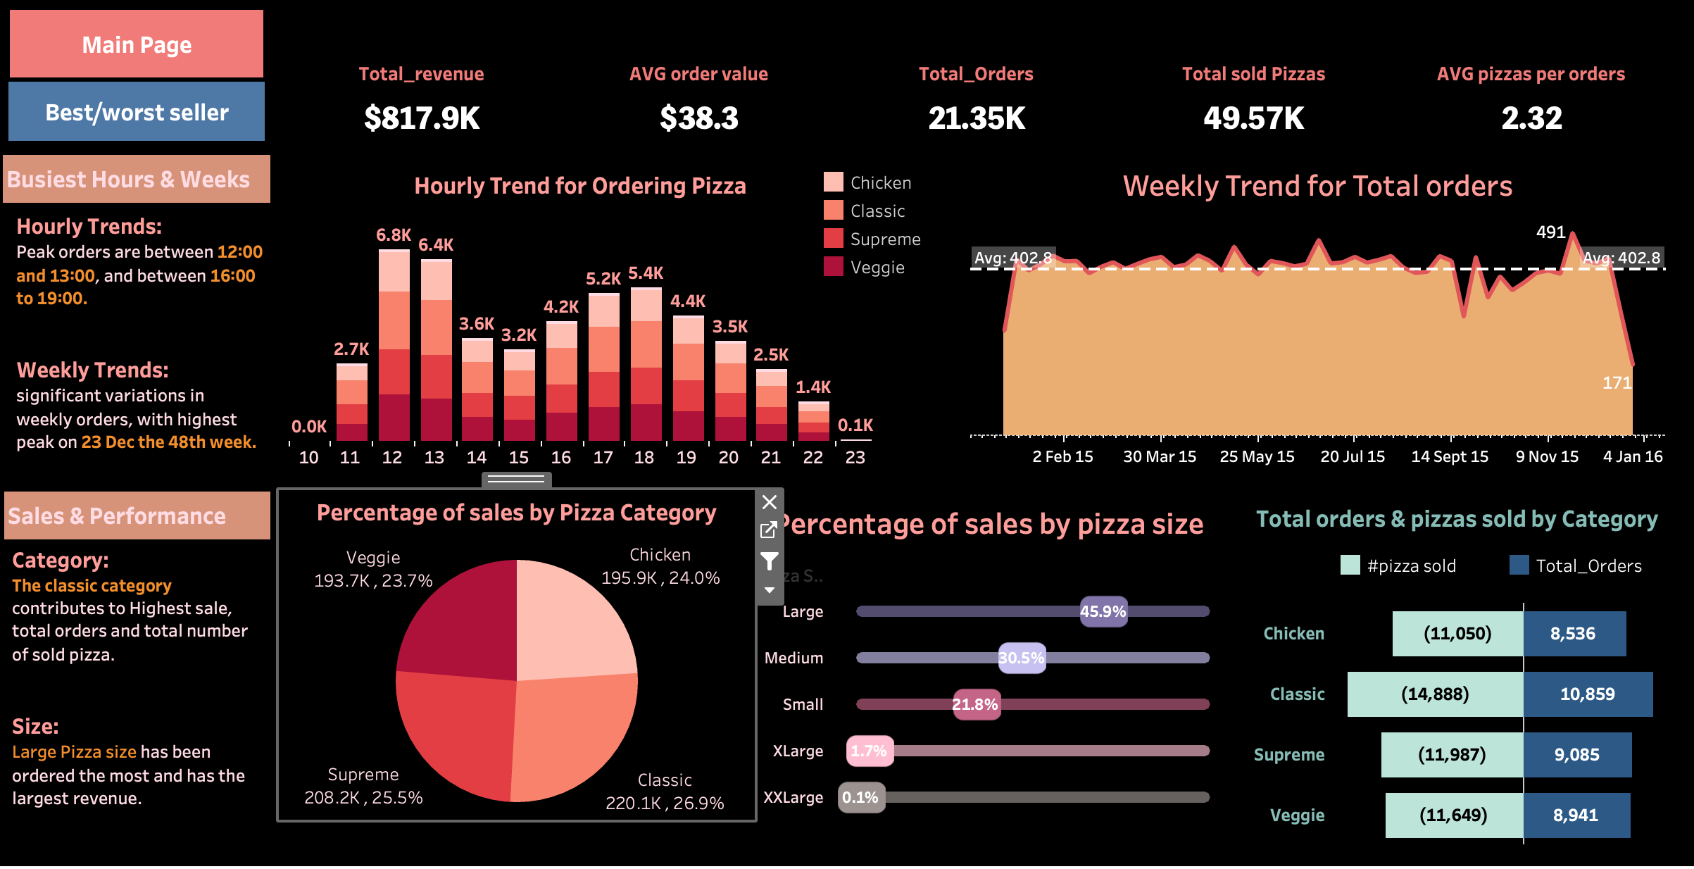
Dashboards: Overall Performance

Slide 7
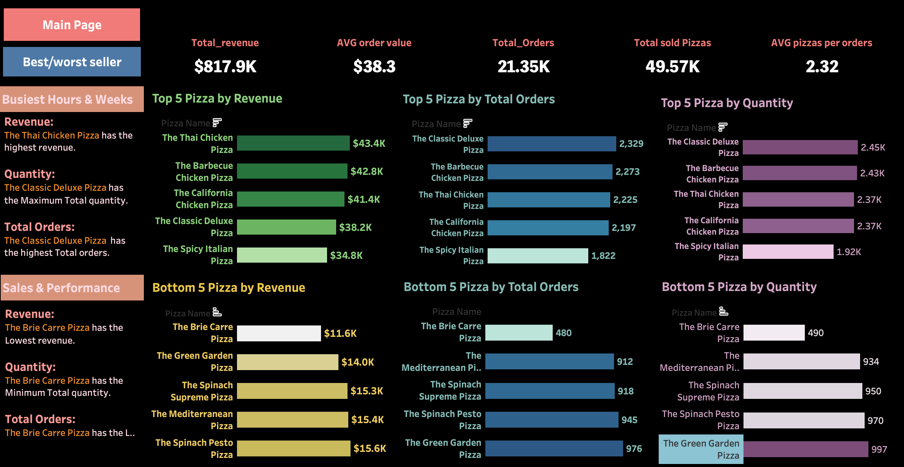
Dashboards: Best/Worst Sellers

Slide 8
Personal Development Plan:
Short-Term Goals
Advanced Power BI Course: Learning power bi to broaden my tools skills and learn more complex visualization techniques.
Python for analysis: Getting into more projects with python to do more complex analysis with different data sets.
Long-Term Goals
Career Aspiration: To become a data analyst specializing in sales data.
Continuous Learning: To stay updated with all the recent trends and tools related to data analysis and its visualization.

Slide 9
Feedback & Improvements:
Sources of Feedback
Peer Reviews: Feedback from classmates provided a source of improving clarity in visualizations
Feedback from Mentor: The mentor suggested that more in-depth analysis be carried out with respect to the customer feedback data.
Implementing the Feedback
Improved Visualizations: This involved visualizations being simplified and clarified and change in color palette using the feedback from peers.
In-Depth Feedback Analysis: As suggested by the mentor, more in-depth analysis was performed with respect to customer feedback.

