Slide 1
Roh Application
Mai Lahlouh 201910890
Dunia Abedalziz 201911893
Hajar Al-hajeh 201911509
Eman Alyat 201911906

Slide 2
Introduction

Slide 3
Presentation Outlines
-Introduction. -Methodology. -SRS. -Conclusion and Future work.

Slide 4

Background
Roh is soul !! The name of our project reflect to our purpose.
Each second is critical when dealing with people lives.
There are a lot of applications for donation . But we focus in time.

Slide 5
Problem Statement
Our problem is time. We suffer from lack of blood units in emergency events in Palestine. So in our system, we hope to spread the need of blood unit in a fastest possible way.
By our application, we can save time and patients life.
In our software, the hospitals will send notifications to the nearest available donors.

Slide 6
1.3 Goals and objectives
Goals
objectives
“This system will make the operation of donating more efficient. Our goal is using every minute to help patients in emergency events. ”
“In the end, we hope to make this product known. Encouraging youth to donate. Also hospitals will share units in most times needed.”

Slide 7
1.4 Main Contributions
Our software is already existed. We add extra features, such as sending notifications instead of massages to save time, every user needs to have an account including some information about him and some campaigns to encourage donating. We focus on emergency times so many people’s life may be saved Insha’Allah.

Slide 8

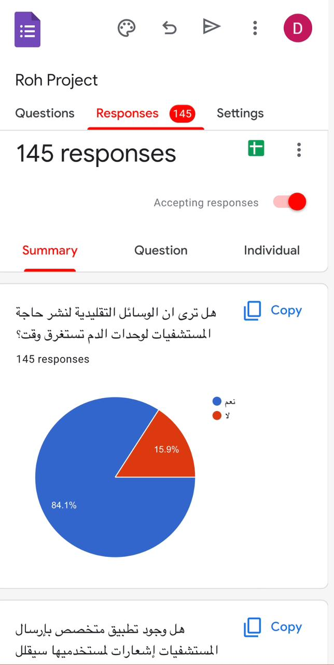
2. Methodology
Wateen Application in KSA
Survey.
Articles.

Slide 9
SRS

Slide 10
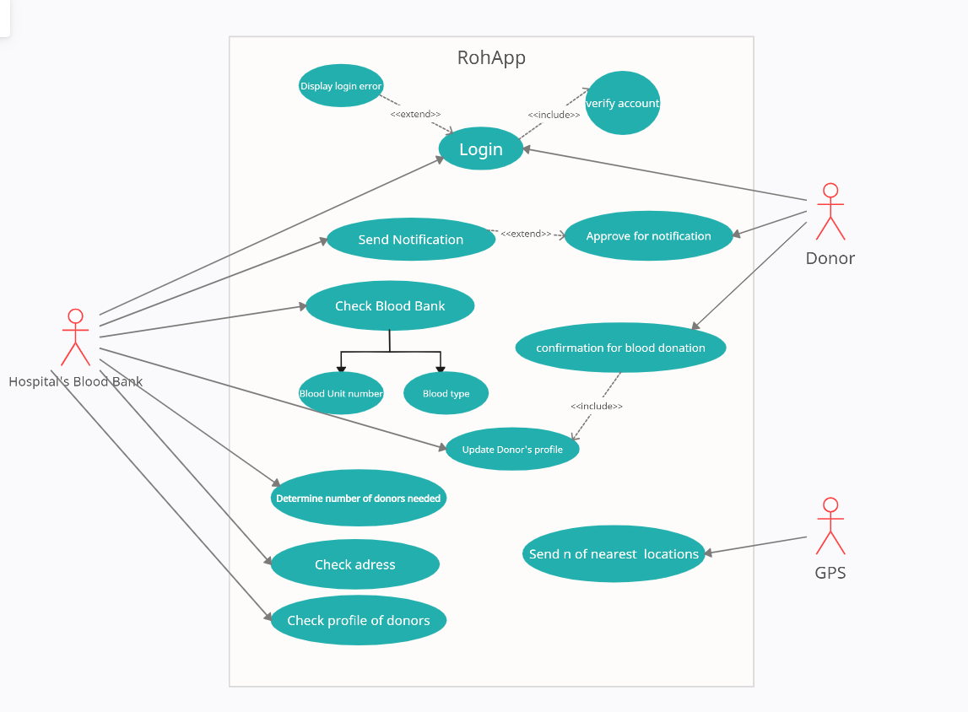
Use case

Slide 11
Functional Requirments
A1 | The system shall receive the number of donors and send this number to GPS system.
A2 | The system shall send notification for returned locations from GPS.
A3 | If the number of confirmed donors are not as required the system shall resend request to GPS for farther distance to complete unit blood number.
A4 | The system shall update the blood bank database when the donor coming and donating.

Slide 12
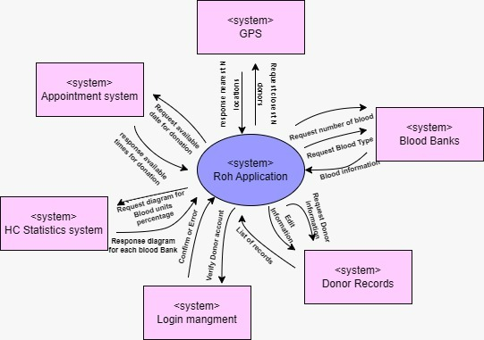
Context model

Slide 13
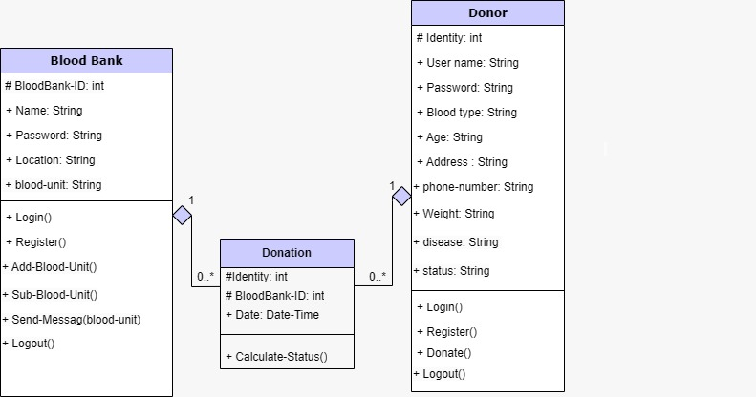
Class diagram

Slide 14
Non-functional Requirment
Usability
Security
Scalability
Performance
safety
maintainable

Slide 15
4.Conclusion and Future Work

Slide 16
We hope to improve blood bank to check the blood unit by itself automatically. And be applicable system in Palestine.

Slide 17
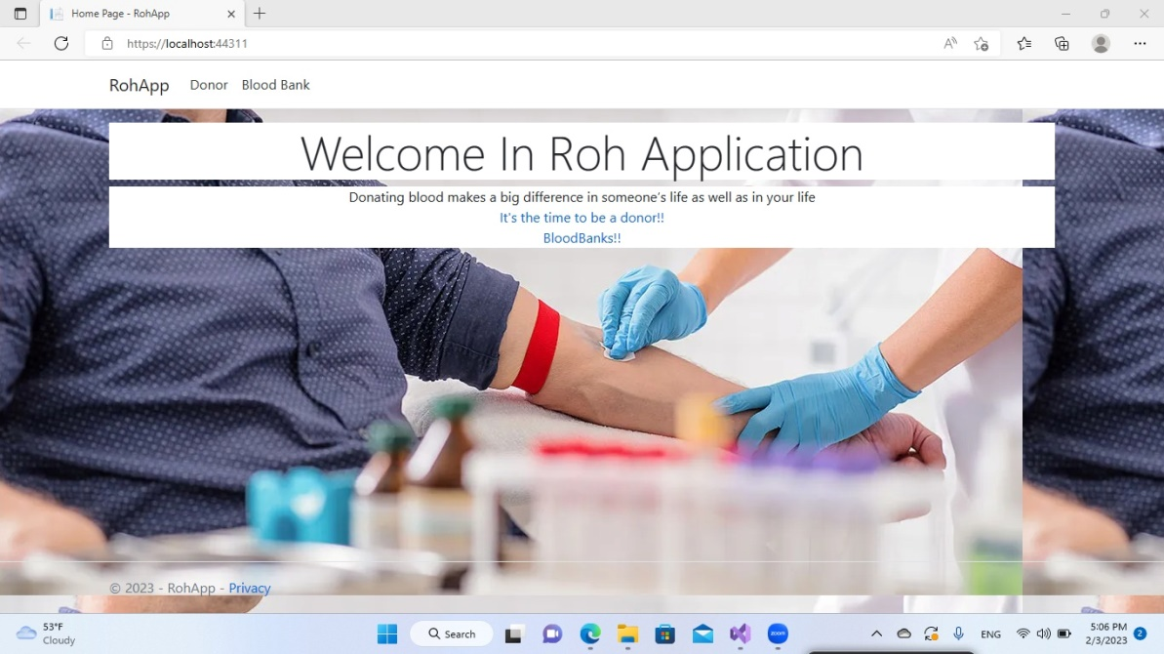
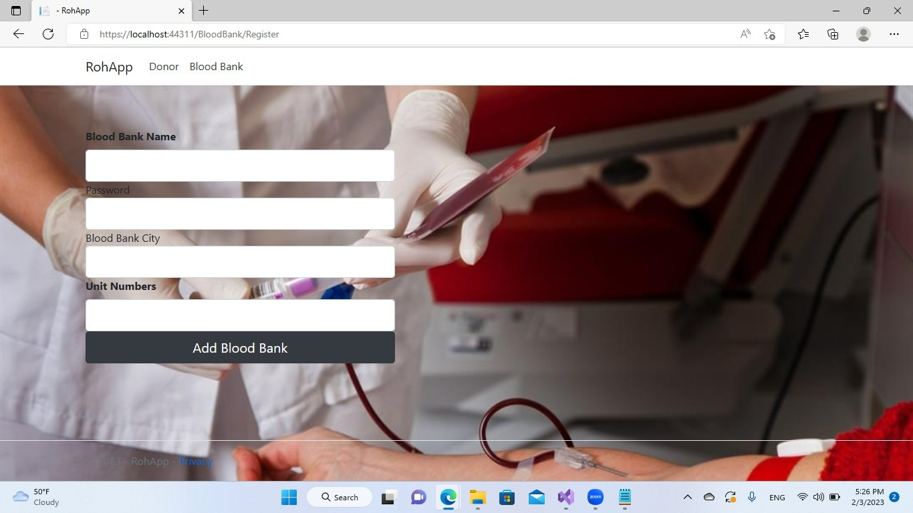
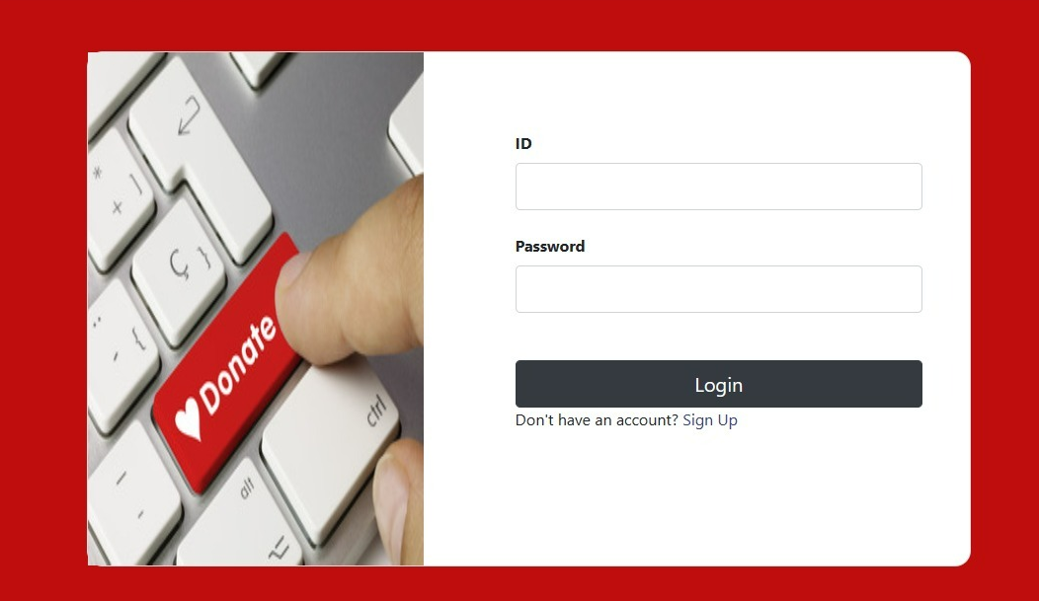

Slide 18
Thanks!

