Slide 1
Enhancing Supply Chain Efficiency
Presented by:
Mai Rashwan Radwan Ali Dimiana Fayek Shafik Kerolos Basem Fayez Madonna Refaat Saad Date: 11/4/2025

Slide 2
Project Idea
Problem: Difficulty in optimizing efficiency in manufacturing, lifecycle, shipping, and supplier coordination.
Solution: Interactive Power BI dashboard that visualizes KPIs across the supply chain.
Unique Value Proposition: Real-time insights, end-to-end visibility, bottleneck detection.

Slide 3
Project Wireframe
Visual: Power BI Dashboard covering supply chain metrics.
User Experience: Interactive visuals for production, sales, shipping, and suppliers.
Focus: Usability and decision-making support through visual clarity.

Slide 4
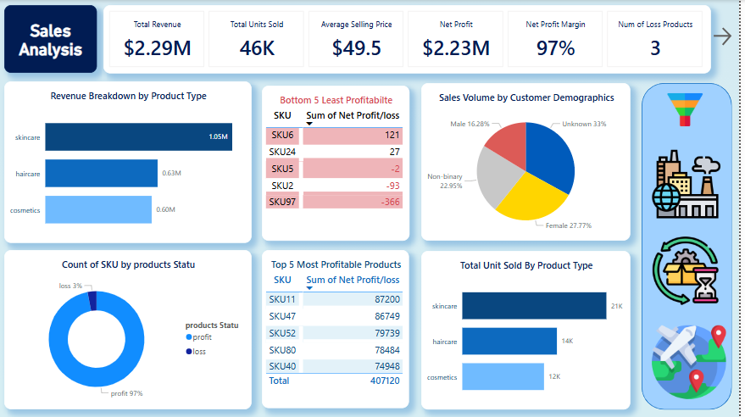

Slide 5
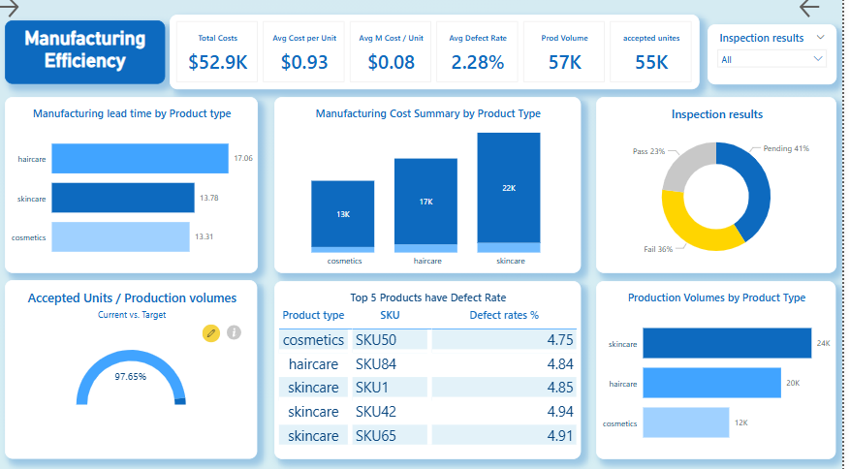

Slide 6
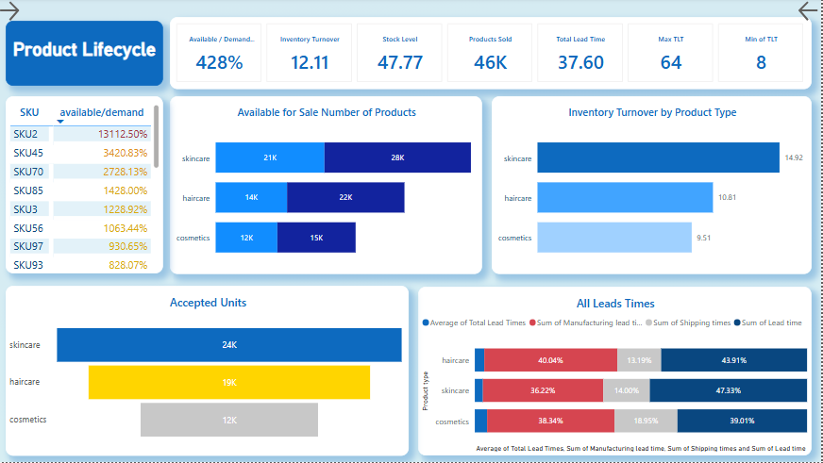

Slide 7
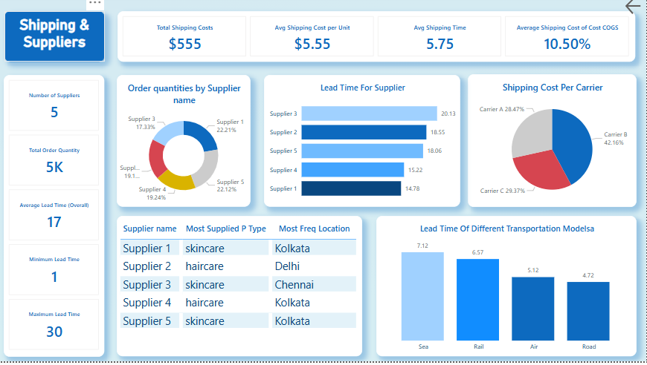

Slide 8
End Users + Features
Primary Users: Supply chain managers, data analysts, operations executives.
Key Features:
- KPI visualization (costs, lead time, defect rates)
- Supplier performance and inventory turnover tracking
- Demographic insights from sales
Solutions Delivered: Reduced inefficiencies, optimized supplier selection, strategic inventory planning.

Slide 9
Data Structure
Database: Structured relational model using SKU as primary key.
Entities: Products, Sales, Manufacturing, Inventory, Suppliers, Shipping, Process Time.
Data Flow: CSV files processed into Power BI with calculated fields and joined by SKU/Product Type.

Slide 10
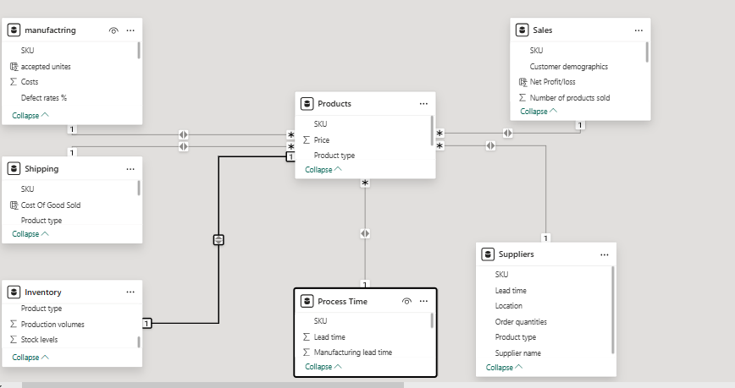

Slide 11
Programming Languages + Frameworks
Languages: DAX
Frameworks/Tools: Microsoft Power BI
Technologies: Excel/CSV files, Power BI DAX, Data Modeling (Star Schema).

Slide 12
Live Application + Test
Status: Deployed Power BI dashboard.
Testing: Verified KPI accuracy, visual interactivity, and filter functions.
User Feedback: Stakeholders reported improved visibility and actionable insights.
Project Link

Slide 13
Deliverables
Provided
Timeline
Final Products
Project report
Data collection
Interactive dashboard
Modeling
Visualization
Review.
Power BI dashboard
documentation.
documentation file
data model schema.

Slide 14
Project Team + Roles
Team:
Mai Rashwan Radwan Ali (Data Analyst)
Dimiana Fayek Shafik (Data Analyst)
Kerolos Basem Fayez (Data Analyst)
Madonna Refaat Saad (Data Analyst)
Responsibilities: Data cleaning, modeling, Power BI dashboard creation, analysis.
Methods: Iterative feedback, collaboration via Teams or emails, Agile-inspired task tracking.

Slide 15
Thank You
Questions or Feedback? Feel free to reach out!

