Slide 1
Java SE 17 – Presentation
(Comeback) - Chapter 1 – Building Blocks

Slide 2
Learning about the environment
Major component of Java
JDK
JRE
JVM

Slide 3
Understanding the class structure
- In a Java ..., ... is the most basic ... block
- It has ... and ...
– To use it, we need to create ... (also referred to as ....)
- Apart from Object (instance), we also need something called ... to use ...
Field and methods
Field ?
Method ?
- The following example is the ... class we can ..
(code illustration snippet 1)
(code illustration snippet 2,3)
- ... name and parameter is called ...

Slide 4
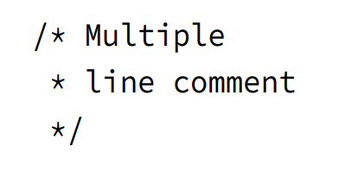
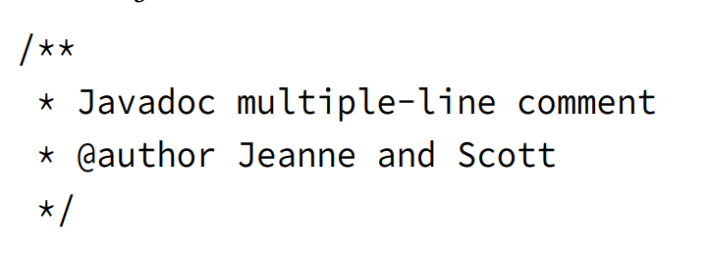
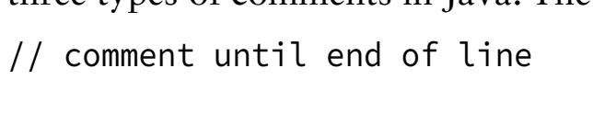


Understanding the class structure
Comments

Slide 5
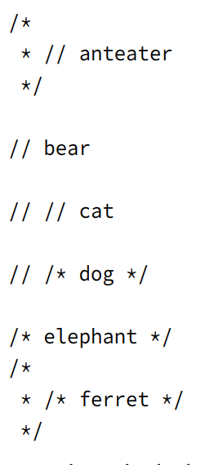
Understanding the class structure
Determine whether these examples are incorrect or not

Slide 6
Understanding the class structure
Classes and Source file
- Most of the ... are in separate ... source ...
- .... is an independent type that can be .... (Chap 7 will reveal more type such as ...)
- A top-level ... is not required to have ...
(code illustration snippet 4)
- A ... source ... can have multiple ... however, only one of them have ...
– This class's ... must also the same as ...
(code illustration snippet 5)

Slide 7
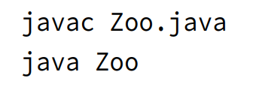
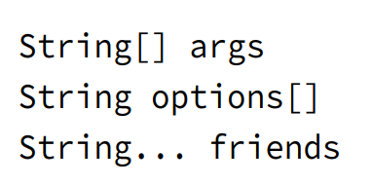




Writing a main() method
(code illustration snippet 6)
- To run this program using ..., we first need to ... it and then we can ...
- To use the ... method, its ... must be correct (keyword...) otherwise ...
- The ... method's parameter ... can be .. like this ...

Slide 8
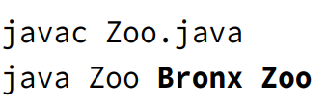
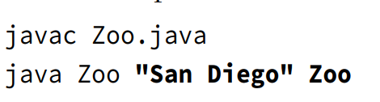
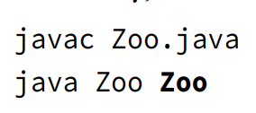

Writing a main() method
- The main() method only allows ... and ... modifier
(code illustration snippet 7)

Slide 9

Writing the main() method
- If we are bored of using ... and ... continuously => we can use something like this
- This is called single ... Instead of using ... and ... endlessly, we can both ... and ... immediately
- However, this feature is designed ... not for ...

Slide 10
Understanding Package Declaration
- Java has many ... in ... => We need a way to ... them => We have ... – a way to manage...
- In order to use a class that Java ..., we need to tell it ...
(code illustration snippet 8)
– In order to tell ..., we need to use ... statement
(code illustration snippet 9)
- According to convention, ... name ...
– Classes in the same ... can be ...
(code illuustration snippet 10)
Note: wildcard wont...
– There is only 1 package that is automatically ..., which is ...
- Java allows ... import
(code illustration snippet 11)

Slide 11
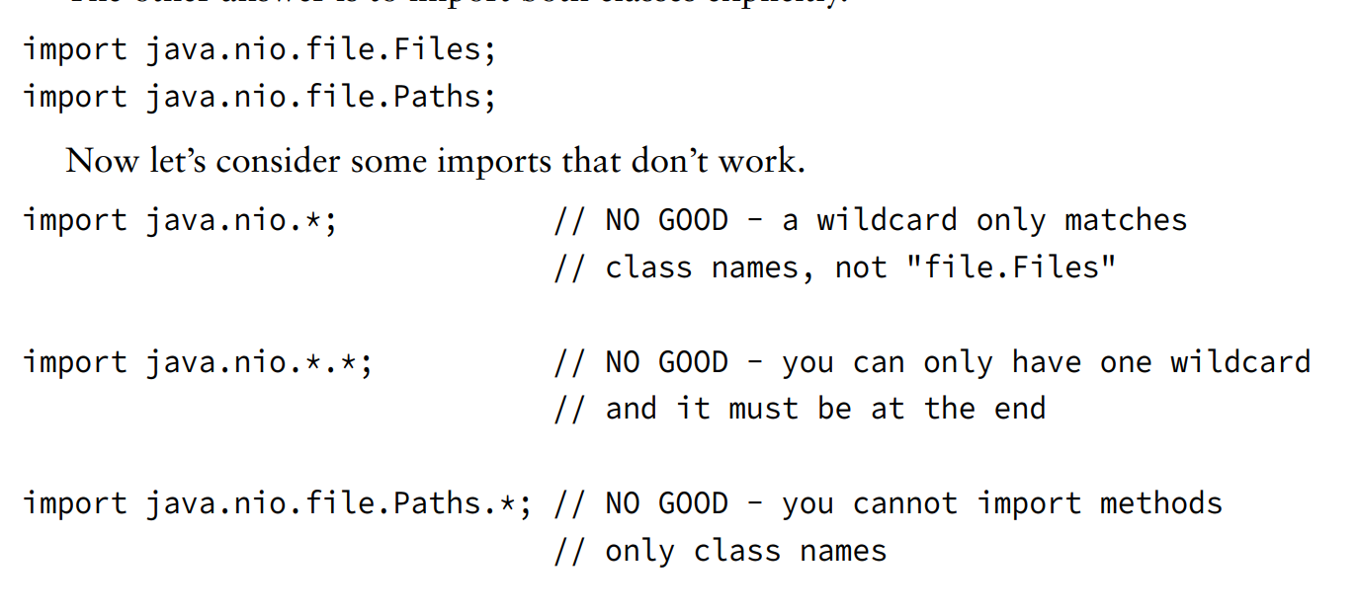
Understanding Package Declaration

Slide 12
Understanding Package Declaration
Naming conflict
- Because classes ... can't ... => We use ... to prevent ... => Multiple ... can be found ...
(code illustration snippet 12)
- In this snippet, we don't know which ... since we got java.... and java... => ???
– We could do like this but...
(code illustration snippet 13)
- A way to solve this is ...
(code illustration snippet 14)
- But what if i need other ...
(code illustration snippet 15)
- What if i try...
(code illustration snippet 16)
- Finally, if we really need ...
(code illustration snippet 17)

Slide 13
Understanding Package Declaration
Creating a new package
- All of the code we just write is inside ....
- This is a special package, ... ,... ...
- ... name = ... ?
(code illustration snippet 17)
Compiling and running code with packages
1. ?
2. ?
3. ?
(code illustration snippet 18)
Note: OCFA books is bad at this topic. According to the official Java specs, the command in this book is ... not what they ... The reason why we keep getting ... is because ... JSE is ... (note 1)
- If we have multiple ... that we need to ..., we can use ...
– Then we can run ..
(code illustration snippet 19)
Notes:
note 1: https://docs.oracle.com/en/java/javase/17/docs/specs/man/javac.html#classpath:~:text=While%20javac%20is,hierarchies%2C%20as%20appropriate.

Slide 14
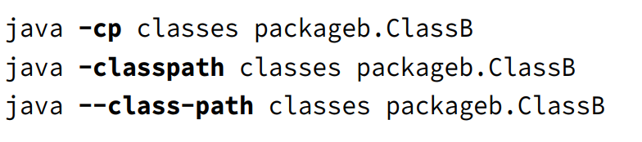
Understanding Package Declaration
- As you can see, the ... file is in the same ... (an example to show how strict ...)
- By default, Java will ... but we can ... this by using the ... flag
Note: the ... command is case-..., therefore, ... is different from ...
(code illustration snippet 20)
- The "—classpath" flags means we tell ... to run the ...
– If this flag is not ... => ... assume ...
– In order to use this flag, we must use a ... that contains ...
- ... difference between 3 ...
(code illustration snippet 21)

Slide 15
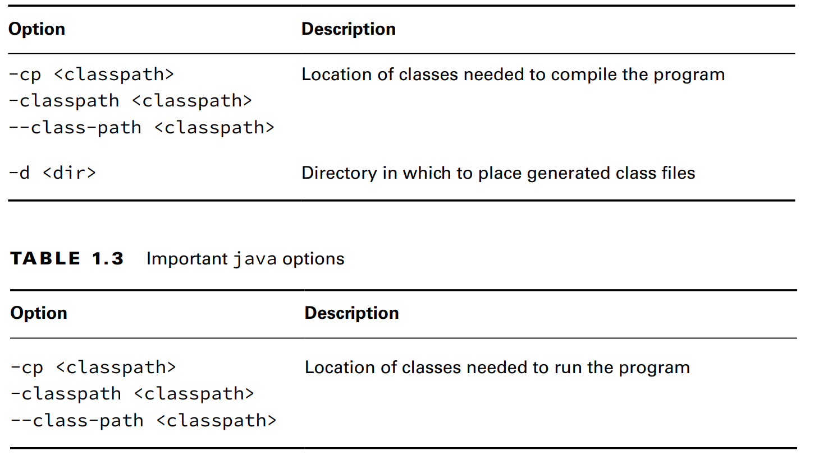
Understanding Package Declaration

Slide 16
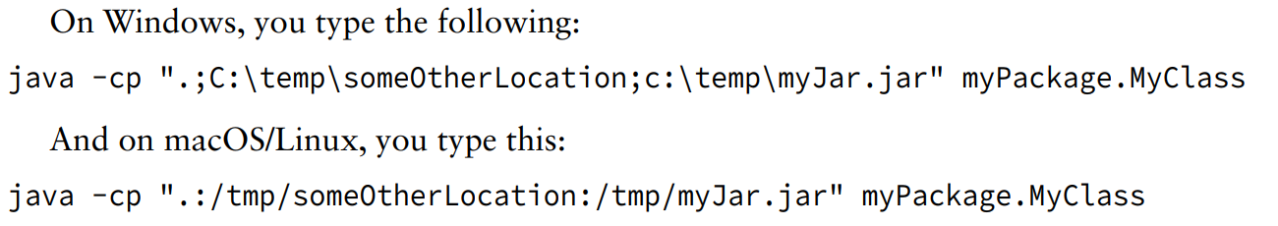

Understanding Package Declaration
- GENERAL INSTRUCTION WITH ... FLAG: only use it with the directory that ...
– For example, you can see that the "classes" directory is not ... because ... => it must be ... in the ... flag
Compiling with JAR files
- We can use multiple ... with ... flag, not just ... and also use with ... file
- The "." is indicating ...

Slide 17
Understanding Package Declaration
(code illustration snippet 23,24,25)

Slide 18
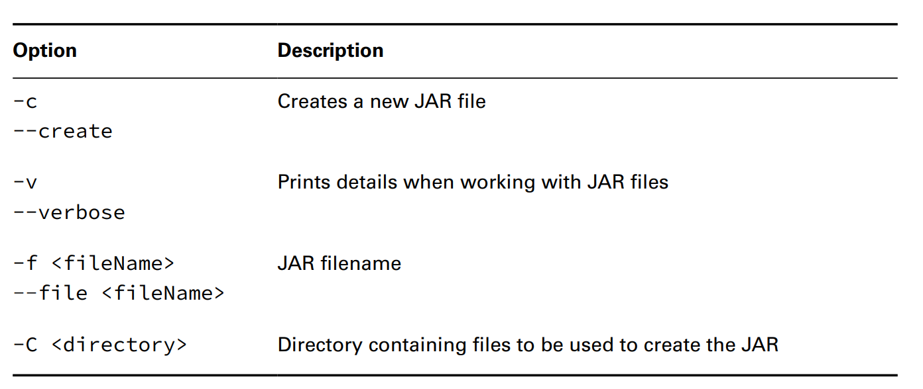
Understanding Package Declaration

Slide 19
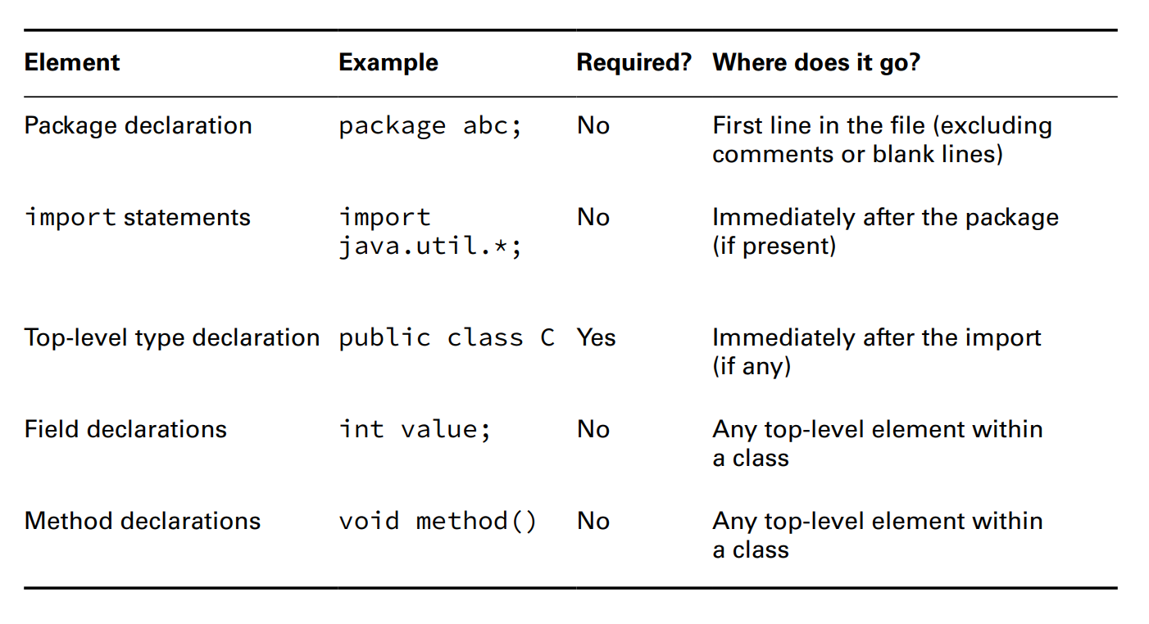





Understanding Package Declaration
Ordering element in a class

Slide 20
Understanding Package Declaration

