Slide 1
Driver - Sleep Awake?
Arduino Nano 33 BLE Sense

Slide 2

Why?
Safety of the driver
Tracking driver behavior (for family members and employers)
Uber drivers
Truck drivers
Parents, Partners and Kids

Slide 3
Tools
Edge Impulse UI
Edge Impulse Model / Library
Built-In Camera OV7675
Arduino Nano 33 BLE Sense Microcontroller
Built-In RGB LED
Labels:
Asleep
Awake
Metrics:
Threshold: 70%

Slide 4
Challenges
Camera Resolution
Building the Dataset
Arduino Memory and Model Size
Using the Bounded Boxes for Object Detection

Slide 5
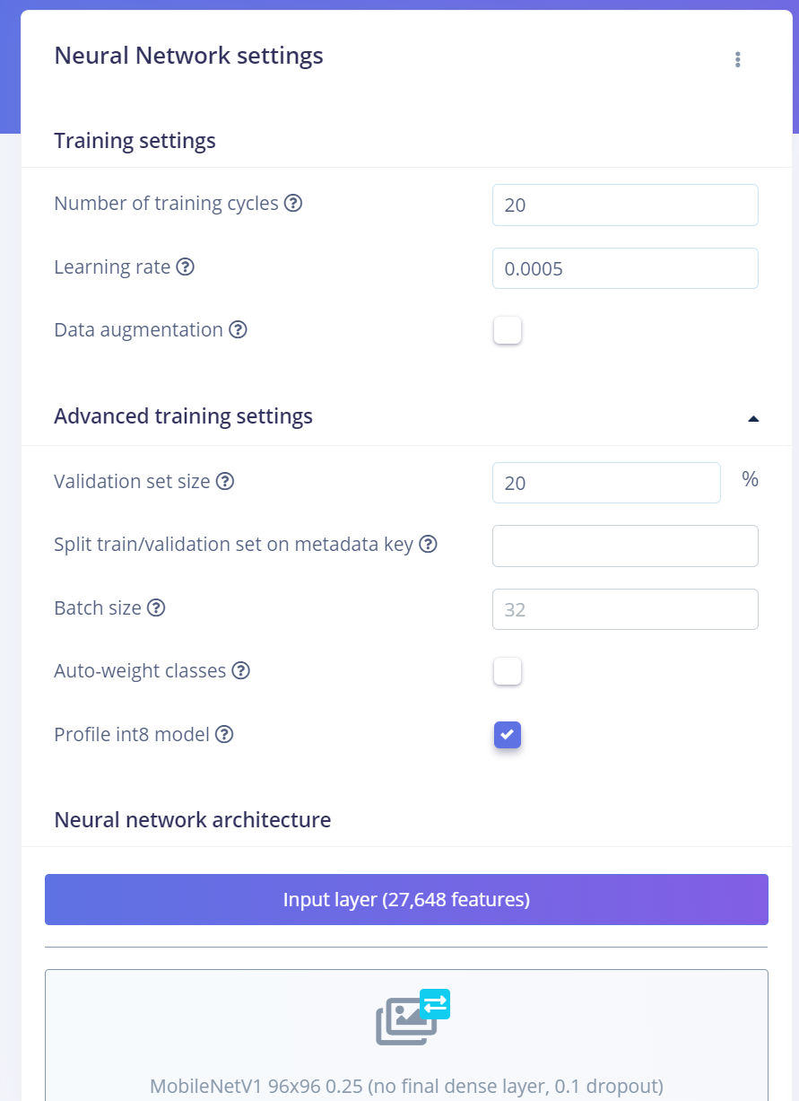
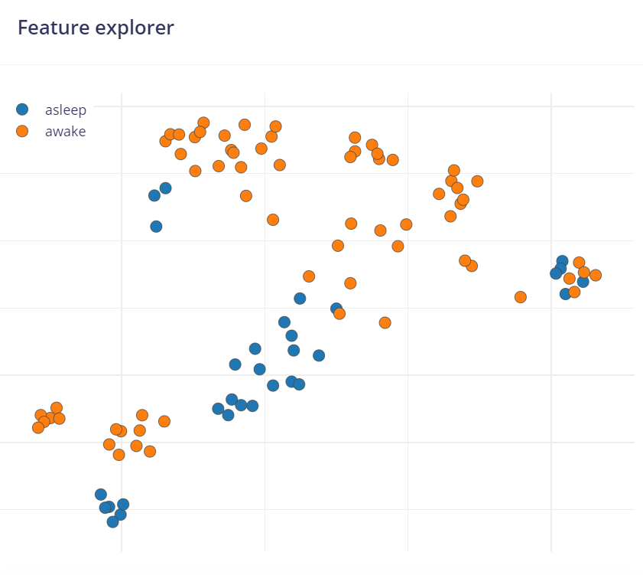

Slide 6
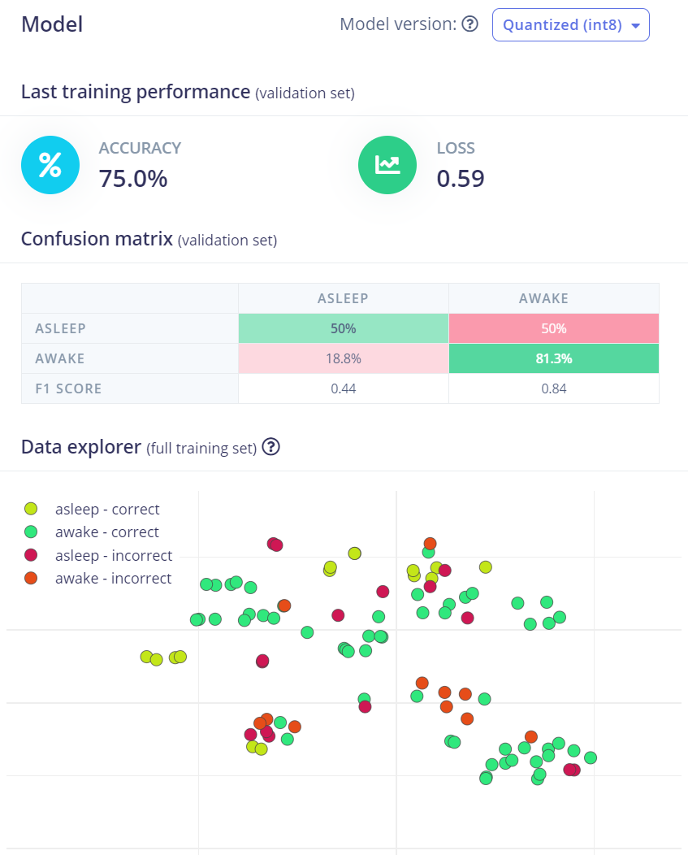
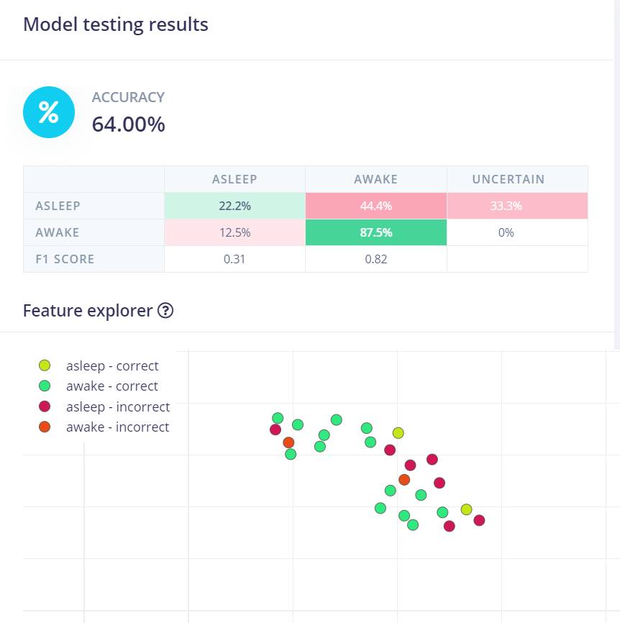

Slide 7
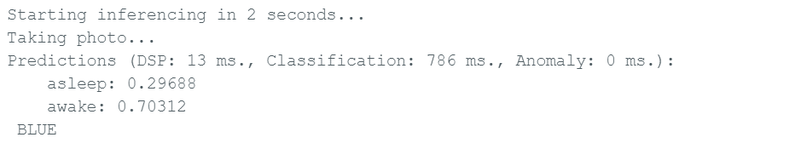
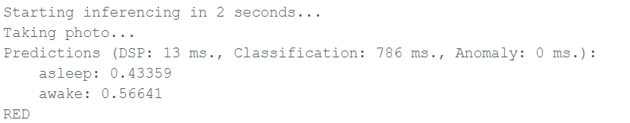

Slide 8
Future Goals
Performance:
Use Bounding Boxes
Clean Dataset
Optimize the Model
Better Quality Camera
Device Control:
Include a Button
Calm Technology:
Include a Buzzer
Additional Features:
Include an Accelerometer
Alert System:
After a few minutes of “Asleep” Status:
Call the driver
Connect to Wifi and contact a family member
Last Resort Contact the Police

