Slide 1


Manual Testing For OrangeHRM Website
Created By
Mai Okasha
Lina Shaqoura
Saif Araj
Zaid Jaber

Slide 2

ABOUT THE PROJECT
OrangeHRM is a robust & scalable open-source Human Resource Management System
Designed to enhance all aspects of the employee lifecycle.
This project is dedicated to conducting Manual & Functional Testing to ensure the website is functioning correctly & aligns with all defined requirements.

Slide 3




Kick-Off Meeting Summary
Project Goal
Task Assignment
Planning Workflow
Align the main Goal.
Two teams assigned per module
Structure the Schedule&
Testing Process

Slide 4


Software Testing Life Cycle
Test Case Execution
Planning
01.
02.
03.
04.
05.
Summary
Requirements Analysis
Test Case Design

Slide 5
Navigating to
Test Phases

Slide 6


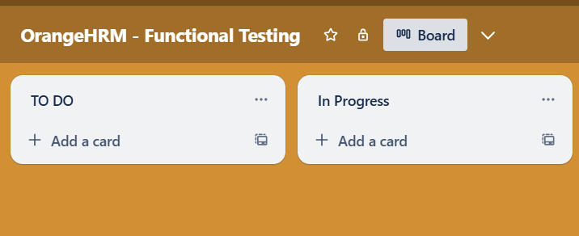

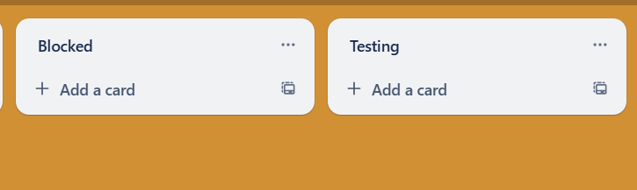
Requirements Analysis
01
Analyzed SRS thoroughly
02
Task Management set up in Trello
03
Mapped Requirements to team members
04
RTM established for traceability

Slide 7
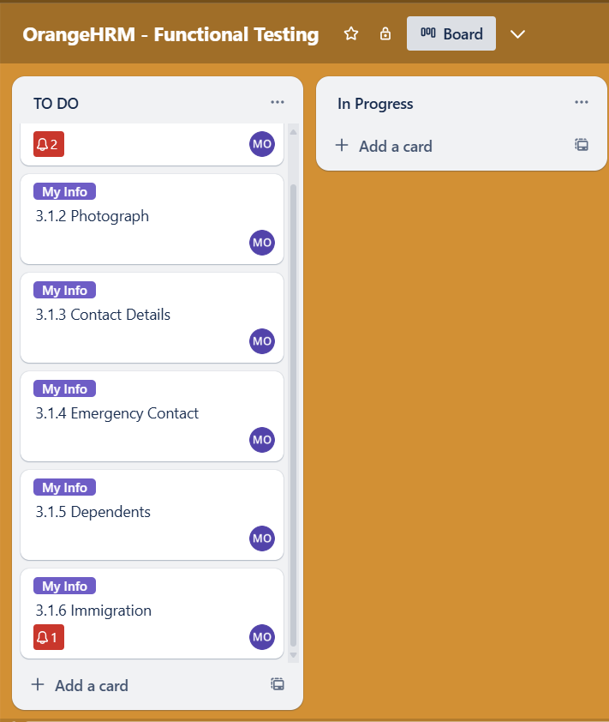
Test Planning
01
Test Plan
02
User Stories
Assign Cards in Trello
03

Slide 8
Navigating to
Test Plan
"This plan outlines the detailed steps to test the website and ensure its quality before launch, ensuring full coverage of the project scope."

Slide 9
1
PARAMETRS
Introduction
Test Plan
2
3
4
Test Approach
Scope
Objectives
8
Test Environment
7
6
5
Roles
Schedule
Deliverables
EDIT

Slide 10

Test Apprach
01
Method : Manual Testing
02
Focus : Functional Testing
03
Daily Iteration
04
Smoke , Sanity & Exploratoty Testing

Slide 11


My Info Module ( EES View )
User Management Module
In Scope
Job Module
Organization Module
Qualifications Module

Slide 12
HR Admin Account
Localization
Out Of Scope
API Testing
Performance Testing

Slide 13

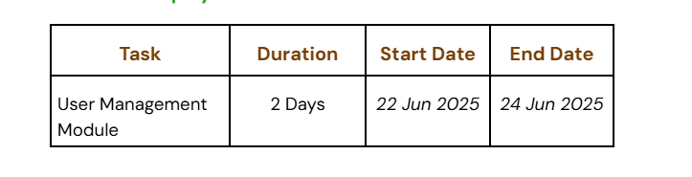
Schedule
ESS-User :

Slide 14
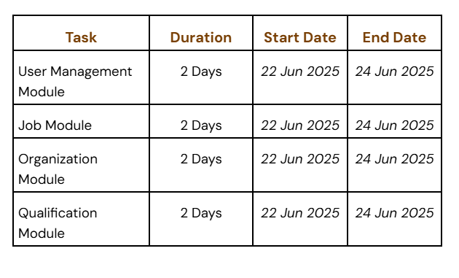
Schedule
Admin :

Slide 15





Test Deliverables
Before Testing
Test Cases, RTM, and Test Plan.
During Testing
Test Cases, Test Data & Bug Reports.
After Testing
Test Summary Report.

Slide 16

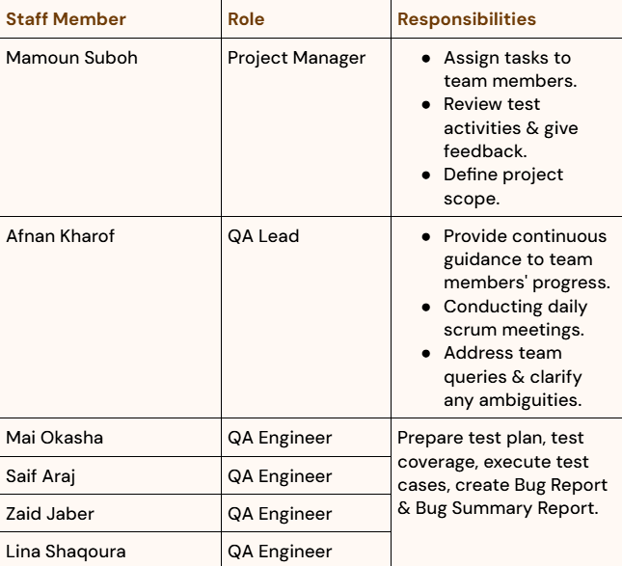
Responsibilities

Slide 17

Resources & Environment Needs
Testing Tools
Tracking : Trello
Recording : Microsoft Word & Excel.
Test Environment
Platform: Laptop
OS: Windows 11
Browsers: Chrome & Microsoft Edge

Slide 18
Test Case Design
01
Two Test Case Documents developed for two modules.
02
Mai & Lina were responsible for the ESS_User Module.
03
Zaid & Saif handled the Admin Module
04
Coverage : Positive, Negative & Edge Cases .
No. of Test Cases Developed for ESS_User : 104
No. Of Test Cases Developed for Admin : 216

Slide 19
Test Case Execution
01
Test Cases Executed
02
Recording Bugs
03
Bug Report
04
Completed RTM
05
No. Of Test Cases Executed for ESS-User : 104
06
No. Of Test Cases Executed for Admin : 216

Slide 20


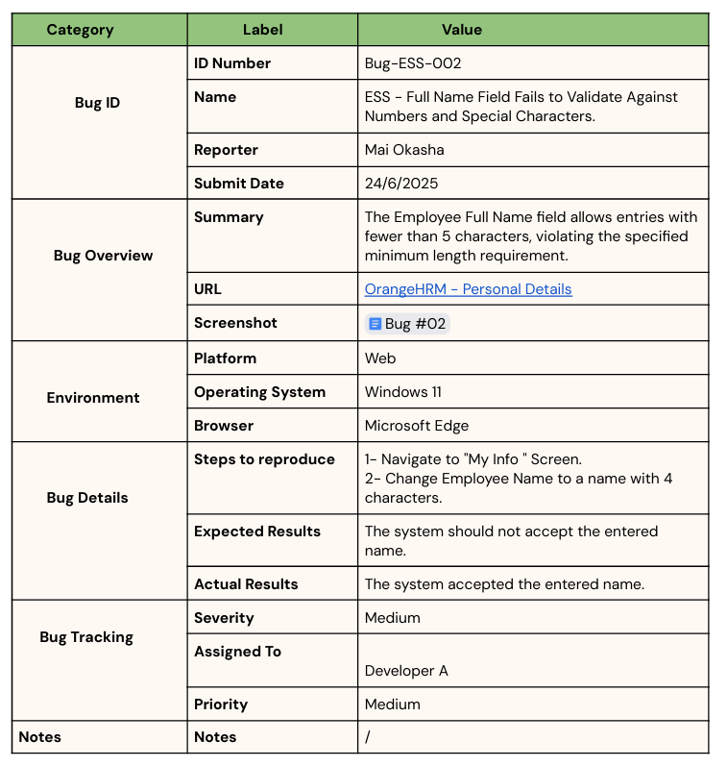
Bug Report
1
0
03

Slide 21
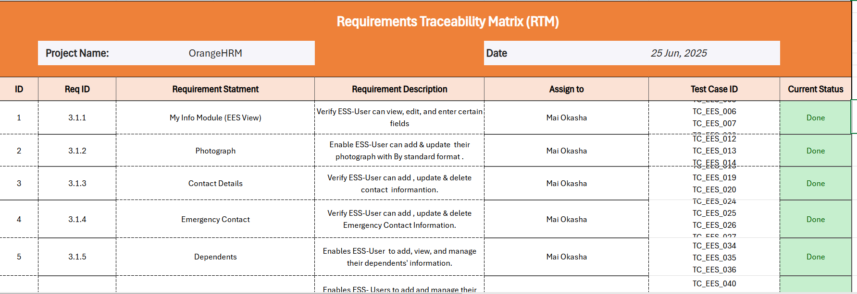
RTM

Slide 22
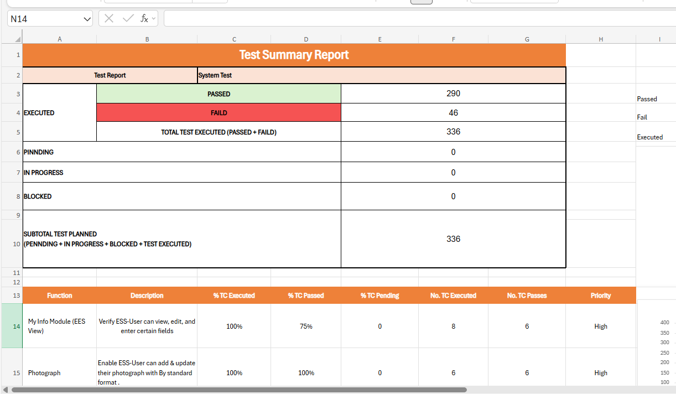
Test Summary Report
01
02
03
04
05
06

Slide 23
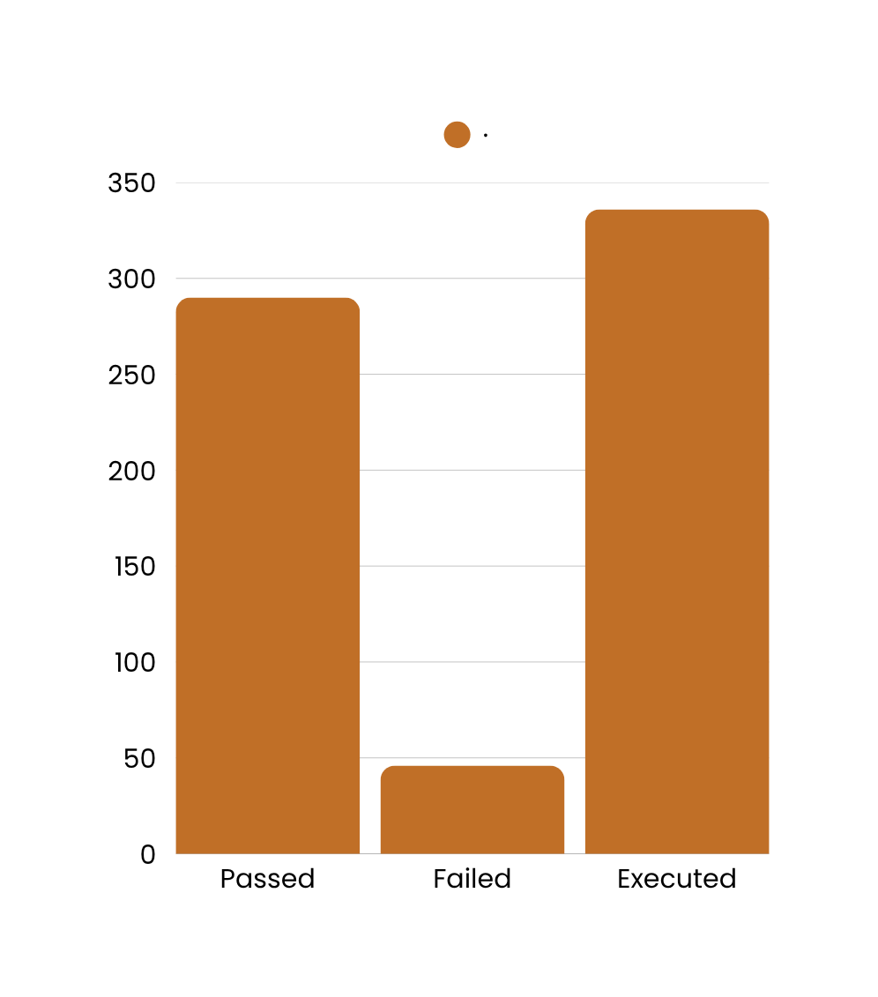
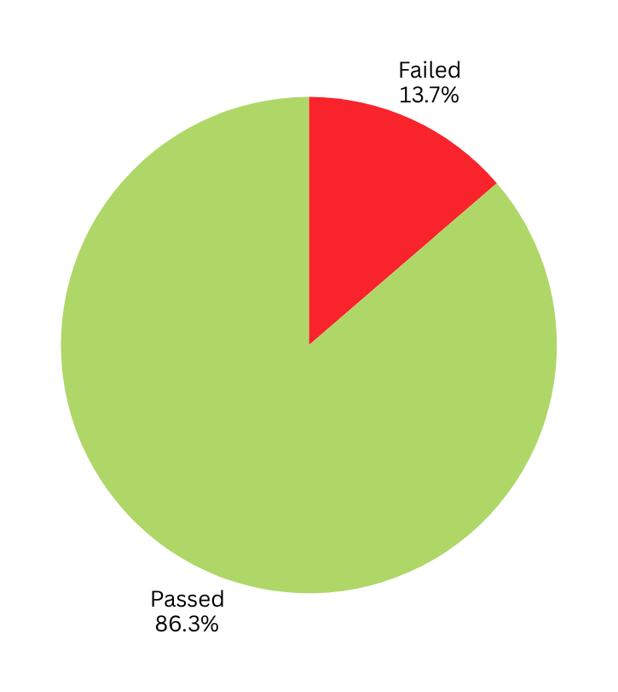
Test Summary Charts
01
02
03
04
05
06

Slide 24


THANK
you

