Slide 1

The Steiner Problem in Metric Spaces
MAI Sophia and REYNAUD Clo
Supervised by Vincent Millot
April 2026
The Steiner Problem

Slide 2
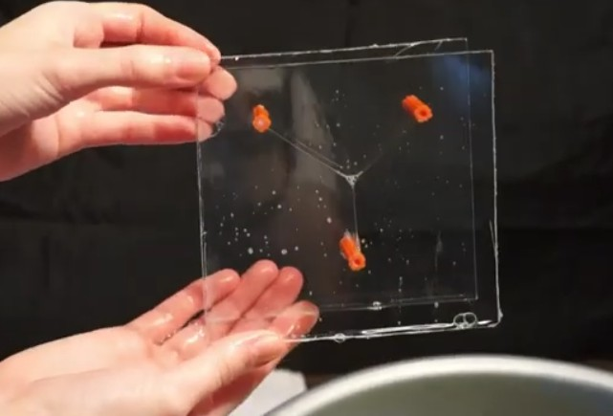
Introduction
The Steiner Problem

Slide 3
Table of content
Introduction
The parametric problem
The intrinsic problem and relation with the parametric problem Conclusion
1
2
3
4
The Steiner Problem

Slide 4
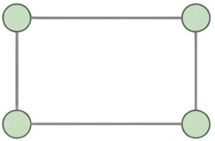
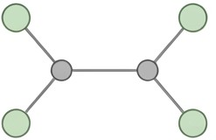
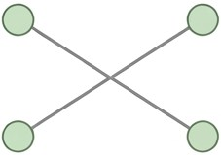
How will the soap film connect four vertices of a rectangle?
The four-point case
The Steiner Problem

Slide 5
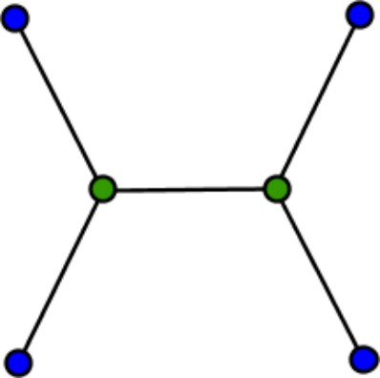
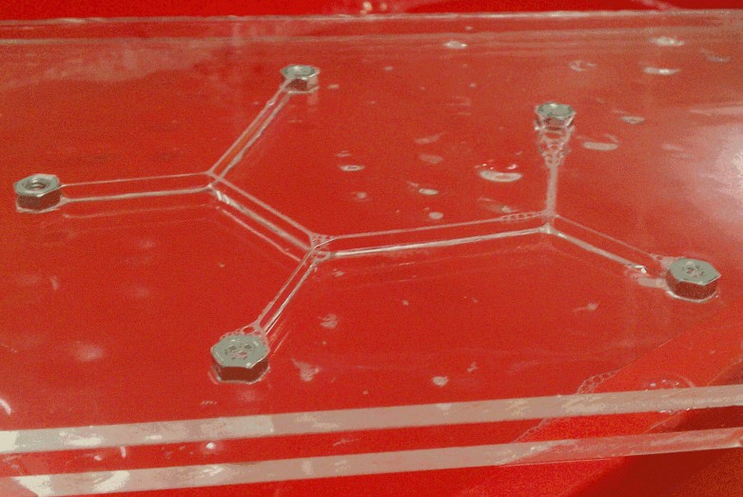
Answer
The Steiner Problem optimizes networks by adding extra junctions to find the shortest path. In 2D, this is a geodesic problem where segments always meet at 120◦. While mathematically complex, nature solves it instantly: soap films naturally minimize their surface area to reach the lowest energy state.
What happens in higher dimensions? Does a solution still exist?
The Steiner Problem

Slide 6
Total variation and formulation of the parametric probem
Definition : (total variation)
The lengh (or variation) of a curve γ : [a, b] →− E is define as :
(
)
n−1
Σ
L(γ) = sup
d (γ(t_{i} ), γ(t_{i +1})) : a = t₀ < t₁ < · · · < t_{n} = b
i =0
where the supremum is taken over all possible finite partitions of the interval [a, b]. A curve is said to be rectifiable if L(γ) < ∞.
The problem can be stated as follows:
min{L(γ) : γ ∈ Lip([a, b], E ), γ(a) = x, γ(b) = y }
(1)
The Steiner Problem

Slide 7
Existence for the parametric problem
Theorem : (Existence for the parametric problem)
Suppose that E i s a compact metric space. Then the minimum problem
(1) admits a solution, provided that the class of Lipschitz curves connecting x and y is not empty.
Idea of proof :
Let be L the infimum for the problem, Take a minimizing sequence γ_{n} :
γ_{n} : [a, b] −→ E, γ_{n}(a) = x, γ_{n}(b) = y, lim L(γ_{n}) = L
x →∞
Show that γ_{n} is equiontinuous by reparametrisation theorem, Use Ascoli-Arzéla theorem to conclude.
The Steiner Problem

Slide 8
Formulation of the intrinsic problem
Definition :
H¹ denotes the 1-dimensional Haudorff measure, define for every subset
A ∈ E as
H¹(A) = lim H¹(A)
δ−→0⁺
δ
where H¹ is given by
δ
∞
Σ
[
1
H (A) = inf{ diam(A
i
) : A ⊆ A , diam(A ) < δ}
δ
i i
i =1
The intrinsic formulation of the Steiner probem is given by :
min{H¹(C ) : C connected and close, and C ′ ⊆ C }
where C ′ is a closed, nonempty subset of E
(2)
The Steiner Problem

Slide 9
Topological Framework
To solve the Steiner problem in abstract settings, we must define how to measure distances between sets and their lengths. We equip our metric space (E, d ) with two primary tools:
Hausdorff Distance (d_{H} ): Provides the topology for the convergence of sequences of compact sets.
1-Dimensional Hausdorff Measure (H¹): Generalizes the concept of length to any subset A ⊆ E .
The Goal
Use these topologies to apply the Direct Method and guarantee the existence of an optimal connected structure.
The Steiner Problem

Slide 10
The Direct Method
Phase 1: Completeness of the State Space.
Phase 2: Compactness: Blaschke Selection Theorem.
Phase 3: Lower Semi-Continuity: Golab’s Theorem.
The Steiner Problem

Slide 11
Completeness of the State Space
Definition
Given a set E , C_{E} is the space of all non-empty closed subset of E , we define the Haudorff distance on C_{E} as : for
C, D ∈ C_{E} , d_{H} (C, D) := min{1, h(C, D)}
where
h(C, D) = inf {C ⊆ D_{r} , D ⊆ C_{r} }
r ∈[0,∞]
The space of non-empty closed subsets (C_{E} , d_{H} ) is complete, provided that the underlying metric space E is complete. This ensures our limits stay within the space.
The Steiner Problem

Slide 12
Compactness: Blaschke Selection Theorem
Theorem : (Blashke)
If the metric space E is compact, then the space of its closed subsets
(C_{E} , d_{H} ) is also a compact metric space.
This allows us to extract a convergent subsequence from any minimizing sequence of sets.
The Steiner Problem

Slide 13
Existence of a Global Minimum
Theorem : (Golab)
If connected sets C_{n} converge to C , then C is connected and:
H¹(C ) ≤ lim inf H¹(C_{n})
n→∞
This ensures the limit C is at least as "short" as the sequence.
The Steiner Problem

Slide 14
Existence for the intrinsic problem
Theorem : (Existence for the intrinsic problem and equivalence)
Suppose that C ′ ⊆ E is nonempty, and assume that there exists a connected closed set C ⊆ E such that H¹(C ) < +∞ and C ′ ⊆ C . If E is such that every closed ball is compact, then the minimum problem (2) has a solution.
In the particular case where C ′ = {x, y } comprises two distinct points, then
(2) is equivalent to the parametric geodesic problem (1), that is, every minimizing set C can be parametrized by an injective Lipschitz curve.
The Steiner Problem

Slide 15
Perspectives
Future Outlook:
Investigating higher-dimensional rectifiable currents.
Studying the regularity and branch points of soap film-like structures.
Final Thought
Starting from a simple set of points, we reach the complex beauty of optimal geometric structures in abstract spaces.
A Gateway to Minimal Surfaces: The Steiner problem can be seen as the simplest, 1-dimensional version of the Plateau Problem.
The Steiner Problem

Slide 16
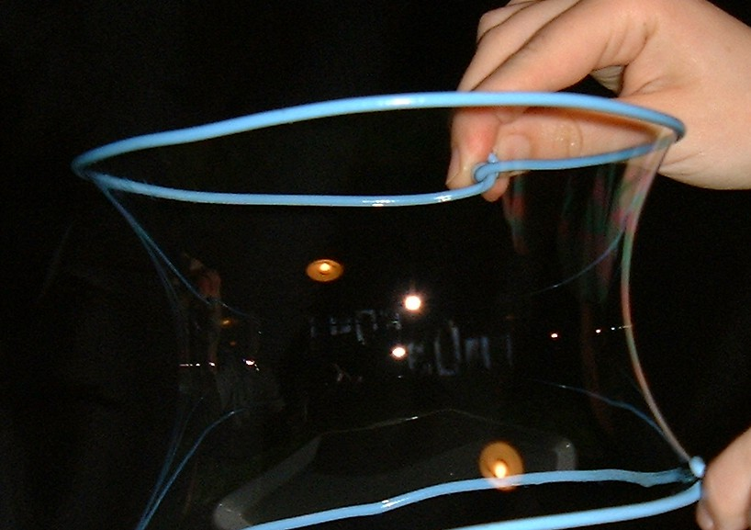
2-dimensional Plateau Problem
The Steiner Problem

