Slide 1

Populating Wikipedia
Keeping population figures up-to-date in place articles
Maia Williams (MaiaCWilliams)
with Sam Wilson, Toby Hudson, Alex Lum and Caddie Brain
February 2022

Slide 2
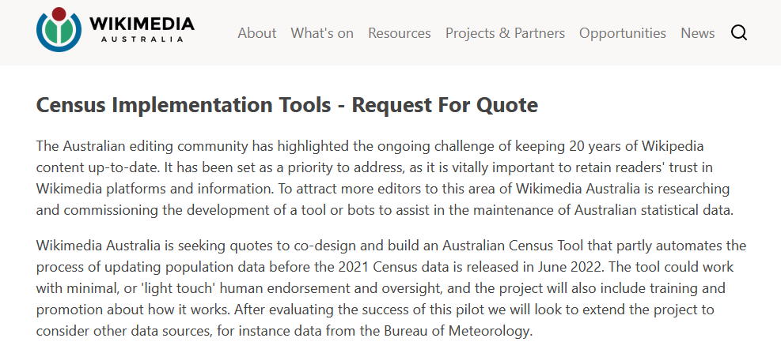
The project
Wikimedia Australia developed project and brief.
I worked with Sam, Toby, Alex and Caddie from April – July 2022.
Project ran concurrently with other Wikidata Fellowships.
Wikimedia Australia project brief

Slide 3
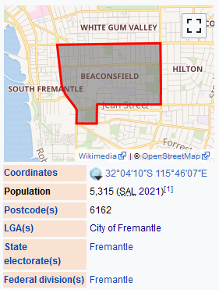
The challenge
15,000 Australian place articles…
and lots of population figures to update!
Could this be done more efficiently?
Wikipedia article Infobox

Slide 4

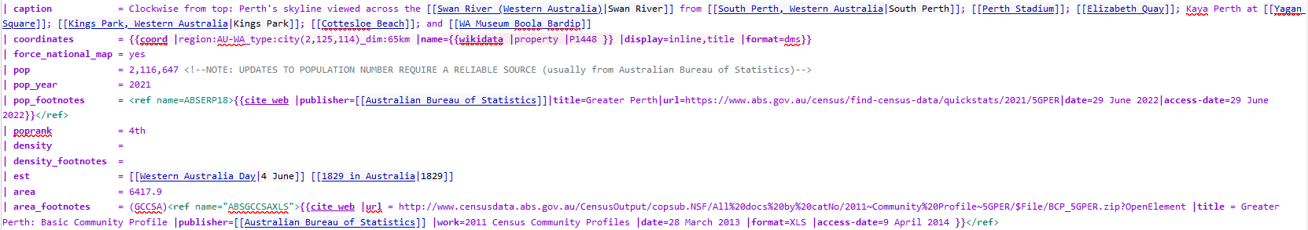
The old method
Manual entry of population value and reference information …
… x 15 000!
Editing using the Infobox Australian place template

Slide 5
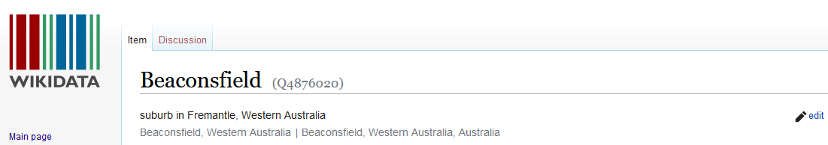
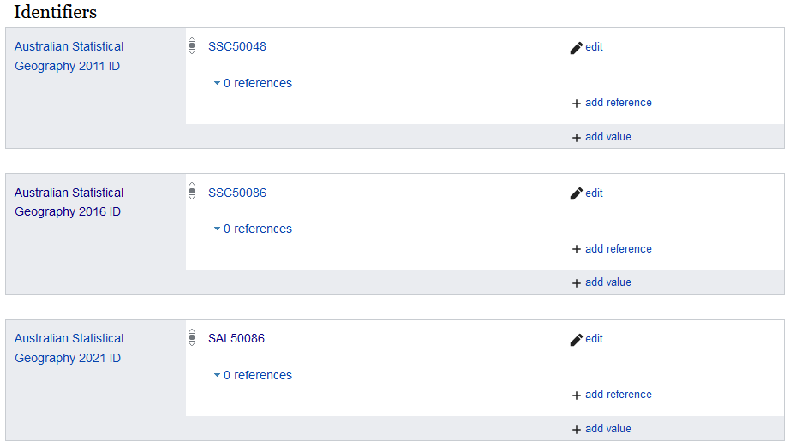
But…Wikidata!
All Australian place articles are linked to Wikidata items.
Most place items include relevant Australian Bureau of Statistics (ABS) IDs and population data.
(Thanks Toby and Alex!)
Wikidata place item

Slide 6
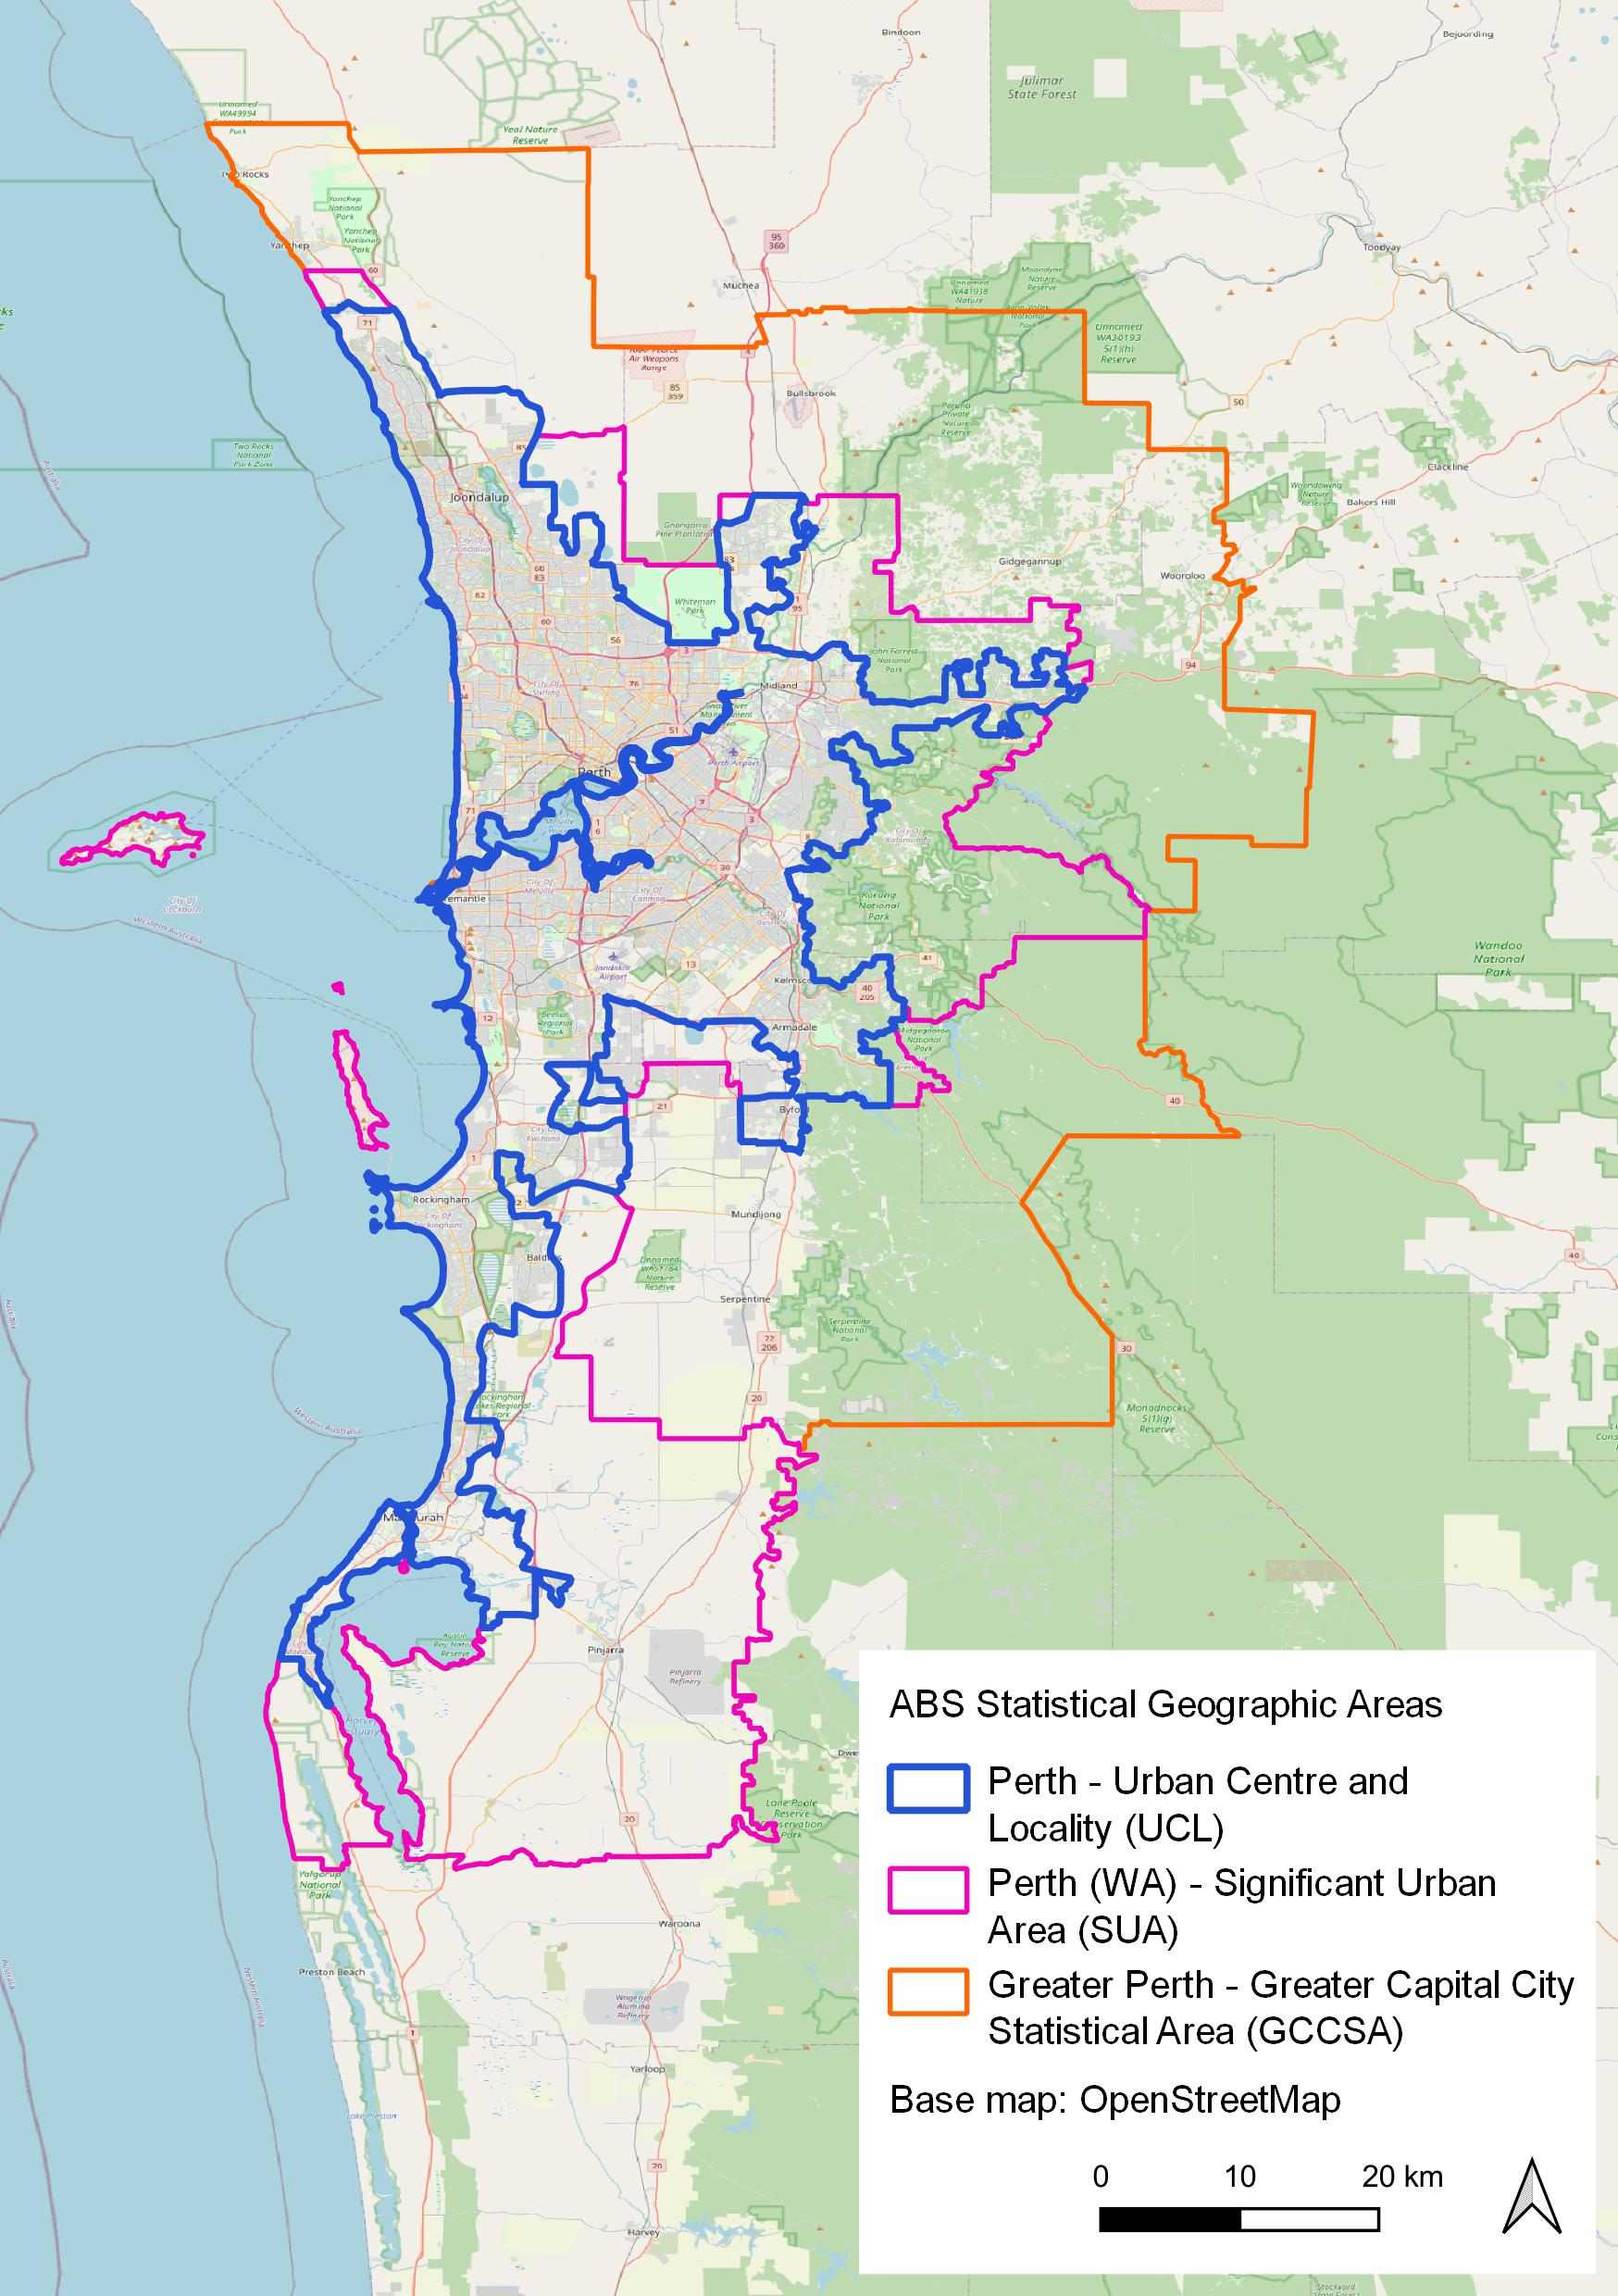
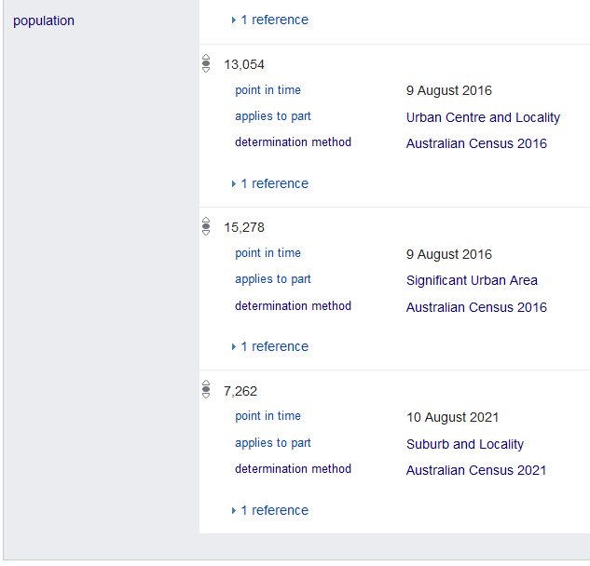
Population data in Wikidata
Many data entry methods.
Many dates.
Many geographies.
Many sources.
Means… multiple population values per place item.
Many population claims

Slide 7
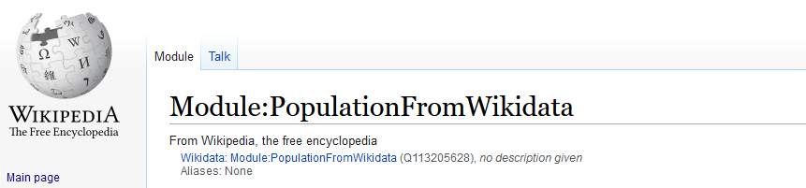
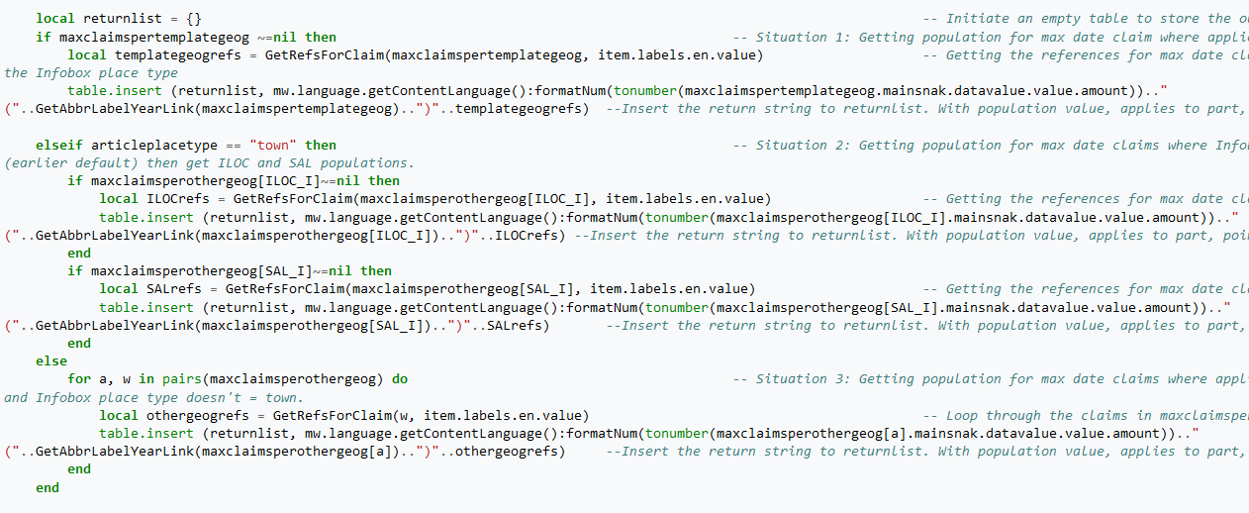
New method - the Lua module
Chooses best population value from linked Wikidata item.
Collates value plus reference.
Formats and gives both to Wikipedia article Infobox.
This happens whenever article Infobox pop field is empty.
PopulationFromWikidata module

Slide 8
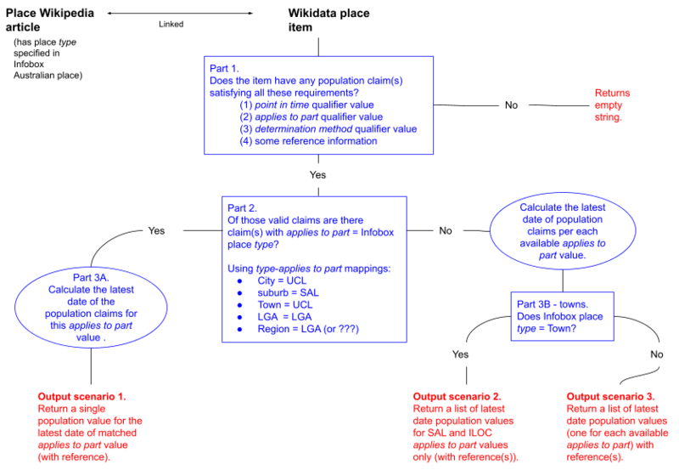
Selecting a population value
The priorities for selecting the best population value are:
Value must have sufficient reference information.
ABS geography type matches Infobox place type (with preference levels).
The value is the most recent of those satisfying the above criteria.
Module workflow

Slide 9
Geographic area mapping
Infobox type | ABS Australian Statistical Geography Standard (ASGS) area
City | Urban Centres and Localities (UCL)
Suburb | Suburbs and Localities (SAL)
Town | Urban Centres and Localities (UCL) Indigenous Locations (ILOC) or Suburbs and Localities (SAL)
LGA | Local Government Areas (LGA)
Region | Local Government Areas (LGA) (or SA2?)
Mapping Infobox type to ASGS areas

Slide 10
Module use
Module will give a population figure if Infobox pop field is empty.
Process:
Pick a Wikipedia place article and check linked Wikidata item has a valid population claim.
Edit the Infobox Australian place template. Remove the pop value and replace with a comment like: “<!--Leave blank to draw the latest automatically from Wikidata-->”. Remove the pop_year and pop_footnotes fields.
Check the output in the article Infobox. If the output is not as expected then edit the Wikidata item.

Slide 11
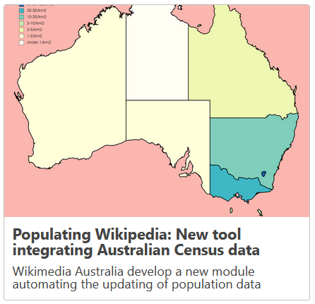
Project outcomes
The module is in action!
2744* articles using module
many conversations
a to-do list
a few key editors
2 graphs
1 blog post
Wikimedia Australia blog post - summary of the project
* As at 12/2/2023

Slide 12
Thank you
Thank you Wikimedia Australia for funding the project!
Thank you Sam, Toby, Alex and Caddie for mentoring!
Find me at MaiaCWilliams.
Chat about future work and issues on the module talk page.

