Slide 1

BI Project Customer Churn Analysis
Prepared by:
Maickery BOZOR

Slide 2
1. Problem
The competitors of our client, a Telecommunications company, trying to attract the customers of the later. This customer churning is the principal problem that they face. This problem is important to the organization, because this impacts investors, incomes and market share.

Slide 3
2. Methodology
We used the database provided by the company to do our analysis.
We performed the analyzes by grouping the relevant data in order to have a concise overview of the data provided.
No data is neglected, all the assumptions are as close as possible to reality and explained.

Slide 4
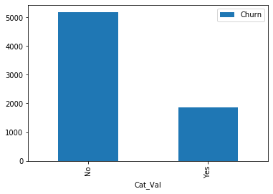
3. Churning
Our client has had 7043 customers the past month but he only have 5174 customer now(73.46%), 1869 (26.54%) of them churning, any category combined.

Slide 5
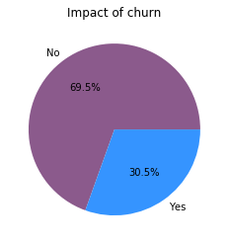
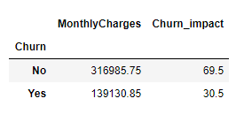
Churning impact
With the Churn, the company lost 30.5% of the revenue that it makes every month.

Slide 6
4.- Analysis

Slide 7
A. Analysis based on the Demographics

Slide 8
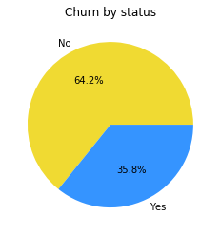
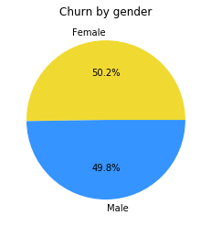
A.1 Status
A. 2 Gender
Of the 3,488 women, 939 are churned, and of the 3,555 men, 930 are. In other words 26.92% of the women are churn and 26.16% of the men too. So 50.24% of churning's population is female and 49.75% is male
Of 1869 customers who are churn, 35.79% have a partner and 64.21% do not have

Slide 9
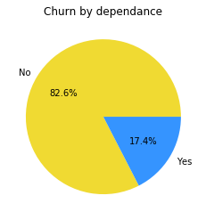
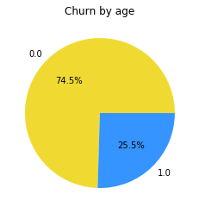
A. 4 Dependance
A.3 Age
Of the 1869 churns, 1393 are young and 476 are old. This represents 23.61% of young people and 41.68% of old people, respectively. But the churning by group of age is 74.5% for youngh people and 25.5% for old
82.56% of clients who are churn, aren't dependents , and the 17.44% are

Slide 10
As we can see the Depedent’s category have the highest percentage or churning

Slide 11
B. Analysis based on services used

Slide 12
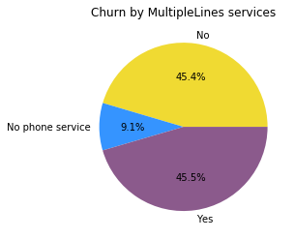
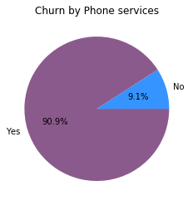
B.1 PhoneService Clients who use phone services are the least likely to leave
The lowest churning percentage is for customers who no have phone service
B. 2. MultipleLines

Slide 13
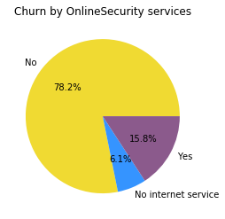
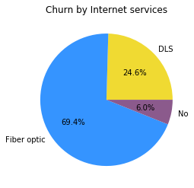
B.3 InternetService
B.4 OnlineSecurity
The highest churning percentage is for customers who use fiber optic for the internet services
Clients who have no internet service stay loyal

Slide 14
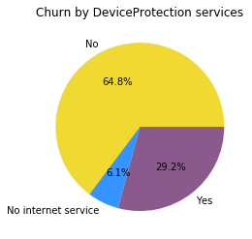
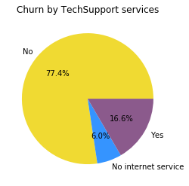
B.5 DeviceProtection
B.6 TechSupport
Clients who don't use TechSupport services are the least likely to leave (churning=77.4%)
Clients who have no internet service are the least likely to stay

Slide 15
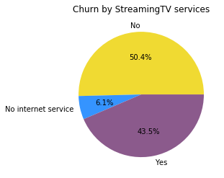
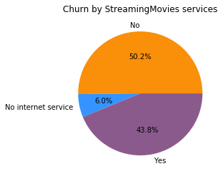
B. 7 StreamingTV
B. 8 StreamingMovies
Clients who have no internet service are the least likely to stay, it’s same for both services.

Slide 16
In conclusion, the OnlineSecurity is the service who have the highest percentage of churning

Slide 17
C. Analysis based on billing informations

Slide 18
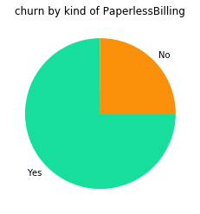
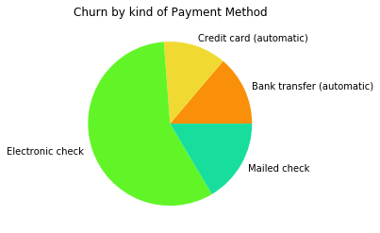
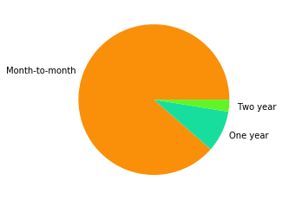
C.1 Kind of contract
C. 3. PaymentMethod
Customers with a monthly contract are those with the highest churn percentage(88.55%). Those with a two-year contract are the most loyal(2.57% of churning)
Clients who use electronic check for payment method are the least likely to leave (churning=57.30%)
C.2 PaperlessBilling
Customers who do not use the Paperless Billing policy are the least likely to stay(469 churn: 25.09% of churning).

Slide 19
Althought that the kind of contract is the category who have the highest pourcentage of churning, the annual contract policy is clearly better for the company

Slide 20
The next month they will churn clients who don’t be dependent, who have monthly contract and who use online security services.

Slide 21
5. Bonus

Slide 22
How long before the company loses all its customers and which demographics will it lose first?
Let U be the number of clients of the company. K the percentage of clients who are not churned, and n a monthly duration.
Assuming that k remains fixed and that the company has no new customers, let :
U = 7043
K= 0.7346 (73.46%)
The first month the company lost 1869 customers or 26.53%. Let's calculate U1
U1= 7043*0.7346
In the event that they continue to lose customers
U2=7043*0.7346*0.7346
….
We can say U_{n} = U₀ * k^{n}

Slide 23
we want to know n
k^{n} = U_{n /} U₀
lnk^{n} = ln(U_{n /} U₀)
n.lnk=ln U_{n}-ln U₀ => n= (ln U_{n}-ln U₀ ) / lnk
In which time the company will have only one customer (U_{n} =1)
n=(ln1-ln7043)/ln0.7346
n= | -28.72552617| => n=28 months 21 days 18 hours 22 minutes 43 sec
In 28 months the company will have only one customer, we can assume that in an additional month it will not have any more.
Demographics say they will first lose all young clients who do not have a partner and are not dependent

Slide 24
6. Discussion & Recommendations

Slide 25
A. Proposed solution
Young people represent the largest part of the company's client population. Solutions should take this into account. The company should :
Put a tempting plan to retain these young addicted to technology and always connected to the internet.
They should cancel the monthly contracts and focus on the annuel contract.
Establish more direct contact with customers
Review the marketing department

Slide 26
B. the exploited forces
Young people is one of the force that the company can exploite. They are known to be snobbish and attracted to all internet, the company can exploite that in study the offerts of the concurency in view to make a better offer to retain customers and attract others.
The variety of services is an other force of the company. It can meet customer needs as much as possible. Customer feel better where he have multiple choice

Slide 27
C. Weaknesses problem
The variety of services can be a problem if the company don’t have a staff for each of them who manage them. Every staff supposed to be proposed a kind of plan in view of the proposed solution.
The company don’t have a good customer service

Slide 28
D. The challenges
Establish effective and efficient plans
Convince my client
Increase the number of customers by at least 20% each month

Slide 29



References & Appendices
Jupyter Notebook: http://localhost:8888/notebooks/Desktop/ChurnAnalysisProject/Output/MaiChurnAnalysis.ipynb
Machine learnia: https://www.youtube.com/channel/UCmpptkXu8iIFe6kfDK5o7VQ
GitHub : https://github.com/Maickery/Ayiti-Analytics-Projects.git

